Slide 1
Creating my first Shiny app

Slide 2
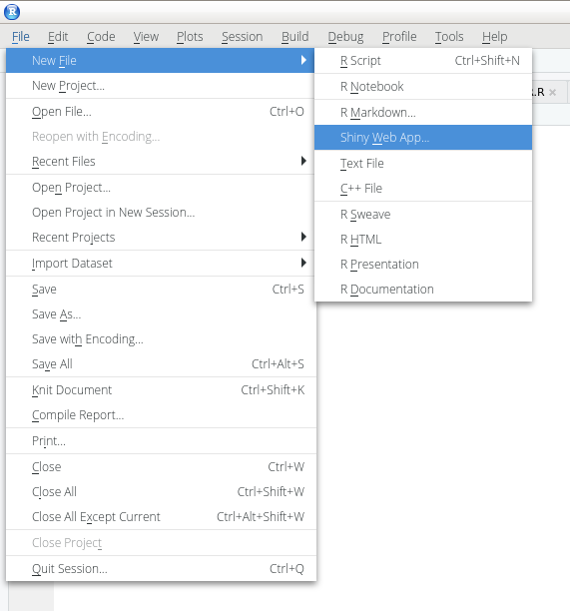
Shiny in RStudio

Slide 3
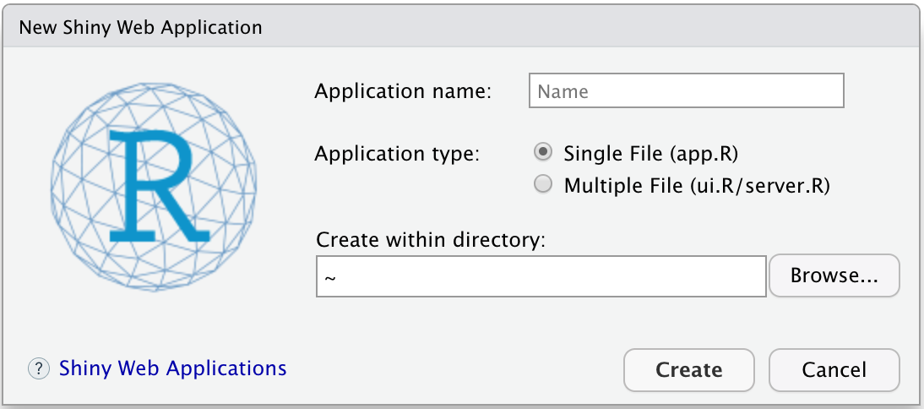

Slide 4
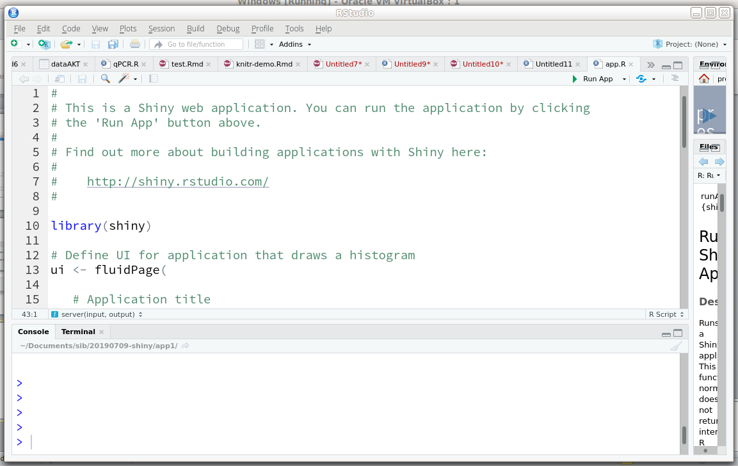

Slide 5
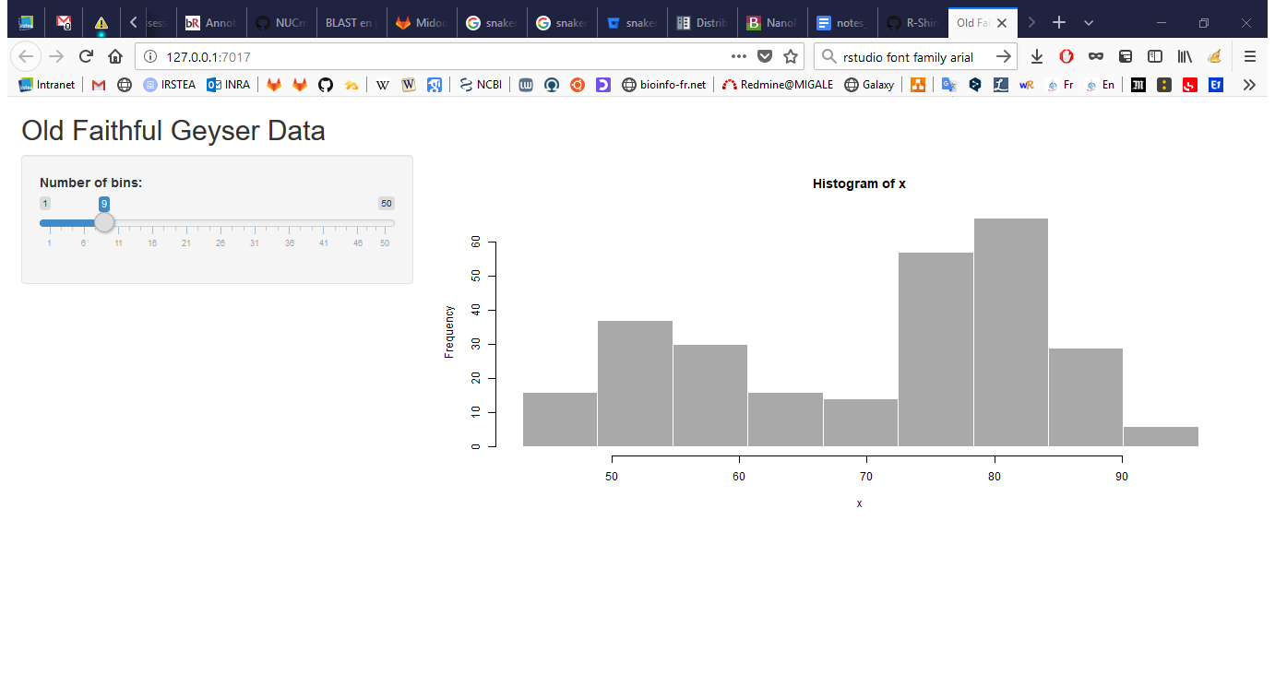

Slide 6
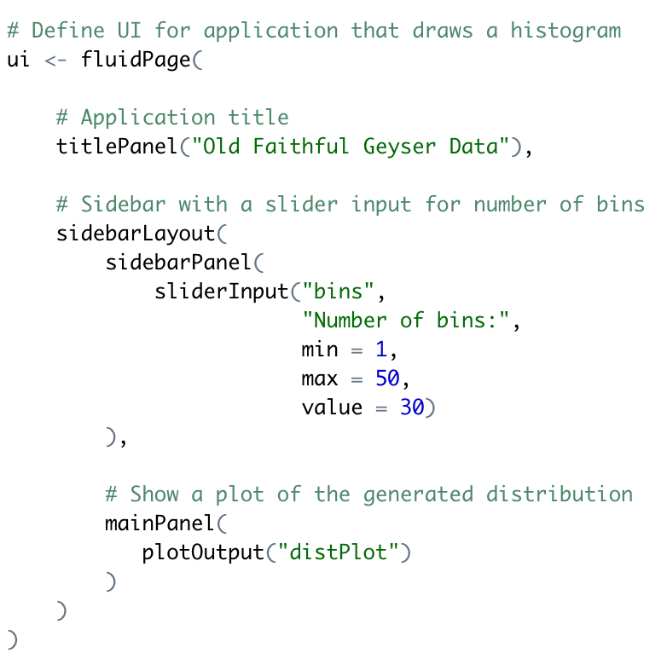
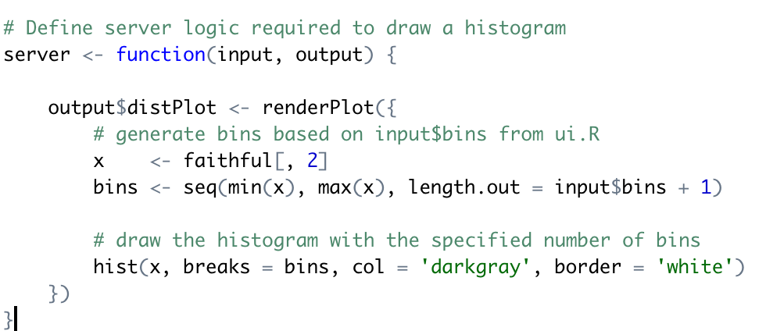


Slide 7
Anatomy of a Shiny app
A simple shiny app consists of two components:
ui (user interface) creates the layout of the application and the user controls
server creates the content based on the user’s selections

Slide 8
Anatomy of a Shiny app
One single file app.R (recommended)
ui <- fluidPage(
)
server <- function(input, output) {
}
shinyApp(ui = ui, server = server)

Slide 9
My first Shiny app (not recommended)
Two files in the same folder (not recommended)
ui.R
server.R
shinyUI(fluidPage(
))
shinyServer(function(input, output) {
})

Slide 10
Others ways to run my app

Slide 11
Anatomy of a shiny app: data flow
ui
Input widgets
Output functions
server
Load data
Load packages
collect
parameters
Conduct analysis – generate tables and graphs
send rendered objects back to UI

Slide 12
Running the Shiny app
Copy/paste the content of app.R or source() its content: app <- source("app.R") app
Use the runApp() function: runApp("test") # Directory runApp("test/app.R") # File
Use RStudio

Slide 13
More about running the shiny app
A garger ici ?
Run an app from github: runGitHub( repo="shiny", username="lecy")
Run the app in "showcase mode" (run app and show source code) runApp("test", display.mode = "showcase")
→ a faire tester

Slide 14
Running the Shiny app
> library(shiny)
> app <- source("test1/app.R")
> app
$value
Listening on http://127.0.0.1:3625
^C
> runApp("test1/app.R")
Listening on http://127.0.0.1:3625
Warning in body(fun) : argument is not a function
^C
>

Slide 15
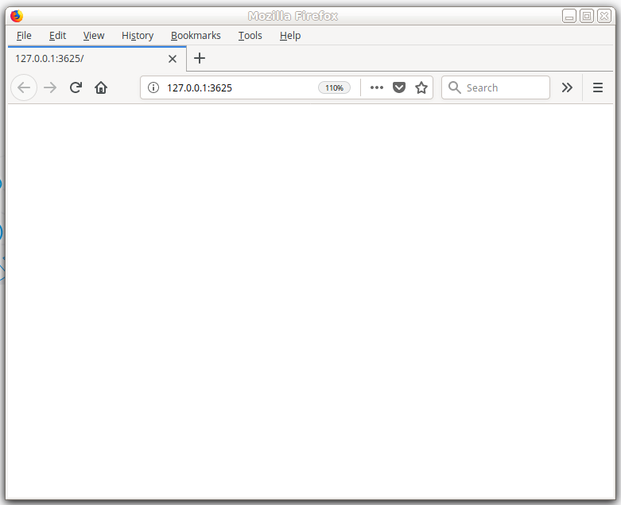
Running the Shiny app
> library(shiny)
> app <- source("test1/app.R")
> app
$value
Listening on http://127.0.0.1:3625
^C
> runApp("test1/app.R")
Listening on http://127.0.0.1:3625
Warning in body(fun) : argument is not a function
^C
>

Slide 16
Architecture of Shiny app

Slide 17
Anatomy of a shiny app: data flow
ui
Input widgets
Output functions
server
Load data
Load packages
collect
parameters
Conduct analysis – generate tables and graphs
send rendered objects back to UI

Slide 18
How do the ui and the server communicate= ?
ui
server
*Input(inputId = « in1 »,
label = « »),
*Output(outputId = « out1 »)
output$out1 <-
render*(input$in1)
* for type keyword
Image Credit: National Socio-Environmental Synthesis Center
https://sesync-ci.github.io/basic-Shiny-lesson/
Notes:
127.0.0.1 is the IP address your laptop uses for itself (it’s the same as ‘localhost’).
Your laptop is hosting a web page (the UI) whose content is controlled by a running R session.
When you run an app through RStudio, that R session is also running the server on your laptop.
The server responds when you interact with the web page, processing R commands and updating UI objects accordingly.
The user interface and the server interact with each other through input and output objects. The user’s interaction with input objects alters parameters in the server’s instructions – instructions for creating output objects shown in the UI.
Writing an app requires careful attention to how your input and output objects relate to each other, i.e. knowing what actions will initiate what sections of code to run at what time.

Slide 19
My first (non trivial) Shiny app: generating random number and plotting and histogram

Slide 20
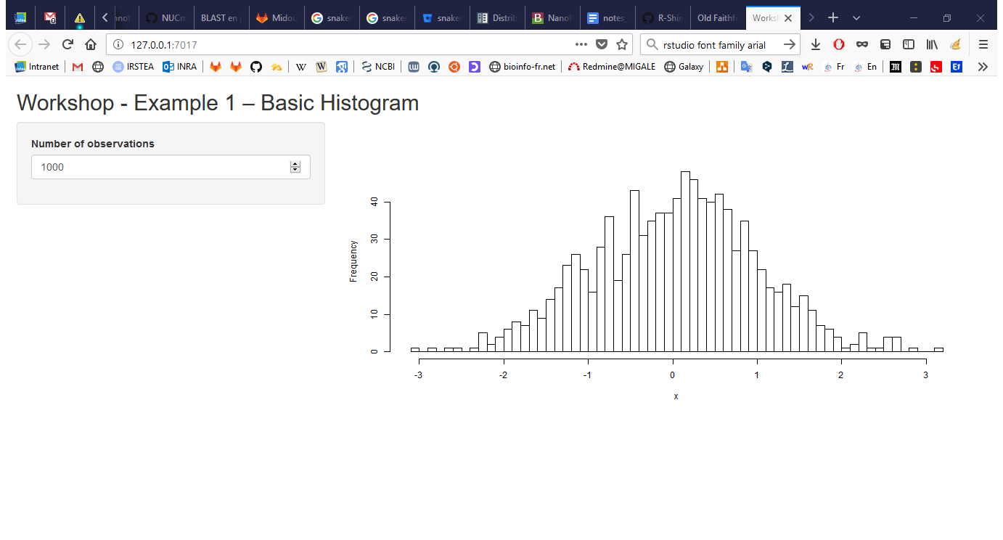

Slide 21
ui <- fluidPage(
titlePanel("Workshop - Example 1 – Basic Histogram"),
sidebarLayout(
sidebarPanel(
numericInput(inputId="n",
label="Number of observations", value=1000) ),
mainPanel(plotOutput("plot"))
)
)
server <- function(input, output) {
data <- reactive({
x <- rnorm(input$n)
x })
output$plot <- renderPlot({
hist(data(), 50, main="", xlab="x")
})
}

Slide 22
ui <- fluidPage(
titlePanel("Workshop - Example 1 – Basic Histogram"),
sidebarLayout(
sidebarPanel(
numericInput(inputId="n",
label="Number of observations", value=1000) ),
mainPanel(plotOutput("plot"))
)
)
server <- function(input, output) {
data <- reactive({
x <- rnorm(input$n)
x })
output$plot <- renderPlot({
hist(data(), 50, main="", xlab="x")
})
}
Most shiny apps use fluidPage():
Creates a page with rows (for element alignment), which contain columns
Fluid pages adapt the size of components according to available space (browser width)

Slide 23
ui <- fluidPage(
titlePanel("Workshop - Example 1 – Basic Histogram"),
sidebarLayout(
sidebarPanel(
numericInput(inputId="n",
label="Number of observations", value=1000) ),
mainPanel(plotOutput("plot"))
)
)
server <- function(input, output) {
data <- reactive({
x <- rnorm(input$n)
x })
output$plot <- renderPlot({
hist(data(), 50, main="", xlab="x")
})
}

Slide 24
ui <- fluidPage(
titlePanel("Workshop - Example 1 – Basic Histogram"),
sidebarLayout(
sidebarPanel(
numericInput(inputId="n",
label="Number of observations", value=1000) ),
mainPanel(plotOutput("plot"))
)
)
server <- function(input, output) {
data <- reactive({
x <- rnorm(input$n)
x })
output$plot <- renderPlot({
hist(data(), 50, main="", xlab="x")
})
}

Slide 25
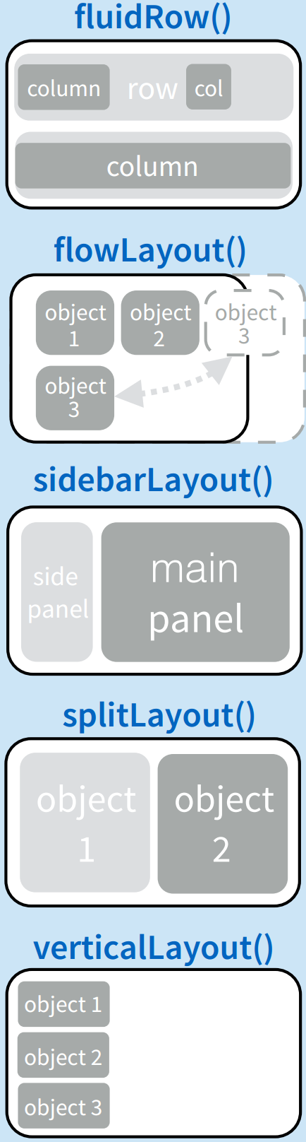
ui <- fluidPage(
titlePanel("Workshop - Example 1 – Basic Histogram"),
sidebarLayout(
sidebarPanel(
numericInput(inputId="n",
label="Number of observations", value=1000) ),
mainPanel(plotOutput("plot"))
)
)
server <- function(input, output) {
data <- reactive({
x <- rnorm(input$n)
x })
output$plot <- renderPlot({
hist(data(), 50, main="", xlab="x")
})
}

Slide 26
ui <- fluidPage(
titlePanel("Workshop - Example 1 – Basic Histogram"),
sidebarLayout(
sidebarPanel(
numericInput(inputId="n",
label="Number of observations", value=1000) ),
mainPanel(plotOutput("plot"))
)
)
server <- function(input, output) {
data <- reactive({
x <- rnorm(input$n)
x })
output$plot <- renderPlot({
hist(data(), 50, main="", xlab="x")
})
}

Slide 27
ui <- fluidPage(
titlePanel("Workshop - Example 1 – Basic Histogram"),
sidebarLayout(
sidebarPanel(
numericInput(inputId="n",
label="Number of observations", value=1000) ),
mainPanel(plotOutput("plot"))
)
)
server <- function(input, output) {
data <- reactive({
x <- rnorm(input$n)
x })
output$plot <- renderPlot({
hist(data(), 50, main="", xlab="x")
})
}

Slide 28
ui <- fluidPage(
titlePanel("Workshop - Example 1 – Basic Histogram"),
sidebarLayout(
sidebarPanel(
numericInput(inputId="n",
label="Number of observations", value=1000) ),
mainPanel(plotOutput("plot"))
)
)
server <- function(input, output) {
data <- reactive({
x <- rnorm(input$n)
x })
output$plot <- renderPlot({
hist(data(), 50, main="", xlab="x")
})
}

Slide 29
Shiny input widgets

Slide 30
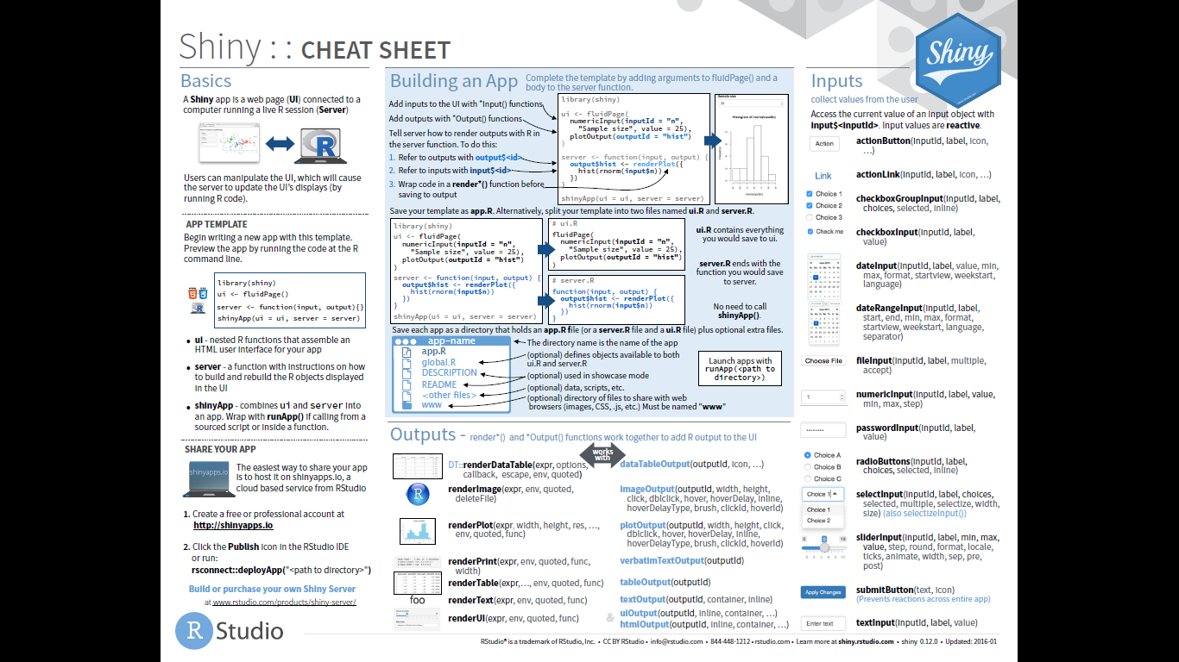
Standard shiny widgets (inputs)

Slide 31
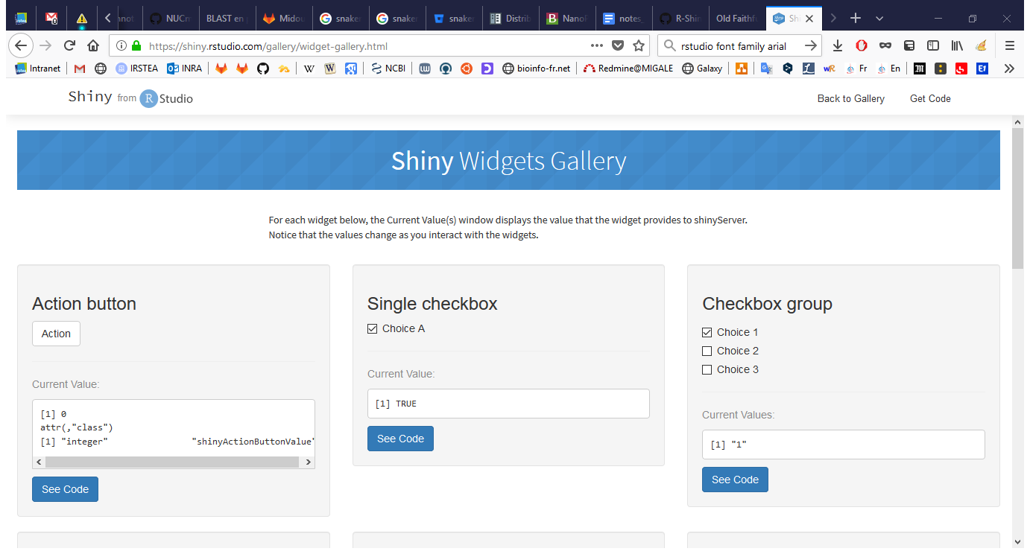
Standard shiny widgets (inputs)
https://shiny.rstudio.com/gallery/widget-gallery.html

Slide 32
ui <- fluidPage(
titlePanel("Workshop - Example 1 – Basic Histogram"),
sidebarLayout(
sidebarPanel(
numericInput(inputId="n",
label="Number of observations", value=1000) ),
mainPanel(plotOutput("plot"))
)
)
server <- function(input, output) {
data <- reactive({
x <- rnorm(input$n)
x })
output$plot <- renderPlot({
hist(data(), 50, main="", xlab="x")
})
}
Creates an entry at input$n
Default value = 1000
The remaining arguments vary from widget to widget, depending on what the widget needs to do its job.

Slide 33
Output functions

Slide 34
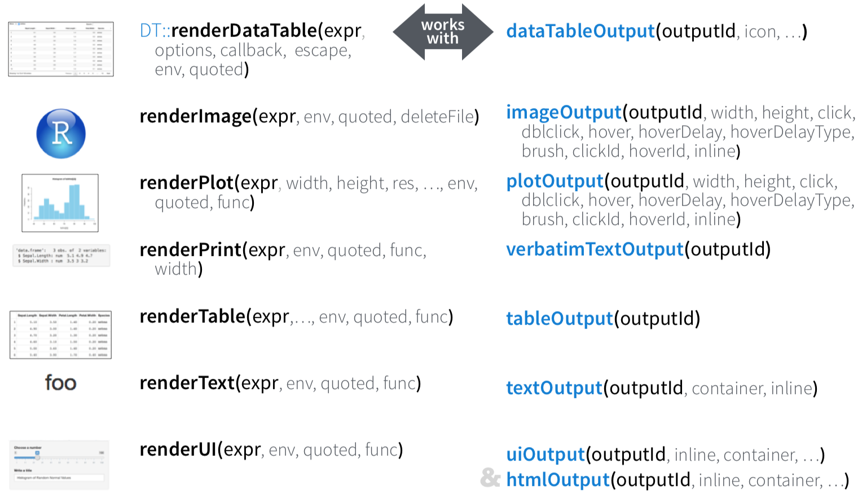
Render and outputs
render*() and *Output() functions work together to add R output to the UI
Server User Interface

Slide 35
ui <- fluidPage(
titlePanel("Workshop - Example 1 – Basic Histogram"),
sidebarLayout(
sidebarPanel(
numericInput(inputId="n",
label="Number of observations", value=1000) ),
mainPanel(plotOutput("plot"))
)
)
server <- function(input, output) {
data <- reactive({
x <- rnorm(input$n)
x })
output$plot <- renderPlot({
hist(data(), 50, main="", xlab="x")
})
}

Slide 36
More on User Interface

Slide 37
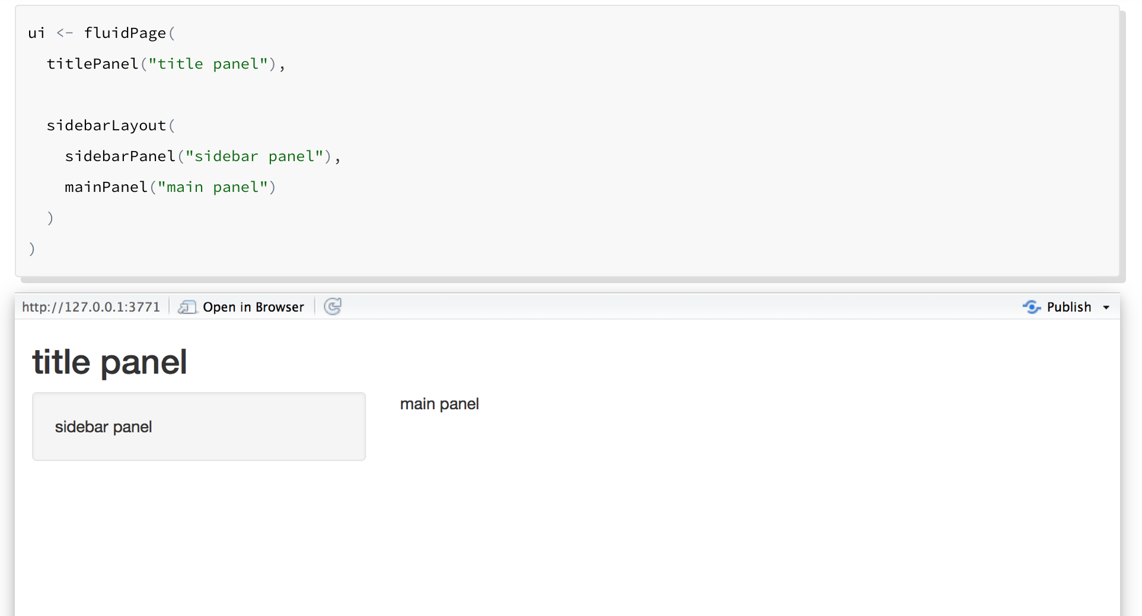
User Interface
Notes:
titlePanel and sidebarLayout are the two most popular elements to add to fluidPage. They create a basic Shiny app with a sidebar.
sidebarLayout always takes two arguments:
sidebarPanel function output
mainPanel function output
These functions place content in either the sidebar or the main panels.

Slide 38

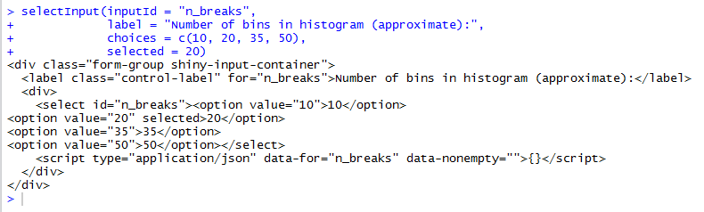
Customize the ui with HTML/CSS
shiny functions that build your user interface are creating HTML code under the hood
R Code
HTML

Slide 39
Customize the ui with HTML/CSS
Tweaking or adding HTML/CSS content can customize the look of your app
Change the relative size of panels
Add additional elements (e.g. headers, paragraphs, links to other content)
Change colors, fonts, and spacing

Slide 40
Customize the ui with HTML/CSS
Adding elements:
HTML elements are building blocks used to create webpages
Elements are surrounded by “tags”
<p>I will become a paragraph.</p>
<h1>I will become a large header.</h1>
shiny has 110 functions, called tags functions, that create HTML elements
tags$p(‘I will become a paragraph.’)
tags$h1(‘I will become a large header.’)
The most common tags functions have helper functions where you can drop the ‘tags$’ part
p(‘I will become a paragraph.’)
h1(‘I will become a large header.’)

Slide 41
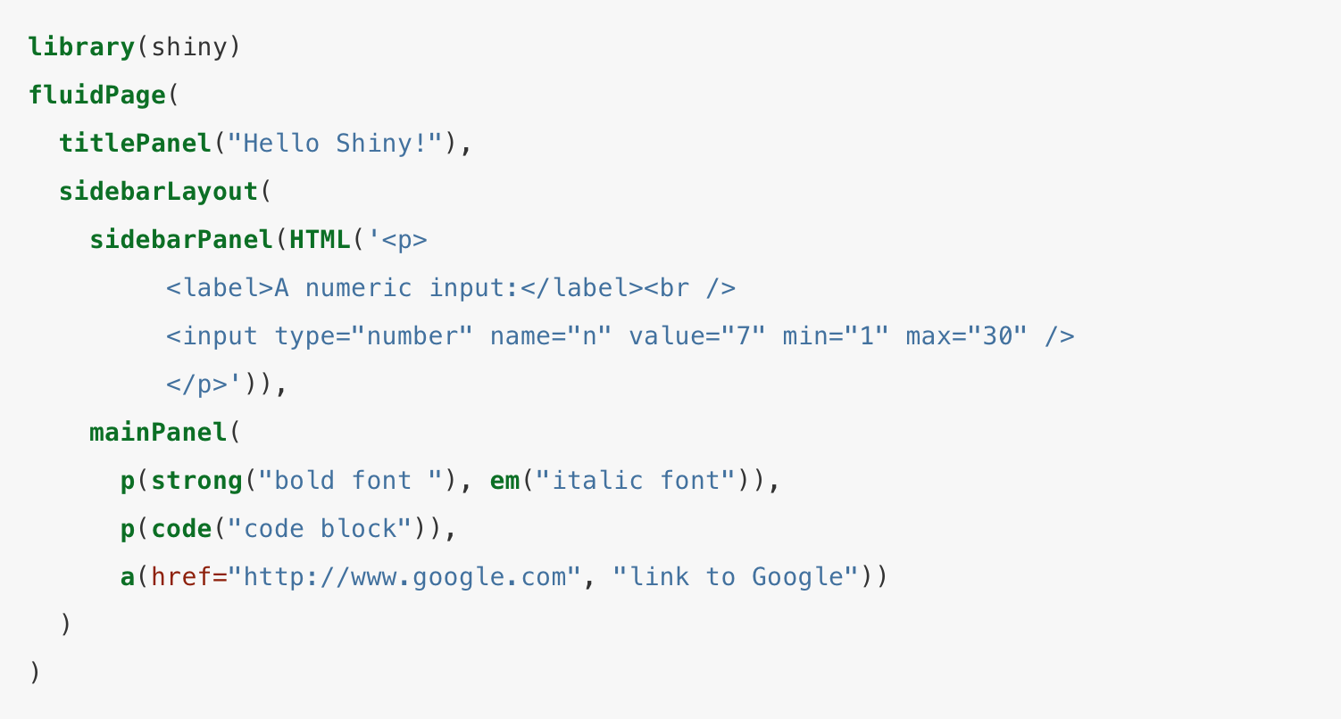
Customize the ui with HTML/CSS

Slide 42
User interface Layouts
titlePanel and sidebarLayout create a basic layout for your Shiny app, but you can also create more advanced layouts.
You can use navbarPage or shinydashboard to give your app a multi-page user interface that includes a navigation bar or side.
Or you can use fluidRow and column to build your layout up from a grid system.

Slide 43
fluidRow: Grid layout
Tweaking lay-outs:
Utilize the fluid “shiny grid system”
Rows sub-divided into 12 columns
Based on popular HTML framework called “Bootstrap”
fluidRow()
fluidRow()
column(1, )
fluidRow()
column(4, )
column(4, )
column(4, )
fluidRow()
column(6, )
column(6, )
column(width = x)
where x is between 1 and 12

