Slide 1
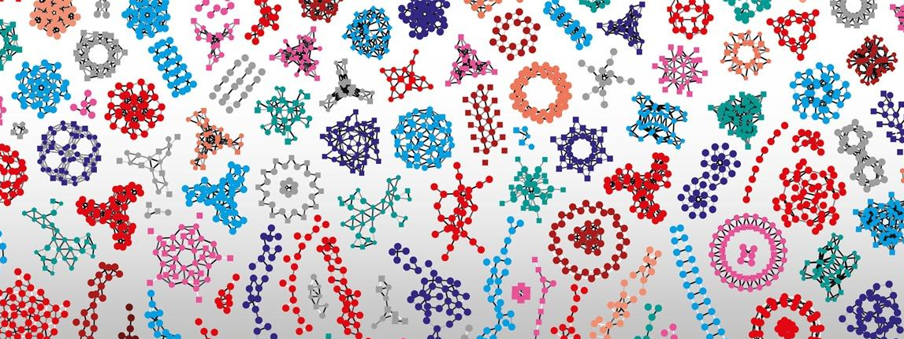

Introduction à R Shiny
Le groupe des apprenants Shiny et Frédéric Schütz
(avec du matériel emprunté à Linda Dib et Martial Sankar du SIB)
Licence Creative Commons préciser laquelle
Notes:
Ajouter logo IFB et changer la présentation

Slide 2
I
♥
?

Slide 3
Matériel de cours et liens utiles
https://github.com/IFB-ElixirFr/R-Shiny_training_2019-07
Shiny gallery widget: https://shiny.rstudio.com/gallery/widget-gallery.html
Shiny gallery: https://shiny.rstudio.com/gallery/
Lien Cheatsheet : https://shiny.rstudio.com/images/shiny-cheatsheet.pdf
Notes:
Distribuer la sheetcheat

Slide 4
Data analysis workflow
Visualize
Prepare
Import
Tidy
Transform
Communicate
Model
R
Adapted from Hadley Wickham
"R for data analysis"

Slide 5
Data analysis workflow
Visualize
Prepare
Import
Tidy
Transform
Communicate
Model
R
Adapted from Hadley Wickham
"R for data analysis"

Slide 6
How do you share R results with your collaborators ?
Notes:
Séquence minutes max

Slide 7
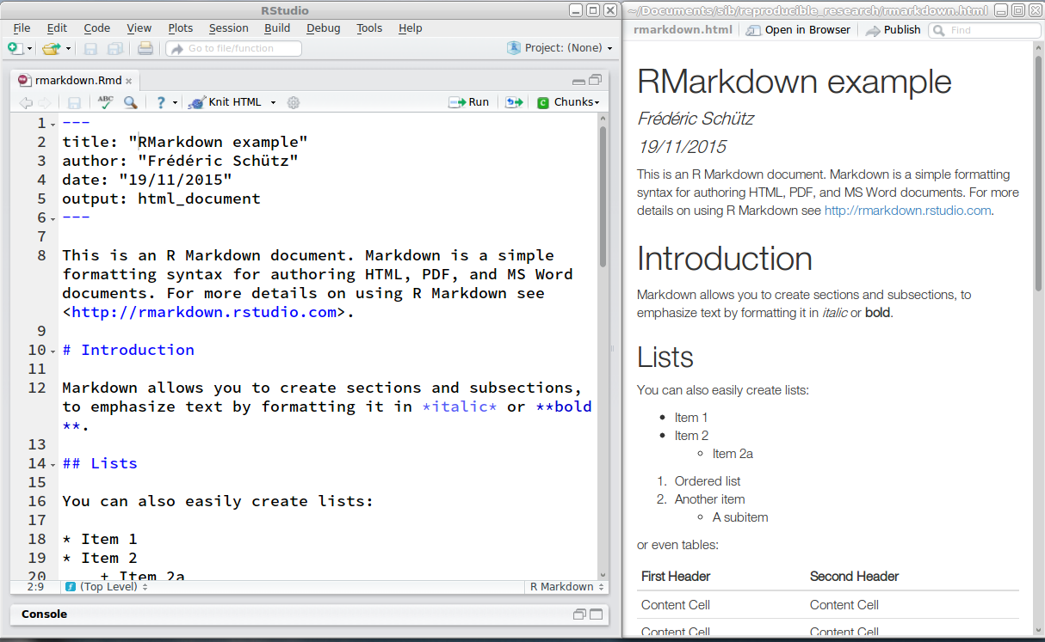
Share my R code and results
knitr and R Markdown

Slide 8
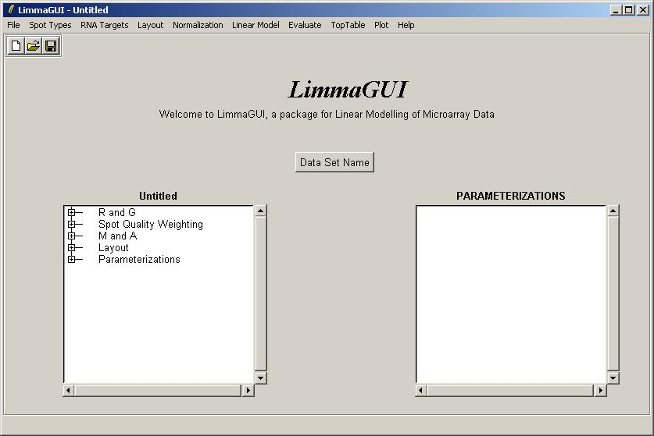
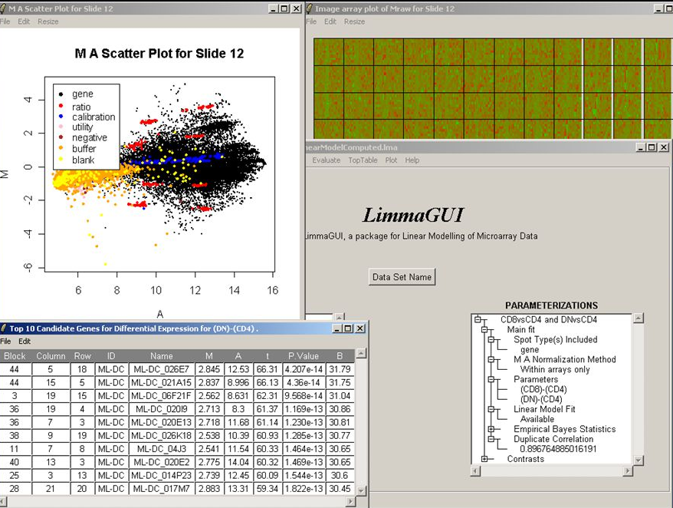
limmaGUI

Slide 9
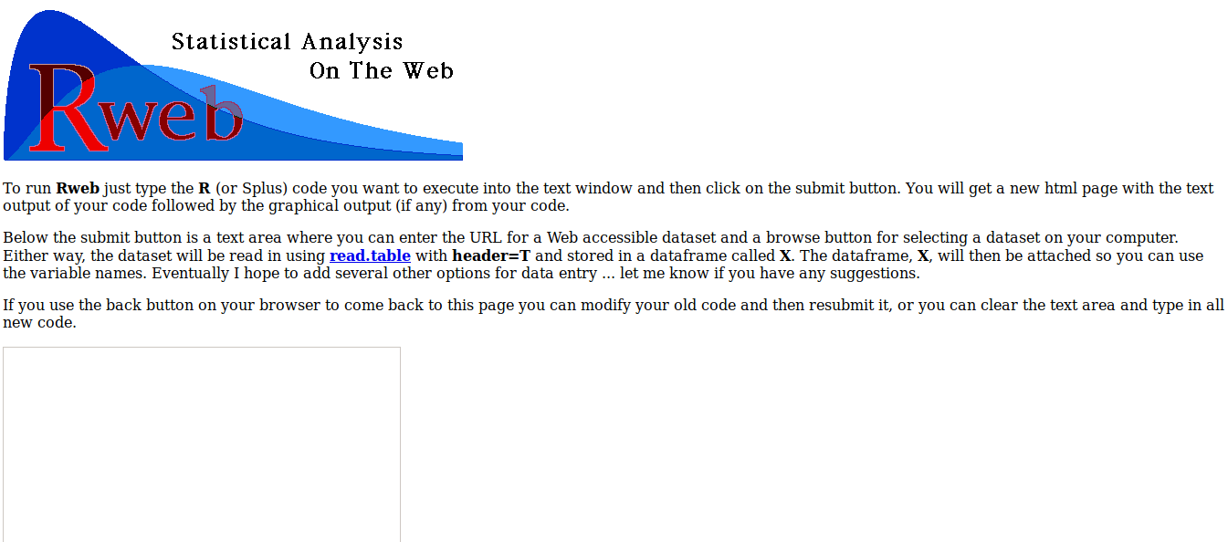
Rweb

Slide 10
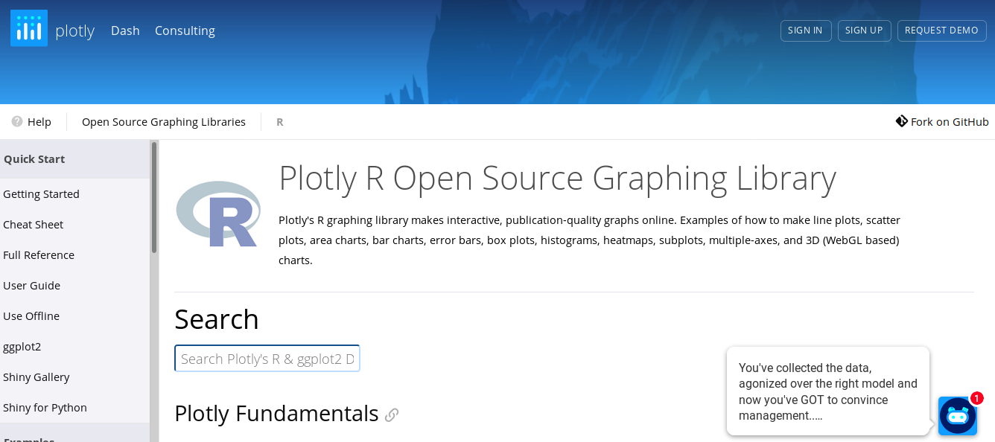
Interactive graphs

Slide 11
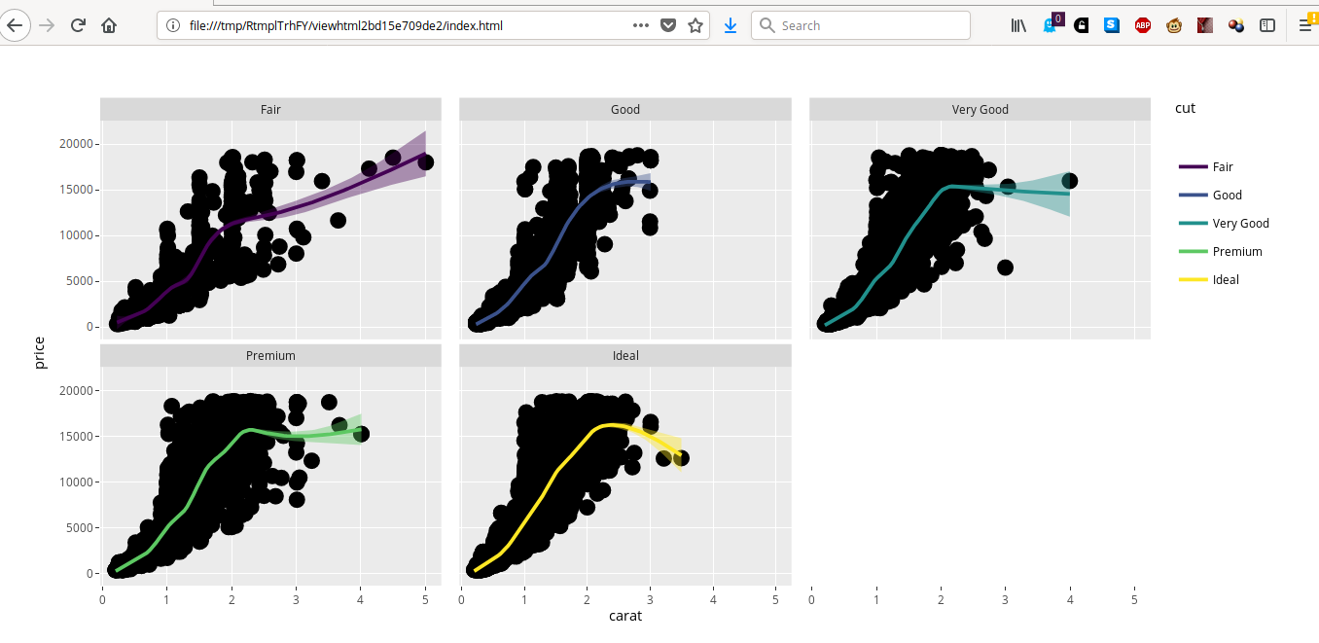
plotly
https://plot.ly/ggplot2/getting-started/

Slide 12
Data analysis workflow
Visualize
Prepare
Import
Tidy
Transform
Communicate
Model
R
Adapted from Hadley Wickham
"R for data analysis"
Notes:
A ce stade : aucun outil ne fait les 3 étape

Slide 13
"Interactive" analysis with R (and Rstudio): accessing an R application

Slide 14
Rstudio code for histogram plot
x <- faithful$waiting
# number of bins = 10
nbins <- 10
hist(x, breaks = nbins, col = "#75AADB",
border = "white",
xlab = "Waiting time to next eruption (in mins)",
main = "Histogram of waiting times")
# number of bins = 50
nbins <- 50
hist(x, breaks = nbins, col = "#75AADB",
border = "white",
xlab = "Waiting time to next eruption (in mins)",
main = "Histogram of waiting times")

Slide 15
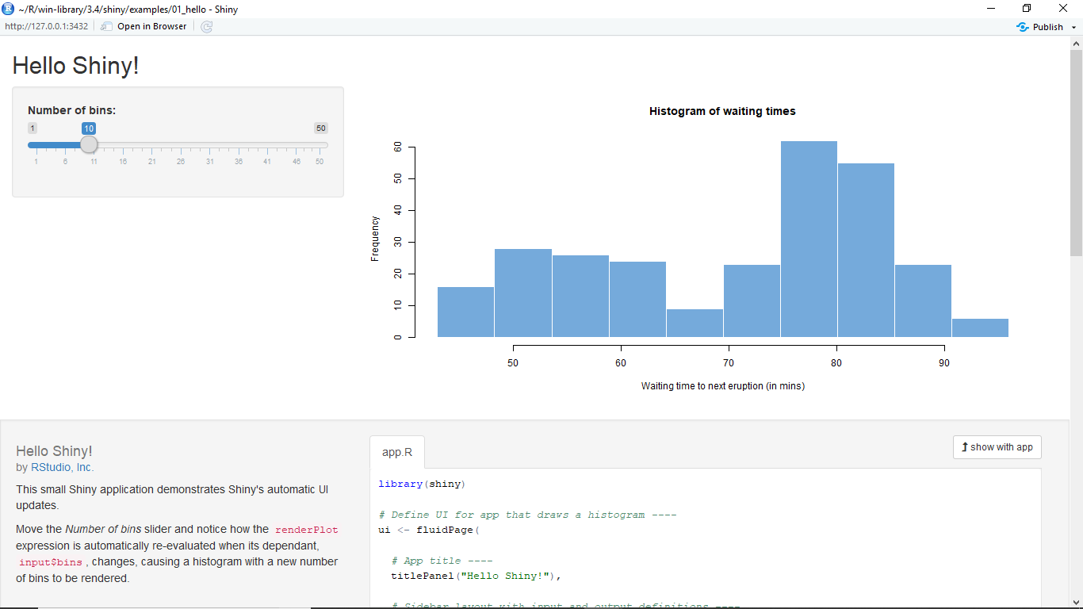
Shiny application for histogram interactive plot
runExample("01_hello")
Notes:
Ajouter le code shiny
Lancer sous Rstudio

Slide 16
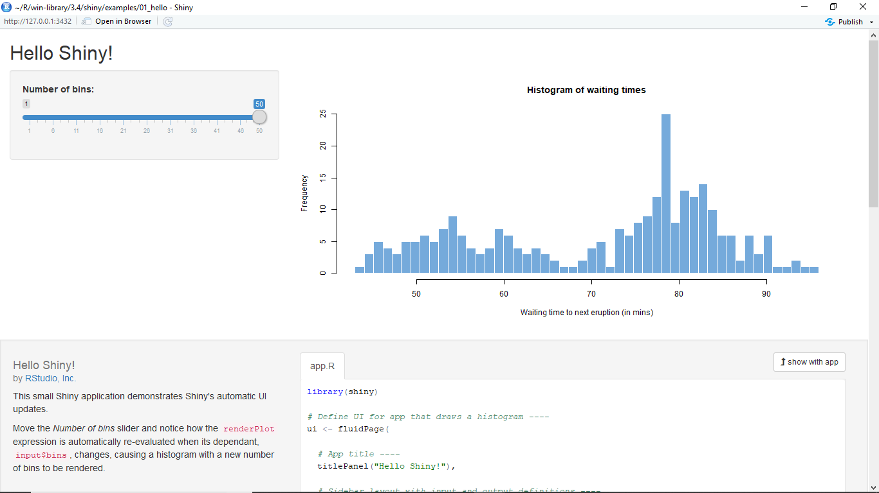
Shiny application for histogram interactive plot

Slide 17
How can I access R results through a web client ?

Slide 18
Web browser
Web page
Client
Local filesystem

Slide 19
Web browser
Web server
Client
Server

Slide 20
Web browser
Web server
R
Client
Server

Slide 21
Web browser
Web server
R
Client
Server
Notes:
Pourquoi 2 fois R ?

Slide 22
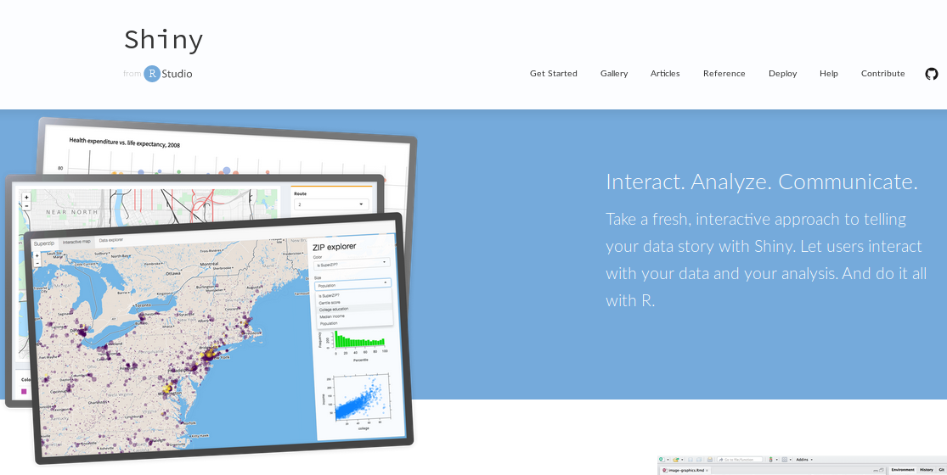
https://shiny.rstudio.com/

Slide 23
Web page
Web browser
Web server
R
Web
framework
R
Client
Server
Notes:
Pourquoi 2 fois R ?

Slide 24
Web browser
Shiny
Client
Server

Slide 25
" Shiny is an R package that makes it easy to build interactive web apps straight from R.
You can host standalone apps on a webpage or embed them in R Markdown documents or build dashboards.
You can also extend your Shiny apps with CSS themes, htmlwidgets, and JavaScript actions."

Slide 26
Shiny advantages
For R developers
Easy distribution via only a web address
Save time, focus on advanced questions
Make work valorisation and code publication easier
Reproducibility
For users
no line command
no install R/library
no update, package issues
Become autonomous for personal data exploration/analysis
Notes:
Parallèle avec Galaxy : permet à certains utilisateurs d’aller vers la ligne de commande

Slide 27
How to start with Shiny?

Slide 28
Setting up shiny in R
> install.packages("shiny")
> library(shiny)

Slide 29
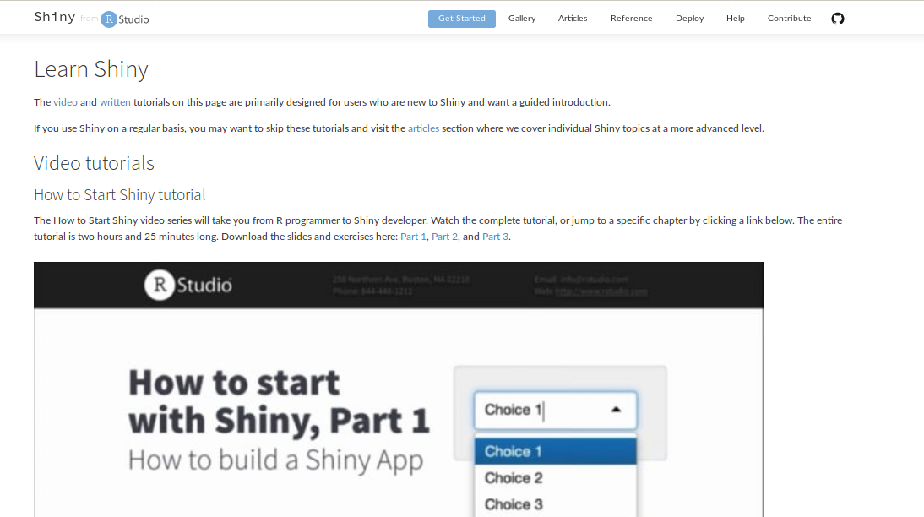
Documentation on Shiny
https://shiny.rstudio.com/tutorial/

Slide 30
Examples of Shiny apps

Slide 31
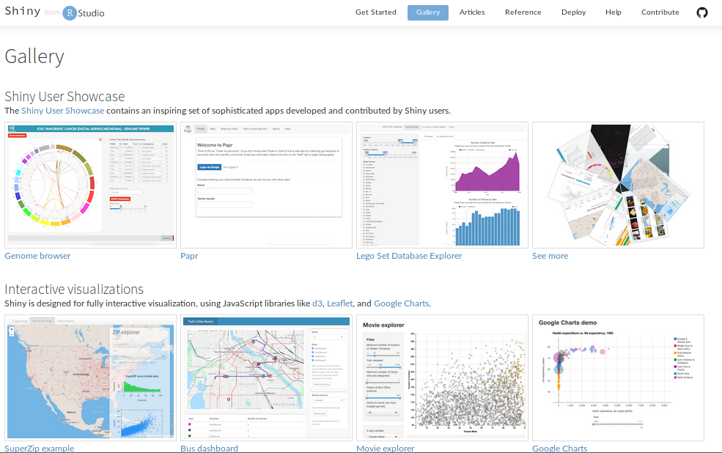
https://shiny.rstudio.com/gallery/

Slide 32
Example of Shiny applications
iSEE application https://marionilab.cruk.cam.ac.uk/iSEE_allen/
Biostats and Bioinfo applications
to do

Slide 33
Shiny includes 11 examples of apps
Practice: pick up one example and run it on your Rstudio
runExample("01_hello") # a histogram
runExample("02_text") # tables and data frames
runExample("03_reactivity") # a reactive expression
runExample("04_mpg") # global variables
runExample("05_sliders") # slider bars
runExample("06_tabsets") # tabbed panels
runExample("07_widgets") # help text and submit buttons
runExample("08_html") # Shiny app built from HTML
runExample("09_upload") # file upload wizard
runExample("10_download") # file download wizard
runExample("11_timer") # an automated timer

Slide 34
Supplementary material

Slide 35
Example: simulation
n1 <- 25
n2 <- 25
d <- 2
sd <- 2.45
p <- NULL
for (i in 1:10000) {
data1 <- rnorm(n1, mean=0, sd=sd)
data2 <- rnorm(n2, mean=d, sd=sd)
p <- c(p, t.test(data1, data2)$p.value)
}
sum(p < 0.05) / length(p)

Slide 36
Execute the code 1 on Rstudio
Change n1 and n2 values

Slide 37
Example: simulation
n1 <- 25
n2 <- 25
d <- 2
sd <- 2.45
p <- NULL
for (i in 1:10000) {
data1 <- rnorm(n1, mean=0, sd=sd)
data2 <- rnorm(n2, mean=d, sd=sd)
p <- c(p, t.test(data1, data2)$p.value)
}
sum(p < 0.05) / length(p)
[1] 0.7997

Slide 38
Example: new simulation
n1 <- 35
n2 <- 15
d <- 2
sd <- 2.45
p <- NULL
for (i in 1:10000) {
data1 <- rnorm(n1, mean=0, sd=sd)
data2 <- rnorm(n2, mean=d, sd=sd)
p <- c(p, t.test(data1, data2)$p.value)
}
sum(p < 0.05) / length(p)

Slide 39
Example: new simulation
n1 <- 35
n2 <- 15
d <- 2
sd <- 2.45
p <- NULL
for (i in 1:10000) {
data1 <- rnorm(n1, mean=0, sd=sd)
data2 <- rnorm(n2, mean=d, sd=sd)
p <- c(p, t.test(data1, data2)$p.value)
}
sum(p < 0.05) / length(p)
[1] 0.7239

Slide 40
Example: new simulation
n1 <- 55
n2 <- 15
d <- 2
sd <- 2.45
p <- NULL
for (i in 1:10000) {
data1 <- rnorm(n1, mean=0, sd=sd)
data2 <- rnorm(n2, mean=d, sd=sd)
p <- c(p, t.test(data1, data2)$p.value)
}
sum(p < 0.05) / length(p)
[1] 0.769

Slide 41
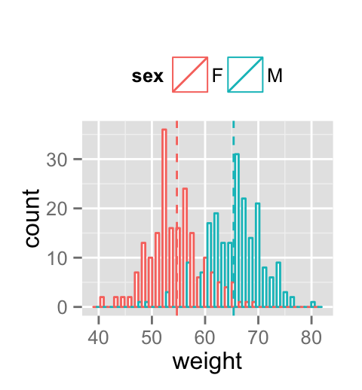
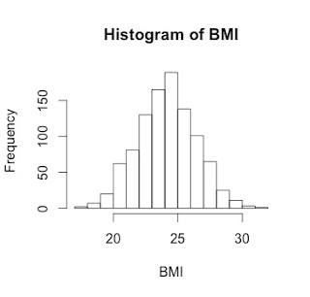
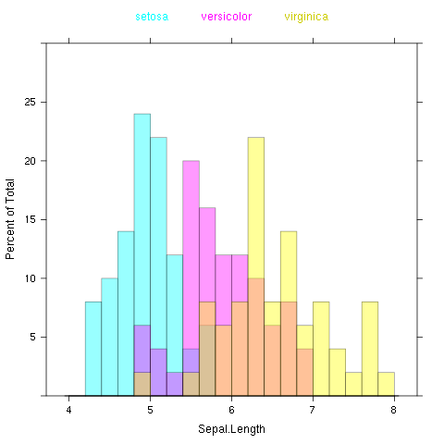
3 models for graphics in R
Base graphics
Lattice
ggplot

Slide 42
Visualising data

Slide 43
Interactive graphs

Slide 44
Plotly & ggplot2
library(plotly)
data(diamonds)
p <- ggplot(
data = diamonds,
aes(x = carat, y = price)) +
geom_point(aes(text = paste("Clarity:", clarity)), size = 4) +
geom_smooth(aes(colour = cut, fill = cut)) +
facet_wrap(~ cut)
(gg <- ggplotly(p))

Slide 46
Data analysis workflow
Visualize
Prepare
Import
Tidy
Transform
Communicate
Model
R
Adapted from Hadley Wickham
"R for data analysis"

Slide 47
Shiny application for puissance computation
Faire une capture d’écran de l’appli Shiny correspondante

