Slide 1
期末大作业的安排

Slide 2
Three different types of topic for choice
open：
EDX data analysis(60-90), with 70-80 as common
Target：
6 different microarray data analysis(70-100), with 75-90 as common
KDD Cup 09 data: orange data classification(75-100), with 80-95 as common
Different score levels are assigned according to the difficulty level.

Slide 3
EDX data
EDX: offers free online courses and classes
The edx data: contains three different tables
The first two tables are pre/post questionnaire
The last table is about the usage of edx and some basic information about users
The last table - raw data, extracted from a large number of log files, exhibiting only the most important summarized information.
Cranbach's Alpha/Composite reliability are used to test the group of different variables.
The aim of the data mining task is to find out the relationships among: the usage patterns of EDX platform, the scores and the questionnaire. Any possible conclusion can be valuable with some data to support.

Slide 5
Micorarray data
6 different multiclass microarray data sets.
Each attribute is a gene expression data, and each row is a sample, either patient or healthy person.
Breast, Leukemia-1, Leukemia-2, Lung-1 are relatively easy to deal with.
GCM is harder.
NCI60 is the hardest one.
Good results in the four datasets can only provide your basic understanding in classification(70-90). GCM is used to improve the score level(85-95).
NCI60 can be used to lift the level to 90-100.

Slide 7
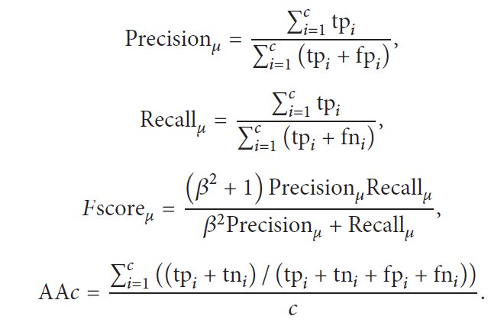
Evaluation of multiclass results

Slide 8
Orange task: KDD Cup 2009
Customer relationship prediction: estimate the probability of customers -- three target values.
Churn: Churn rate is also sometimes called attrition rate. It is one of two primary factors that determine the steady-state level of customers a business will support. In its broadest sense, churn rate is a measure of the number of individuals or items moving into or out of a collection over a specific period of time. The term is used in many contexts, but is most widely applied in business with respect to a contractual customer base. For instance, it is an important factor for any business with a subscriber-based service model, including mobile telephone networks and pay TV operators. The term is also used to refer to participant turnover in peer-to-peer networks.
Appetency: In our context, the appetency is the propensity to buy a service or a product.
Up-selling (wikipedia definition): Up-selling is a sales technique whereby a salesman attempts to have the customer purchase more expensive items, upgrades, or other add-ons in an attempt to make a more profitable sale. Up-selling usually involves marketing more profitable services or products, but up-selling can also be simply exposing the customer to other options he or she may not have considered previously. Up-selling can imply selling something additional, or selling something that is more profitable or otherwise preferable for the seller instead of the original sale.

Slide 9
In the small dataset, both training and test sets contain 50,000 examples. The data sets have numerical and categorical variables.The first 190 variables are numerical and the last 40 are categorical. Toy target values are available only for practice purpose.
The datasets use a format similar as that of the text export format from relational databases:
One header lines with the variables names
One line per instance
Separator tabulation between the values
There are missing values (consecutive tabulations)

Slide 10
The large matrix results from appending the various chunks downloaded in their order number. The header line is present only in the first chunk.
The target values (.labels files) have one example per line in the same order as the corresponding data files. Note that churn, appetency, and up-selling are three separate binary classification problems. The target values are +1 or -1. We refer to examples having +1 (resp. -1) target values as positive (resp. negative) examples.
There are a lot of papers discussing the process of handling data effeciently. Winners' papers can be found with:
http://jmlr.csail.mit.edu/proceedings/papers/v7/

Slide 11
Finish the tasks as a team:
Each team contains three members at most;
There are m*100% points to be assigned according to each member's contribution, if there are m members in a team. One can take 120% at most, and 80% at least. The sum of points
The score for the task of each one would be: the points * the average mark got from the teacher and the tutors.
Each team should prepare: a presentation about five minutes, and the question/answer process.
Each team should submit: the ppt and a final report, source code and processed data.
All the files should be included in a zip file.

Slide 12
The schedule for the last month
5.12 for the preparations of the final task. Queries are welcome. No more experiments ever since.
The team membership should be declared and emailed the tutor Mr. Lv before 5.15 (1832961256@qq.com).
All the teams consisting of members with ID(2010，2011，2012) should be prepared for the presentation in 5.26. Such teams should inform the tutor Mr. Lv.
5.26(in Room 201)/5.31 for the presentation of the final task.
Each team should submit the final report before 12pm in 5.26.
All other classes will go ahead as normal classes.

