Slide 1

PhD project presentation:
Feasibility studies of artificial intelligence driven diagnostics
(Second doctoral seminar in TSD PAN)
Abdalraheem Ijjeh
Supervisor: Prof. Pawel Kudela
IFFM, Polish Academy of Sciences.
Notes:
Welcome and thank you for joining me here at this remote seminar.
Today I am going to briefly present my PhD project progress entitled by Feasibility studies of artificial intelligence-driven diagnostics.

Slide 2

Table of contents
Introduction
  What is deep learning?
  What is CNN and computer vision?
  What is RNN?
  Deep learning for SHM applications
Implemented semantic segmentation techniques
  Using RMS images:
    Residual UNet
    VGG16 encoder-decoder
    FCN DenseNet
    Pyramid Scene Parsing Network (PSPNet)
    Global Convolutional Network (GCN)
  Using Full wavefield Frames:
    RNN/ConvLSTM2D Encoder-Decoder
Results
Conclusions and future works
Notes:
The presentation will be as follow: In the first section, I am going to introduce deep learning, convolutional neural network CNN and computer vision.
Also, I will talk briefly about recurrent neural networks RNN and Long short term memory LSTM.
Additionally, I will talk about deep learning for SHM applications.
In the second section, I will briefly introduce my implemented models for semantic segmentation
In the next section, I will show some results regarding each implemented model.
In the final section conclusions and future works will be presented.

Slide 3

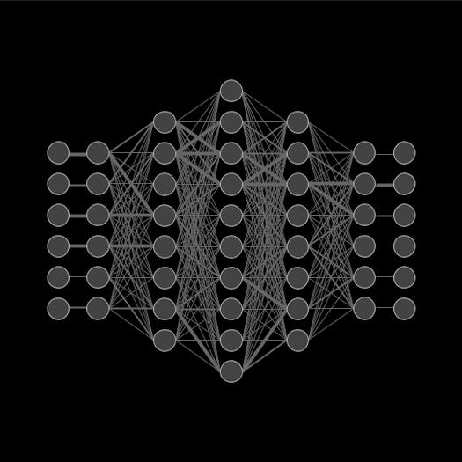
  Introduction- What is deep learning?
What is deep learning?
How does deep learning works?
https://www.analyticsinsight.net/deep-learning-technologies-impacting-computer-vision-advances/
https://www.cloudpainter.com/ai-art-blog/tag/Portrait
Notes:
What is deep learning?
Deep learning, which also known as deep neural networks or neural learning, is a form of artificial intelligence (AI) that seeks to imitate the workings of a human brain. It is a form of machine learning, with functions that operate in a nonlinear decision-making process.
How does it works?
As a subset of machine learning, deep learning uses hierarchical neural networks to analyze data.
Neuron units are linked together within these hierarchical neural networks, similar to the human brain.
The hierarchical structure of deep learning allows it to take a nonlinear approach, processing data across a series of layers which each will integrate subsequent tiers of additional information.

Slide 4
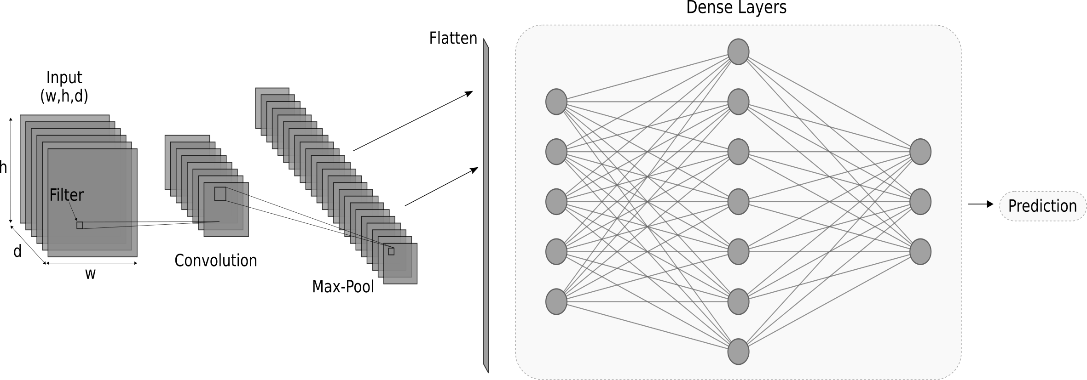
  Introduction- What is CNN and computer vision?
What is Convolutional neural network (CNN)?
What is computer vision?
Notes:
Convolutional neural network (CNN) or ConvNet is considered as class of a deep neural networks, which is mostly applied to analyze images.
A CNN uses a system much like a multilayer perceptron that has been designed for reduced processing requirements.
The layers of a CNN consist of an input layer, an output layer and a hidden layer that includes multiple convolutional layers, pooling layers and normalization layers.
CNN could be built as fully convolutional network FCN, or it could has fully connected layers or dense layer.
Mainly, CNN architectures are utilised for computer vision applications in which
images are processed for classification, object detection, localization and segmentation purposes.

Slide 5
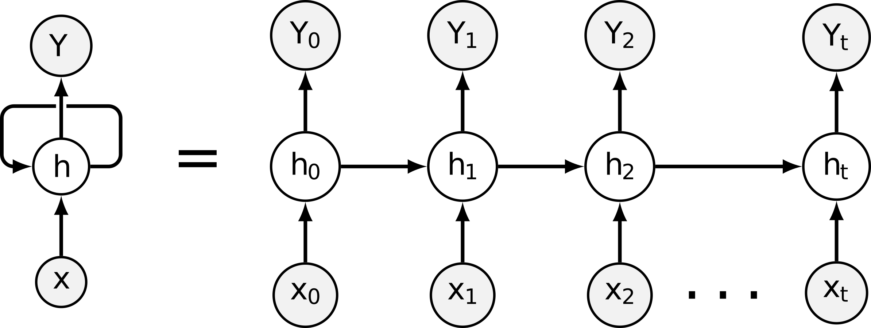
  Introduction What is RNN?
A recurrent neural network (RNN) is a deep learning model that handles time-series data (sequential data)
RNN models can remember its data input because of its internal memory which means the output of RNN depends on the prior input sequence
The figure shows the visualization of a RNN model and an unrolled RNN model equivalence.
RNN has two paths of data propagation (Forward and Backward)
Learnable weights are for both directions that are updated using Back propagation through time (BPTT) technique.
Notes:
A recurrent neural network (RNN) is a Deep Learning model that handles time-series data (sequential data).
That means RNN technique can remember its data input, because of its internal memory which makes it a powerful and promising technique in the field of Deep Learning.
In the traditional deep neural networks (feed-forward) it is assumed that there is no correlation between the inputs and the outputs, while this assumption is not true for the RNN technique, that means the output of the RNN depends on the prior input sequence.
The future events can also be used in predicting the output of a given sequence.
In RNN, weights are updated using back-propagation through time (BPTT). Essentially, BPTT
performs back-propagation algorithm on unrolled RNN.
Two issues may arise during updating the learnable weights:
One . Exploding gradients: that can occur when the assigned values to the weights become so large that leads to overflow
The second issue is the Vanishing gradients: that can occur when the assigned values to the weights become too small which affects the learning process to be very slow or to stop.

Slide 6
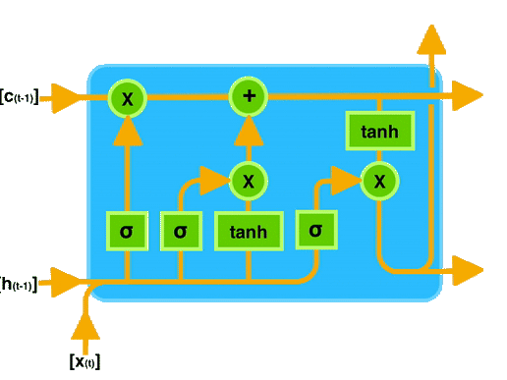
  Introduction What is RNN? Cont.
Long short term memory (LSTM) shown in the figure was introduced to solve issues raised during updating the learnable weights:
(Exploding gradients and vanishing gradients)
LSTM consists of three units:
  Forget gate
  Input gate
  Output gate
Source: https://towardsdatascience.com/ghost-writing-with-tensorflow-49e77e26978f
Notes:
long short-term memory (LSTM) was introduced to solve the issue of vanishing and exploding gradients. LSTM is an memory extension for regular RNN. Which addresses the problem of long-term dependencies. LSTM is composed of three gates: an input gate, a forget gate, and a output gate.
The purpose of the forget gate is to figure out which information needs to be considered and which needs to be neglected.
The purpose of the input gate is to quantify the importance of the new information carried by the input.
The purpose of the output gate is to compute the future hidden state and cell state which is the output used with next timestamp

Slide 7
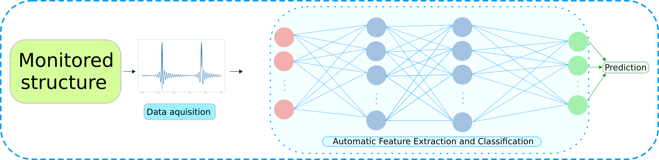
  Introduction- Deep learning for SHM applications
Deep learning techniques have been utilised in structural health monitoring (SHM)
Deep learning techniques has an end-to-end structure.
Notes:
Deep learning techniques in structural health monitoring (SHM) is gaining popularity due to recent technological advancements in sensors, as well as high-speed internet and cloud-based computation.
Deep learning approach makes it possible to use registered data in their raw form without any need to perform features extraction, hence, such an approach has an end-to-end structure that will automatically learn and discover the hidden features in high dimensional input data.
Furthermore, Several Deep Learning-based techniques were applied for SHM including damage detection and localisation, corrosion detection, and concrete crack detection.
To do so, we need to train the deep learning models on dataset whether are numerically generated or registered from real monitoring.

Slide 8
Implemented semantic segmentation techniques
What is semantic segmentation?
Implemented deep learning models are capable of performing semantic segmentation utilised for delamination detection, localisation and size estimation in CFRP.
Models based on RMS images:
  Residual UNet
  FCN DenseNet
  PSPNet
  GCN
Model based on full wavefield frames:
  RNN with ConvLSTM
Notes:
Image semantic segmentation is a well-known technique employed for computer vision.
It aims to label each pixel in the input image to its matching class and it is applied in many real-life practical applications such as self-driving cars, medical imaging, traffic control systems, video surveillance, and many others.
In this work, several deep learning models were implemented to perform semantic segmentation in order to predict and localize the damage in CFRP

Slide 9

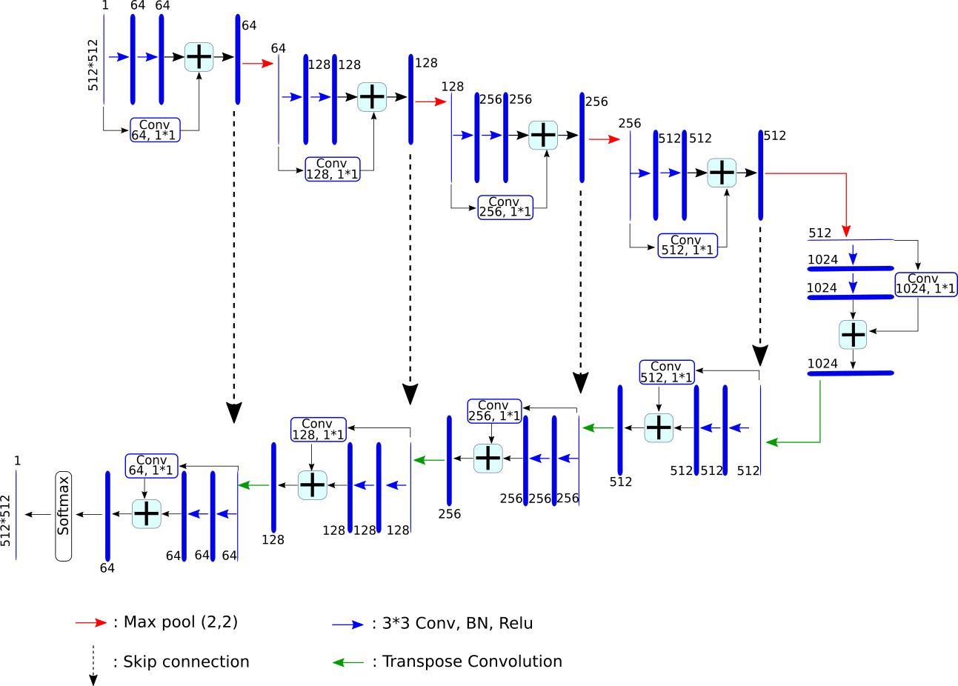
  Residual UNet
Notes:
Residual UNet (Res-UNet) model is based on the residual learning and the UNet technique.
It is a well-known architecture that performs a biomedical segmentation based on encoder-decoder.
The Res-UNet has a U-shape convolutional network that is based on encoder-decoder style.
The encoder (contracting) path is responsible for capturing the detailed context of an input image,
while the decoder (expansive) path is responsible for enabling a precise localisation.
Residual connections are added at two levels to maintain the spatial and contextual information from the previous layers from being lost.
Moreover, the number of convolutional filters is doubled after each downsampling block therefore the model can learn complex patterns effectively.
The bottleneck layer lies in between the encoder and the decoder as a joining point in the deepest layer in the model.
The decoder consists of several upsampling blocks to retrieve the dimensions and increase the resolution

Slide 10
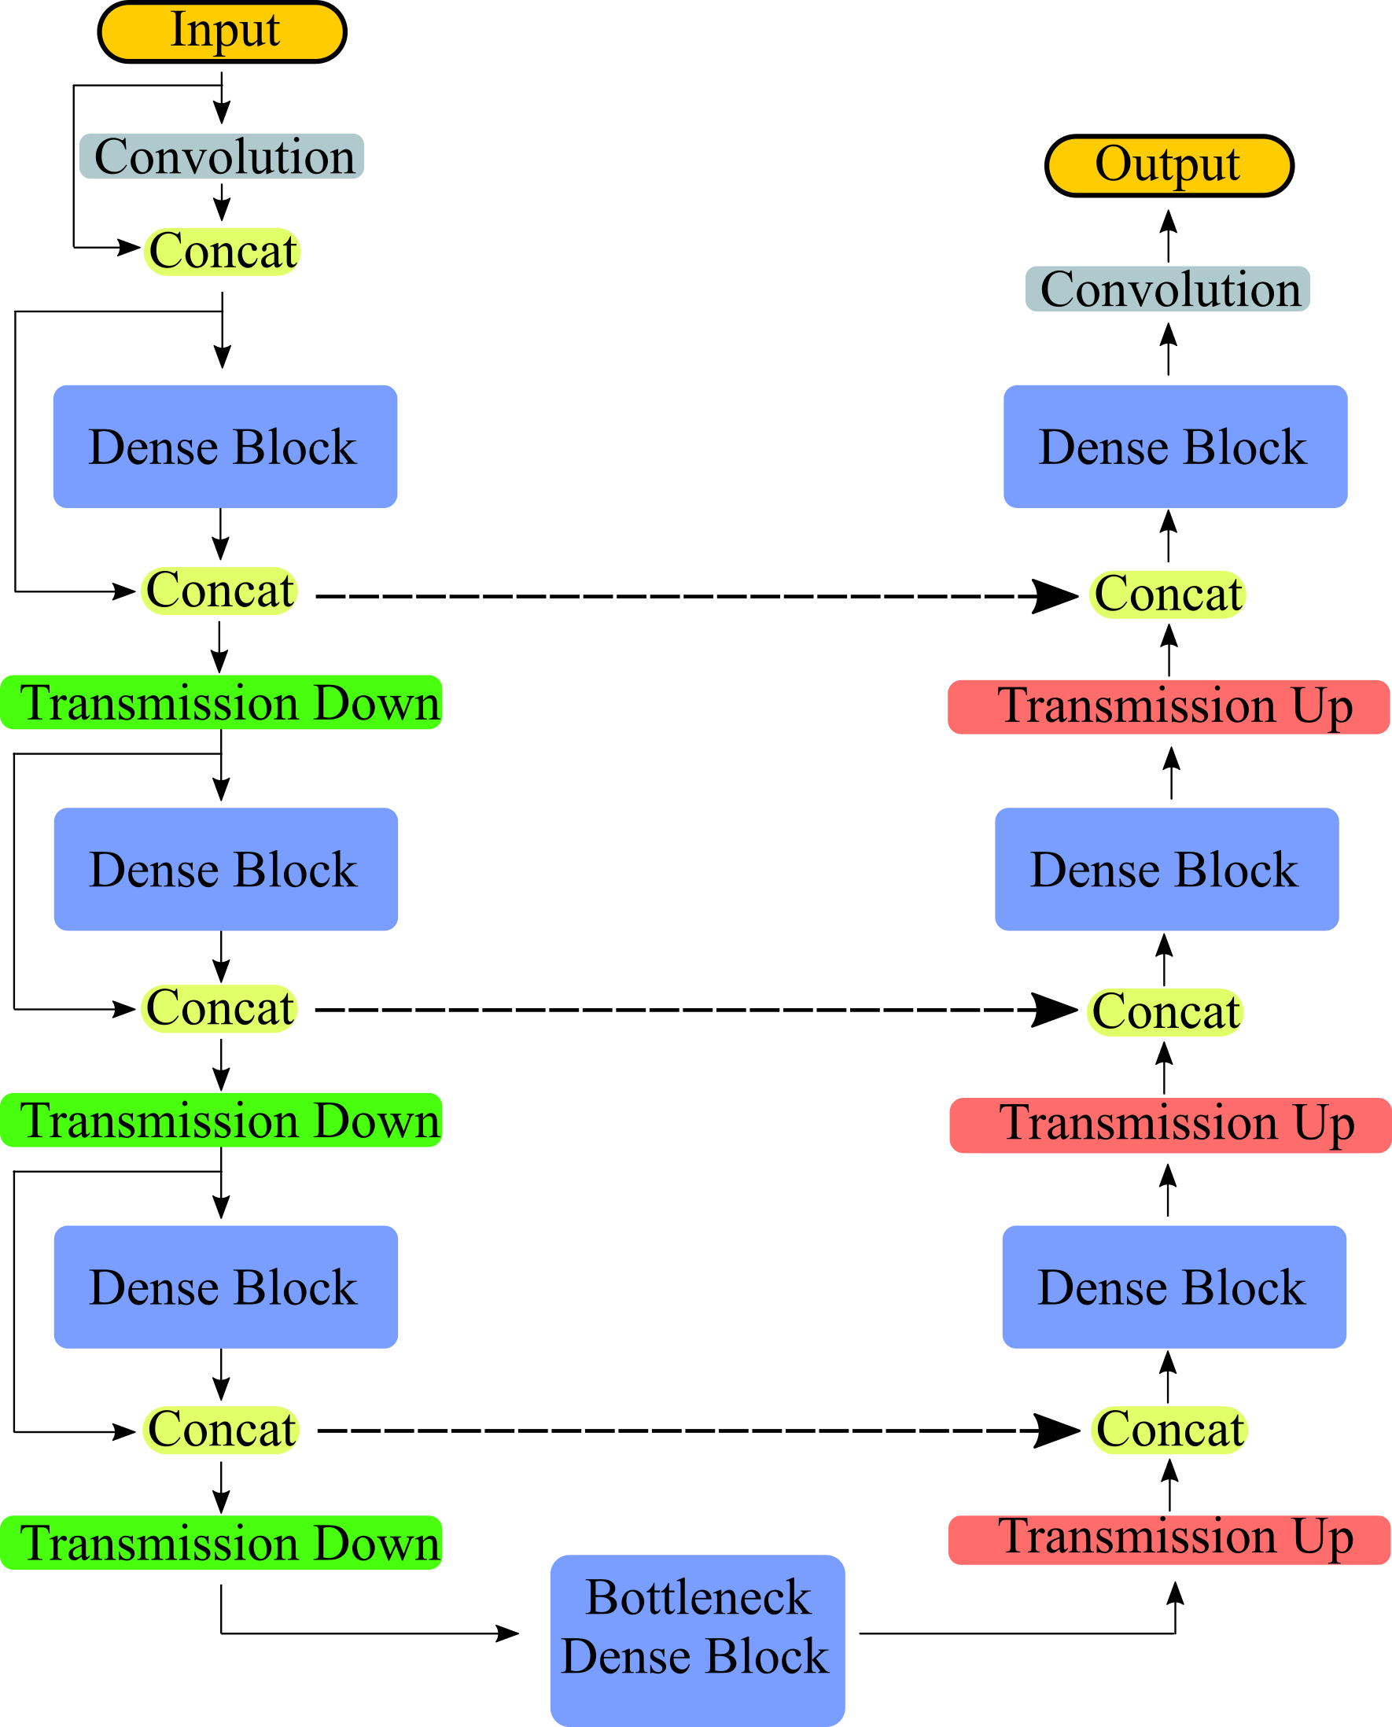

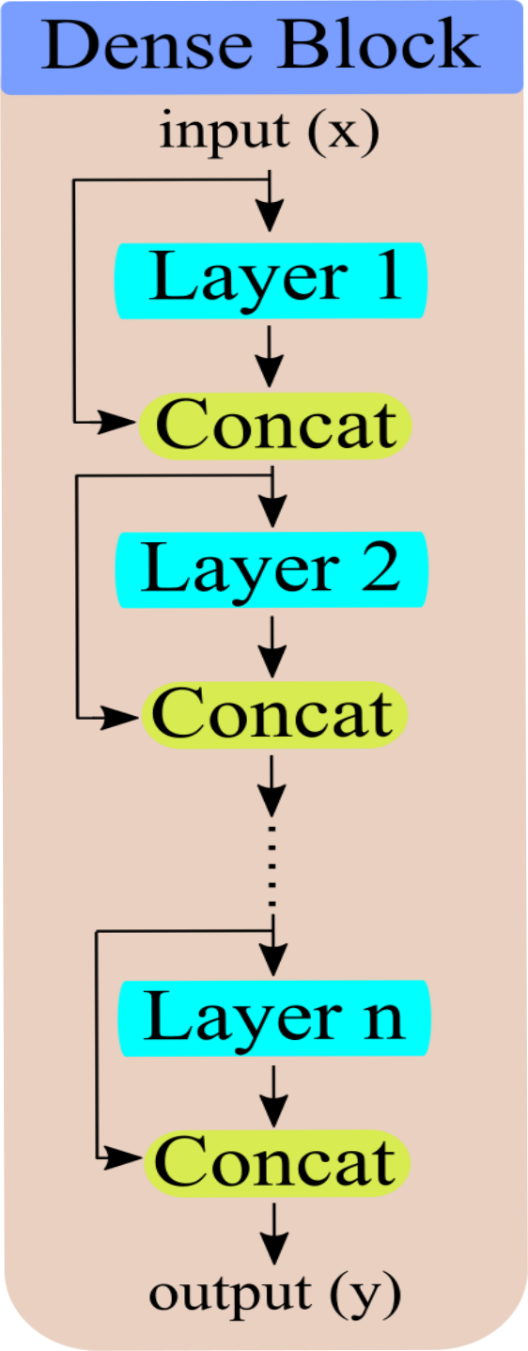
  FCN DenseNet
Notes:
FCN-DenseNet for semantic segmentation is based on the DenseNet model originally proposed by Huang et al. [36]. The main advantage of FCN-DenseNet over DenseNet is the extra utilizing of feature maps by adding the upsampling path to the model. FCN-DenseNet is composed of downsampling path, upsampling path and skip connections.
Skip connections from the downsampling path to the corresponding upsampling path are essential for recovering spatially detailed information by reusing feature maps.
The essential component in FCN-DenseNet is a dense block. Its purpose is to concatenate layer input with its output to emphasize spatial details information.
The transition down layer was introduced to reduce the spatial dimensionality of the feature maps. For the transition up layer, it was introduced in FCN-DenseNet to recover the input spatial resolution. Feature maps emerging from upsampling are concatenated with the ones resulting from the skip connection forming the input to a new dense block.
During the upsampling, the input to the dense block is not concatenated with its output to overcome the overhead of memory shortage since the upsampling path expands the spatial resolution of the feature maps.

Slide 11
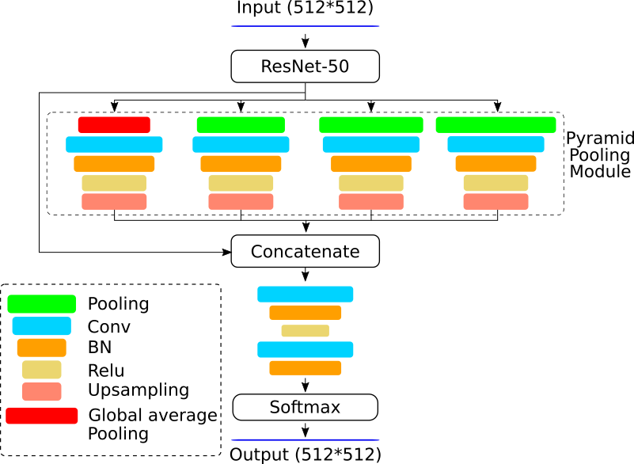
  Pyramid Scene Parsing Network (PSPNet)
Notes:
The principle idea of PSPNet is to provide adequate global contextual information for pixel-level scene parsing through concatenating the local and global features together.
A spatial pyramid pooling module was introduced to perform four different pooling levels with four different pooling sizes and strides. In this way, the pyramid pooling module is able to capture contextual features from different scales.
In this work, we implemented PSPNet with ResNet-50 as a backbone for feature map extraction.
The pyramid pooling module was applied on four levels.
Global average pooling was used to produce the coarsest level of a single bin output shown in the red box. The other three sub region levels have different pooling sizes of (2 2); (4 4) and (8 8).
The feature maps produced from the different levels were upsampled with bi-linear interpolation.
Moreover, the upsampled features are concatenated with the output of the ResNet-50 model to obtain both local and global context information.
Finally, 2 convolutional layers followed by softmax were used for generating the pixel-wise segmented predictions.

Slide 12
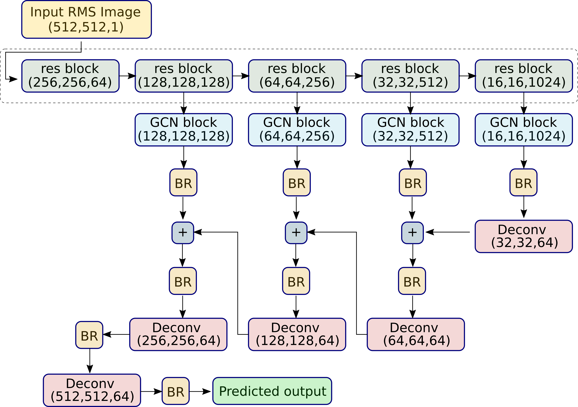
  Global Convolutional Network (GCN)
Notes:
Global Convolutional Network (GCN) addresses the importance to have large filters for both localisation and classification for semantic segmentation to enlarge respective fields. However, classification tasks require the models to be invariant for different transformations such as rotation. On the other hand, localisation tasks require the models to be sensitive for any transformation, to accurately assign each pixel for its semantic category. Therefore, to solve this contradiction, two design principles were suggested:
1. For the classification task, a large filter size must be used to enable dense connections between feature maps and per-pixel classifiers.
2. For localisation task, the model must be fully convolutional. Additionally, fully connected or global pooling layers are not applied as these layers will discard the localisation information.
In the figure on the left, the residual block are in green, the GCN block in blue and the Boundary refinement in yellow which can be considered as an additional residual block to refine the predictions near the object boundaries ended up generating a lower resolution score map.
Furthermore, the upsampling operation is done recursively, it upsamples the low resolution score maps then concatenate it with a higher one to produce a new score maps.

Slide 13
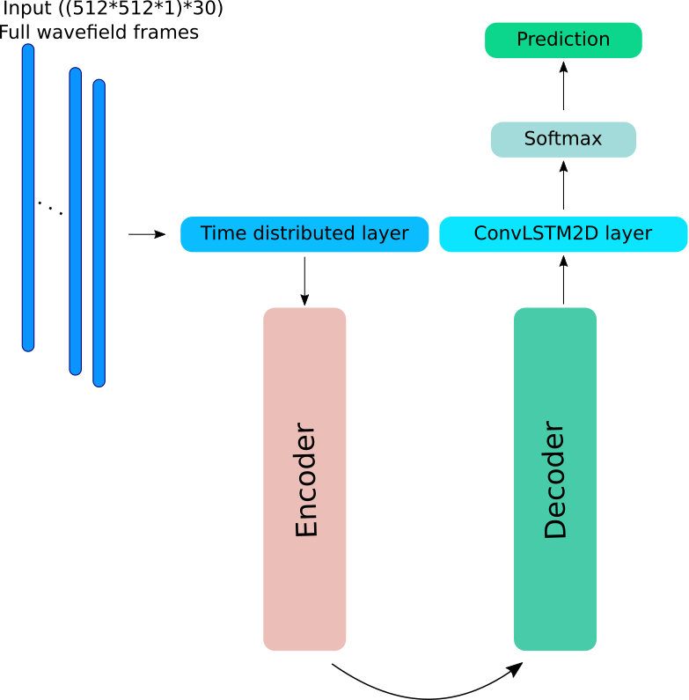
  RNN/ConvLSTM2D Encoder-Decoder
Full wavefield frames as input
Based on UNet encoder-decoder model
Input patch (512*512*1)*30
Time distributed layers
ConvLSTM2D layer
Notes:
The figure shows an abstract level of the implemented model
The model is based on the UNet model in which it has encoder and decoder paths
ConvLSTM2D layer is an LSTM layer combined with 2D convolution operation
In this model, the input data are consecutive full wavefield frames of propagating Lamb waves interacting with the delamination
Each Delamination case has 512 frames
For this model, only 30 chosen frames were used, these frames are prior and post to the interaction with the delamination.
Accordingly, this means there will be a time distributed layer to handle 30 frames during each iteration
The ConvLSTM2D layer is utilized at the end of the model to capture the temporal dependencies from the different timestamped frames
The model is capable to predict the location of the delamination based on the full wavefield frames only without any need for further processing.

Slide 14
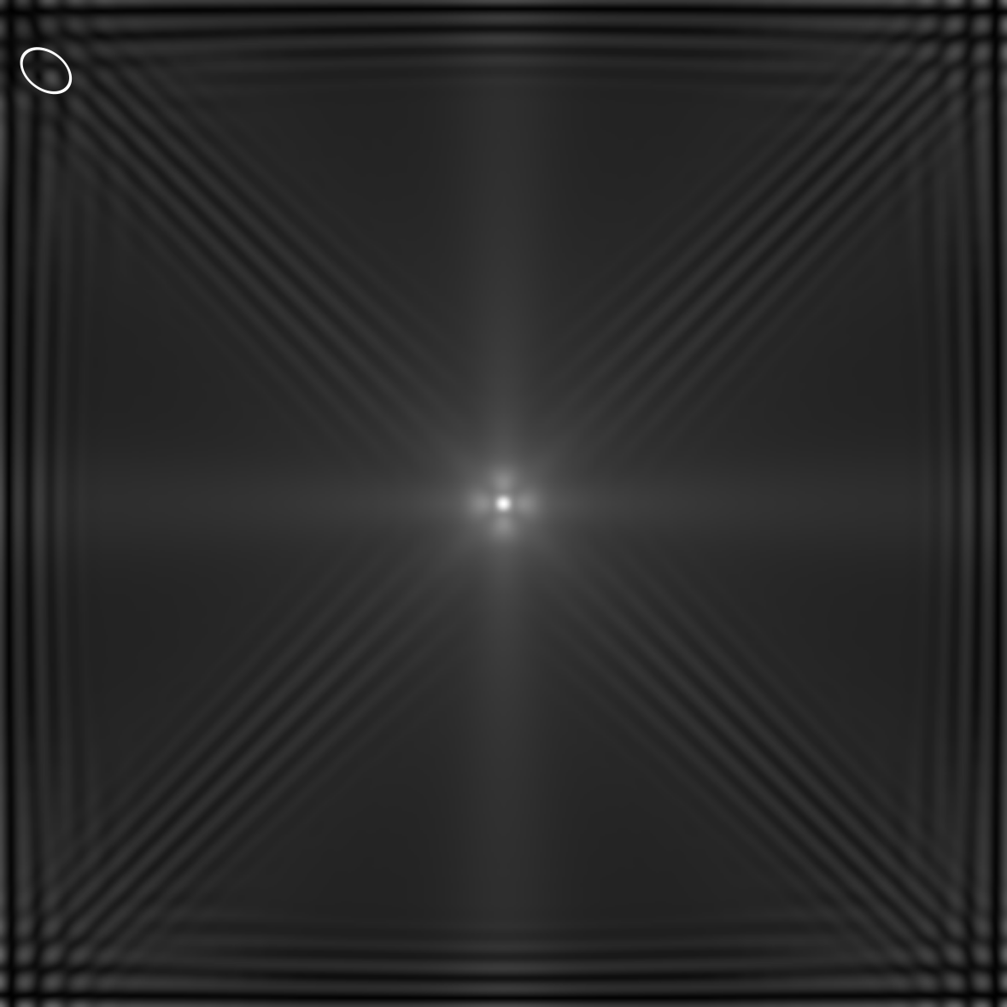
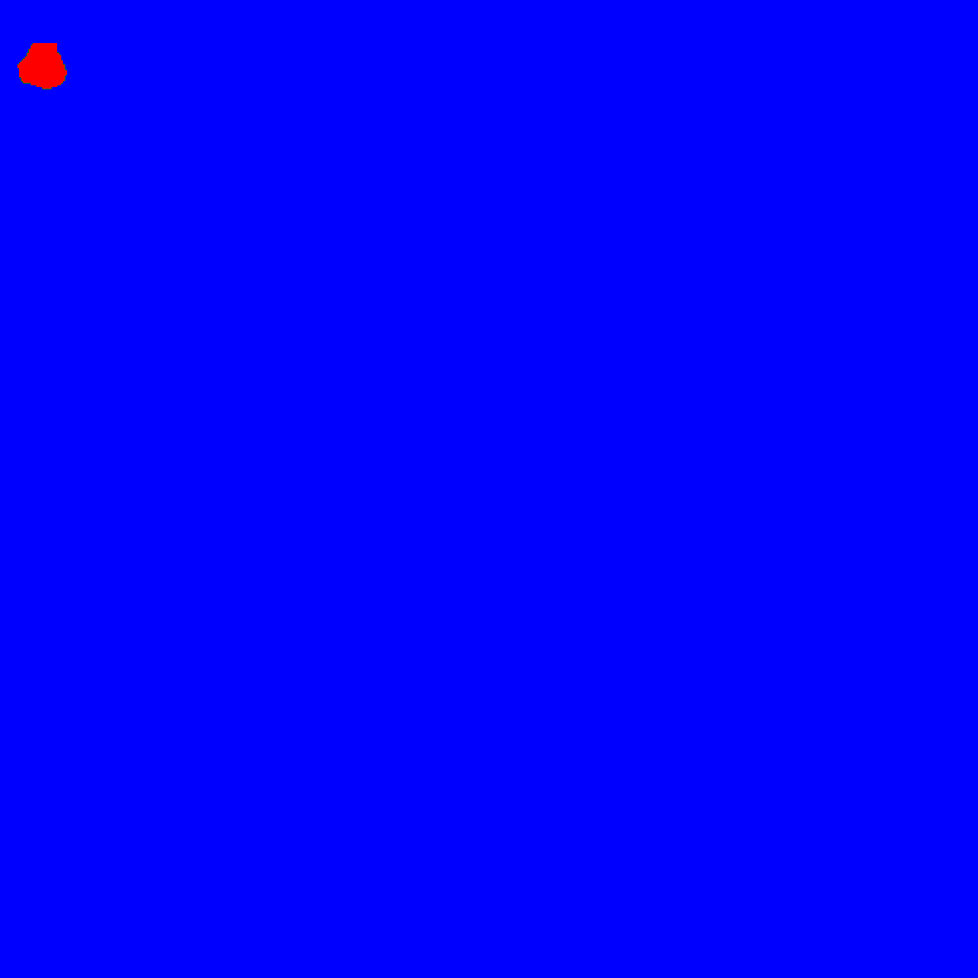
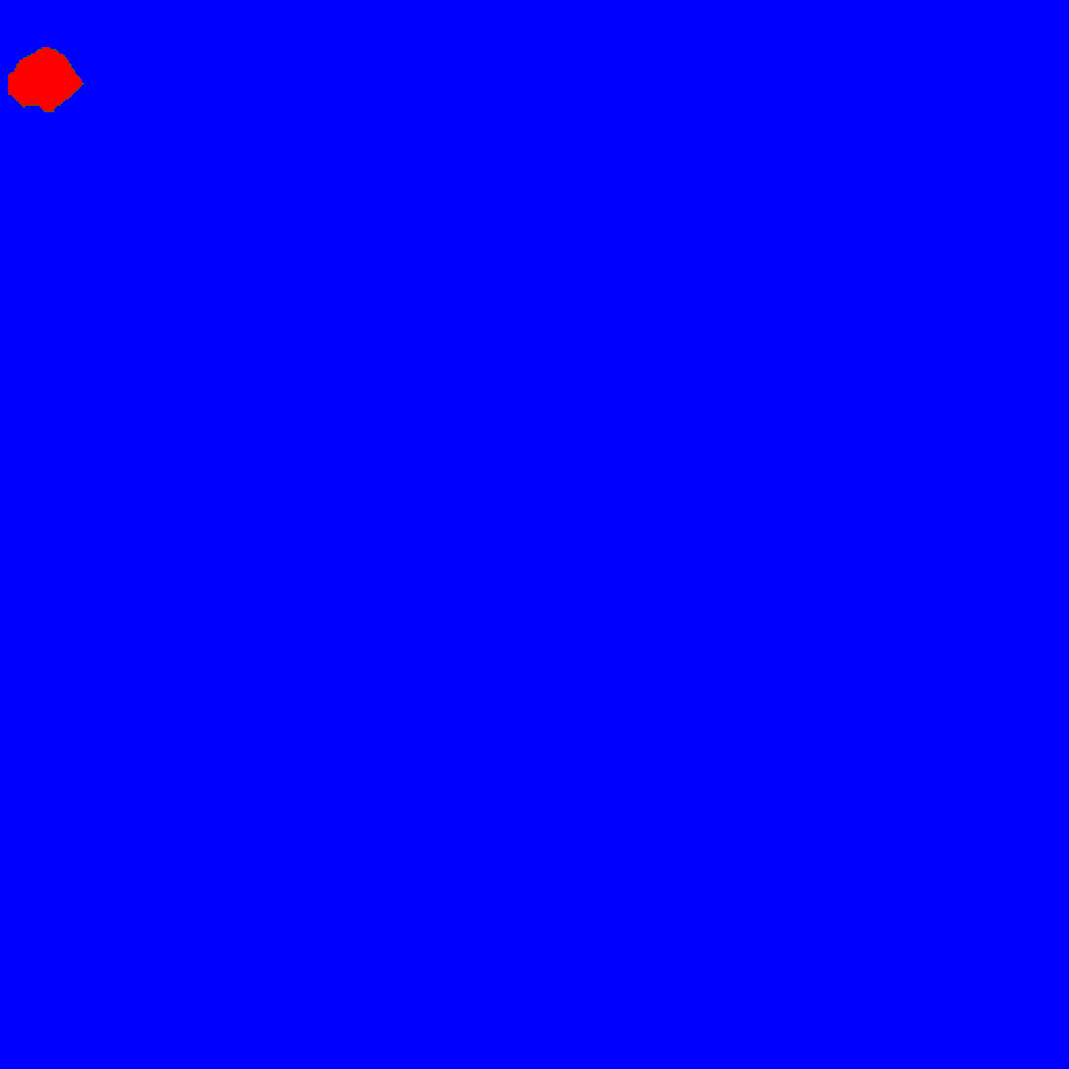
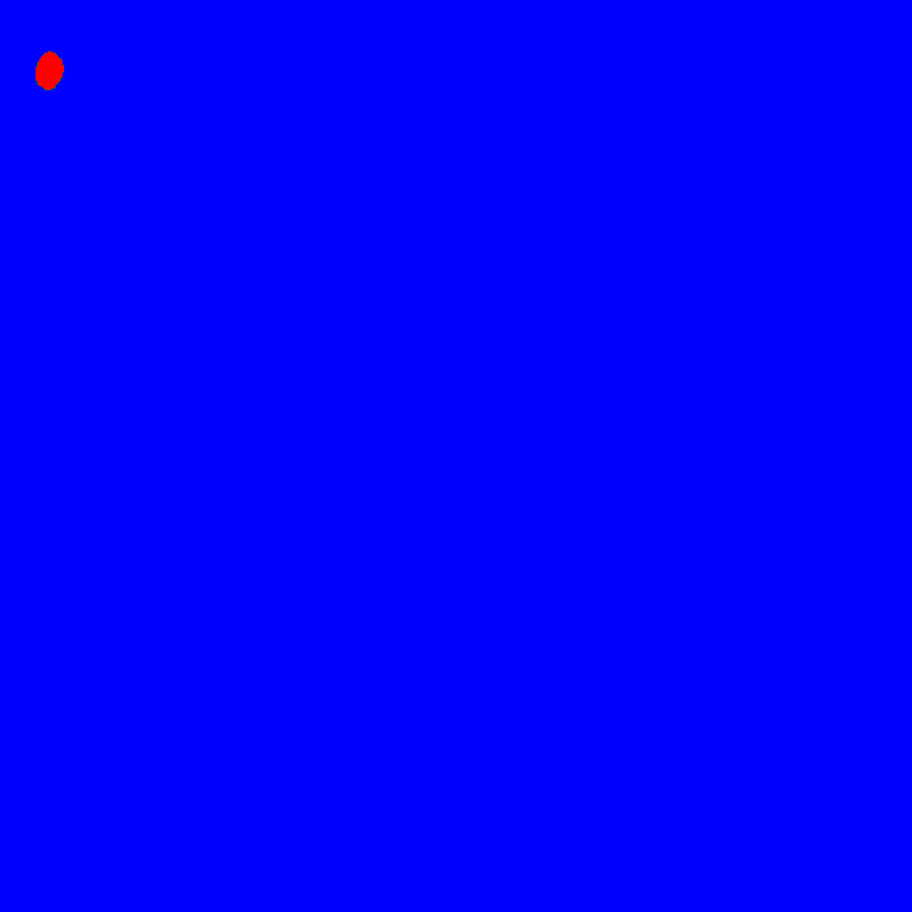

Results - Numerical scenario
RMS image with label
Residual UNet
FCN-DenseNet
PSPNet
GCN
Model | IoU
Residual UNet | 0.782
FCN-DenseNet | 0.612
PSPNet | 0.496
GCN | 0.696
Notes:
In this numerical scenario, the delamination is located at the upper left corner of the plate and it is surrounded by an ellipse to represent its shape and location as shown in the top left figure.
The rest Figures show the predicted output of the Res-UNet, FCN-DenseNet, PSPNet, and GCN models, respectively.
The table shows the intersection over union metric values for the implemented models

Slide 15
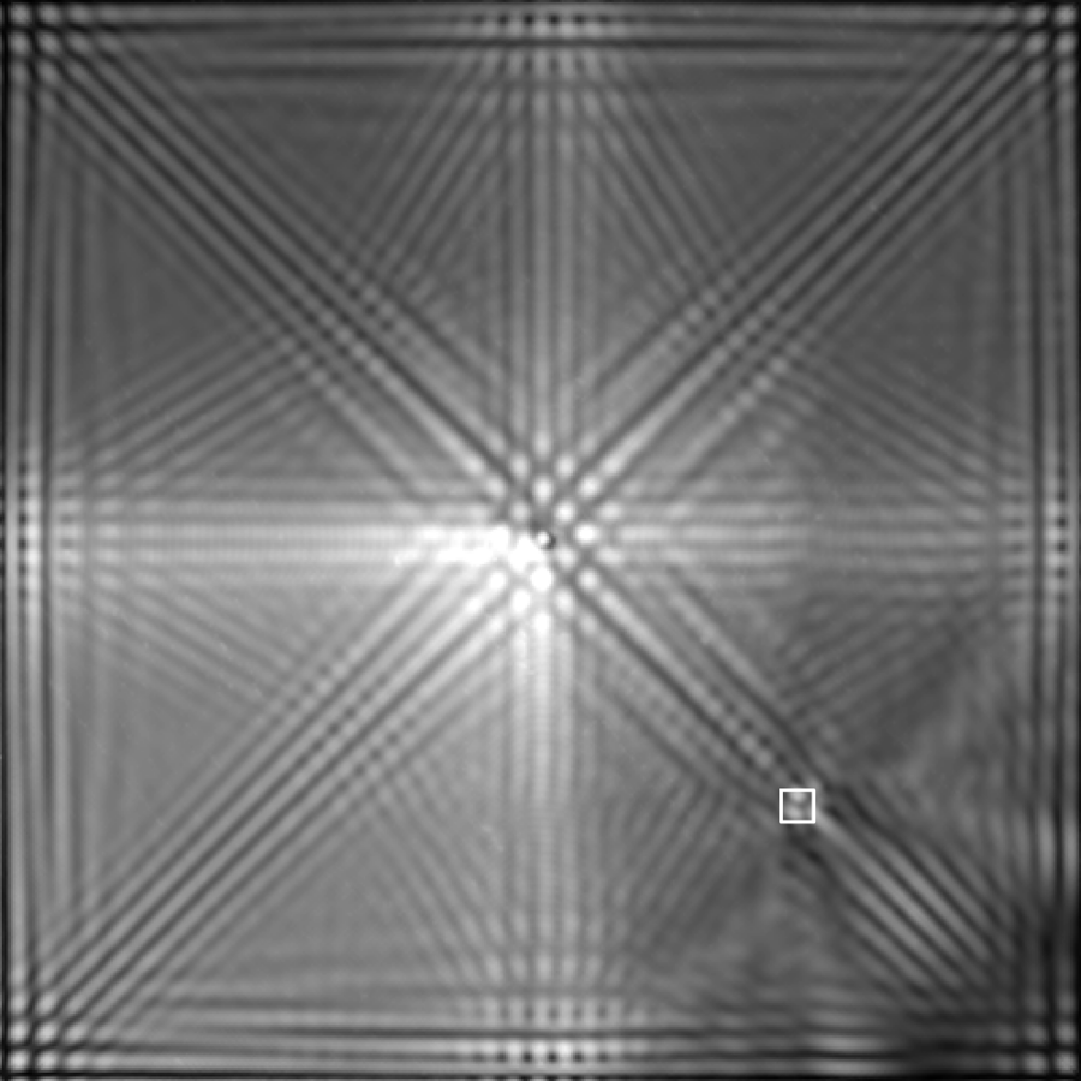
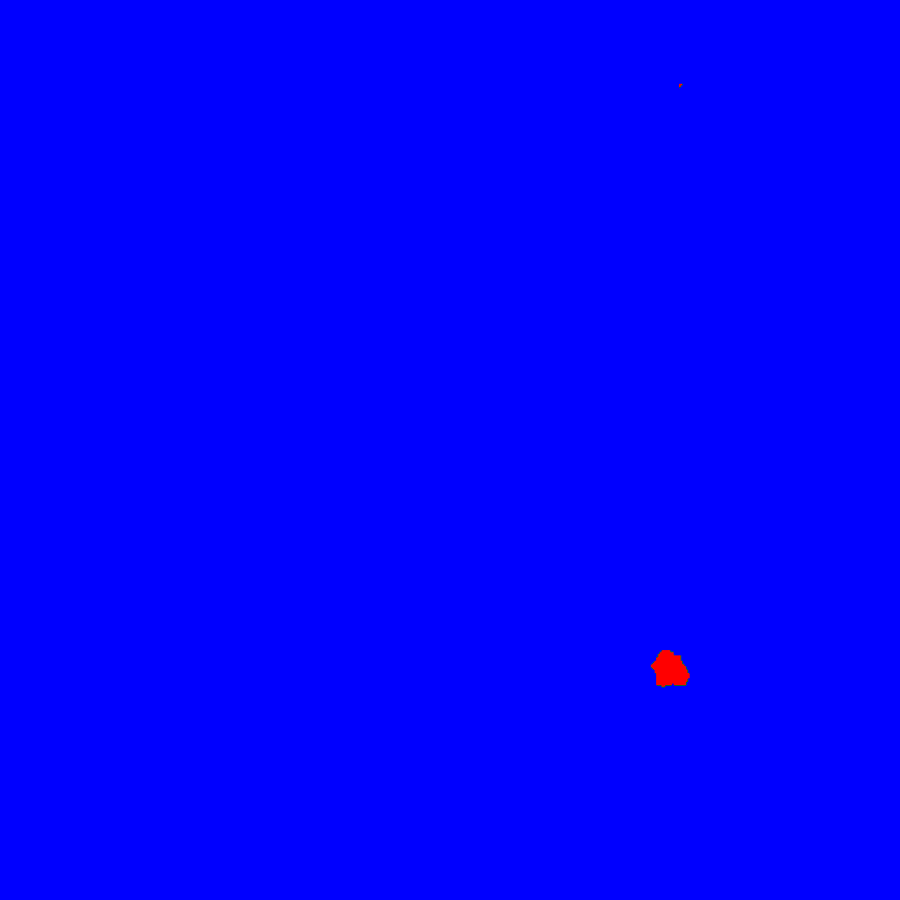
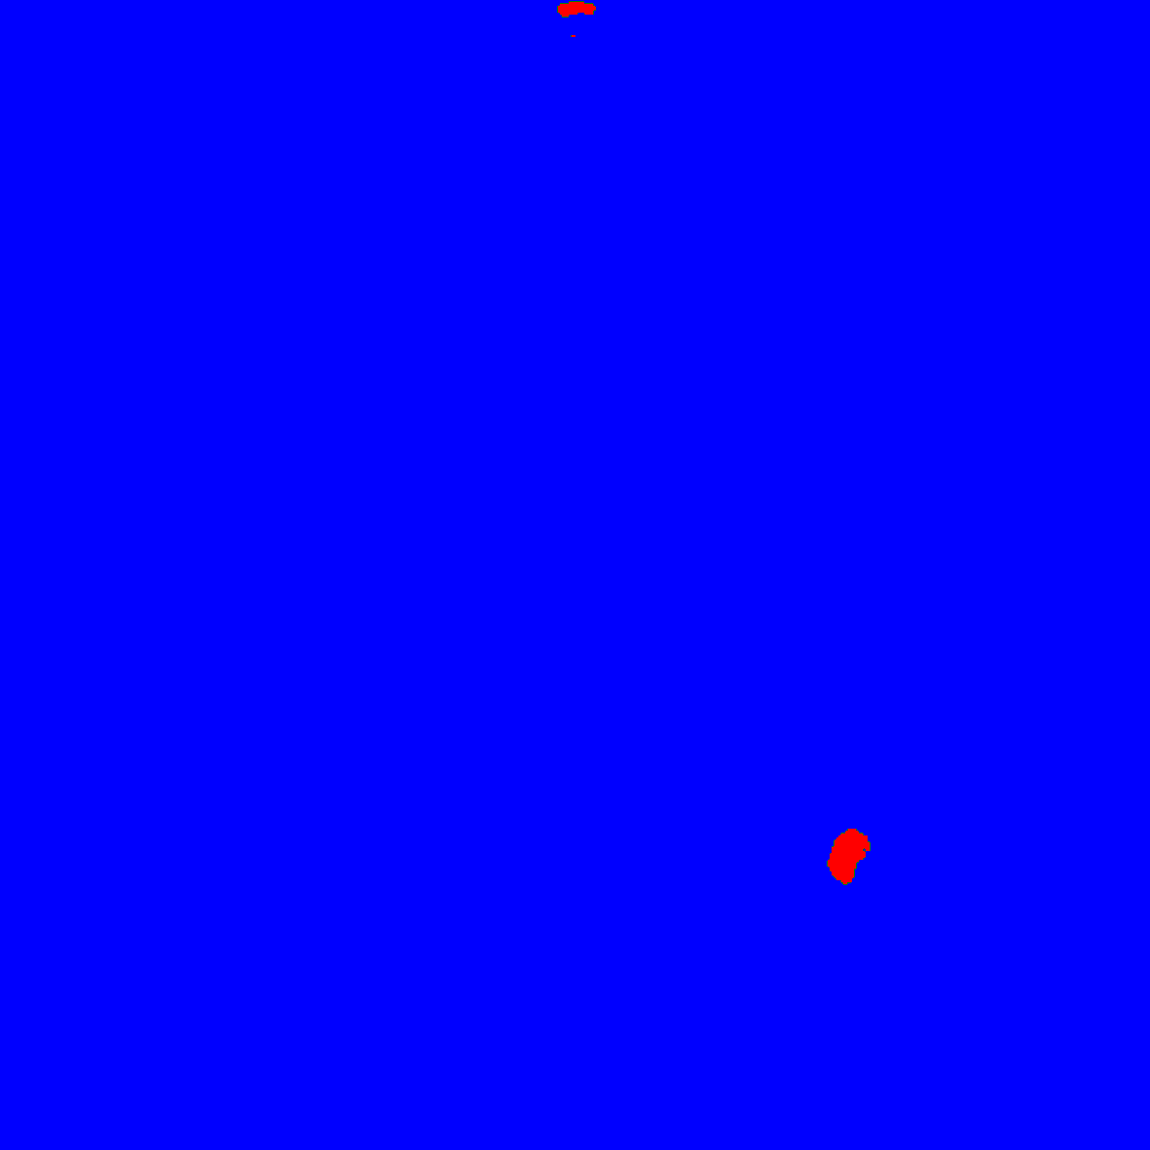
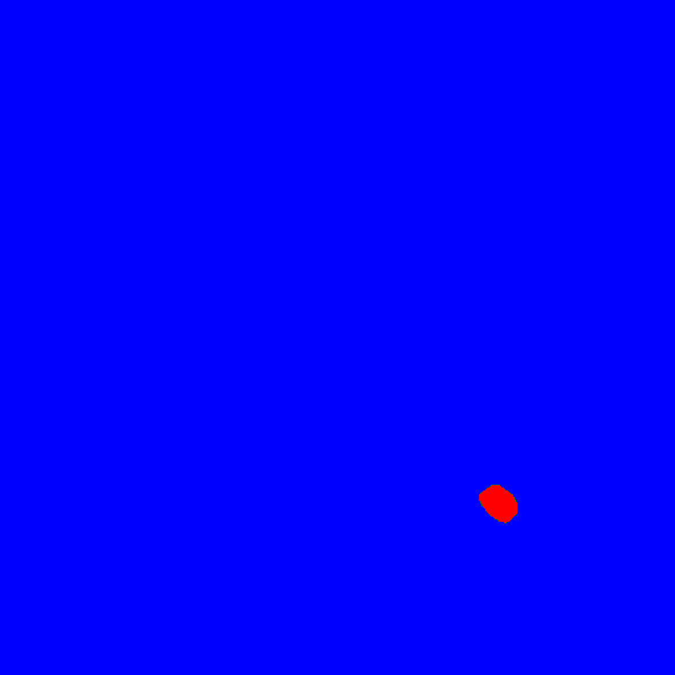

Results - Experimental scenario
ERMS CFRP Teflon inserted & Label
Residual UNet
FCN-DenseNet
PSPNet
GCN
Model | IoU
Residual UNet | 0.577
FCN-DenseNet | 0.537
PSPNet | 0.488
GCN | 0.723
Notes:
In this scenario, an experimental case of CFRP with Teflon insert as artificial delamination is investigated.
The top left figure is an energy compensated RMS that takes into account wave attenuation, further, the delamination is surrounded by a square to represent its shape and location.
The Figures show delamination prediction maps for Res-UNet, FCN-DenseNet, PSPNet, and GCN models, receptively.
As shown, the models are capable of detecting and identifying the delamination.
The Res-UNet model detect the delamination with IoU = 0: 577, FCN-DenseNet IoU = 0: 537, the PSPNet IoU = 0: 488, the and the GCN IoU = 0: 723.
We can see that the models can identify the delamination with almost free noise, this indicates that the models are capable to generalise and detect the delamination on previously unseen data. Considering that the presented models were trained only on the numerically generated dataset, the models show great generalization capability.

Slide 16
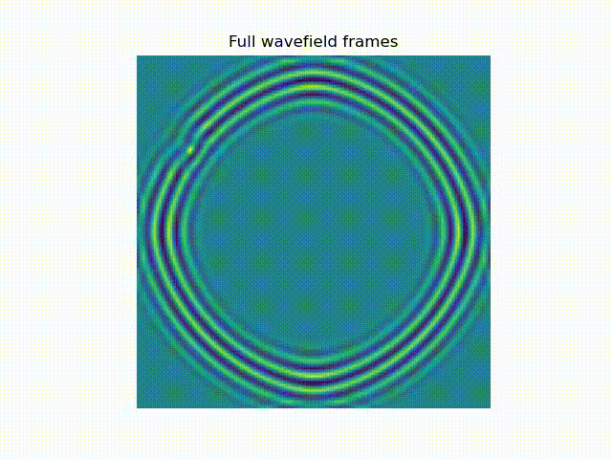
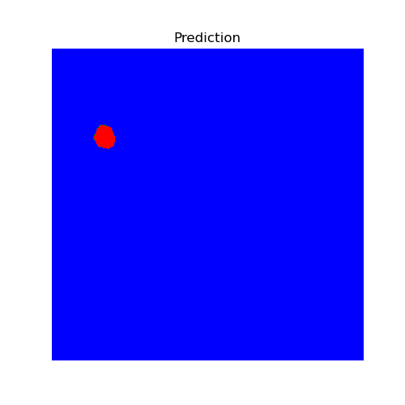
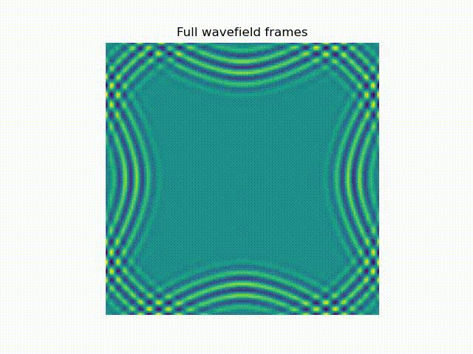
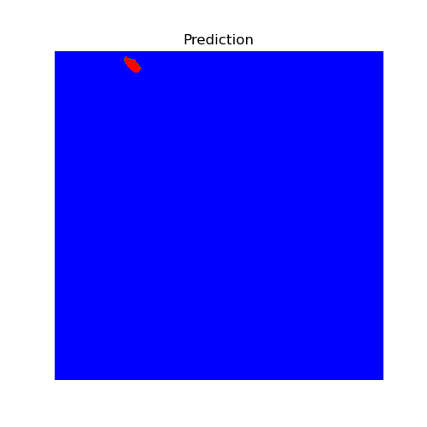
Results - Numerical scenario/ RNN-ConvLSTM model
IoU | 0.887
IoU | 0.698
Notes:
In this slide, I present two numerical scenarios.
The upper left case presents the interacting frames of propagating Lamb waves with the delamination.
As shown in the upper right image the model is capable of predicting the delamination with no noise and the intersection over union equals to 0.887
The bottom case shows another numerical scenario in which the delamination is located almost at the upper left corner.
For this scenario the Intersection over union was almost 0.7

Slide 17
Conclusions and future works
Deep learning techniques show promising results in identifying various types of delamination.
The models show their ability to generalise by detecting the delamination in the experimentally acquired data.
Published paper:
  “Full wavefield processing by using FCN for delamination detection”,
  [Abdalraheem A. Ijjeh, Saeed Ullah, and Pawel Kudela. Full wavefield processing by using FCN for delamination detection. Mechanical Systems and Signal Processing , 153:107537, may 2021. ]
  Furthermore, another paper was submitted and under review entitled:
  “Deep learning based segmentation using full wavefield processing for delamination detection: a comparative study”
For future works:
  A new dataset for the case of a higher excitation frequency was recently created, which we plan to train the models with.
  Further, expand the number of experimental scenarios.
Notes:
Deep learning techniques show promising results in identifying various types of delamination regarding their locations, shapes, sizes, and angles.
The models show their ability to generalize by detecting the delamination in the experimentally acquired data.
Furthermore, the performance of the models can be further improved if they are trained on experimental data which allows them to learn new complex patterns.
We have already published a paper article entitled: “Full wavefield processing by using FCN for delamination detection” in this paper the FCN-DenseNet model was implemented and compared with a conventional method
Furthermore, another paper article was submitted and under review entitled:
“Deep learning-based segmentation using full wavefield processing for delamination detection: a comparative study”.
In this paper, we have implemented different deep learning models and prepared a thorough comparison among them.
For future works:
Recently, we have created a new dataset for the case of a higher excitation frequency, with which we plan to train the models.
Further, expand the number of experimental scenarios.

Slide 18
References
Kaiming He, Xiangyu Zhang, Shaoqing Ren, and Jian Sun. Deep residual learning for image recognition. In Proceedings of the IEEE Computer Society Conference on Computer Vision and Pattern Recognition , volume 2016-Decem, pages 770{778, dec 2016.
Olaf Ronneberger, Philipp Fischer, and Thomas Brox. U-net: Convolutional networks for biomedical image segmentation. In Lecture Notes in Computer Science (including subseries Lecture Notes in Articial Intelligence and Lecture Notes in Bioinformatics) , volume 9351, pages 234{241. Springer Verlag, may 2015.
Yann Lecun, Yoshua Bengio, and Georey Hinton. Deep learning, may 2015.
Computer Society Conference on Computer Vision and Pattern Recognition Workshops, 2017-, pp. 1175–1183.
G. Huang, Z. Liu, L. Van Der Maaten, K.Q. Weinberger, Densely connected convolutional networks, in: Proceedings - 30th IEEE Conference on Computer Vision and Pattern Recognition, CVPR 2017, volume 2017-Janua, pp. 2261–2269.
Hengshuang Zhao, Jianping Shi, Xiaojuan Qi, Xiaogang Wang, and Jiaya Jia. Pyramid scene parsing network. In Proceedings - 30th IEEE Conference on Computer Vision and Pattern Recognition, CVPR 2017 , volume 2017-Janua, pages 6230{6239, 2017.
Chao Peng, Xiangyu Zhang, Gang Yu, Guiming Luo, and Jian Sun. Large kernel matters - Improve semantic segmentation by global convolutional network. In Proceedings - 30th IEEE Conference on Computer Vision and Pattern Recognition, CVPR 2017 , volume 2017-Janua, pages 1743{1751. Institute of Electrical and Electronics Engineers Inc., mar 2017.
Paul J. Werbos. Backpropagation Through Time: What It Does and How to Do It. Proceedings of the IEEE, 78(10):1550 -1560, 1990.
Abdalraheem A. Ijjeh, Saeed Ullah, and Pawel Kudela. Full wavefield processing by using FCN for delamination detection. Mechanical Systems and Signal Processing , 153:107537, may 2021.

Slide 19
Thank you for listening
Questions?

