Slide 1


Feasibility studies of artificial intelligence driven diagnostics
(PhD mid-term presentation)
PhD student name: Abdalraheem Ijjeh
Supervisor: Prof. Pawel Kudela
IFFM, Polish Academy of Sciences.
Notes:
First of all, let me introduce myself; my name is Abdalraheem Ijjeh, a Ph.D. student at the Institute of fluid flow machinery, the Polish Academy of sciences.
Supervised by professor Pawel Kudela.
In the beginning, I would like to thank the committee for my Ph.D. mid-term evaluation.
Today I am going to present my Ph.D. progress based on the Ph.D. plan schedule.

Slide 2
Objective of the Project
To utilise deep learning techniques in the field of NDT/SHM in order to develop an AI-driven diagnostic system for delamination identification in composite laminates such as carbon fibre reinforced polymers (CFRP)
End-to-end approach (that automatically perform feature extraction, selection and classification.)
Notes:
Deep learning techniques utilized in Non-Destructive Testing (NDT) and structural health monitoring (SHM) are gaining popularity due to recent technological advancements in sensors, as well as high-speed internet and cloud-based computation.
The main objective of this project is to explore the feasibility of utilizing deep learning techniques for the identification of delamination location, size, and shape in composite laminates such as carbon fiber reinforced polymer CFRP.
Hence, deep learning approaches present an end-to-end structure that will automatically learn and discover the hidden features in high-dimensional input data.

Slide 3
Research tasks schedule
PhD project schedule of tasks:
Preparation of dataset regarding the first CNN models for delamination detection, accordingly, two separate forms of the dataset were prepared with respect to two CNN models. (Completed)
Designing CNN models to detect delamination using bounding boxes, for this purpose, two CNN models were implemented using the dataset prepared at the first task. (Completed)
Conference paper entitled: ‘Feasibility study of Full Wavefield Processing by Using CNN for Delamination Detection’ was accepted at SHMII-10 conference in Portugal.
Notes:
In this section, I will present the schedule of my Ph.D. tasks mentioning the completed tasks and the ongoing tasks.
In the beginning, I would like to mention that a large dataset of Lamb waves propagation patterns resulting from the interaction with delaminations of random location, size, and shape was used for training the deep learning models.
In which it resembles the full wavefield measurements acquired on the surface of the plate by scanning laser Doppler vibrometer SLDV.
My first task was to prepare two training datasets using the RMS of the full wavefield from the top surface of the plate, these two training datasets were used in the second task which was implementing CNN models for delamination detection using bounding boxes.
Accordingly, I have written a conference paper entitled “Feasibility study of Full Wavefield Processing by Using CNN for Delamination Detection”. The paper was accepted at the SHMII-1o conference in Portugal

Slide 4
Research tasks schedule Cont.
Preparing the research literature with respect to deep learning techniques used for delamination detection. (Completed)
Preparing the dataset for FCN models using RMS images. (Completed)
Various FCN models of semantic segmentation for delamination identification are prepared: (Completed)
  Residual UNet
  VGG16 encoder-decoder
  FCN-DenseNet
  Pyramid scene parsing network (PSPNet)
  Global convolutional network (GCN)
Notes:
My third task was to write a monograph of the research literature with respect to deep learning techniques used for delamination detection.
The next task was to prepare a dataset for Fully convolutional network models to perform semantic segmentation utilizing the RMS of the full wavefield from the bottom surface of the plate.
Next, I have implemented several deep learning architectures for delamination identification:
Res Unet, vgg16 encoder-decoder, fcn-densenet, pspent and gcn.

Slide 5
Research tasks schedule Cont.
Journal publication based on the results from task 5. (Completed)
Dataset preparation for RNN models, in which a sequence of frames (time sequence) regarding Lamb wave propagation and the interaction with the delamination scenario is utilised. (Completed)
Implementation of RNN models. Several RNN/LSTM models were implemented for delamination identification. (Completed)
Experimental measurements of full wavefield by SLDV. (Six months - expected deadline on Nov 2021)
Notes:
Based on the results obtained from task number five, I have written a journal paper entitled: “Full wavefield processing by using FCN for delamination detection” which was accepted and published in the journal of Mechanical Systems and Signal Processing.
On task number 7, I have prepared several datasets for RNN and LSTM models. The datasets contain various scenarios of a sequence of Lamb waves propagation frames interacting with the delamination.
Next, I have implemented various RNN+LSTM architectures for delamination identification trained on the datasets obtained in the previous task.
In task number 9, we are going to perform experimental measurements of full wavefield by SLDV on various specimen, the measurements will be used in testing the deep learning models.

Slide 6
Research tasks schedule Cont.
Journal publication based on the results task 8. Currently, we are in the writing stage. (Four months - Planned deadline on Nov 2021)
Writing the thesis, stages of thesis preparation: first draft, reworked draft, penultimate draft, final Draft. (Eight months – Expected deadline on Sept 2022)
Thesis submission on Sept, 2022. (Expected on Sept 2022)
Thesis defense date on Oct 2022 (approximate date). (Expected on Oct 2022)
A report of PhD progress is delivered every three months (quarter report). (Done on a regular basis)
Notes:
In task number 10, we will publish a paper based on the results obtained from task number 8. Currently, we are in the writing stage of the paper article. expected to be submitted before proposed deadline
In task number 11, I will start writing my Ph.D. thesis in which there will be several stages of preparation: the first draft, the reworked draft, the penultimate draft, and the final draft.
The expected date of thesis submission is on Sept 2022
And the thesis defense date is expected to be on Oct 2022.
Furthermore, there is a Ph.D. progress report is delivered every three month s.

Slide 7
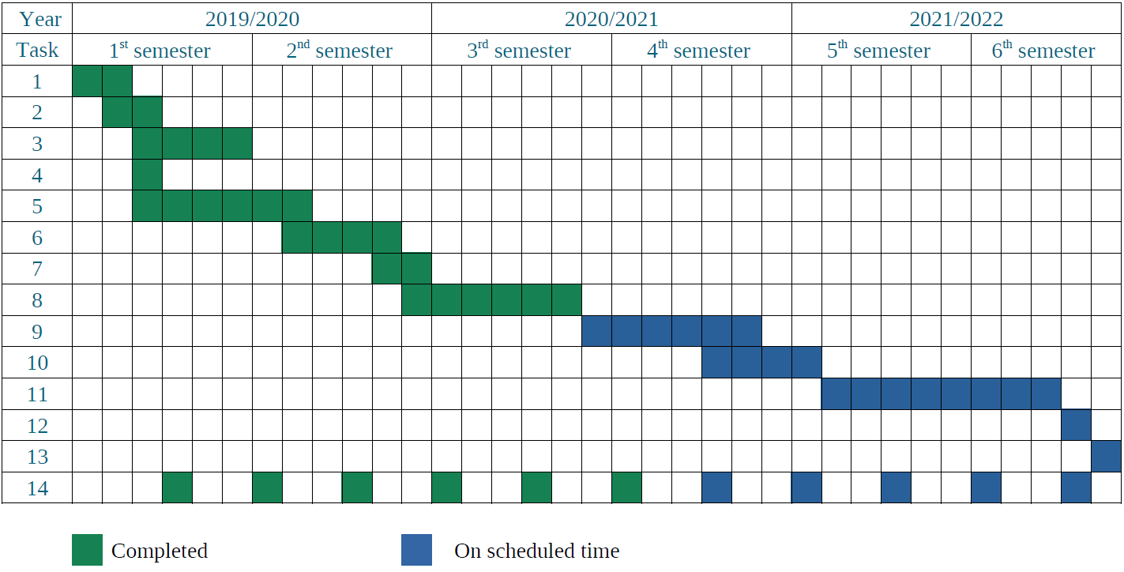
PhD time schedule: Gantt chart
Notes:
The Ph.D. schedule of tasks in the form of a Gantt chart is presented in the shown table.
The greet color represents the completed tasks, and the blue color represents tasks to be delivered on the scheduled time.

Slide 8
Publications
Full wavefield processing by using FCN for delamination detection (Published)
DOI: 10.1016/j.ymssp.2020.107537
Deep learning based segmentation using full wavefield processing for delamination detection: a comparative study (submitted and under review)
Notes:
In this slide, I present you my first published paper entitled Full wavefield processing using FCN for delamination detection, MSSP journal.
The second paper entitled “ Deep learning based segmentation using full wavefield processing for delamination detection: a comparative study” is submitted and under review.

Slide 9
Monographs/ chapters in monographs
Machine Learning for SHM: Literature Review. IMP Institute, Polish Academy of Sciences, 2020 (Published)
ISBN 978-83-88237-3
Data-driven based approach for damage detection. IMP Institute, Polish Academy of Sciences, 2021 (Accepted for publication)
Notes:
I have prepared two monographs that were accepted at the TriCity Doctoral School of the Polish Academy of Sciences.
The first monograph entitled
Machine learning for SHM: literature review (it accepted and published)
The second monograph entitled: ”Data-driven based approach for damage detection” (which is accepted for publication)

Slide 10
Conference proceedings
Abdalraheem Ijjeh, Pawel Kudela, ‘Feasibility Study of Full WavefieId Processing by Using CNN for Delamination Detection’, SHMII-10, 10th International Conference on Structural Health Monitoring of Intelligent Infrastructure Advanced Research and Real-world Applications 30 June – 2 July 2021 Porto, Portugal. (Accepted)
Notes:
I have written a conference paper entitled: “
Feasibility study of full wavefield processing by using CNN for delamination detection”
it was accepted at the SHMII-10, 10th International Conference on Structural Health Monitoring of Intelligent Infrastructure Advanced Research and Real-world Applications, Porto, Portugal

Slide 11
Presentations
Abdalraheem Ijjeh, first doctoral seminar in TSD PAN, Sept. 2020.
Abdalraheem Ijjeh, second doctoral seminar in TSD PAN, June 2021.
Abdalraheem Ijjeh, Conference presentation (SHMII-10), June 2021.
Notes:
Regarding presentations, I have prepared three presentations:
two of them were presented at the yearly doctoral seminar
the third presentation will be presented at the SHMII-1o conference this June

Slide 12
Acknowledgment
I would like to thank my Supervisor Professor Pawel Kudela for his consistent support and guidance during the running of this project.

Slide 13
Thank you for listening

