Slide 1
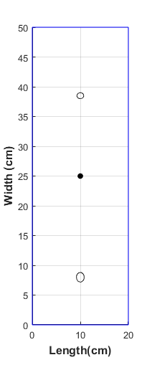
Bvid2
(10,38.5)
cycles | Frequency used (kHz) | Sampling period delt (s) | Samples
5 | 50 | 1.953e-6 | 1024
5 | 100 | 0.7813e-6 | 1024
5 | 150 | 3.906e-7 | 1024
5 | 200 | 3.906e-7 | 1024
0.5 cm D
Height (cm)
PZT (10,25)
Slide 2 time plot location
Bvid1
(10,8)
0.8 cm D

Slide 2
10^-3 is in all 50,100,150,200 expt cases

Slide 3
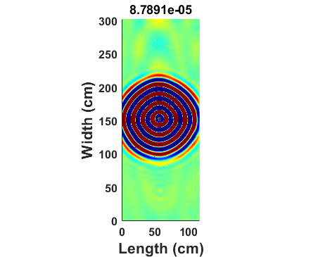
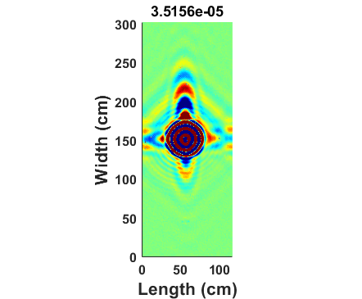
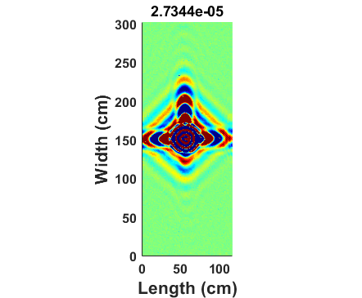
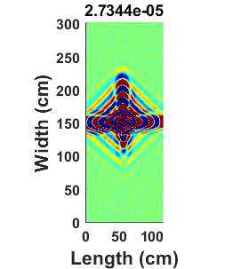
50 kHz
100 kHz
150 kHz
200 kHz

Slide 4
200 kHz
 | X | Y
X1 | 13.54 | 28.54
X2 | 17.07 | 32.07
X3 | 10 | 30
X4 | 10 | 35
X5 | 6.464 | 28.54
X6 | 2.929 | 32.07
X7 | 6.464 | 21.46
X8 | 2.929 | 17.93
X9 | 10 | 20
X10 | 10 | 15
X11 | 13.54 | 21.46
X12 | 17.07 | 17.93
Needs SEM time signal for these pts at 150,200 kHz

