Slide 1

Introduction to Machine Learning
By:
Samardeep Verma
C20-132

Slide 2
Definition
Machine Learning is a field of study that gives computers the ability to learn on their own without giving any instructions explicitly. The purpose is to improve the performance of a task with experience, similar to what humans do.

Slide 3
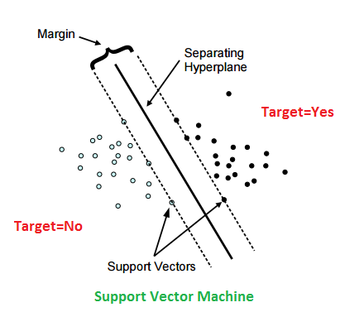
Terminologies
Parameters: A parameter is a variable whose value can be estimated from the data. It is internal to the model. E.g. Coefficients In Linear regression etc.
Hyperparameters: These are the variables whose value is external to the model i.e. user set this values by himself. E.g. k in k-nearest neighbors etc.
Classifier: An algorithm that maps the input data to a specific category.
Hyper Plane: The separation plane between the data classes.
Support vectors: The data points that lie closest to the decision surface (hyper plane).
Target Variable: It is the output variable. It can be binary or continuous.

Slide 4
Tools
At the root level, ML requires extensive application of mathematics and coding but there are tools available in the markets which users can directly use to implement machine learning in at their workplace.
Some tools:
Amazon Lex
Auto WEKA
Big ML
Data Robot
H2O Driverless AI.
Google Cloud Auto ML
IBM Watson Studio
Microsoft Azure Machine Learning Studio
Rapid Miner
Trifacta

Slide 5
Amazon Lex
This service is used to make conversational interfaces like Chatbots into any application.
Conversation can be done via text or voice.
To provide real life like conversational experience, this service uses:
Deep learning capabilities of automatic speech recognition for voice to text conversion.
Natural language procession to get the intent of the text.
Price is charged based on based on number of text or voice requests processed by the bot in a month.
$0.004 per speech request.
$0.00075 per text request.
The most common use-cases include:
Informational bot – build an automated customer support agent or bot that answers questions.
Application/Transactional bot – build a stand-alone pizza ordering agent or a travel bot.
Enterprise Productivity bot – build custom bots to connect to enterprise data resources.
Device Control bot– use Amazon Lex to issue control commands to connected devices.

Slide 6
Pro’s
SDK support – You can build iOS, Android, Java, JavaScript, Python, .Net, Ruby, PHP, Go, and C++ bots that span mobile, web, desktop, and IoT platforms.
Natural language processing
Speech and text support
Utterance Monitoring
Scalable
Mobile integration
Con’s
Complex web integration.
Less deployment channels.
Lex in not multilingual, supports only English.
Preparation of data set is complicated, the utterances and entities mapping is somewhat critical.

Slide 7
WEKA
WEKA is short for Waikato Environment for Knowledge Analysis.
It is developed by the University of Waikato, New Zealand.
It is an open source Java software that has a collection of machine learning algorithms for data mining and data exploration tasks.
It is a very powerful tool for understanding and visualizing machine learning algorithms on your local machine.
It contains tools for data preparation, classification, regression, clustering, and visualization.
Auto-WEKA is the Auto ML implementation for Weka. It automatically finds the best model with its best hyperparameter settings for a given classification or regression task.
Pros:
Open source software.
Covers large number of machine learning algorithms.
Can be easily learned from free online content.
Can be used to process data and perform deep learning.
Cons:
WEKA runs on Java, which is memory intensive.
Lack of features in GUI as compared to CLI.

Slide 8
Big ML
Big ML provides a selection of robustly-engineered Machine Learning algorithms proven to solve real world problems by applying a single, standardized framework.
It facilitates unlimited predictive applications across industries including aerospace, automotive, energy, entertainment, financial services, food, healthcare etc.
This platform covers various types of ML algorithms like Classification, Regression, Cluster analysis, Anomaly detection, Association discovery etc.
Consists of 2 types of accounts for subscription:
Free Accounts: All the latest features can be accessed, but maximum dataset size is 16MB and maximum parallel tasks in 2.
Prime Accounts: Process larger datasets and run more parallel. Access to ”BigML Organisations”, which let us to collaborate on projects with team members. Price range varies depending upon the size of the requirement.

Slide 9
Data Robot
This platform enables the users to deploy machine learning models by automatically detecting the best data preprocessing.
It employs encoding, scaling, text mining etc. and also uses distributed algorithms when data set is large.
How Data Robot works:
Ingest your data
Select the target variable
Build hundreds of models in one click
Explore top models and get insights
Deploy the best model
It is not a freeware and prices are only decided after contacting with the vendor.
Some benefits:
All models designed using Data Robot publish a REST API endpoint, which means integrating them within your modern enterprise applications is easy.
Data Robot supports both on-premise and cloud-based deployment.
Cloud environment ensures a low total cost of ownership by trashing the need for infrastructure setup, hardware installation, and additional computing cost.
It runs multiple experiments simultaneously to minimize the time it takes to complete a data science project.

Slide 10
H2O Driverless AI
H2O is a machine learning platform which supports the most widely used statistical & machine learning algorithms including gradient boosted machines, generalized linear models, deep learning and more.
It has an industry leading Auto ML functionality that automatically runs through all the algorithms and their hyperparameters to produce a leader board of the best models.
It offers free trial of 21 days, after that prices can be negotiated with vendor.
Key Features:
Higher accuracy and speed using GPU acceleration.
Data can be ingested from variety of options.
Designed to work with latest GPUs.
Deployment can be on cloud or on premise.
Some use cases:
Fraud Detection
Claims Management
Digital Advertising

Slide 11
Google Cloud Auto ML
It is a suite of machine learning products with a simple GUI used to train, evaluate, improve and deploy machine learning models based on the given data.
Products:
Auto ML Vision: It helps to train machine learning models to classify images according to our own defined labels
Auto ML Natural Language: It is used to create custom machine learning models to classify English-language content into a custom set of categories
Auto ML Translation: It helps to create custom translation models so that translation queries return results specific to our domain.
Features:
Integration with other google cloud services like data storage etc.
Integration with human labelling.
Flexible charges.

Slide 12
IBM Watson Studio
IBM Watson Studio provides a set tools to enterprises to build and train machine learning models.
It provides 30 day free trials and after that paid plans depending upon requirements.
Features:
It allows extracting meaningful and important information by analysing diverse data sources faster and more accurately.
The AI platform is designed to help enterprises better understand their customers and interact with them in a better way.
The advanced AI platform allows enterprises to leverage employee expertise and develops a valuable pool of their knowledge.
Provides access to open source tools like Jupyter Notebooks, R studio etc. for fine tuning the parameters.
Provides a drag-and-drop, no-code interface deep learning programming.

Slide 13
Microsoft Azure Machine Learning Studio
Azure Machine Learning Studio is an interactive programming tool for predictive analytics.
It provides a drag and drop like environment to create ML models.
Here we have to load the data on platform, then data cleaning, splitting (test and train datasets) and training of model is done. Finally model is scored and predictions are made.
It comes with both free package (limited services) and a standard package.
Features:
Due to its visual connections, no heavy programming is required and models are completed at a faster pace.
Provide access to Cortana Intelligence Gallery where users from various places can collaborate with each other to share knowledge and solve problems.
Developed model can be directly pushed to the web for mass usage. Later on changes can also be made on published models.
Developers have access to vast set of AI algorithms for better predictive modelling.
It is a browser based platform so can be accessed anywhere.

Slide 14
Rapid Miner
Rapid Miner is a ML platform that provides an integrated environment for data preparation, machine learning, deep learning, text mining, and predictive analytics.
Its free edition is limited to 1 logical processor and 10000 data rows, while commercial pricing starts at $2500.
Tools provided on this platform:
RapidMiner Studio: Used to create predictive models using drag and drop approach.
RapidMiner Auto Model: Automatically predicts the best model for our data.
RapidMiner Turbo Prep: Helps to evaluate the quality of data and make changes if required.
RapidMiner Server: Used to deploy models into production.
RapidMiner Radoop: To build and run predictive models in Hadoop.

Slide 15
Trifacta
This software provides GUI for effective data preparation for further uses.
It takes data as input and evaluates a summary with multiple statistics by column. Then for each column, it recommends some transformations automatically.
The data preparation can be done by various options present in the software like discovering, structure, cleaning etc.
Three editions of this software:
Wrangler: Free with up to 100MB of data wrangling capacity only.
Wrangler Pro: Starts at 419$/month with many other features.
Wrangler Enterprise: Pricing based on negotiation and includes all software features.

Slide 16
Machine Learning Techniques
Machine Learning
Supervised Learning
Un-Supervised Learning
Semi supervised learning
Reinforcement Learning
Classification
Regression
Clustering
Association

Slide 17
Supervised Learning
In this technique, a model is built to predict the outcomes based on certain inputs. Here first we train the model based on the data which has both inputs and outputs, also call training data. Then values are predicted based on the similar kind of inputs from test data. The predicted outcomes are matched with the outcomes in test data. If both of them match to required extent then it means our model is fine.
Some Examples of Supervised Learning:
Predicting house rent based on locality, size of house, number of rooms etc.
Fruit detection in a basket of fruits.
Rank prediction in an entrance exam.

Slide 18
Types of Supervised Learning
There are 2 types of supervised learning techniques:
Classification technique:
In this case, input data is categorized based on some characteristics. It predicts discrete responses like Email detection( genuine or spam), car type( SUV, Hatchback or Sedan).
Regression Technique:
This technique is used when our responses are continuous and is in the form of a real number e.g. prediction of stock price, power demand, electricity load forecasting etc.

Slide 19
Unsupervised learning
This technique is used to find hidden patterns, structures or groupings in an input data without labelled responses.
Types:
Clustering: It is the most common unsupervised learning technique where unlabeled data is grouped together based on some characteristics.
Association: In this we want to discover rules that describe large portions of our data, such as people that buy X also tend to buy Y. This procedure is also called Frequent Pattern Mining.
Examples:
Anomaly detection like detecting suspicious credit card transactions.
Grouping photos based on person, place etc.
Grouping customers by purchasing behavior.

Slide 20
Reinforcement Learning
Here, the system observes the environment and try to learn from it based on the reward system. It will accept those actions which lead to reward maximization and reject those which lead to penalties.
Overtime it learns those strategies that maximize reward and lower the penalties. E.g. In Robotics we use this technique.

Slide 21
Semi supervised learning
Use of both supervised and unsupervised techniques is there. It makes the use of large amount of unlabeled data with small amount of labelled data. The goal is to classify the unlabeled data using the labeled information set.
Examples:
Classification of web pages.
Speech Analysis.
Protein Sequence Classification

Slide 22
Machine Learning Algorithms
An Algorithm is a step by step method of solving a problem. They are used for data processing, calculation, reasoning and other tasks.
Logistic Regression
Linear Regression
Linear Discriminant Analysis
Naive Bayes Classification
Support Vector Machines
Decision Trees
Random Forest
K - Nearest Neighbor

Slide 23
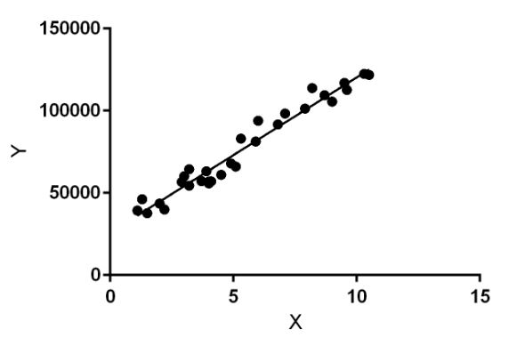
Linear Regression
Equation is in the form of Y= a0 + a1 * X. We have to predict Y given the input X.
The aim of the regression learning algorithm is to find the values of the coefficients a0 & a1 in order to get the line to get the line of best fit.
Some use cases:
Predict property prices.
Food demand in canteen.

Slide 24
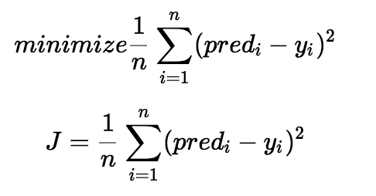
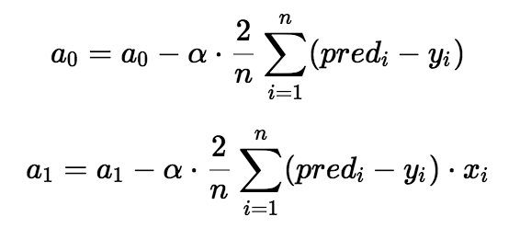
calculations for LR
Line of best fit is achieved by minimising the cost function which is nothing but the average of sum of squared differences in Y-predicted and Y-actual.
Then we use the Gradient Descent method. Gradient descent is a method of updating a0 and a1 to reduce the cost function(MSE).

Slide 25
Linear Regression in Python
from sklearn.linear_model import LinearRegression
from sklearn.metrics import r2_score
clf = LinearRegression(normalize=True)
clf.fit(x_train,y_train)
y_pred = clf.predict(x_test)
print(r2_score(y_test,y_pred))

Slide 26
Linear Regression in R
# load data
Data(train_data)
# fit model
model <- lm(dependent_variable~. , sampledata)
# make predictions
predictions <- predict(model, test_data)

Slide 27
Logistic Regression
The purpose of logistic regression is to make predictions in binary format. (0 or 1)
Approach is similar to linear regression i.e. find the values of b0 & b1 which can best categorize the data.
Some use cases:
Predict person is Male or Female.
Win or Loose in a match.
Die or Live after an accident.
Logistic regression equation:
Y = e^(b0 + b1*X) / (1 + e^(b0 + b1*X))

Slide 28
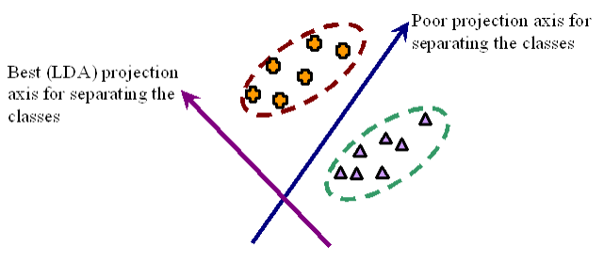
Linear Discriminant Analysis (LDA)
Linear Discriminant Analysis is a dimensionality reduction technique used as a pre-processing step in Machine Learning and pattern classification applications.
It is used in Supervised classification technique.
This technique can also be used as a classifier in case data is linearly separable to get faster results.
Steps:
Calculate the between class variance.
Calculate the with class variance.
Construct a low dimensional space which maximizes between class variance but minimizes within class variance.

Slide 29
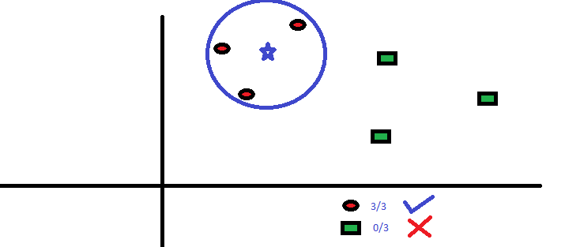
K-Nearest Neighbors
Here each test data point will look at the nearest K training data points and take the most frequently occurring classes and assigns the class to that test data.
This algorithm is most widely used for classification purpose.
It is a non-parametric algorithm means it does not make any assumptions about the underlying data.
Features:
Easy to interpret.
Low calculation time.
It can be used for both classification and regression.
Cons:
Computationally expensive because the algorithm stores all of the training data.
High memory requirement.
Sensitive to irrelevant features and the scale of the data.

Slide 30
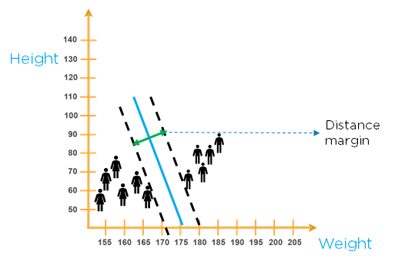
Support Vector Machines
This algorithm is used for both classification and regression techniques. Here we plot the points in a n-dimensional space ( n dimensions are the features that target variable has). Then classification is done by forming a hyperplane which differentiates the two classes.
SVM has the capability to ignore the outliers if any. Also the that plane is chosen which has the maximum distance from the neighbouring points as this will provide good flexibility.
Real life use cases:
Face Detection.
Text and Hyper Text Categorization.
Handwriting Recognition.

Slide 31
SVM in Python
#Import Library
from sklearn.svm import SVC
x= np.array([[-3,-7],[1,5], [1,-2], [-2,0], [2,3], [-4,0], [1,1], [1,-1], [-2,2], [2,-7], [4,1], [2,7]])
y = np.array(['N','P','N','N','P','N','P','N','N','N','P','P'])
model = SVC(kernel='linear')
model.score(x, y)
#Predict Output
model.predict([[3,-4]])
Output:
array(['N'], dtype='<U1')

Slide 32
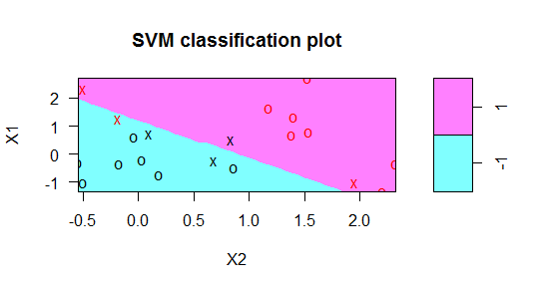
SVM In R
set.seed(10111)
x = matrix(rnorm(40), 20, 2)
y = rep(c(-1, 1), c(10, 10))
x[y == 1,] = x[y == 1,] + 1
plot(x, col =5, pch = 19)
library(e1071)
dat = data.frame(x, y = as.factor(y))
svmfit = svm(y ~ ., data = dat, kernel = "linear", cost = 10, scale = FALSE)
print(svmfit)
plot(svmfit, dat)

Slide 33
Naive Bayes
This is a classification algorithm which is based on Bayes theorem which assumes that all the features in a class are independent of each other.
Here first the data is converted into a frequency table. Then various probability tables are created internally based on different features.
These tables include conditional probabilities.
Finally from that table we get the probability of happening of an event in the presence of certain conditions.
Practical Applications:
Detect person is male or female based on features like height, weight etc.
Email spam detection.
Categorizing news.
Digit recognition.

Slide 34
Naïve Bayes in python
from sklearn.naive_bayes import GaussianNB
import numpy as np
x= np.array([[-3,-7],[1,5], [1,-2], [-2,0], [2,3], [-4,0], [1,1], [1,-1], [-2,2], [2,-7], [4,1], [2,7]])
y = np.array(['N','P','N','N','P','N','P','N','N','N','P','P'])
model = GaussianNB()
model.fit(x, y)
p= model.predict([[1,2],[3,-4]])
print (p)
OUTPUT: ['P' 'N']

Slide 35
Naïve Bayes in R
library(e1071)
x= c(-1,2,-3,-6,3,-4,4,-5,-7,-5,3,5)
y = c('N','P','N','N','P','N','P','N','N','N','P','P')
testdata = data.frame(y,x)
Naive_Bayes_Model=naiveBayes(y~x,data = testdata)
m = c(3,5,-9,5)
k = data.frame(m)
names(kc('x’)
k
predict(Naive_Bayes_Model , k)
Output: [1] P P N P

Slide 36
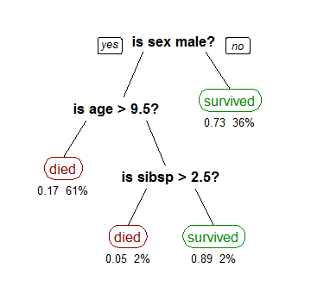
Decision Trees
Decision trees are used for both classification and regression techniques.
They form the decision model in the form of a tree like structure.
All the attributes in a decision tree are made in categorical format.
Attributes at the upper end are given priority as compared to the lower ones.
Sometimes too many branches in a decision tree can lead to the problem of overfitting. This can be avoided by cutting down some of the branches.

Slide 37
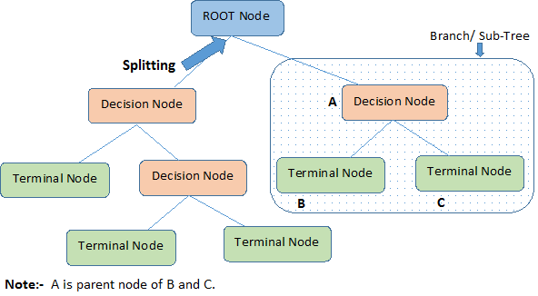
Terminologies related to decision trees:
Root Node: Top most node also called best predictor. It best classifies the training data set.
Decision Node: These are the lower nodes which split further and are helpful in making final decision.
Branch: A sub section of entire tree is called branch or sub-tree
Leaf/Terminal Node: This is the result node which does not split further.
Algorithms to build decision trees:
CART (Classification and Regression Trees)
ID3 (Iterative Dichotomiser 3)
CHAID(Chi-square Automatic Interaction Detector)

Slide 38


ID3(Iterative Dichotomiser 3):
This algorithm uses entropy and information gain to select the attributes.
Attribute with highest information gain is chosen for splitting the data.
Entropy, H(S) is a measure of the amount of uncertainty in the (data) set S.
S – The current dataset for which entropy is being calculated.
X – The set of classes in S.
p(x) – The proportion of the number of elements in class x to the number of elements in set S.
Information gain IG(A) is the measure of the difference in entropy from before to after the set S is split on an attribute A.
H(S)– Entropy of set S.
t – The subsets created from splitting set S by attribute A.
p(t) – The proportion of the number of elements in “t” to the total elements in set S.
H(t) – Entropy of subset t.
how much uncertainty in was reduced after splitting set on attribute .

Slide 39
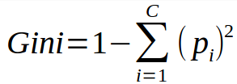
CART (Classification and Regression Trees):
Here the independent variable should be binary. (True or False)
CART uses Gini Index as cost function used to evaluate splits in the dataset.
A Gini score gives an idea of how good a split is by how mixed the classes are in the two groups created by the split.
A perfect separation results in a Gini score of 0.
Attribute which provided lower value of Gini index is preferred.
p(i) – The proportion of the “i” elements to the total elements in set S.
CHAID(Chi-square Automatic Interaction Detector):
This method will find the chi-squared value or the statistical significance between sub nodes and parent node.
Higher the value, higher the significance.
Here, independent variable can be of more than 2 categories.
Chi-square = ((Actual – Expected)^2 / Expected)^1/2

Slide 40

Random forest
This algorithm builds multiple decision trees based on different variables and then mergers them to get a more accurate output. It can be used for both classification and regression. Here, when data is provided to the algorithm, then it automatically selects the number of observations and features (variables) and based on that create a decision tree. Then like this many decision trees are made and finally the average result or most common output is taken into account.

Slide 41
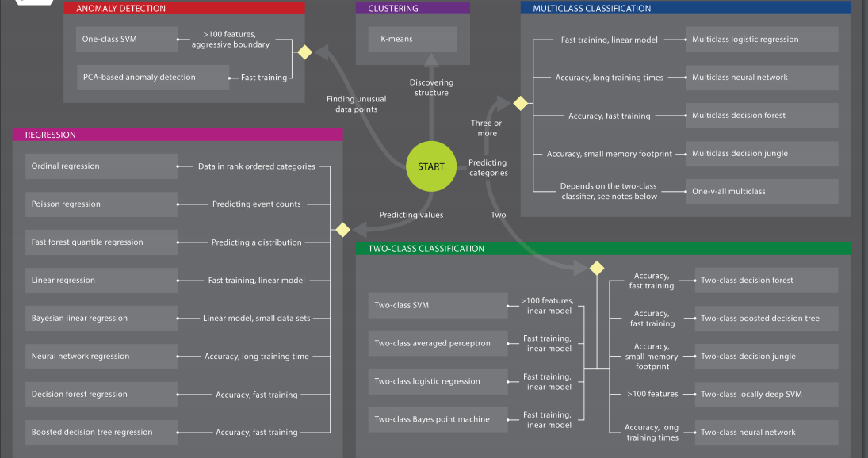

Slide 42
Error Measures
The type of error measure we are using depends upon the model we selected
Regression Error Measures:
R-squared: This measurement shows of how correlated our predicted values are with the actual observed values.
It ranges from 0 to 1, with 0 being no correlation and 1 being perfect correlation.
Higher the value, better the model fit.
Root mean squared error (RMSE): This is an average of how wrong we are from the each point we predicted.
Range is from 0 to infinity.
Closer RMSE to 0 better the prediction.
This is also called Standard error.
Outliers can inflate this measure.

Slide 43
Classification Error Measures:
Confusion Matrix: It is a table with the actual labels along one axis and the predicted labels along the other (in the same order).
Each cell of the table has a count value for the number of predictions that fell into that category.
Correct predictions will fall along the centre diagonal.
Useful to compare performance across different classes.
Accuracy: This is proportion of the test cases that our model got right.
It ranges from 0 (all wrong) to 1 (all right).
Higher the value, better the classification.
Works best for balanced data.
Precision: It tells how many correct options we got out of the total options we predicted for a particular class.
It ranges from 0 (all wrong) to 1 (all right).
Higher the value, better the classification.
Recall: It measures how many correct options we got out of the actual options of a particular class.
It ranges from 0 (all wrong) to 1 (all right).
Higher the value, better the classification.
It is also called Specificity.

Slide 44
F-Score: This is the harmonic mean of both precision and recall.
It is calculated based on the specific class we are interested.
It ranges from 0 (all wrong) to 1 (all right).
Higher the value, better the classification.
Confusion Matrix Terms:
True positives (TP): These are cases in which we predicted CAT and it is actually a CAT.
True negatives (TN): We predicted no CAT, and it is actually no CAT.
False positives (FP): We predicted CAT, but it is actually no CAT.
False negatives (FN): We predicted no CAT, but it is actually a CAT.
Total Predicted Values: TP+FP
Total Actual Values: TP+FN

Slide 45
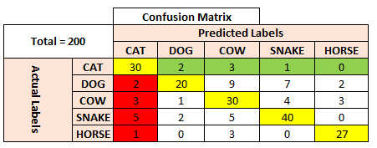
Green coded is FN for A
Red coded is FP for A

Slide 46
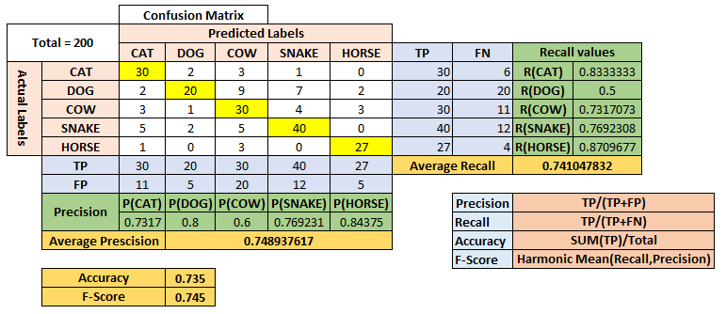

Slide 47
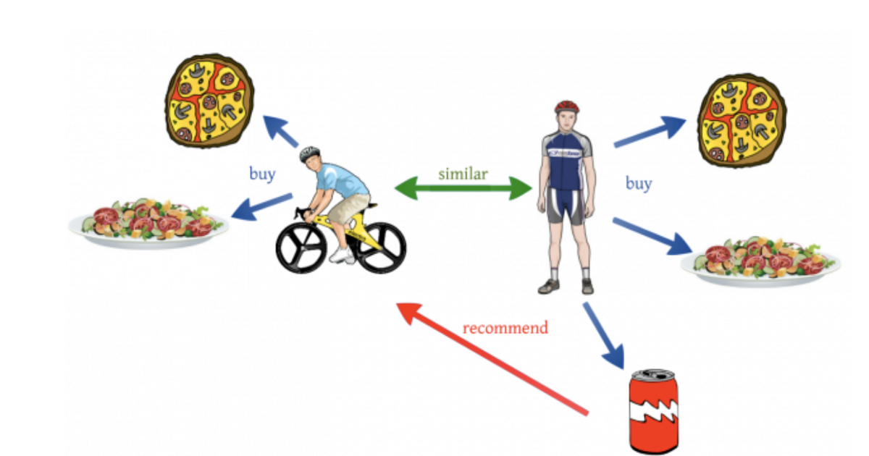
Collaborative Filtering
It is a technique used by recommender systems to make automatic predictions about the interests of the users by collecting preferences and tastes from many users.
The underlying assumption of the collaborative filtering approach is that if a person A has the same opinion as a person B on an issue, A is more likely to have B's opinion on a different issue.

Slide 48
Types of Collaborative Filtering:
Memory Based
Model Based
Hybrid
The memory-based approach uses user rating data to compute the similarity between users or items.
It takes a particular user, find users that are similar to that user based on similarity of ratings, and recommend items that those similar users liked
Here we are not learning any parameter.
In this technique, CF models are developed using different data mining and machine learning algorithms to predict user’s rating of unrated items.
Here we have to train the model to optimize parameters in order to make accurate predictions.
In this case, both the memory-based and the model-based CF algorithms are used.
They overcome the CF problems such as sparsity and loss of information.
They have increased complexity and are expensive to implement.
Google News Recommender uses this model.

Slide 49
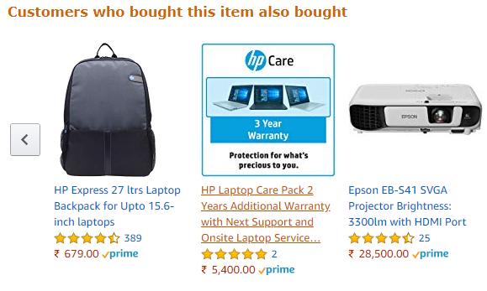
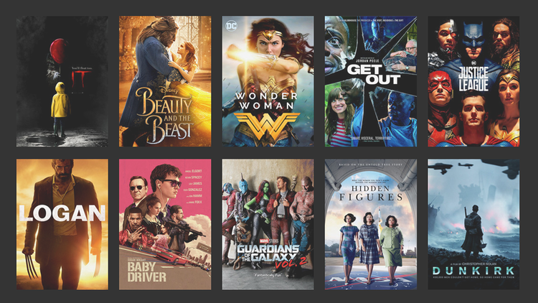

Example of CF
Movies recommendations by Netflix.
Product recommendations by Amazon, Flipkart etc.
Facebook recommends friends.
Gaana, Apple music recommends songs.
Zomato recommends restaurants.
Food recommendations by Swiggy.

Slide 50
OLS vs MLE
Ordinary Least Square
Maximum Likelihood Estimation
OLS provide that line which minimizes the sum of square distance of (observed - predicted).
We measure the residuals, the distance between the data and the line and then square them so that negative values do not cancel out the positive values and then add them up. Then we rotate the line a little bit, measure the residuals and square them and add them up. The line with the smallest sum of squared residuals is the line chosen to fit best.
This is a method for approximately determining the unknown parameters located in a linear regression model.
MLE is a method used in estimating the parameters of a statistical model like mean & variance from a given set of observations.
The method obtains the parameter estimates by finding the parameter values that maximize the likelihood function.
MLE is usually recommended for large samples because it is versatile, applicable to most models and different types of data, and produces the most precise estimates.

Slide 51
given 1000 records of 30 columns each. 5% of the data has missing values. What percentage of data is to be discarded if the missing values are (a) widely spread (b) concentrated (c) sequentially/evenly spread
Total data values = 1000*30 = 30000
Number of missing values = 5% * 30000 = 1500
Worst case:
(1500/1000) = 1.5 values missing in each row.
This can lead to removal of 100% of data (Whole rows corresponding to missing values removed).
Best case:
Total number of rows missing = (1500/30) = 50
This lead to removal of only 5% of data.
So for all the above options, range to data to be removed is 5-100%

Slide 52
References
https://www.analyticsvidhya.com/blog/2016/04/complete-tutorial-tree-based-modeling-scratch-in-python/
https://www.analyticsvidhya.com/blog/2018/03/introduction-k-neighbours-algorithm-clustering/
https://www.geeksforgeeks.org/k-nearest-neighbours/
https://in.mathworks.com/discovery/machine-learning.html
https://www.analyticsvidhya.com/blog/2017/09/common-machine-learning-algorithms/
https://download.microsoft.com/download/A/6/1/A613E11E-8F9C-424A-B99D-65344785C288/m
icrosoft-machine-learning-algorithm-cheat-sheet-v7.pdf https://medium.com/deep-math-machine-learning-ai/chapter-4-decision-trees-algorithms-b93975f7a1f1
http://www.learnbymarketing.com/481/decision-tree-flavors-gini-info-gain/
http://dataaspirant.com/2014/09/19/supervised-and-unsupervised-learning/
https://medium.com/machine-learning-for-humans/unsupervised-learning-f45587588294
https://medium.com/@jrodthoughts/understanding-semi-supervised-learning-a6437c070c87

Slide 53
https://makingnoiseandhearingthings.com/2017/12/30/how-to-be-wrong-measuring-error-in-machine-learning-models/
https://makingnoiseandhearingthings.com/2017/12/30/how-to-be-wrong-measuring-error-in-machine-learning-models/
https://www.youtube.com/watch?v=VPZiJGNX4_s
https://www.youtube.com/watch?v=fcO9820wCXE
https://www.dataschool.io/simple-guide-to-confusion-matrix-terminology/
https://www.youtube.com/watch?v=HBi-P5j0Kec
https://towardsdatascience.com/various-implementations-of-collaborative-filtering-100385c6dfe0
https://aws.amazon.com/lex/
https://medium.com/datadriveninvestor/simplifying-machine-learning-using-weka-3df458fd2c6f

Slide 54
https://www.cs.waikato.ac.nz/ml/weka/
https://machinelearningmastery.com/what-is-the-weka-machine-learning-workbench/
https://bigml.com/features.
https://cloud.google.com/automl/
https://reviews.financesonline.com/p/ibm-watson/
https://azure.microsoft.com/en-us/pricing/details/machine-learning-studio/
https://rapidminer.com/products/
https://en.wikipedia.org/wiki/ID3_algorithm
http://www.learnbymarketing.com/481/decision-tree-flavors-gini-info-gain/
https://towardsdatascience.com/k-nearest-neighbours-introduction-to-machine-learning-algorithms-18e7ce3d802a
https://medium.com/@srishtisawla/linear-discriminant-analysis-d38decf48105
https://towardsdatascience.com/is-lda-a-dimensionality-reduction-technique-or-a-classifier-algorithm-eeed4de9953a

Slide 55
Thank You!!

