Slide 1
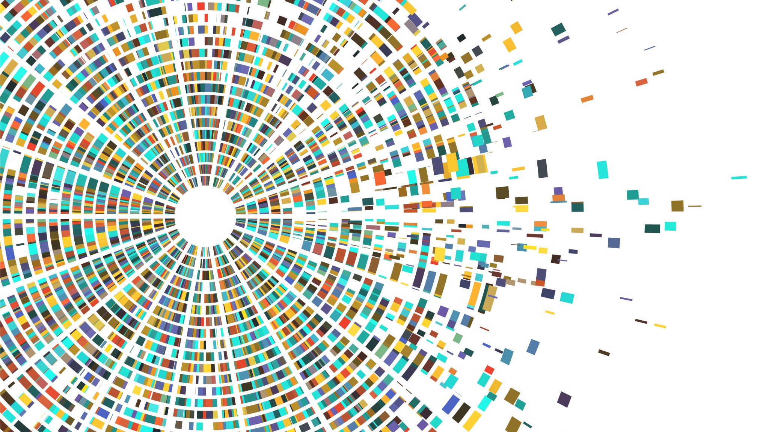
Patients’ Stratification in Advanced Gastric Cancer

Slide 2

Data
RNA-seq count data
National Cancer Institute, Regina Elena – IRE (Rome, Italy)
The Cancer Genome Atlas Program – TCGA
Microarrays
Gene Expression Omnibus – GEO
Clinical Annotations

Slide 3
Pipeline
Cellular Line Genes Extraction
Patients Level
RESISTANT - SENSITIVE
TPM
Cellular Line
Differential
Gene Expression
Genes
Selection
ssGSEA
Survival
Analysis
Multivariate
Analysis
PARAMETERS:
log2FC = 0.8
Adjusted p-value = 0.05
N. Genes:
Down-Regulated: 594
Up-Regulated: 775
ENRICHMENT PATIENTS:
182 Patients x 198 Genes
NETWORK ANALYSIS:
Differential Expression Gene Network
OUTPUT:
50% Hubs for Degree (102 genes)
SIGNATURE:
102 genes
PARAMETERS
High: z ≥ 0
Low: z < 0
IRE:
OS
PFS
TCGA:
OS
PFS
MICROARRAY:
OS
COVARIATES:
AGE
PERFORMANCE STATUS
METASTASIS NUMBER
SEX
METASTATIC LOCAL
ADVANCED
SIGNATURE

Slide 4
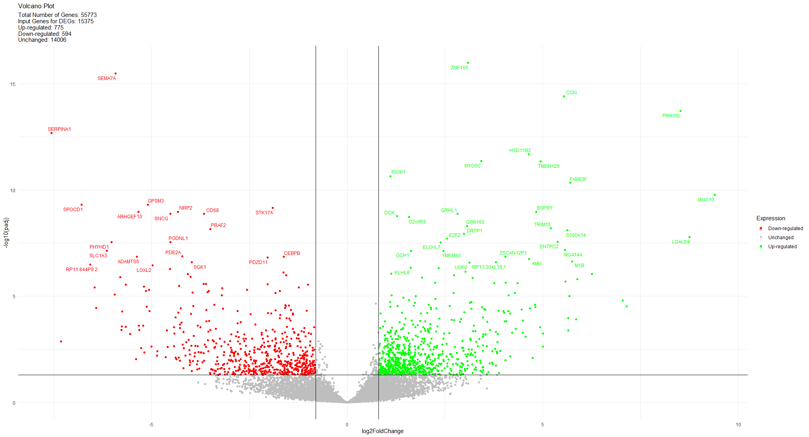

Slide 5
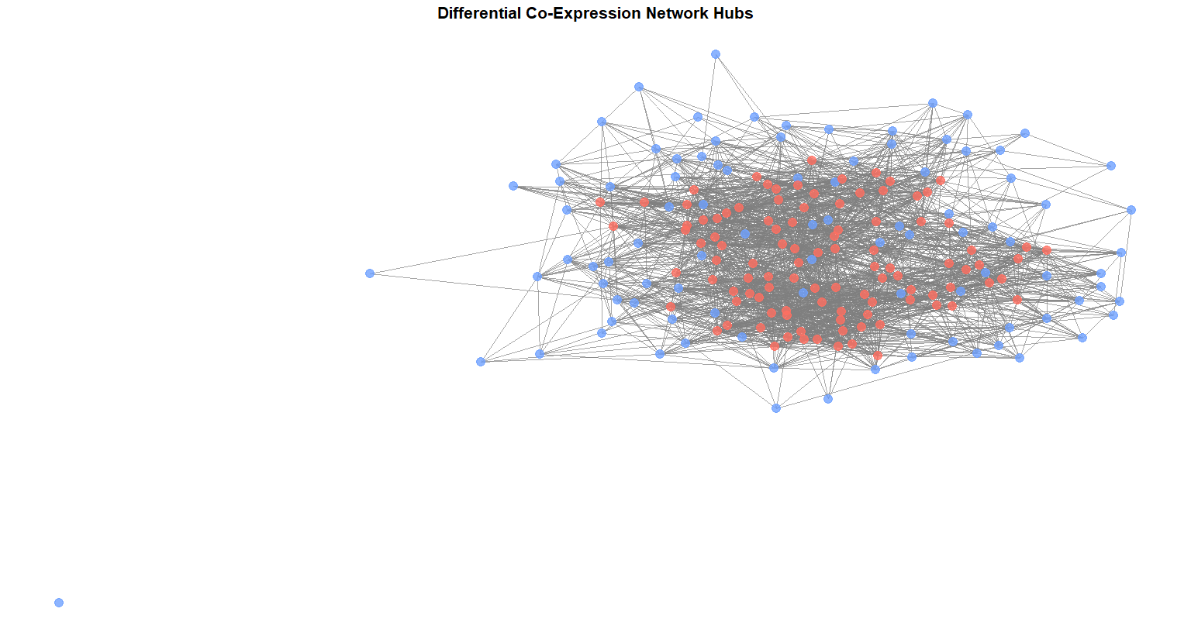
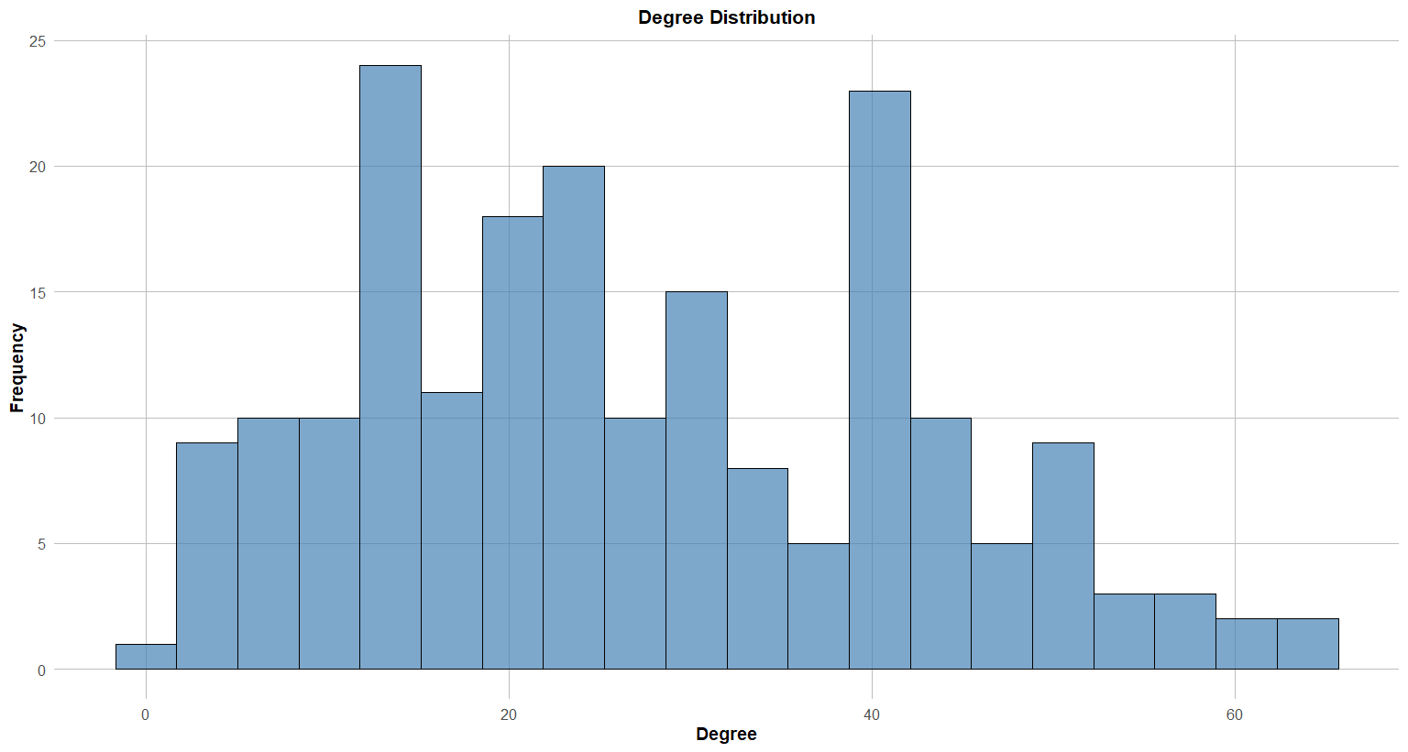
Network Analysis
Hubs: GNAI2, RSU1, NRP1, GNS, IFITM3, MMP14, FYN, TUBA1A, TNFRSF1A, CTSZ, CLIC4, TNIP1, C1S, HIF1A, PGK1, PIP4K2A, LGALS1, SPARC, SERPINH1, ECE1, FBN1, TMSB10, DCTN2, PDLIM1, GNAS, DBN1, IGFBP4, CTSD, C3, NONO, ITGB1, LTBP3, MYADM, COL18A1, CAV1, CD68, CUL4B, C1R, SPON2, ABCA1, TAF10, EMP3, CSGALNACT2, CD44, GRN, PLP2, RBM3, PHF11, SYNPO, GDI1, CTSH, DSE, GABARAPL1, ZEB1, VDAC2, SMAD3, FAM3C, VIM, MORF4L2, NRBP1, PRNP, TUBB6, RAP18, CD82, ARFGAP1, NRP2, VPS26A, PML, TAGLN, SART1, CLDND1, SERPINE1, RAB8B, TPP1, UGP2, MPI, CAPG, SEMA3C, ARHGEF10, AAK1, MCU, RUNX1, IL1RAP, DCTN1, NDST1, UROD, SLC25A28, APIS2, TMSB4X, SLC1A3, DLGAP4, DENND3, HCLS1, LAMB3, FIBP, NAMPT, MARS, CTSA, EIF3E, LGALS8, CYR61, LGALS9.

Slide 6
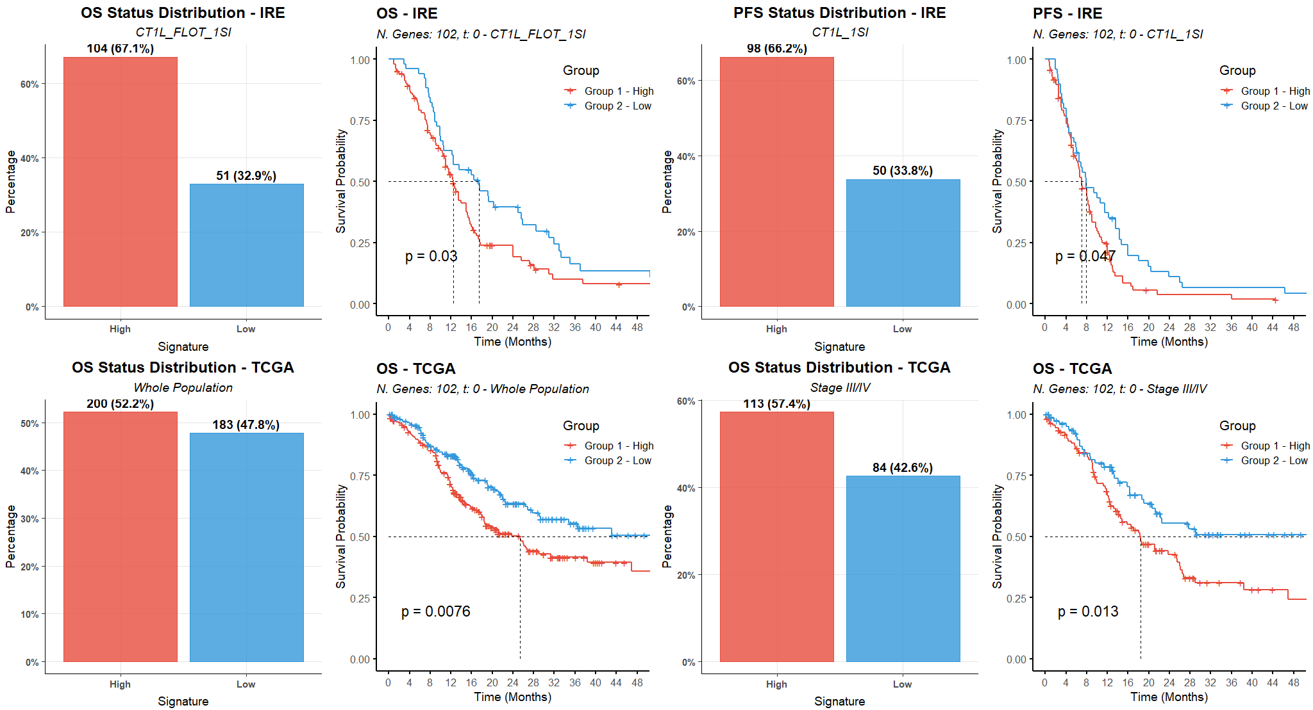

Slide 7
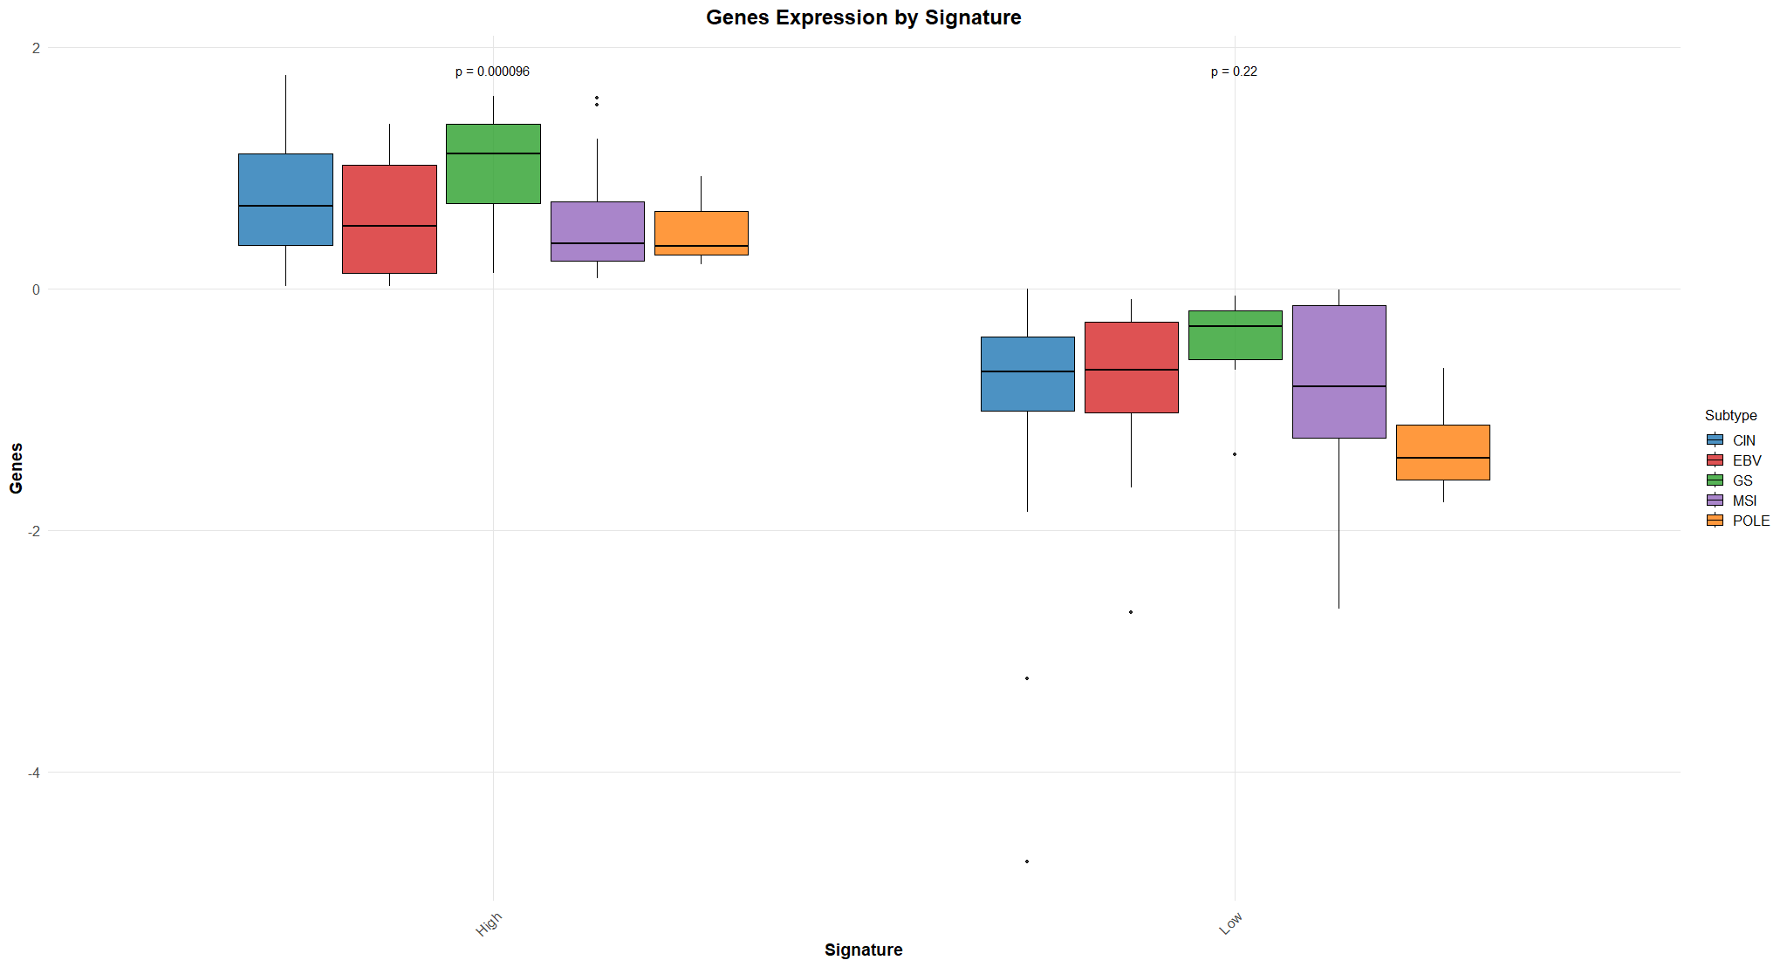

Slide 8
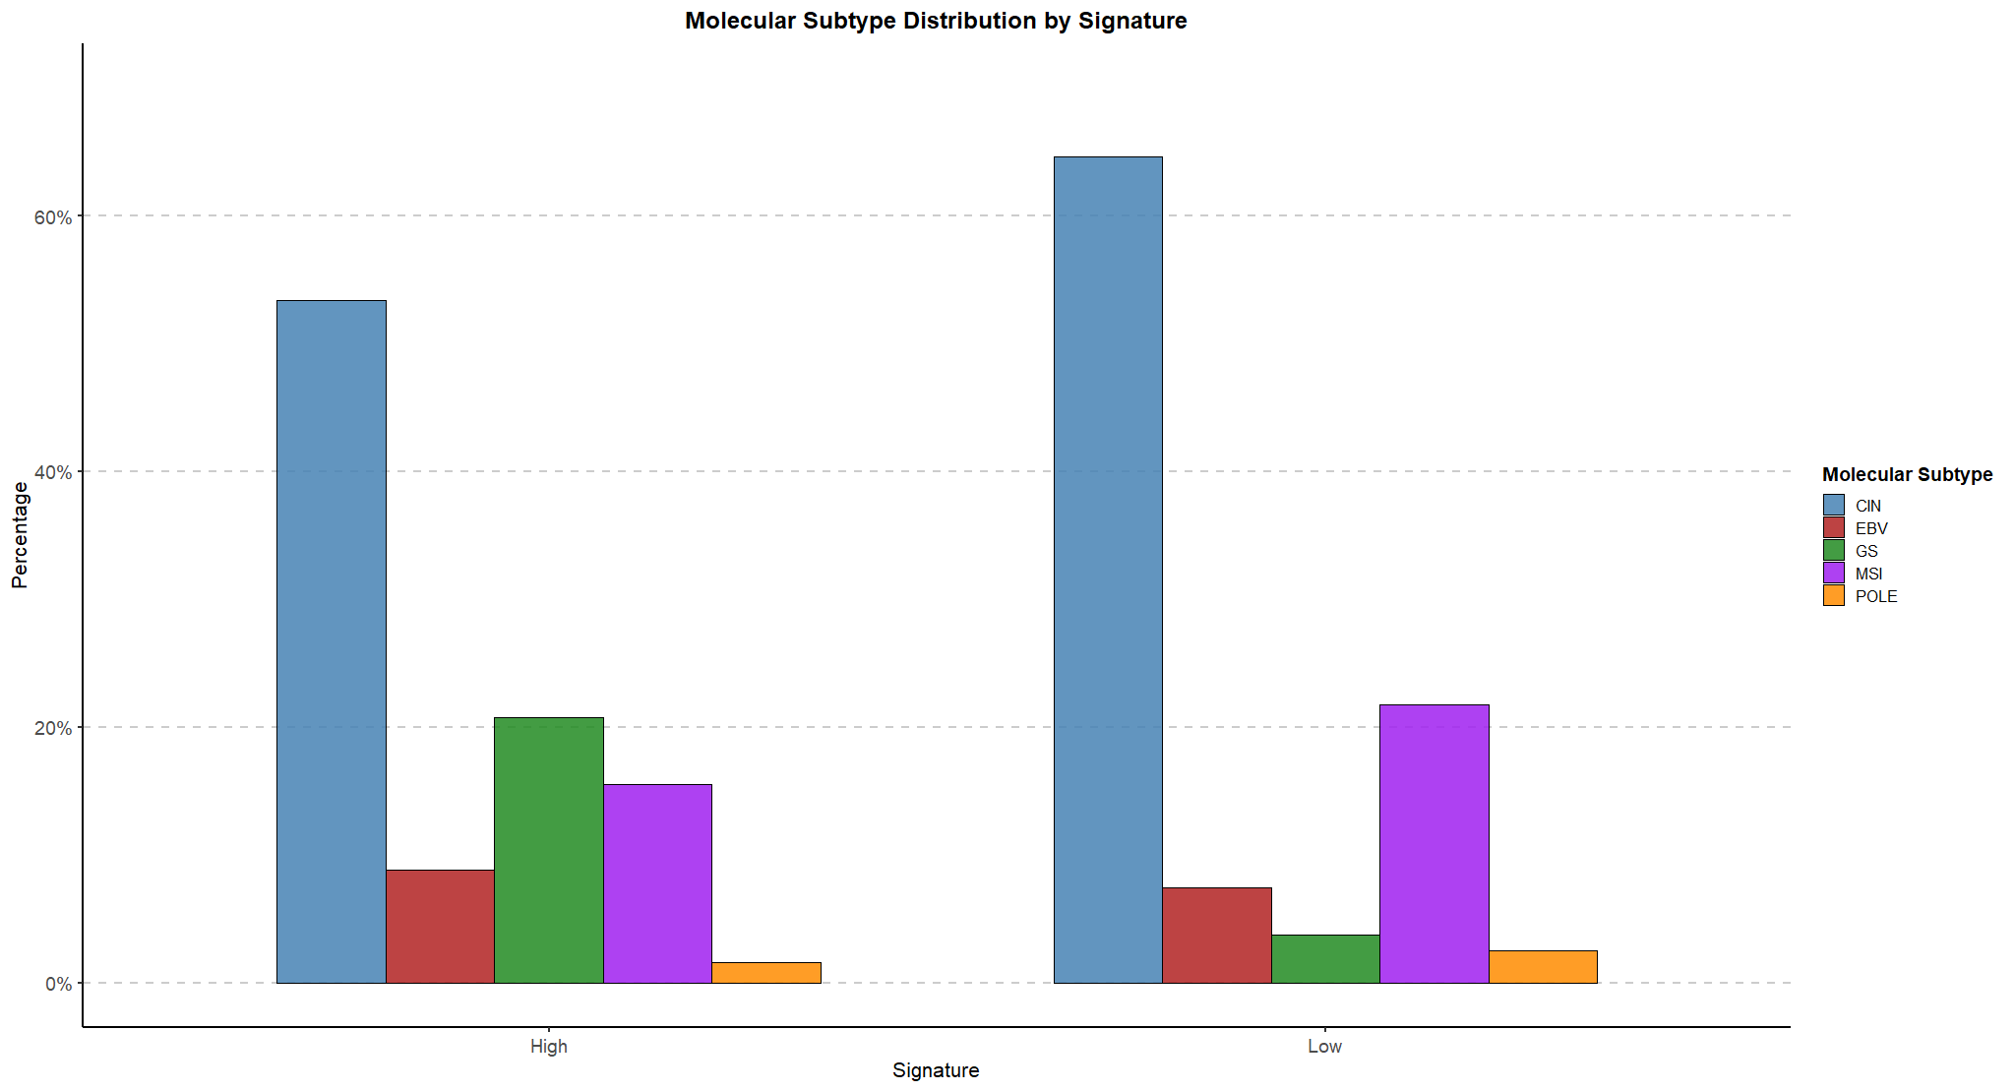

Slide 9
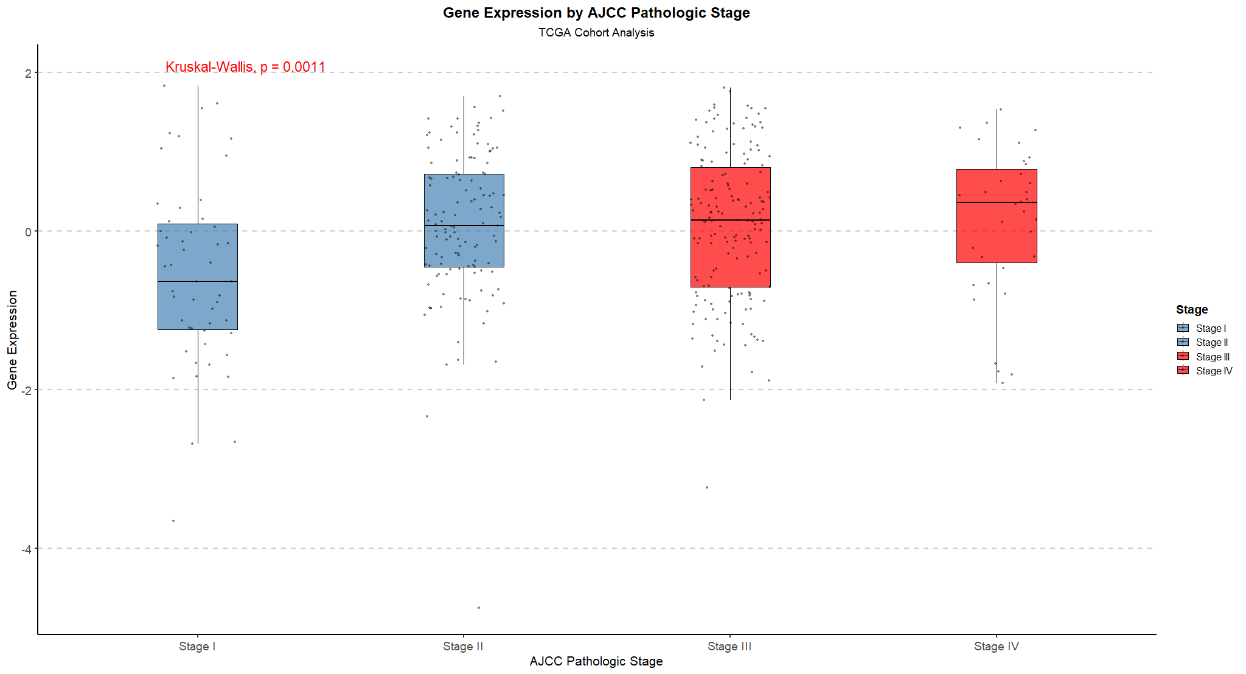

Slide 10
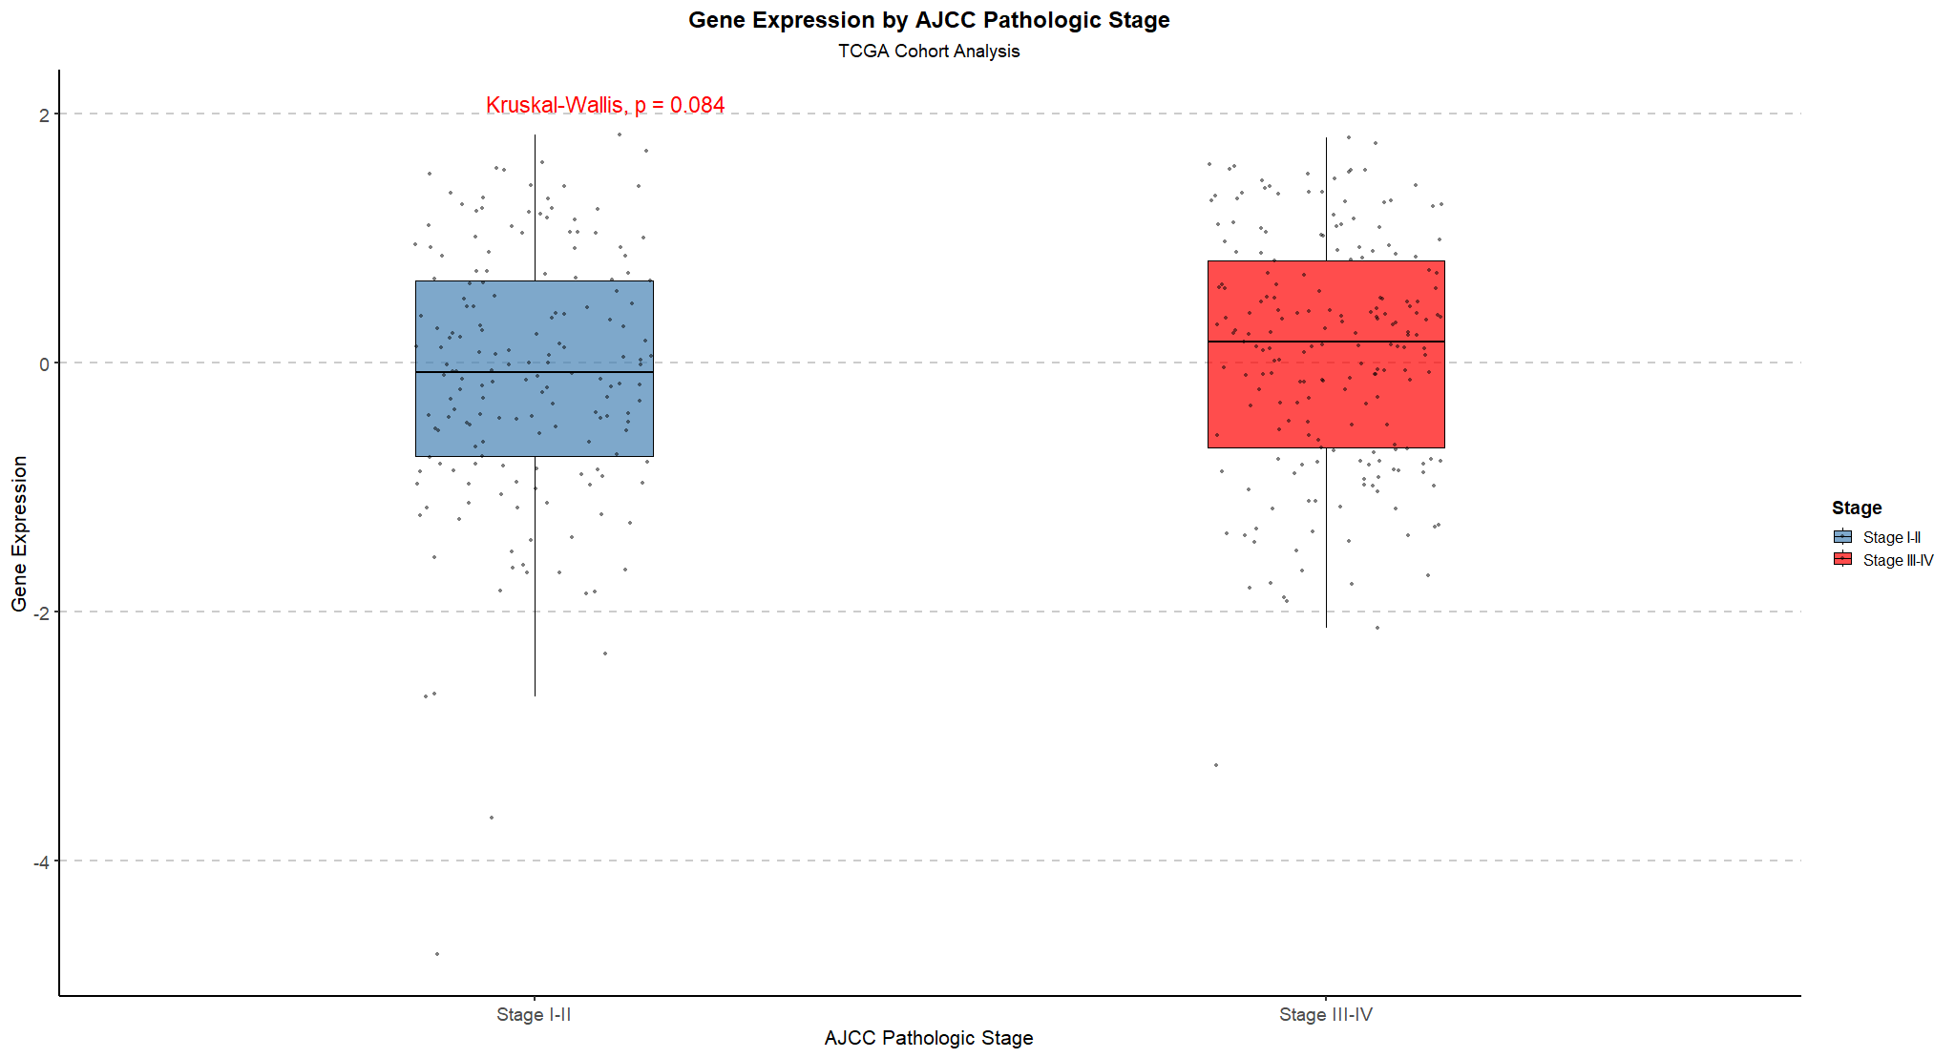

Slide 11
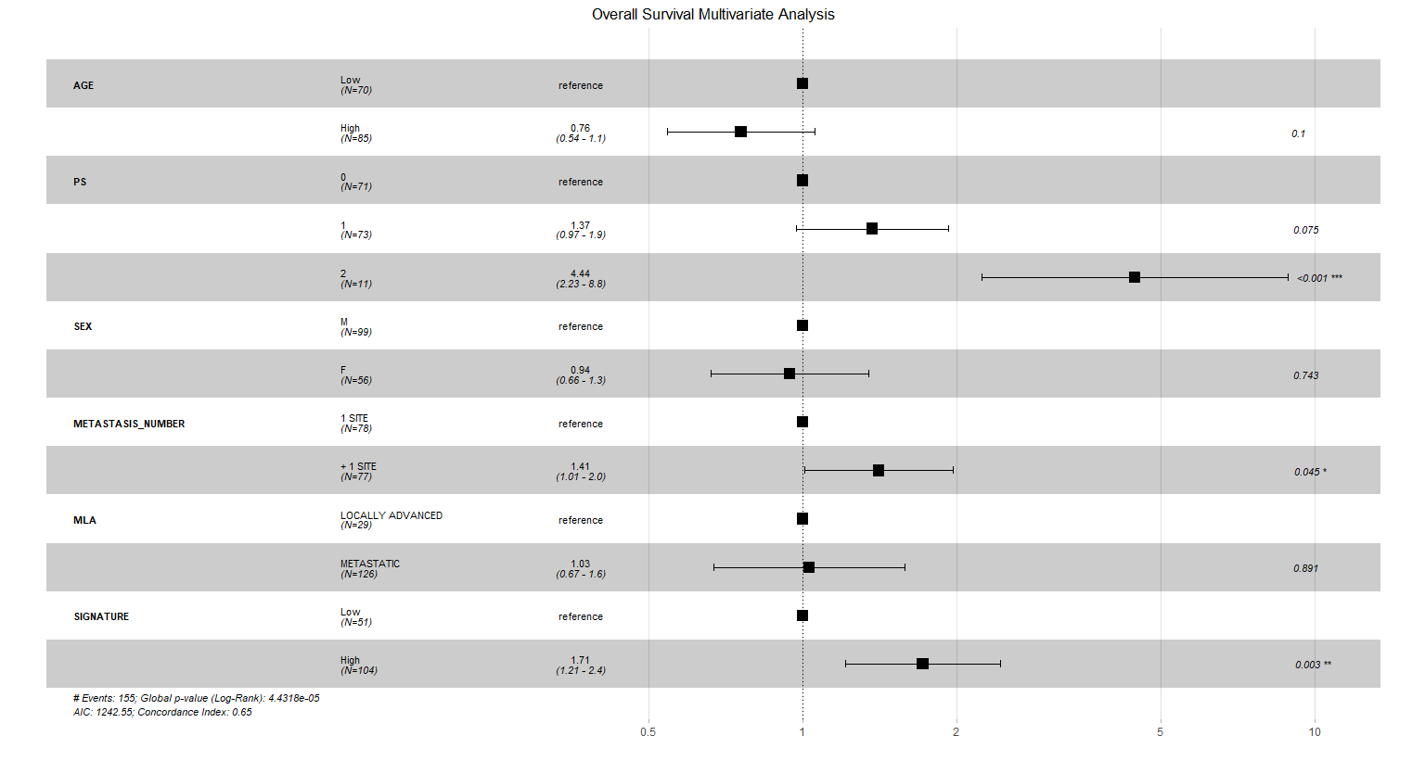

Slide 12
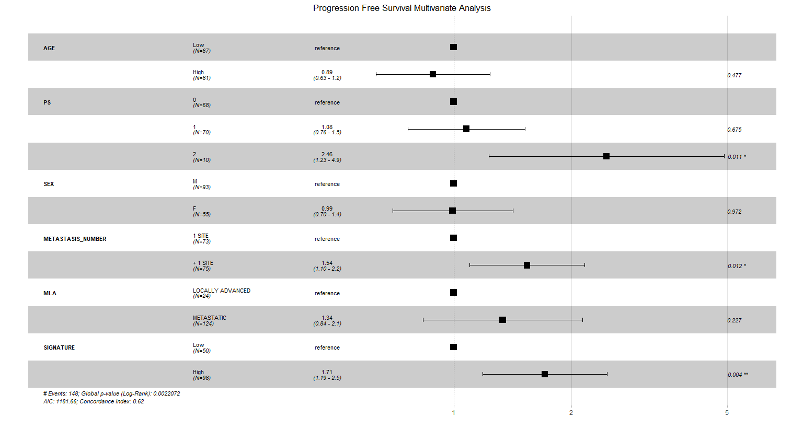

Slide 13
