Slide 1
Inverse reinforcement learning with multiple morphologies
By Mathieu D’Onofrio

Slide 2
Motivation
Enhanced Safety in RL: Transfer the constraints or rules governing a set of agents to a different kind of agent.
Generalization Across Morphologies: Enhance the adaptability of inferred reward functions to accommodate various kinds agents.
Streamlined: Achieve more efficient data utilization and reduce the need for agent-specific tuning.

Slide 3
Literature Review

Slide 4
Inverse reinforcement learning (IRL)
IRL: Learn the underlying reward function based on observed behavior of an expert
Nested structure issue:
Inner loop: Find optimal policy under current reward function
Outer loop: Find a better reward function
Computationally expensive due to quadratic time.

Slide 5
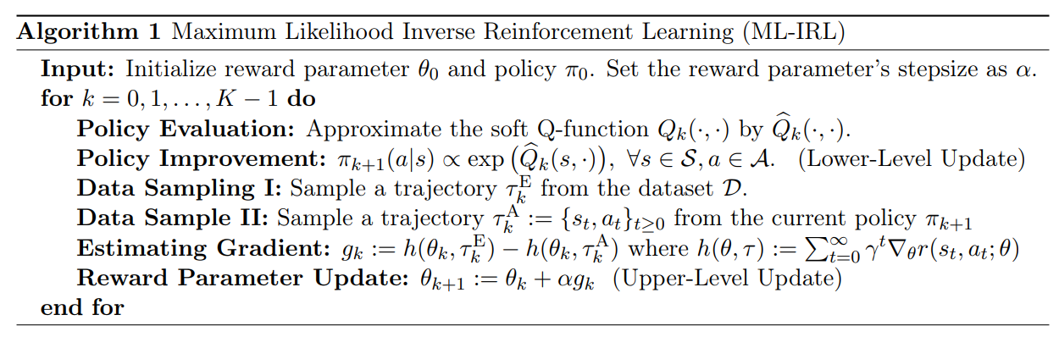
Maximum likelihood inverse reinforcement learning (ML-IRL)
Reward functions
States + Actions
States only
Transfer methods
Reward transfer
Data transfer
[2210.01282] Structural Estimation of Markov Decision Processes in High-Dimensional State Space with Finite-Time Guarantees (arxiv.org)
Notes:
2 steps:
Lower level update
Upper level update
Lower level update requires entropy regularized methods such as SAC (What we use)
Upper level update → gradient ascent
Paper considered same morphology but disabled in some way.
Only state only considered for transfer.
Lower dimensionality helps predict the optimal policy under different environment dynamics or learning new tasks

Slide 6
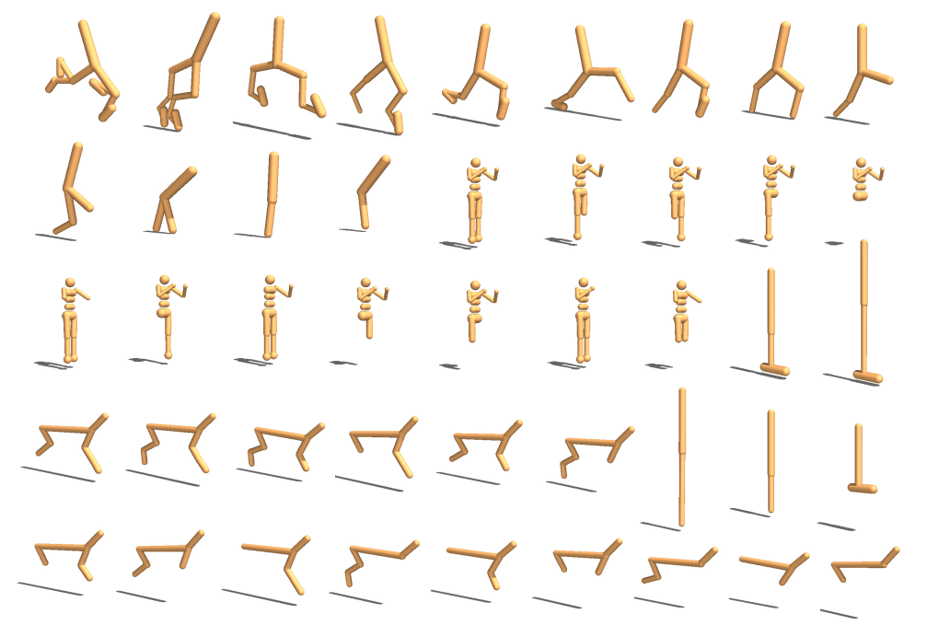
Shared policies
Line of work that aim to control various agent types, even when the dimensionality of their state and action spaces varies.
Mostly a model architecture challenge.

Slide 7
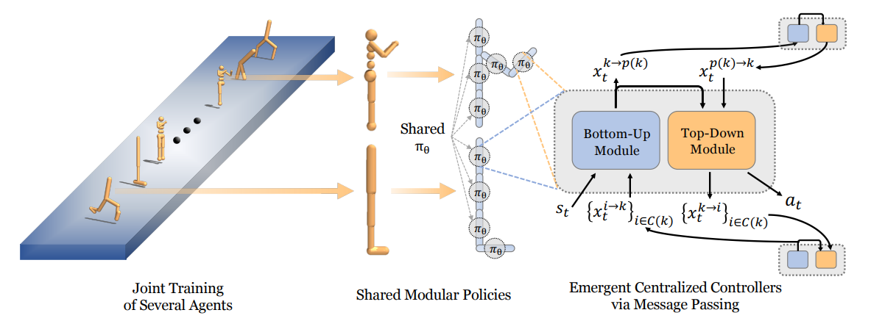
Shared modular policies
Policy is a composition of modular components
Per limb modules
Modules are neural networks
Message passing as outputs
Per limb observations
Position
Orientation
dPosition / dt
dOrientation / dt
Type
Angle
Joint Range
[2007.04976] One Policy to Control Them All: Shared Modular Policies for Agent-Agnostic Control (arxiv.org)

Slide 8
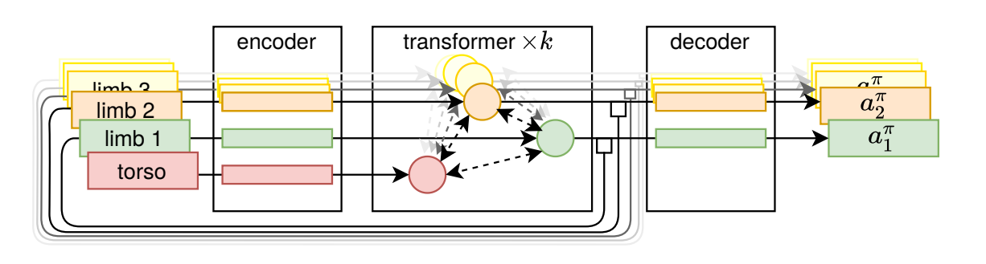
Amorpheus
Message passing as attention in a transformer block
Per limb embeddings
Encoder and decoder are simply linear projections
[2010.01856] My Body is a Cage: the Role of Morphology in Graph-Based Incompatible Control (arxiv.org)
Notes:
Encoder and decoder are simply per limb linear projections

Slide 9
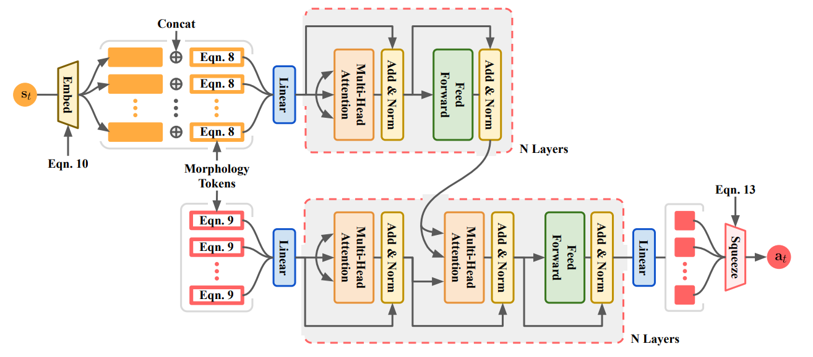
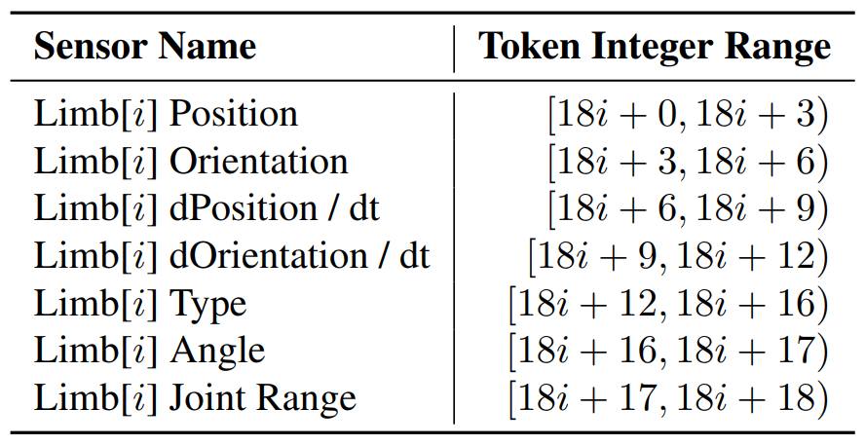
Anymorph
No graph structure or limb alignment required
Per sensor & motor tokens + frequency encoding
Best performance + most flexible
[2206.12279] AnyMorph: Learning Transferable Polices By Inferring Agent Morphology (arxiv.org)
Notes:
Not restricted to homogenous parts like limbs
Full transformer allows different sequence length for the output than the input

Slide 10
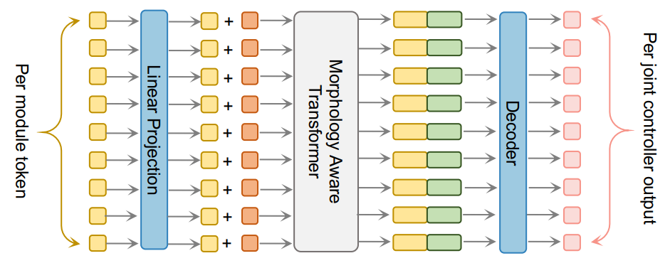
Metamorph
Environments: 100 evolved robots (UNIMAL)
Per limb embedding + Positional encoding
[2206.12279] AnyMorph: Learning Transferable Polices By Inferring Agent Morphology (arxiv.org)

Slide 11
Methods

Slide 12
Multi ML-IRL
ModularRL (SMP) cheetah environments used (12 with experts 3 without experts)
Experts obtained by training SAC policy with a regular MLP
ML-IRL trained policies on single morphology used as baseline
Data transfer is the only method for transfer that worked
for k = 0, 1, . . . , num_epochs − 1 do
for i = 0, 1, …, num_experts - 1 do
update policy i
update reward
for i = 0, 1, …, num_no_experts do
update policy i + num_experts

Slide 13
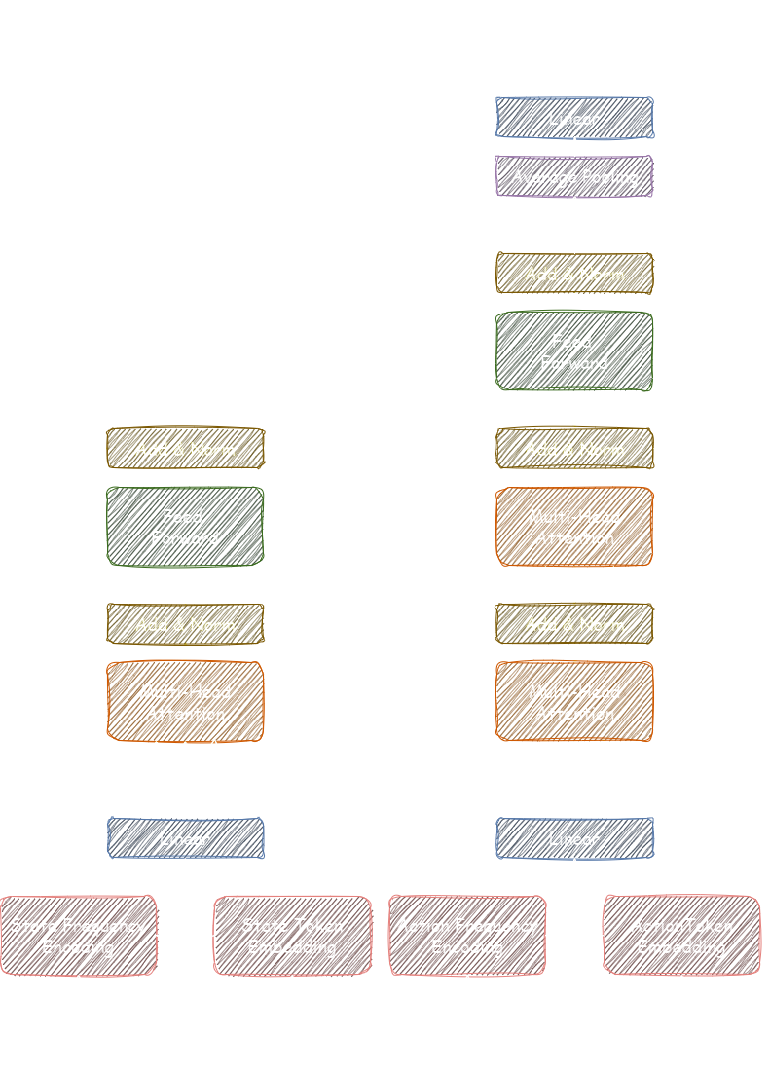
Adjusted AnyMorph Architecture
Actions are embedded like states
Average pooling is used to output a fixed size
Notes:
Full transformer
Frequency encoding
Average pooling

Slide 14
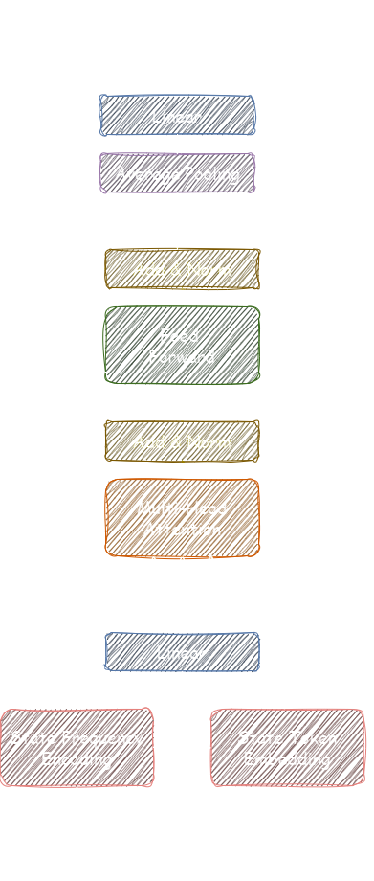
State-Only Architecture
Requires transformer encoder only
Less parameters
State-only is preferred for more transferable reward functions in ML-IRL
Notes:
Full transformer
Frequency encoding
Average pooling

Slide 15
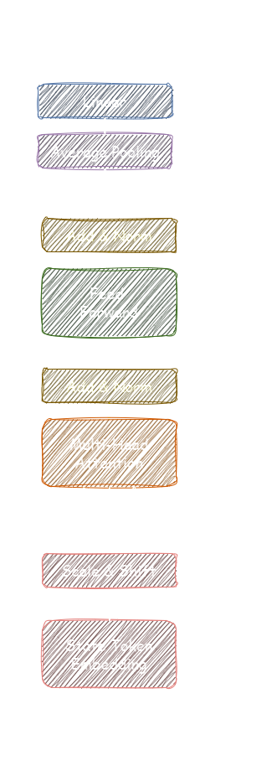
No frequency encoding
No scale hyperparameter
Might be more general for different types of states
Notes:
Full transformer
Frequency encoding
Average pooling

Slide 16
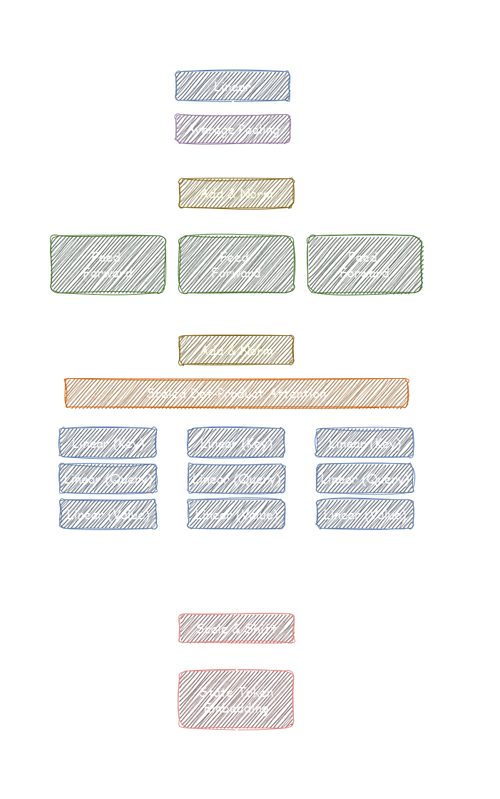
Heterogeneous Transformer Architecture
Sensors are not homogeneous
Sensor interactions are still captured
Less representation sharing
More parameters
May need to be more regularized
Regularization idea: Penalize pooling layer variance?
[2311.05884] Hiformer: Heterogeneous Feature Interactions Learning with Transformers for Recommender Systems (arxiv.org)

Slide 17
Results

Slide 18
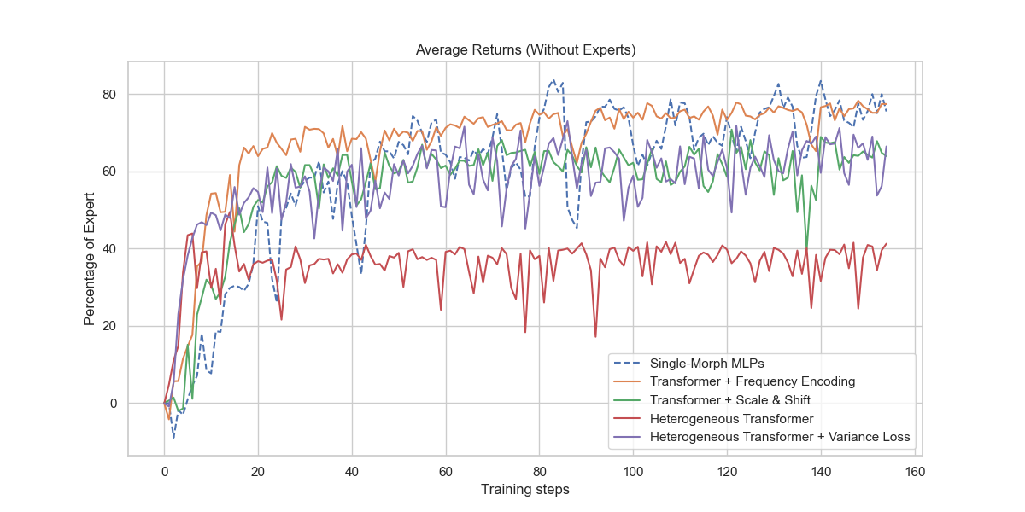

Slide 19
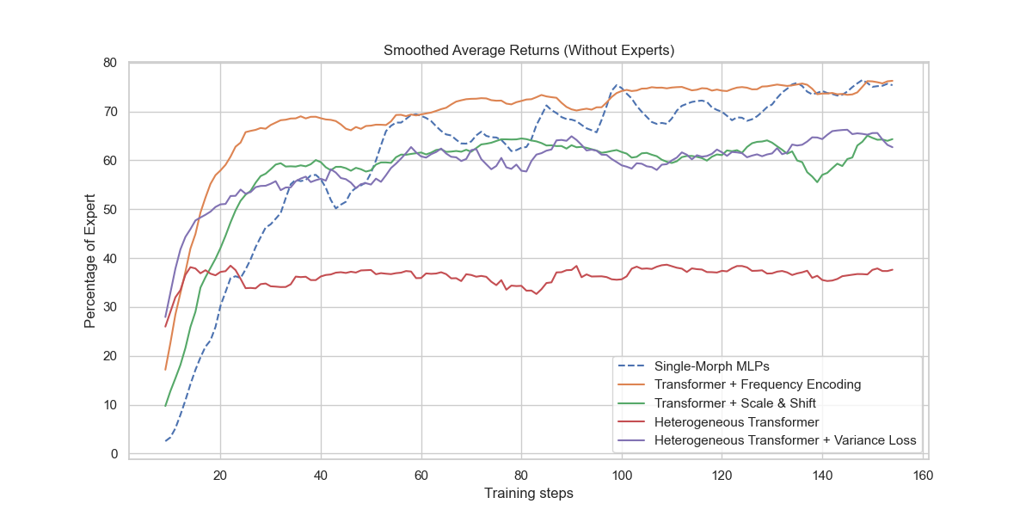

Slide 20
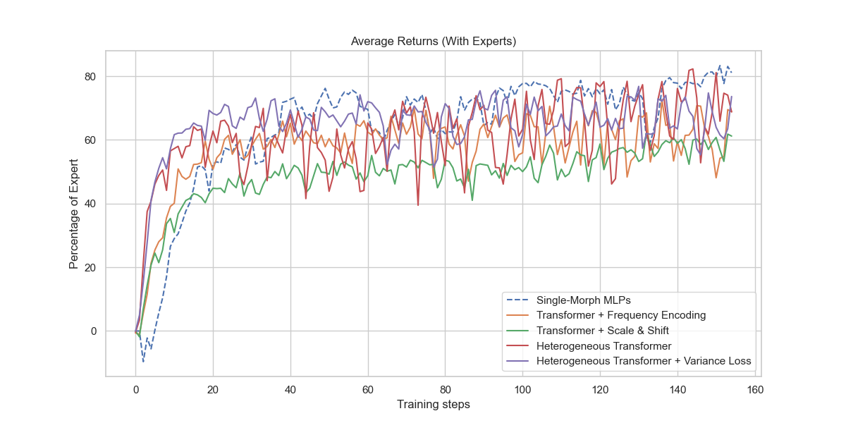

Slide 21
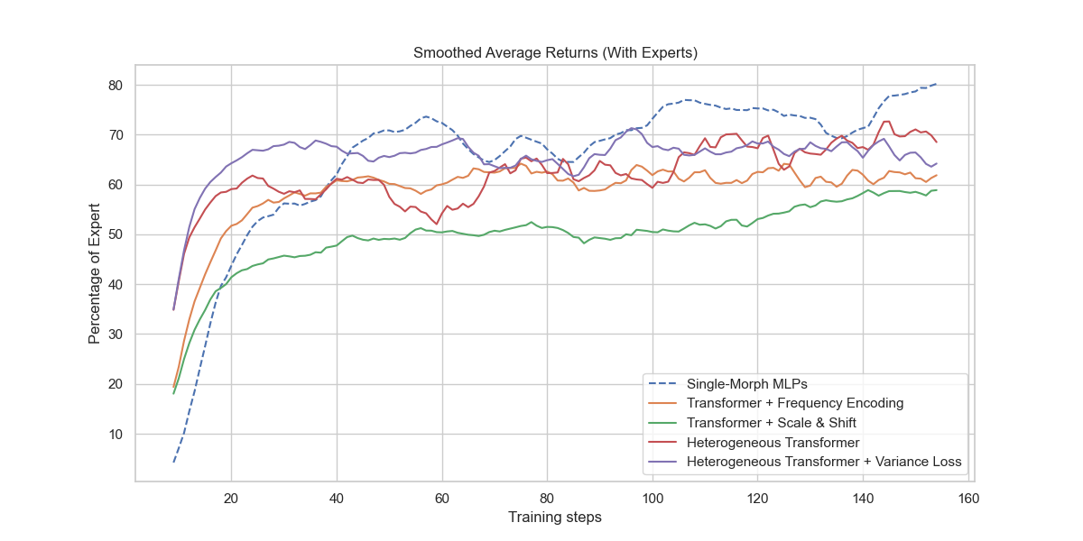

Slide 22
Conclusion

Slide 23
Next Steps
Run on multiple seeds
Investigate reward transfer
Inverse constrained reinforcement learning (ICRL)
Heterogeneous architectures (for policies as well)?
Tokenization
Standard
DFS
Evolution historical markings?
…
State embedding (mix?)
Scale & Shift
Frequency encodings
Categorical embeddings ?
…
Environments
UNIMAL
…

Slide 24
Questions

