Slide 1

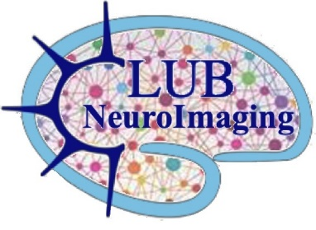








NeuroImaging club – 65th meeting
Welcome back to the NeuroImaging club
Feedbacks from OHBM2026, REMI2026, resources & more!
25th Sept. 2026
INSERM UMRS 1028 – CNRS UMR 5292

Slide 2
Round-table discussion

Slide 3
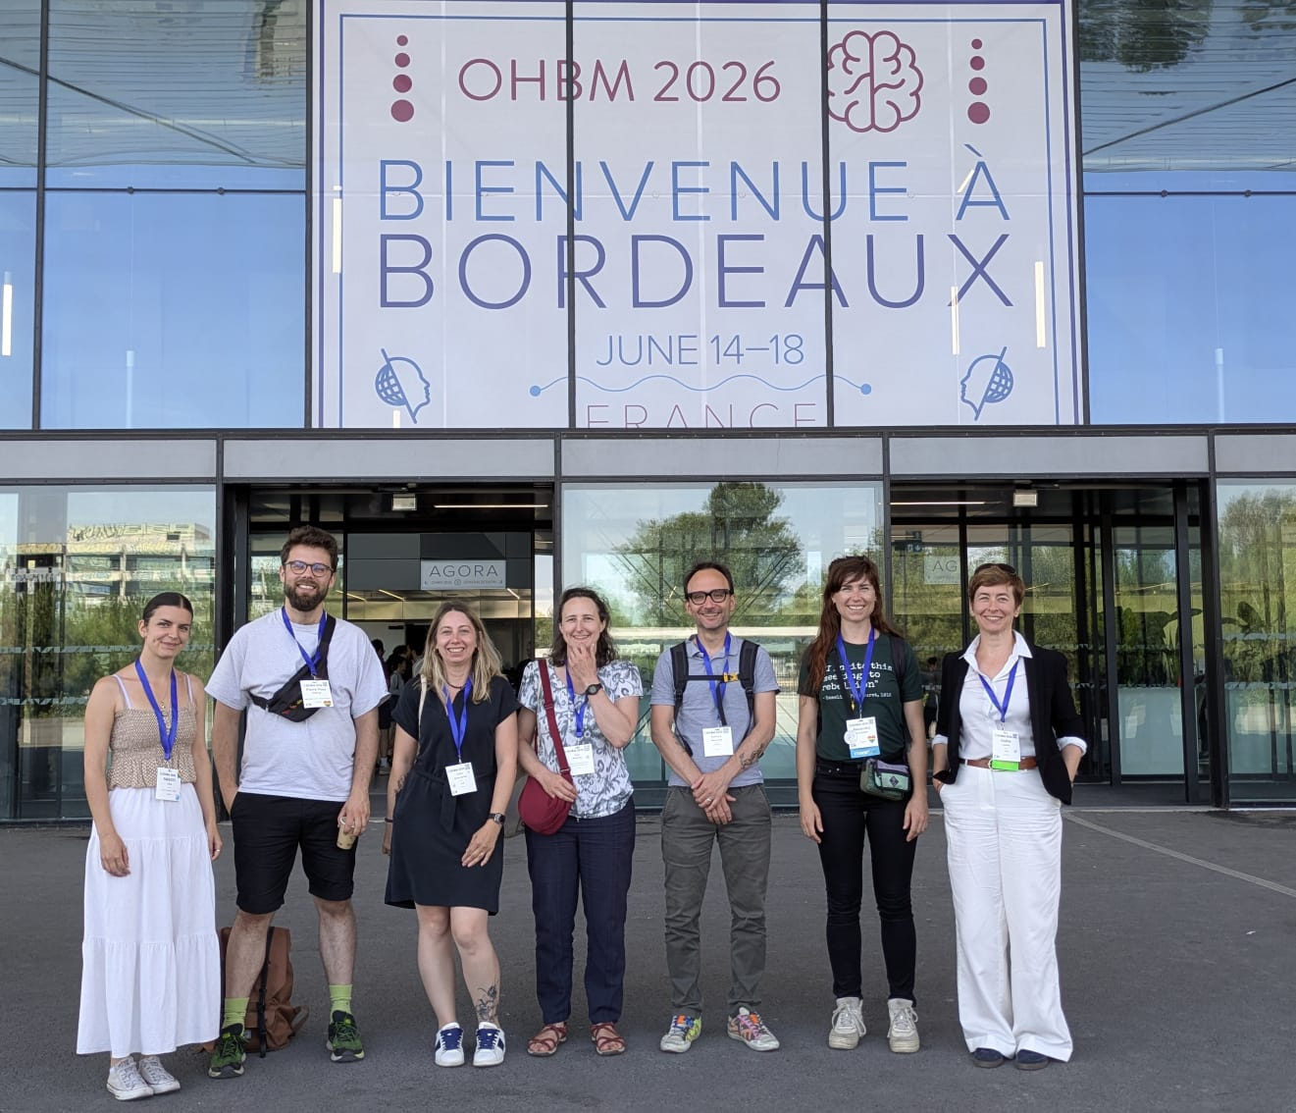
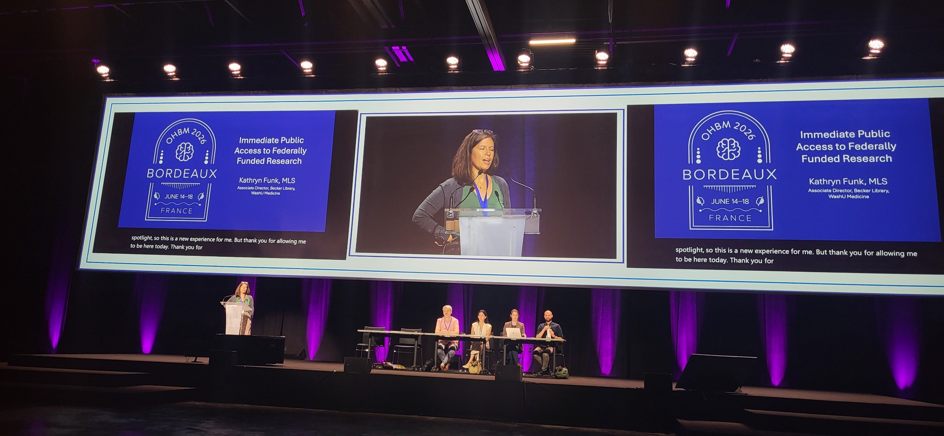
Feedback from
Notes:
Since 1995 in Paris
In roughly ten years, we’ve gone from an organization that only runs an annual meeting, to a Society with 6 Regional Chapters and 5 Special Interest Groups (SIGs) and events throughout the year.
Awards: Glass Brain, open science, Replication study, Early Career Investigator , Diversity & Inclusivity Champion, Education in Neuroimaging, Karl Zilles, Mentor, merit abstract, Sustainability
France: Daniel Marguiles, Early Career Investigator / Stephanie Forkel Education in Neuroimaging / article de Marion Leboyer, Edouard Duchesnay, Pierrick Coupé, Replication study

Slide 4
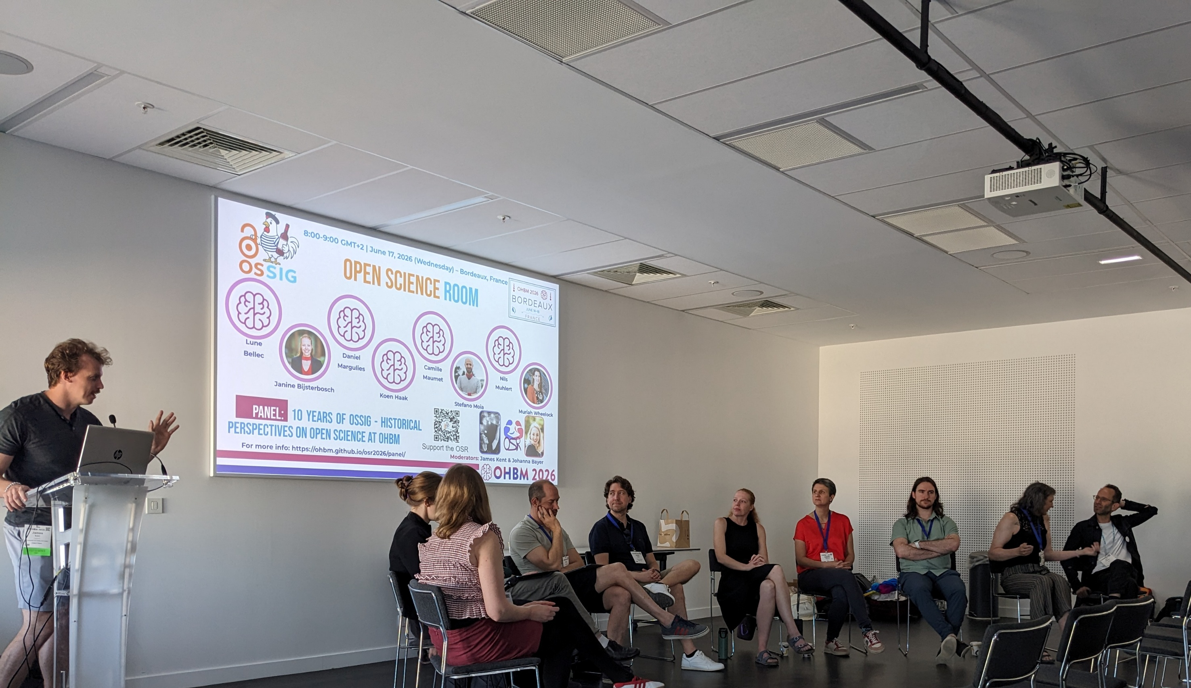
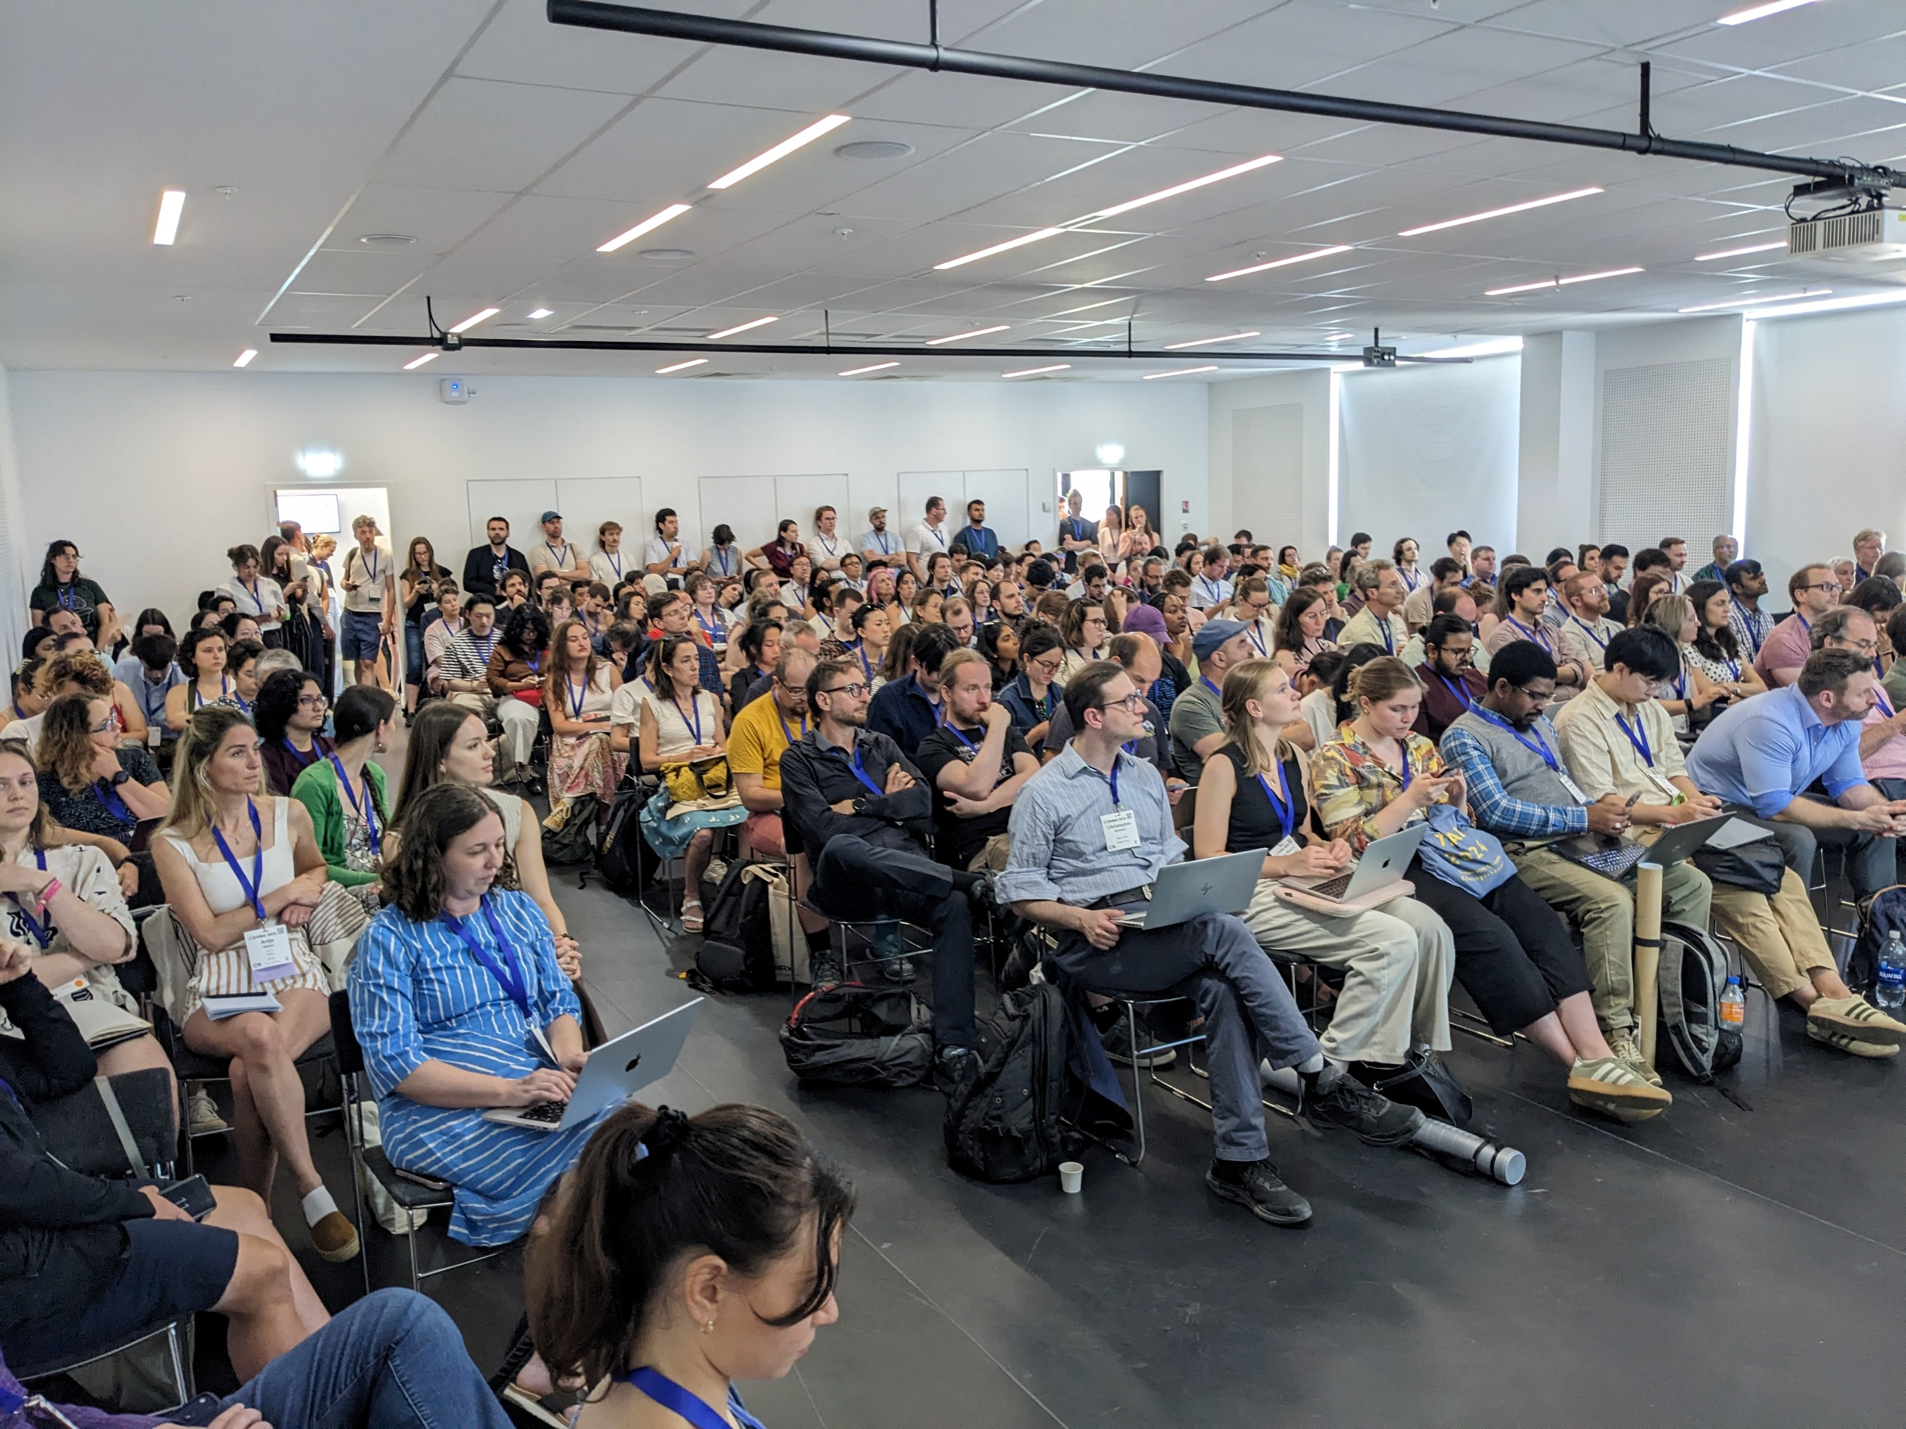
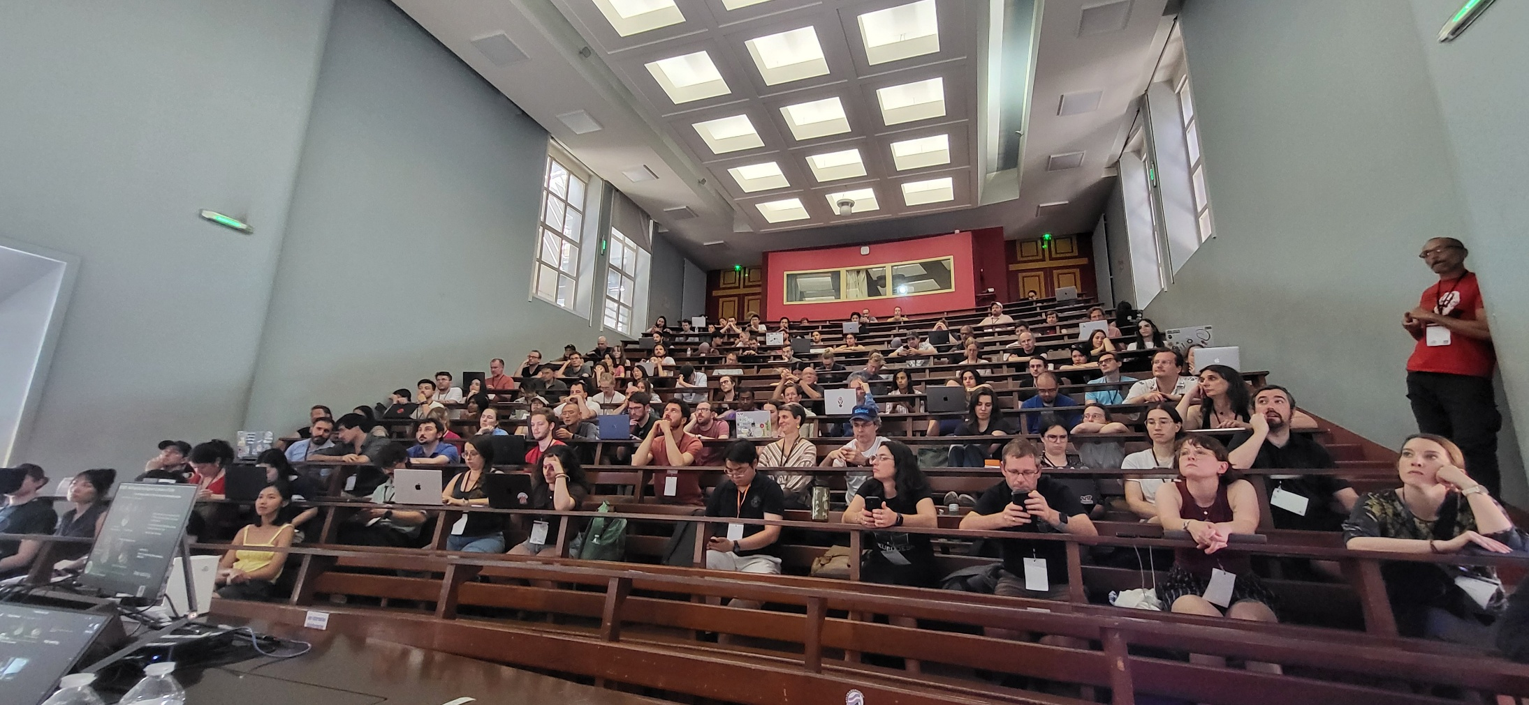
Feedback from
Notes:
Since 1995 in Paris
In roughly ten years, we’ve gone from an organization that only runs an annual meeting, to a Society with 6 Regional Chapters and 5 Special Interest Groups (SIGs) and events throughout the year.
Awards: Glass Brain, open science, Replication study, Early Career Investigator , Diversity & Inclusivity Champion, Education in Neuroimaging, Karl Zilles, Mentor, merit abstract, Sustainability
France: Daniel Marguiles, Early Career Investigator / Stephanie Forkel Education in Neuroimaging / article de Marion Leboyer, Edouard Duchesnay, Pierrick Coupé, Replication study

Slide 5



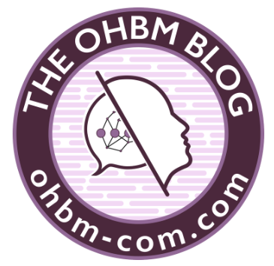
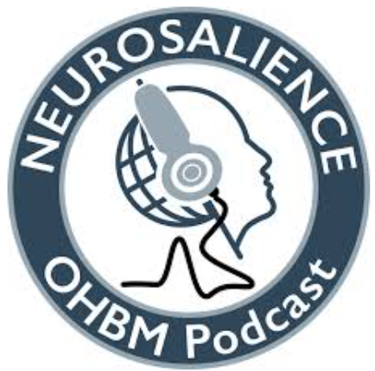

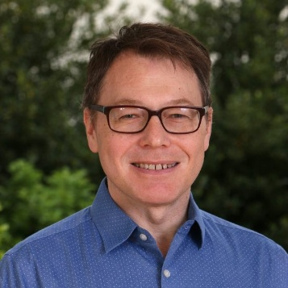
Feedback from
OHBM YouTube channel
2026 videos soming soon
OHBM Abtract book & Atlas
OHBM awards (10)
Special Interest Groups - SIG
1. Brain Art SIG
2. Open Science SIG - OSSIG
3. Sustainability and Environment Action SIG
4. Students and Post-Doc SIG
5. Women Faculty SIG
OHBM BrainHack (part of OSSIG)
Best practices committee
The official open access journal of OHBM for methodological, educational, and community-driven contributions, including non-traditional research outputs such as code, dataset & protocol descriptions, tutorials, and replication studies.
Interviews of well-known neuroscientists
Brain Bites are written for a non-specialist audience.
OHBM 2027 Toronto, Canada
OHBM 2028 Yokohama, Japan
OHBM 2029 Rotterdam, The Netherlands
The OHBM Communications Committee’s is looking for new members – students, post-docs, faculty- for 2026-2027:
Click here to apply. Nominations close September 29, 2026.
Thomas Nichols, New OHBM Council Chair
Notes:
Since 1995 in Paris
In roughly ten years, we’ve gone from an organization that only runs an annual meeting, to a Society with 6 Regional Chapters and 5 Special Interest Groups (SIGs) and events throughout the year.
Awards: Glass Brain, open science, Replication study, Early Career Investigator , Diversity & Inclusivity Champion, Education in Neuroimaging, Karl Zilles, Mentor, merit abstract, Sustainability
France: Daniel Marguiles, Early Career Investigator / Stephanie Forkel Education in Neuroimaging / article de Marion Leboyer, Edouard Duchesnay, Pierrick Coupé, Replication study

Slide 6

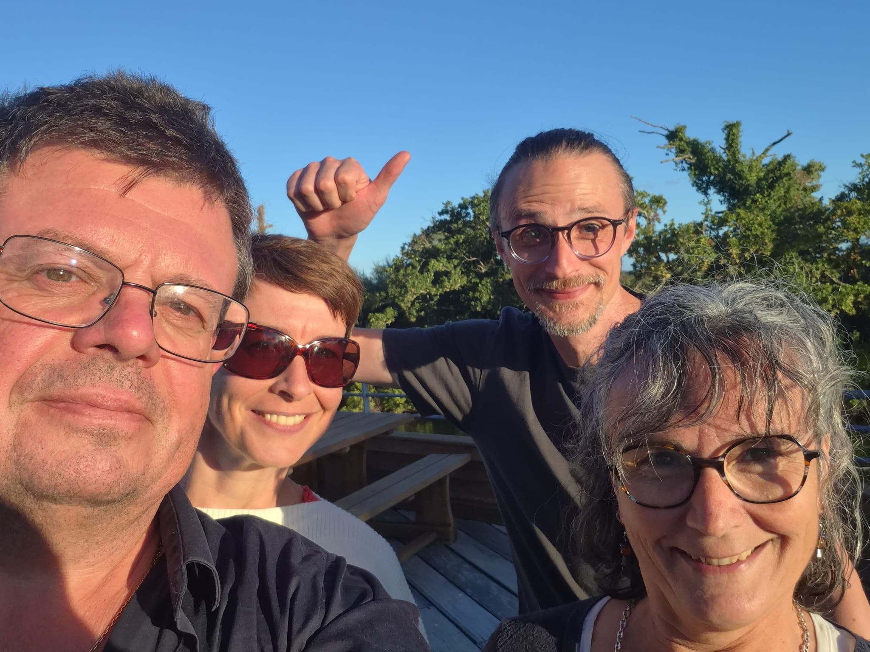
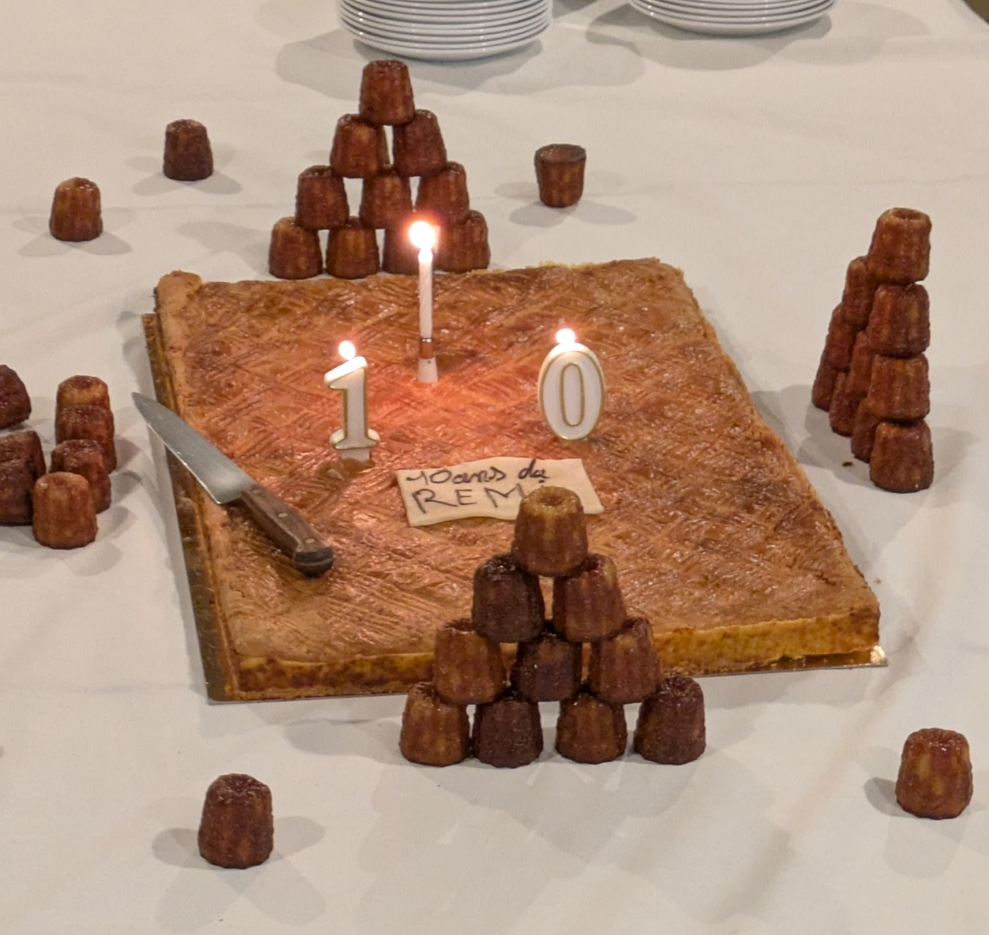
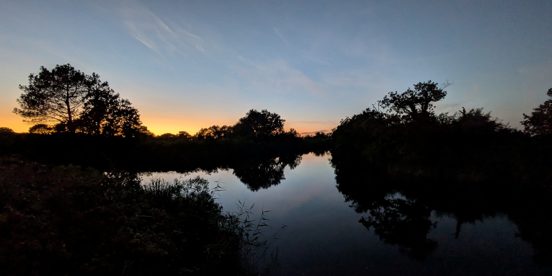
Reflections on REMI's network 10th anniversary

Slide 7
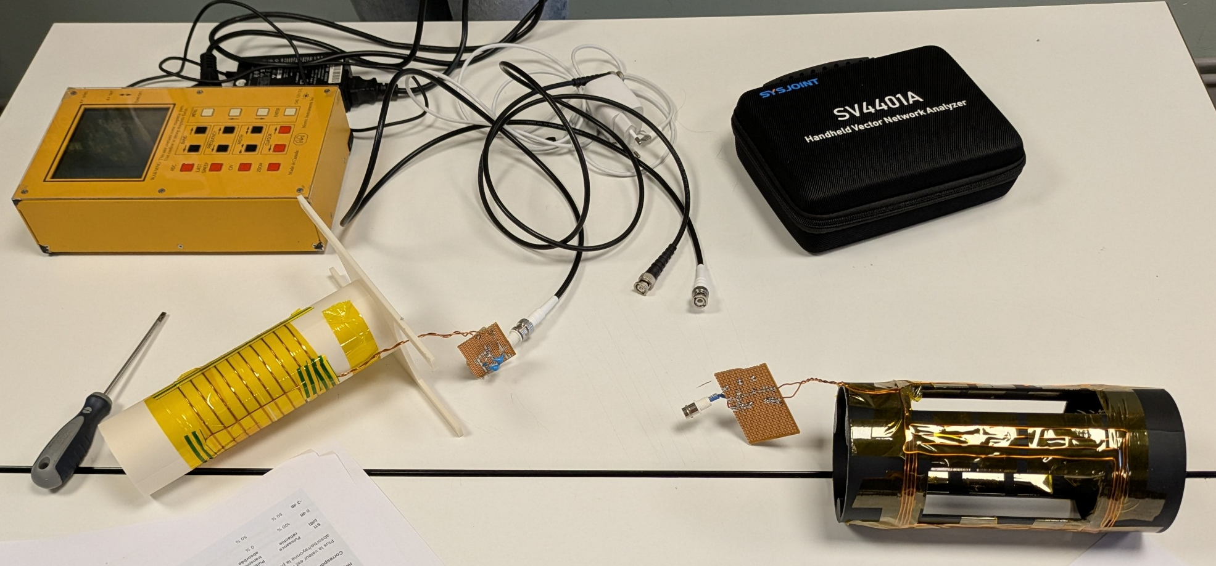
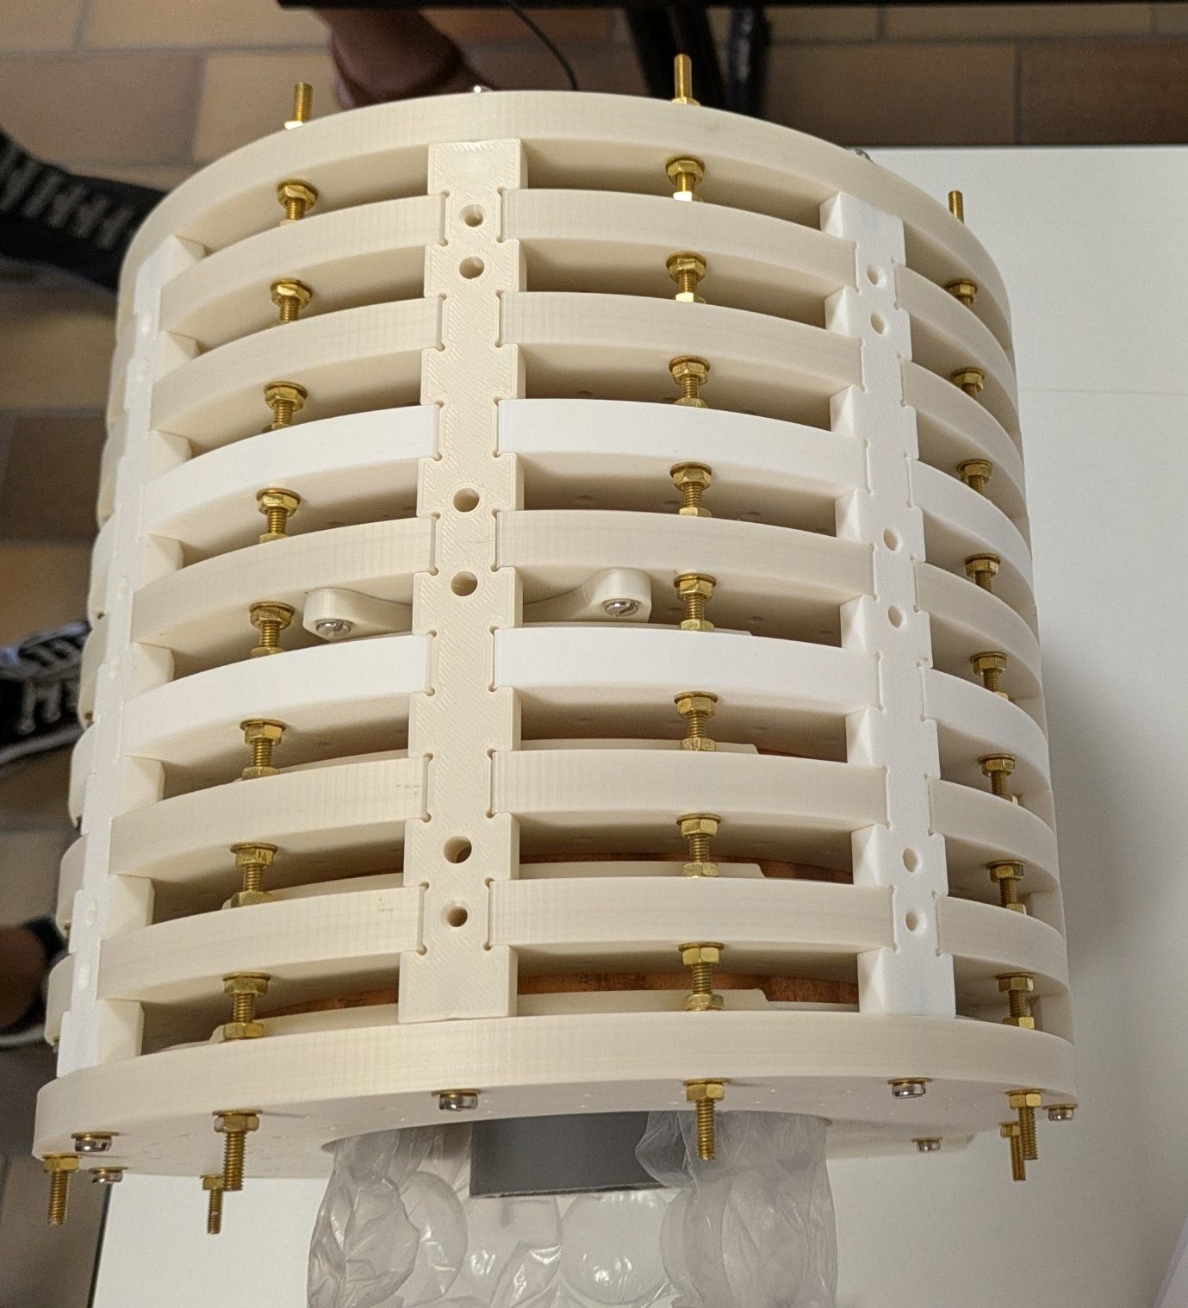
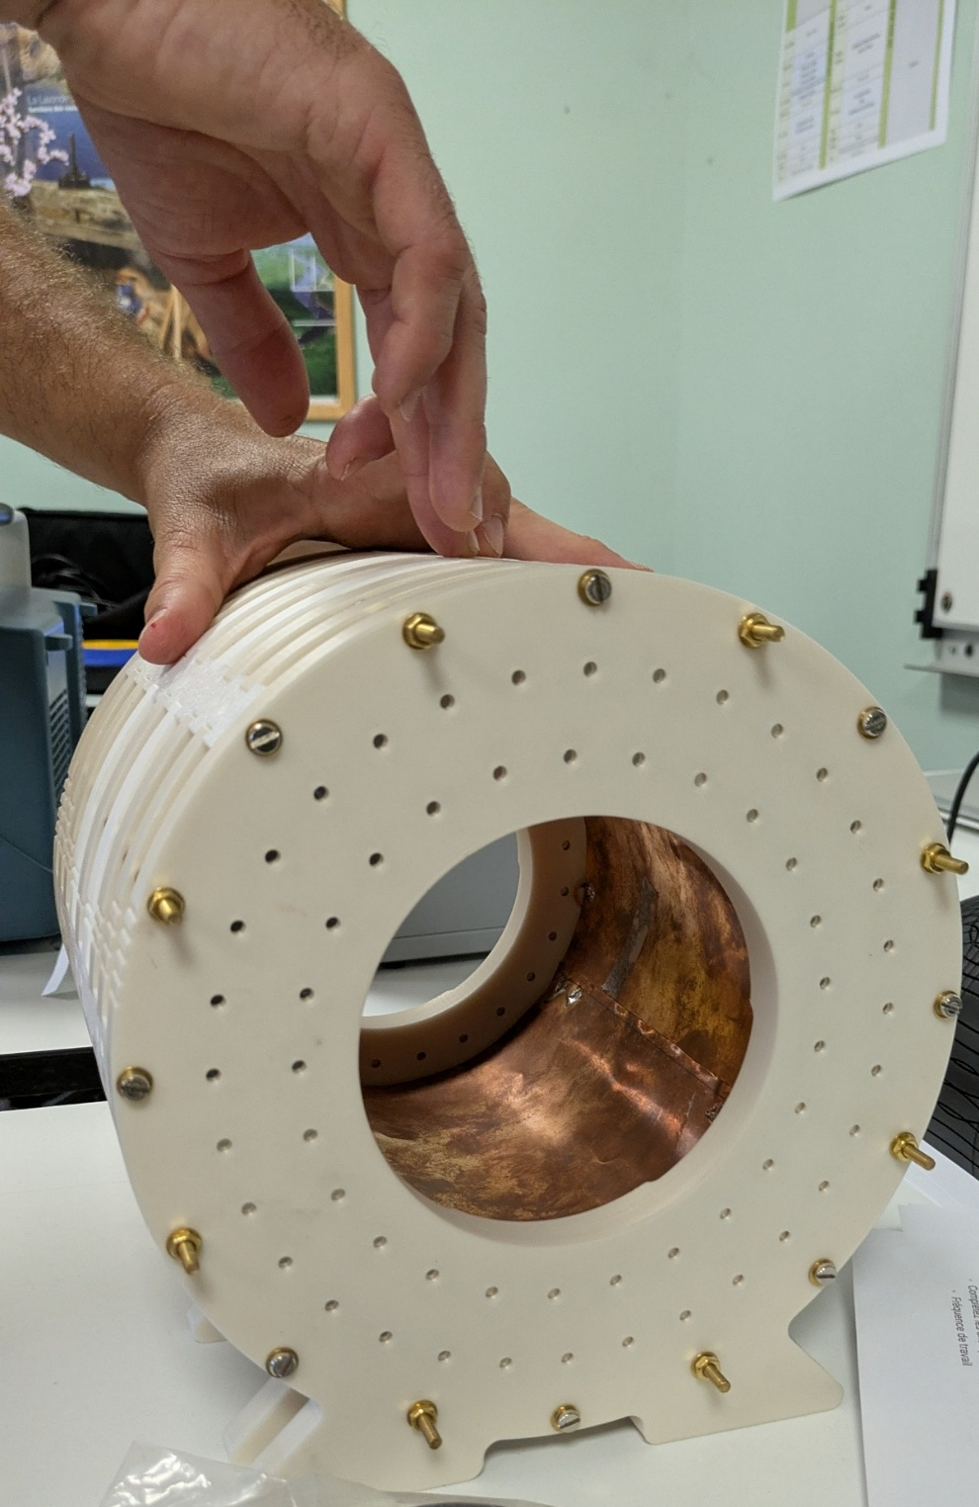
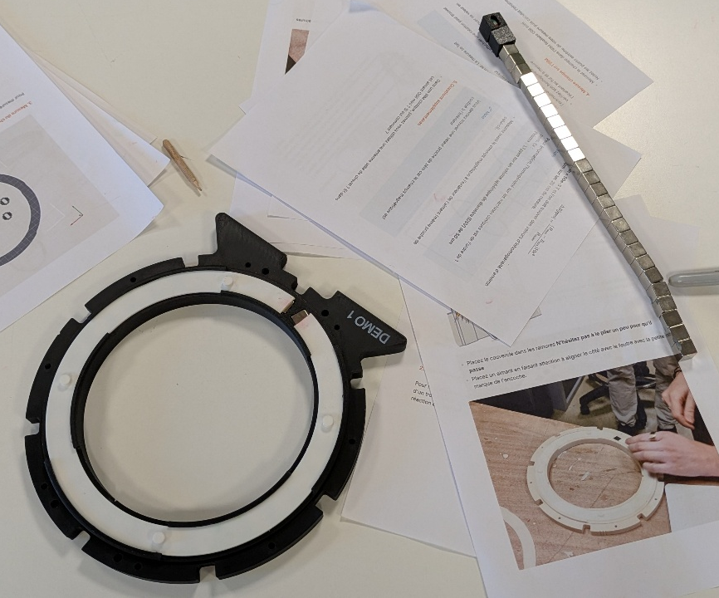
Reflections on REMI's network 10th anniversary
Low field MRI scanner (50 mT) by the Centre de Résonance Magnétique des Systèmes Biologiques – CRMSB – (Bordeaux)

Slide 8
Reflections on REMI's network 10th anniversary
Livre Blanc « UTILISATION SECONDAIRE DES DONNÉES D’IMAGERIE À DES FINS DE RECHERCHE», publié conjointement par le Collège des Enseignants en Radiologie de France (CERF), la Société Française de Radiologie (SFR) et France Life Imaging (FLI).
4 WG:
fMRI
DWI
2nd level tatistics
(Plateform management)

Slide 9
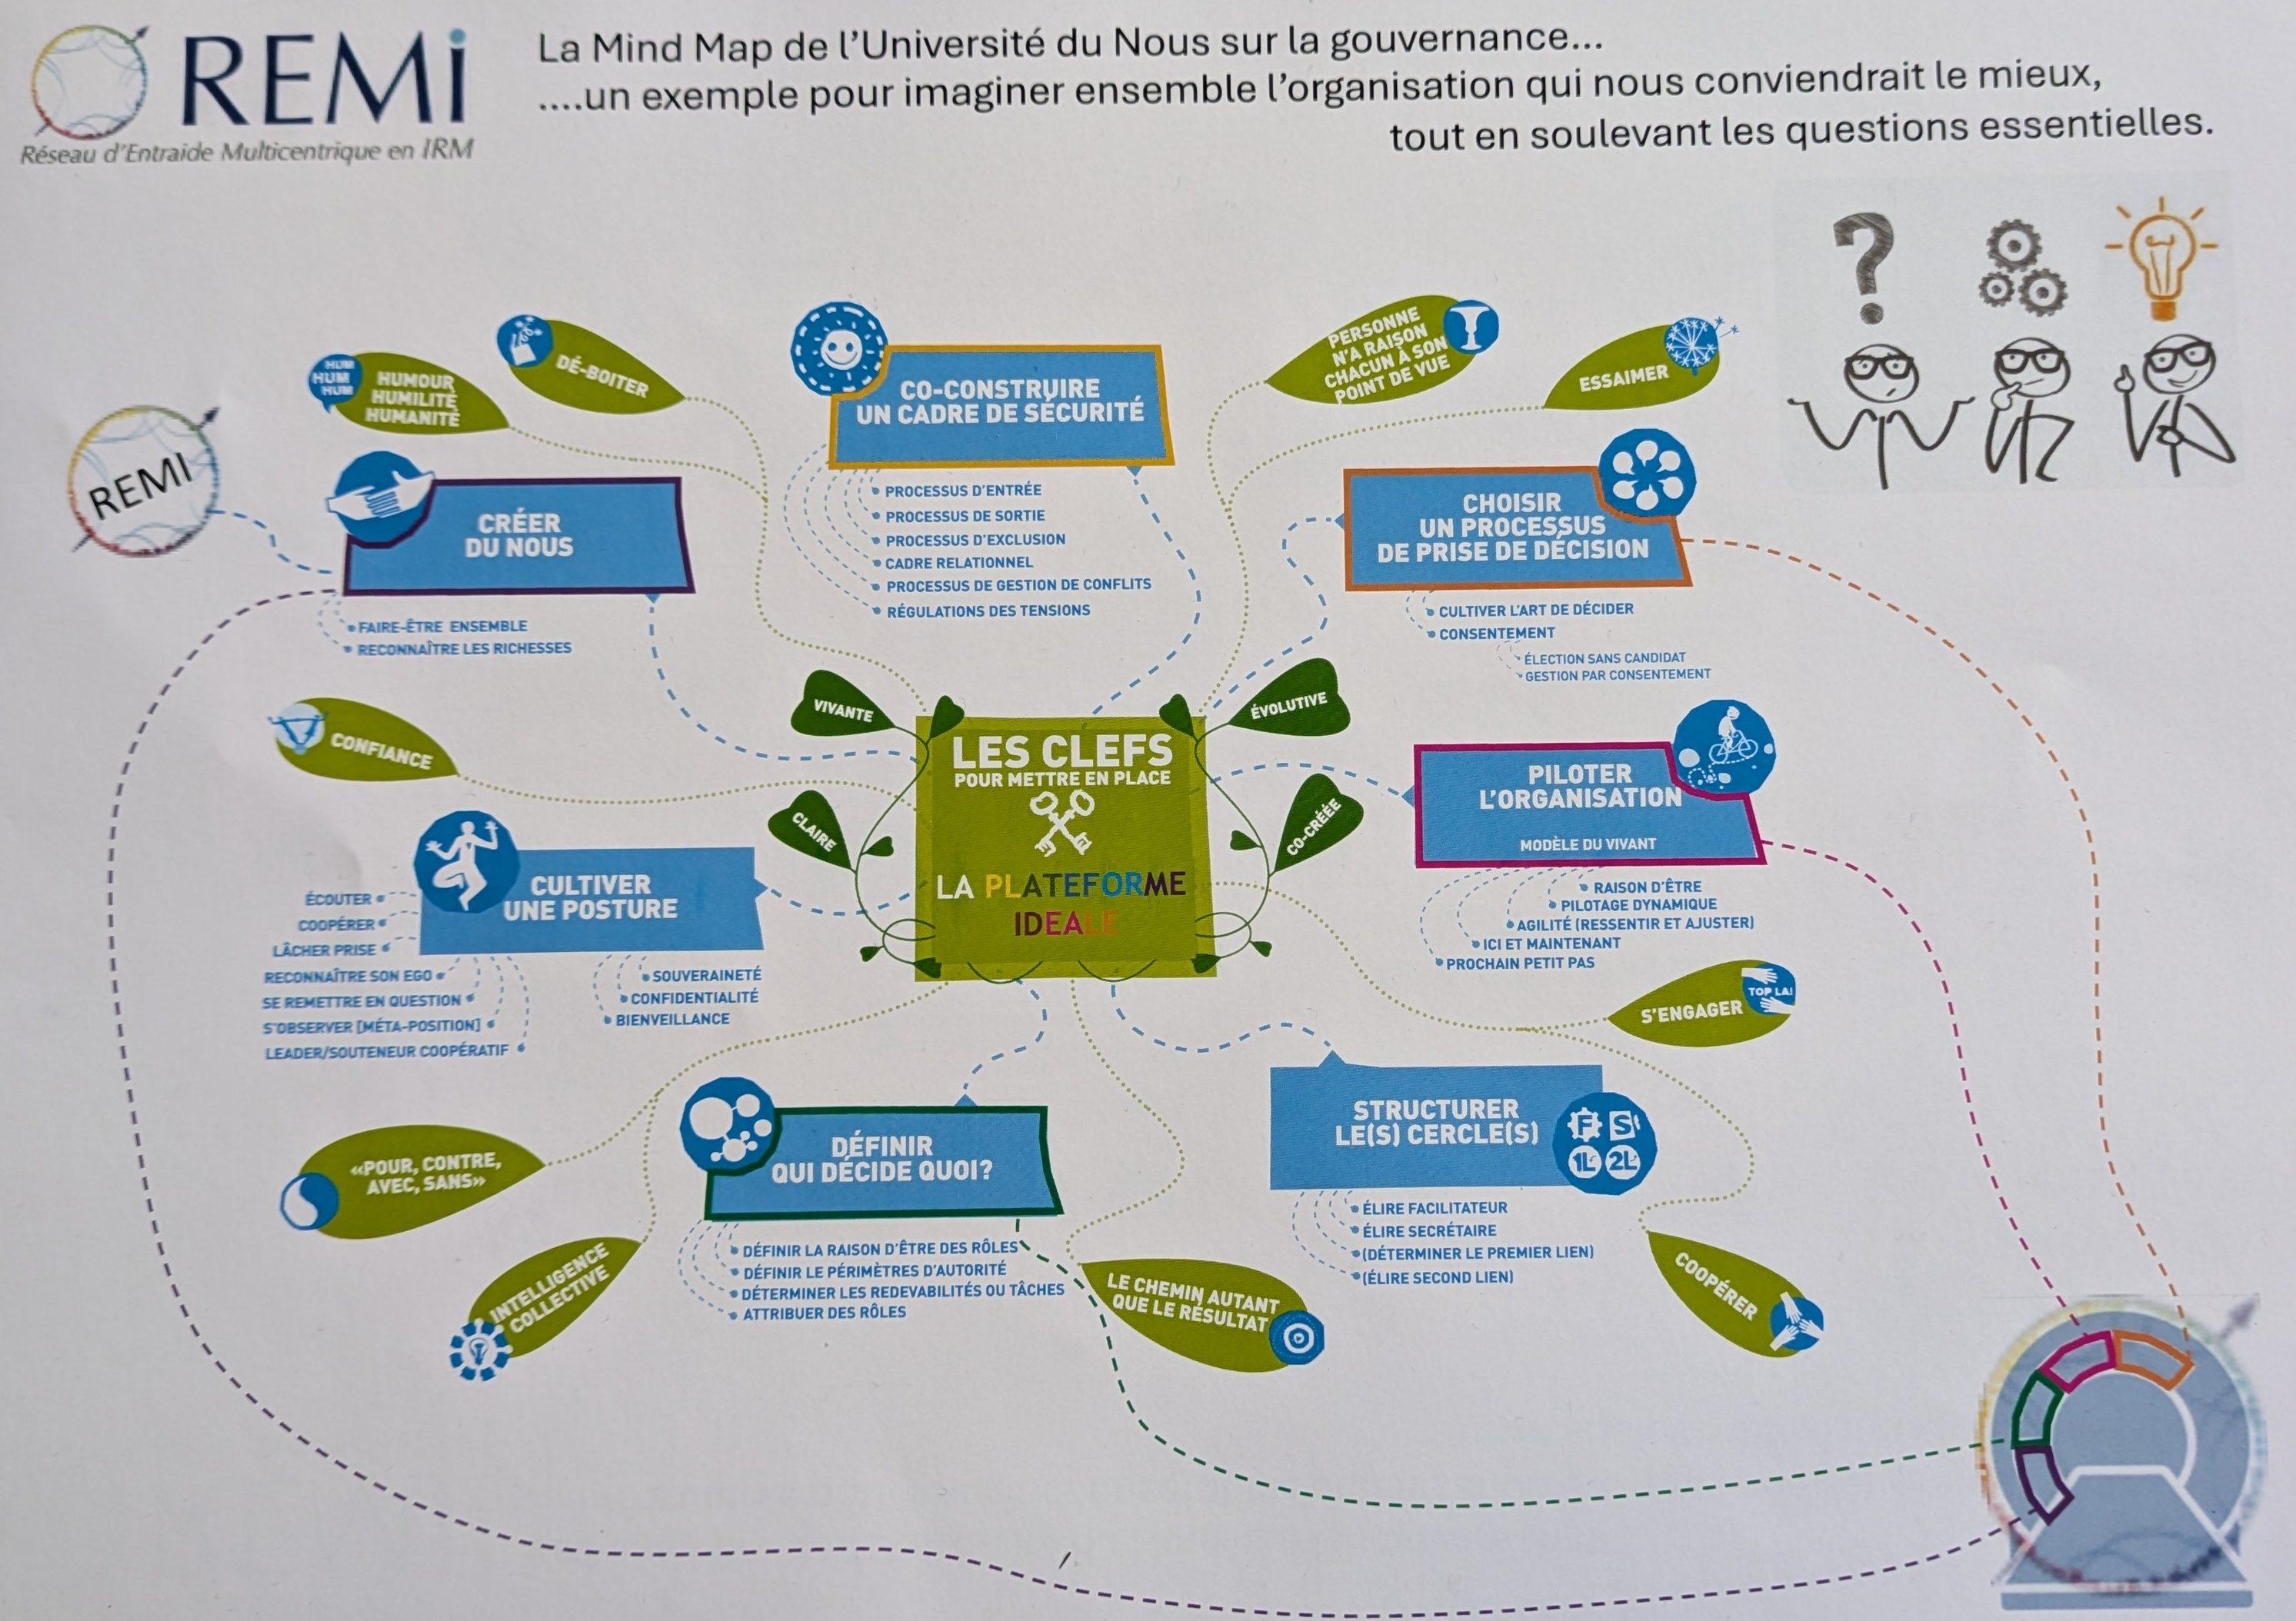
Reflections on REMI's network 10th anniversary

Slide 10
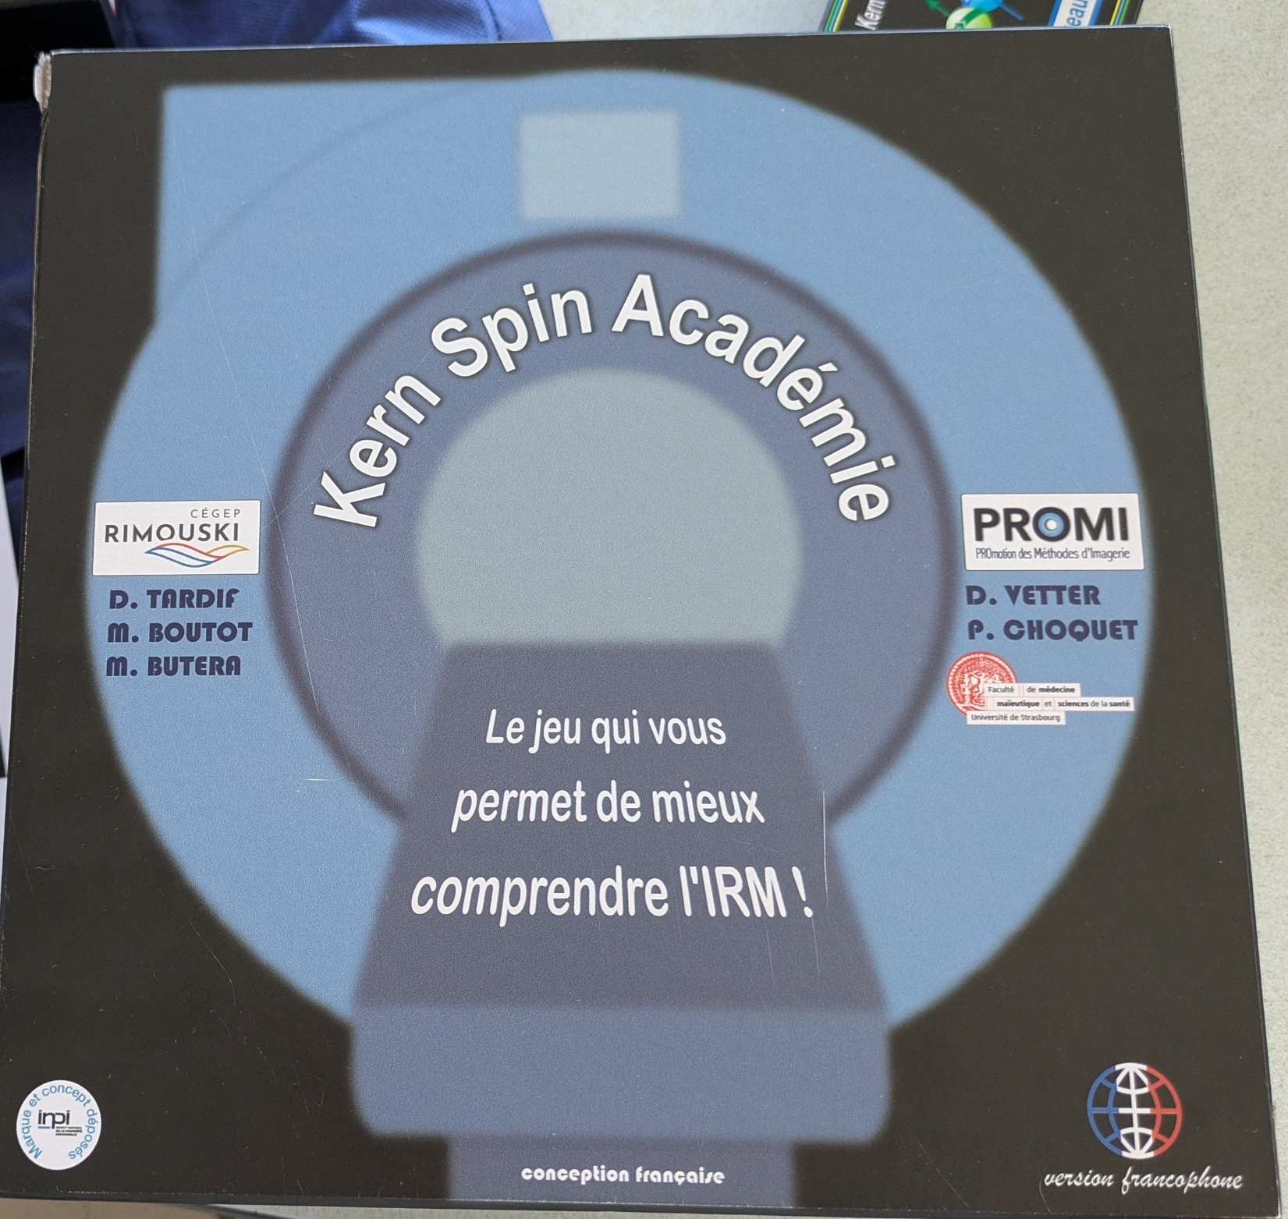
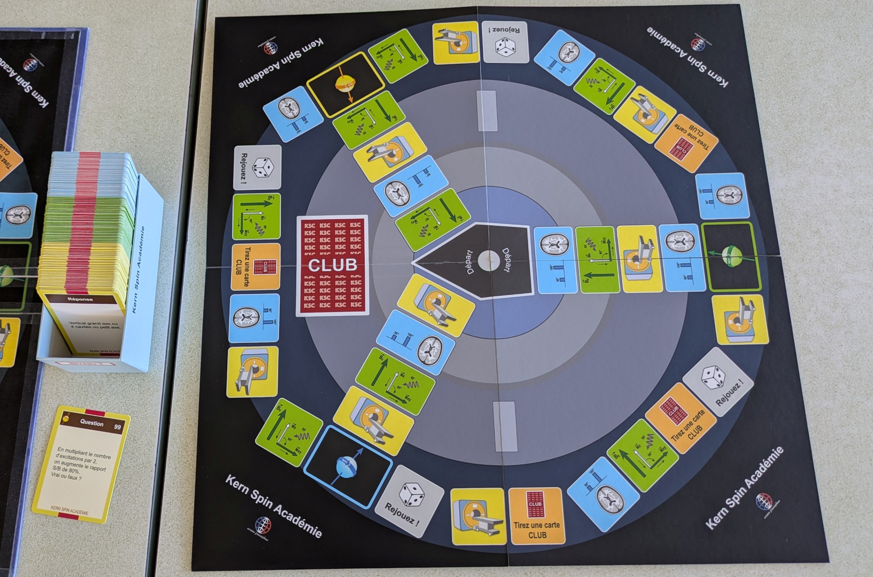

Slide 11
A new website for the NeuroImaging club
- https://project.crnl.fr/page/ mais drupal9 n'est pas à jour (et ne sera plus maintenu bientôt) + solution peu aimée des informaticiens du CRNL car failles de sécurité potentielles (quid de la mise à jour de Drupal...)
- un site cnrs mais c'est limité à 2 Go et on a déjà plus de 3 Go de fichiers en téléchargements
- inserm : pas de proposition "gratuite"
- https://grist.numerique.gouv.fr/o/docs/ ou d'autres via le CNRS mais c'est uniquement avec identification individuelle via Renater donc pas ouvert sur le web
Zenodo : community
Notion
Très flexible : pages wiki, bases de données, upload de fichiers, calendrier intégré (vue "Calendar" sur une base de données)
Interface simple, bon pour petites équipes
Gratuit pour usage basique, payant pour plus de fonctionnalités/stockage
Nextcloud
Solution auto-hébergée (intéressant si l'université a déjà une instance) : module Collectif/Wiki + Files pour les documents + Calendar intégré
Contrôle total des données, souvent déjà proposé par les services informatiques universitaires
GitHub/GitLab : au CRNL ou online
Google Sites + Google Drive (gratuit avec un compte Google/Workspace)
Google Sites pour le wiki, Drive pour héberger les ppt/docs
Simple mais moins riche qu'un vrai wiki collaboratif
Wiki.js (auto-hébergé)
Solution open-source complète, mais nécessite un serveur pour l'héberger
Pour un groupe de travail universitaire, je vérifierais d'abord si l'UJM a une instance Nextcloud institutionnelle — sinon, Notion est probablement le meilleur compromis simplicité/fonctionnalités pour démarrer rapidement sans rien héberger.

Slide 12
A new website for the NeuroImaging club
Platform | Cost for us | Accessibility for readers | Regulation | Server location | Size limit | Comments
OSF | 0 | web | USA | Germany | - | Easy to use
Wiki du CRNL | 0 | Ldap | FR | CRNL | - | Not public on the web
Projets du CRNL | 0 | Web | FR | CRNL | - | Outdated version of the soft, soon not even maintained
GitLab du CRNL | 0 | Ldap | FR | CRNL | - | Not public on the web
Site web CNRS | 0 | Web | USA | USA | 2 Go | 3,2 Go in 7 years on OSF
NextCloud (sDRIVE au CNRS, etc.) | 0 | Renater | FR | FR | Variable
Grist | 0 | Renater | FR | FR
Zenodo | 0 | Web | EU | Switzerland | 2 Go | No agenda/text on the page
GitHub | 0 | Web | USA
Notion
GoogleSite | 0 |  | USA

Slide 13
Resources to share
Elements of fMRI analysis by Tor Wager

Slide 14
Latest news about the 7T scanner in Lyon

Slide 15
Next meetings
66) 16 Oct. 2026: Céline Provins, MRIQC & Defacing, Switzerland
67) 27 Nov. 2026: Hélène Ratiney, Creatis Lab
68) 18 Dec. 2026
69) 22 Jan. 2027: special meeting for new students & new colleagues @CRNL
70) 12 Feb. 2027
71) 26 March 2027
72) 30 April 2027
73) 28 May 2027
74) 25 June 2027

