Slide 1
ch9

Slide 2

box_shadow

Slide 3

Z-index

Slide 4

overflow-auto

Slide 5

Padding

Slide 6


float
float: left
Float:none

Slide 7
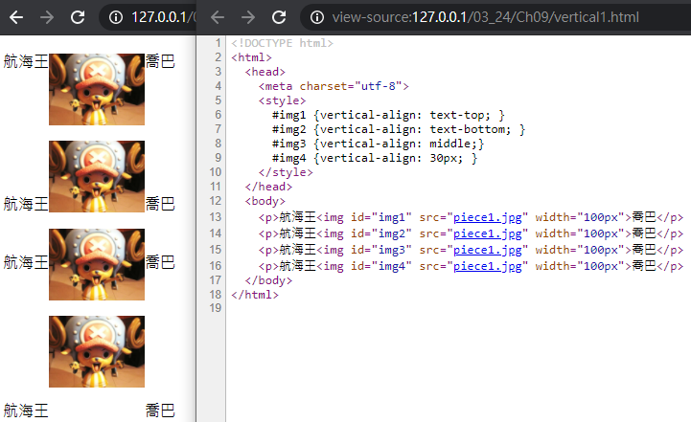
Vertical-align

Slide 8
Ch10

Slide 9
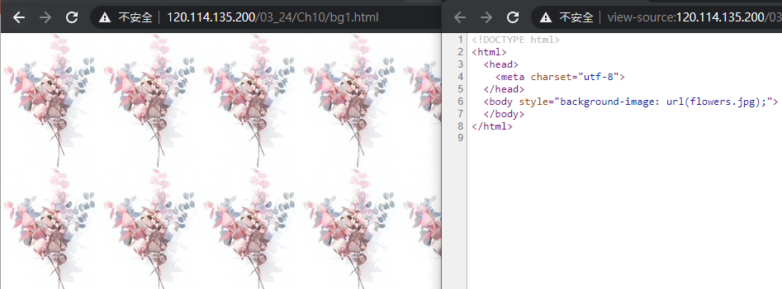
Background1(img.jpg)

Slide 10

Background2(img.png)

Slide 11

Background3(img.gif)

Slide 12
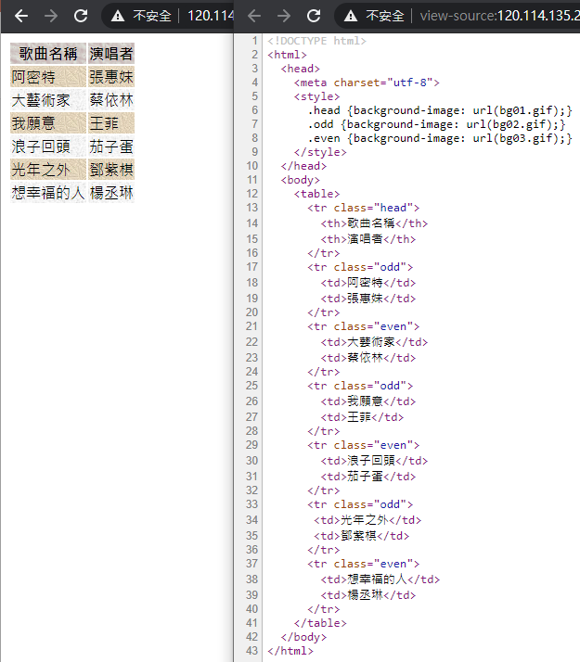
Background4(img.gif)

Slide 13
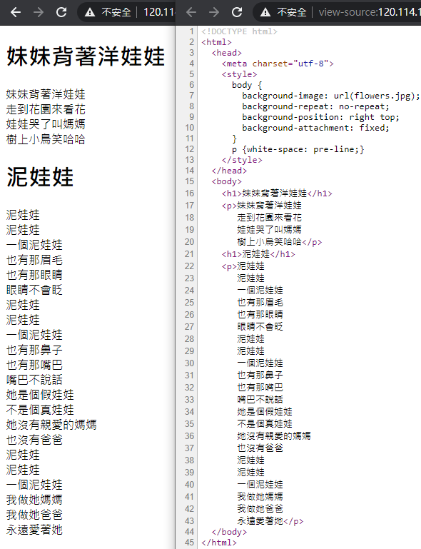
Background-type

