Slide 1

Connections workshop Research Software Engineers/ Research Data Scientists
September 2022

Slide 2
Welcome!
2 day workshop to explore what it is like to work as a Research Software Engineer or Research Data Scientist.
Mixture of talks and hands-on sessions, to get an idea of variety of projects we do, and the type of work involved.
Meet and chat to several people from the Turing Research Engineering Group.

Slide 3
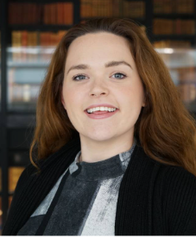
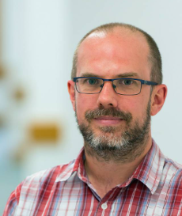
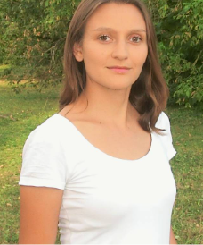
Who are we?
Harriet McCann
Academic Programmes Manager
Nick Barlow
Research Software Engineer
Pam Wochner
Research Data Scientist
Plus several members of Turing REG and the SciVision research team

Slide 4
Overview of the next 2 days: today
Lightning talks – short summaries of a few projects that Turing REG have worked on.
Networking – chat with lightning talk presenters.
Introduction to the SciVision project.
Scoping/setup for hands-on activity – using, and contributing to, the SciVision project.

Slide 5
Overview of the next 2 days: tomorrow
Talk and Discussion about Research Engineering.
Hands-on activity – using, and contributing to, the SciVision project.
Wrap-up.

