Slide 1

Connections workshop RSE/RDS Scoping and organizing a project
September 2022

Slide 2
Project Scoping
A RSE / RDS project begins with an initial question or problem.This can originate from (for example):
These initial questions are often vague – to move to a well-defined project scope we need to engage with stakeholders.
A domain expert who observes some issue in their day-to-day work and questions how to address it.
A formal or informal discussion between various members of a team or unit that leads to an idea
An external client with a specific request.
The availability of a new dataset in a specific research domain.

Slide 3
Talking to Stakeholders
Requires open dialogue, often across different communities, with diverse areas of expertise and academic cultures.
Build a welcoming and respectful environment, and document all discussions and decisions.
Agree (and document) what needs to be delivered and how.

Slide 4
Questions to ask/consider during scoping
What is the problem we are trying to solve?
What is the specific research question? How does it translate to a data science / software engineering problem?
Domain experts may not have a good grasp of their area, but may not have good grasp of data science methods and computing.
Conversely, we will likely be strangers to the domain area, lacking understanding of how the field operates, how data are generated etc.

Slide 5
Questions to ask/consider during scoping
Is data available and appropriate?
What are stakeholders’ expectations?
What does the output product look like, and how will it be used?
What is in-scope and out-of-scope?
How do we measure success?
What resources are available?
Ethical considerations.

Slide 6
Project scoping
For more details, and in-depth exploration of project scoping, please consider our Research Data Science course, which will be held again next February!
https://alan-turing-institute.github.io/rds-course/index.html

Slide 7
Project organisation
In our team, we mainly use Github for organizing our work on projects (in addition to using it for version control).
In particular, we use Issues to identify and describe specific tasks, and Projects to organize these in “Kanban boards”.

Slide 8
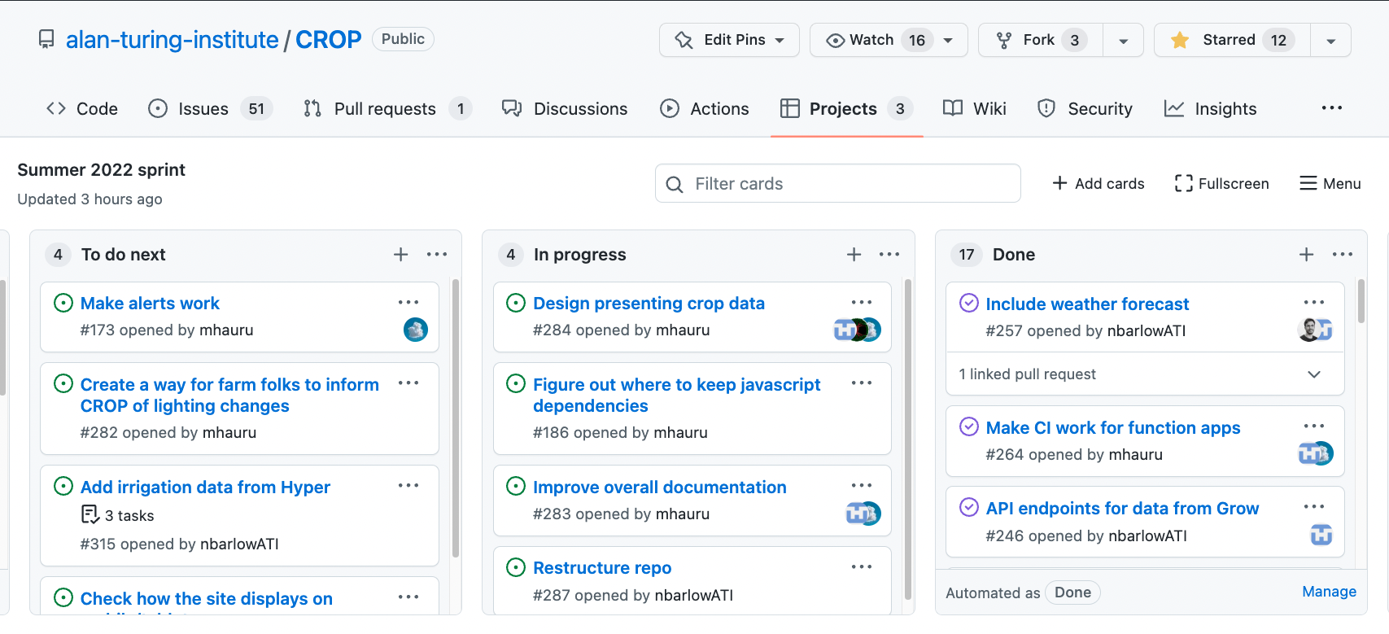
Kanban board on Github (classic) Project

Slide 9
More Github: Forking and Pull Requests
To contribute to a project where you don’t have “write” access to the repository, the usual method is:
Fork the repo (i.e. make a copy of the repo, which is now associated to your Github account).
Clone this forked repo to your local machine
Make your changes, commit, and push back to your forked repo.
Submit a Pull Request from your forked repo back to the original one.

Slide 10
Other working practices
Code review: when we are working on a project together, we will review each others Pull Requests.
Co-working: even when working remotely, some people would choose to be on a zoom call with colleagues, to foster a sense of camaraderie.
Pair programming: we sometimes work together on one computer, with one person typing and the other making suggestions and spotting typos.

Slide 11
Please talk to any of the helpers if you’d like more details on any of this!
And remember, our team offers courses on Research Software Engineering (start of November this year) and Research Data Science (February next year) – ask for more details if you’re interested!

