Slide 1
PLASMA ARC TECHNOLOGY IN WASTE DISPOSAL
GUIDED BY: PRESENTED BY:
AKHIL .B. NAIR AJIN RAJ.P.R
LECTURER OF CIVIL DEPARTMENT REG NO:2101010010

Slide 2
CONTENT
INTRODUCTION
COMPONENTS OF PLASMA GASIFICATION SYSTEM
WORKING
INCINERATION VS PLASMA GASIFICATION
ADVANTAGES
DISADVANTAGES
CASE STUDY
CONCLUSION
REFERENCES

Slide 3
INTRODUCTION
The increasing industrialization, urbanization and changes in pattern of life give rise to generation of increasing quantities of wastes.
This increase threats to the environment

Slide 4
4 Ways of disposal of waste
COMPOSTING
Composting is one of the oldest methods
Decomposition of organic waste material by bacteria,and other organisms under aerobic conditions.
Demerit – very slow process

Slide 5
Ways of disposal of waste
LAND FILLING
•Cheapest and easiest method
•Low level areas are target areas of dumping solid waste thus levelling the ground for useful purpose.
•This method suffers from the disadvantage of releasing poisonous gases like methane causing deterioration of environment.
Notes:
Edit Master text styles
Second level
Third level
Fourth level
Fifth level

Slide 6
Ways of disposal of waste
INCINERATION
It is a waste treatment process that involves the combustion of organic substances contained in waste materials.
It converts the waste into ash, flue gas, and heat.
The ash is formed by the inorganic constituents of the waste, and may take the form of solid lumps or particulates carried by the flue gas.
The flue gases must be cleaned of gaseous and particulate pollutants before dispersed into the atmosphere.

Slide 7
Ways of disposal of waste
Plasma gasification
Extreme thermal process using plasma converts organic matter into syngas.
A plasma torch ionize gas and catalyze organic matter into syngas, with slag as a byproduct.
Used as a form of waste treatment and has been tested for the gasification of refuse-derived fuel, biomass,industrial waste,hazardous waste, and solid hydrocarbons

Slide 8
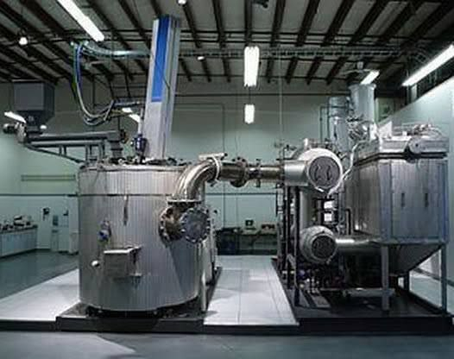
8 FIGURE OF PLASMA GASIFICATION PLANT
(Source:researchgate)

Slide 9
COMPONENTS OF PLASMA GASIFICATION SYSTEM
The essential components of a plasma gasification plant are:
TRITURATION AND CONVEYOR SECTION
PLASMA TORCH
PYROLYSIS CHAMBER
GAS REFORMER AND HEAT EXCHANGER
GAS CLEANUP FILTER

Slide 10
TRITURATION AND CONVEYOR SECTION
Consists of a grinder for breaking the trash into manageable size
PLASMA TORCHES
Convert organic material into syngas with hydrogen and carbon monoxide content through an extreme thermal process.

Slide 11
PYROLYSIS CHAMBER
It is an air-locked chamber with one or more plasma torches.
It allows the garbage in but prevents hot gases from escaping in to the atmosphere.
The chamber is lined with heat-resistant refractory material.
Towards the bottom side of the chamber is drainage system for slag.
It also incorporates a water-cooling system.
Towards the top of the chamber is the exit vent for the gases

Slide 12
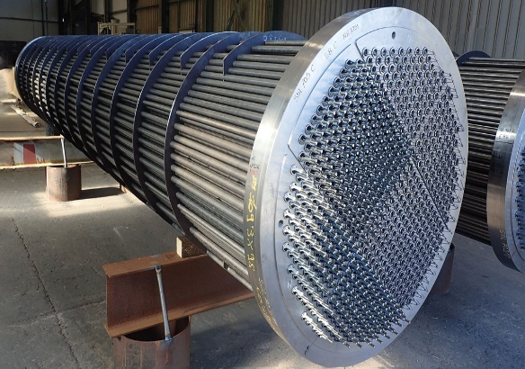
GAS REFORMER AND HEAT EXCHANGER
•Reforms hydrocarbon fuel into a reformate gas
such as hydrogen-rich gas known as syngas.
•Heat ex-changer, the hot gases heat water to
produce steam turbine generator to produce electricity.
(Source:researchgate

Slide 13
GAS CLEANUP FILTER
.
As the gases produced by pyrolysis mainly comprise carbon monoxide, hydrogen and hydrocarbons and carbon dioxide and nitrogen
The next step is to ‘clean’ the syngas or producer gas. It is done using gas cleanup filter.
The gas is burned in internal combustion engine generator turbines to produce electricity.

Slide 14
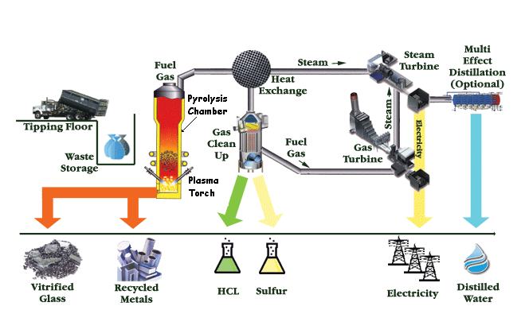
WORKING
process of plasma gasification plant

Slide 15
WORKING
The crushed waste is fed in to the pyrolysis chamber from the top where one or more plasma torches are installed in the chamber.
Hot air is injected to chamber heating a bed of coke and limestone
Hot gases break down the fuel to produce syngas
Remaining inorganic components are converted into slag and cooled into a glass like product
The syngas exit the top of chamber and enters a heat recovery unit
Cooled syngas move to cleanup filter,separate particular matter from syngas

Slide 16
WORKING
Then moves to gas turbine,spins the generator to produce electricity.
Exhaust heat from gas turbine is then used to create steam in the heat recovery steam generator.
This steam drive steam turbine which spins another generator to create additional clean energy through an efficient combined cycle process.

Slide 17
INCINERATION VS PLASMA GASIFICATION
Plasma gasification | incineration
In absence of oxygen | Presence of oxygen,complete combustion
Gases resulting from degradation of organics are collected and used for production of various forms of energy and/or industrial chemicals. | All potential energy converted to heat.
Products of degradation largely converted to inert (non-hazardous) glass-like slag of a volume 6% to 15% of the original solids volume. | Combustion results in ash (as much as 30% of original solids volume) that must often be treated as hazardous waste.
Emissions substantially lower than those resulting from incineration. | Far greater emissions of GHG and other pollutants than with thermal gasification systems.

Slide 18
ADVANTAGES
Less atmospheric pollution.
Non-Polluting and Environmentally Safe
Does not produce hazardous bottom ash and fly ash.
It takes very less time to dispose waste materials
The by-products of the process have varying applications.
less running cost.
The by-products of the process have varying applications

Slide 19
DISADVANTAGES
Plasma torches use a lot of electrical energy;
Waste needs to be shredded (size <100 mm) for better gasification;
Rate investment higher than other technologies results in a longer payback period.
The installation cost of the waste treatment plant is high
The electrodes used to produce the arc are consumed gradually during the waste melting cycle. They should be replaced regularly.

Slide 20
CASE STUDY
AL-EKAIDER LANDFILL
Al Ekaider landfill is located in the northern region of Jordan, near the main road to
Mafraq Governorate. It is part of the Irbid and Mafraq Governorates, located in the
boundaries of the Yarmouk Watershed with a Palestinian coordinate of 251° 22’ E and
216° 33’ N. This site was chosen because of its low population density, low land cost
and to minimize the leakage of contaminants into groundwater. Nowadays, the area
near the landfill has become more populated and the impacts of the landfill on the public health and the surrounding environment should be investigated

Slide 21
CONCLUSION
Plasma Gasification Process, is considered very profitable with zero waste .
The plasma gasification process has many merits
There are skepticism about the technology.
Willingness of government and people to change.

Slide 22
REFERENCES
[1] Bhasin, K. C.(2009),”Plasma Arc Gasification for Waste Management”, Electronics For You,41(1), 115-122
[2]Carpinlioglu,Meldaozdinc and Aytacsanlisoy (2018) “Performance assessment of plasma gasification for waste to energy conservation: A methodology for thermodynamic analysis”
[3] Nema, S.K. and Ganeshprasad, K.S.(2002), ”Plasma Pyrolysis of Medical Waste”, Current Science, 83(3), 271-278
[4] Mott MacDonald (2008), Review of Plasma Arc Technology, Surrey County Council, Surrey.

Slide 23
THANK YOU

