Slide 1
Openvino
Da Costa Tatiana, Cortés Julio, Fernandes Walter
63-51 Emerging Technologies
Part time – Spring 2026

Slide 2
Plan
What is Openvino?
Benchmark
ASR
SLM
Platform
Sof-IA as POC
Technologies
Data management
UI
Conclusions about Openvino
Notes:
What is Openvino? - Tatiana
Benchmark - Julio
ASR - Julio
SLM - Julio
Platform - Julio
Sof-IA as POC - Tatiana
Technologies - Walter
Data management - Tatiana
UI - Walter
Conclusions about Openvino - Walter

Slide 3
What is Openvino?
Open-source AI inference toolkit by Intel
Inference is the phase where a trained AI model is used to make predictions on new data.
Optimizes and deploys trained AI models
Runs efficiently on Intel hardware
Benefits: faster AI inference, lower latency, better hardware efficiency
Use cases: computer vision, speech recognition, etc.
Notes:
Training teaches the model, while inference is the model using what it learned to give answers quickly.

Slide 4
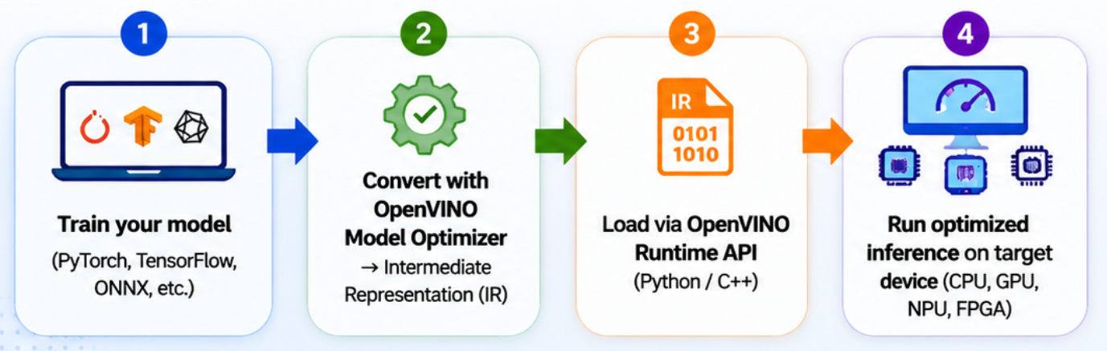
Openvino Workflow
Notes:
Step 1 — Train your model
First, the AI model is created and trained using frameworks like PyTorch or TensorFlow. (PyTorch (Meta) and TensorFlow (Google) are popular frameworks used to build and train AI models.) At this stage, the model has already learned how to recognize patterns or make predictions.
Step 2 — Convert with OpenVINO
Then, OpenVINO converts the trained model into an optimized format for fast inference called IR.
It mainly does 4 things:
Removes unnecessary operations
Combines layers to reduce computations
Optimizes memory and hardware usage
Converts the model into an efficient format for Intel devices
This step improves the model so it can run faster and more efficiently on Intel hardware.
Step 3 — Load the model
Next, the optimized model is loaded using the OpenVINO Runtime API. Loading is like putting the optimized model into memory and preparing the hardware so it is ready to make predictions.
During this step, OpenVINO:
reads the model files
allocates memory
prepares the CPU/GPU/NPU
initializes the inference engine
This allows applications to use the model for inference.
Step 4 — Run inference
Finally, the model runs on the target device such as a CPU, GPU, or NPU. The result is faster predictions with lower latency and better performance.
CPU General computing
GPU Parallel AI processing
NPU Dedicated AI acceleration
FPGA Custom hardware optimization

Slide 5
What we benchmarked
ASR: Whisper Medium
6
SLM: Phi-3 Mini
7
Does INT8 quantization on OpenVINO hurt accuracy? Can it transcribe in real time on CPU?
Can a Small Language Model generate clinical notes on CPU within acceptable latency?
Experiment: Apertus 8B
8
Benchmark Platform
9
Stretch test: does the pipeline scale to a larger 8B model with INT4 quantization?
FastAPI dashboard, A/B design and warm-up methodology behind all our numbers.

Slide 6

Whisper Medium: CPU Speed vs. Accuracy
Why Whisper Medium?
Multilingual (French clinical vocabulary), 99 languages, trained on 680K hours
Open-source, widely adopted, large community
Medium: sweet spot at ~769M params, best accuracy-to-speed ratio
Test conditions
LibriSpeech audio sample
Key results
WER: 0% on both backends, no accuracy loss from INT8 quantization
RTF: PyTorch ~9,807 ms vs OpenVINO INT8 ~6,023 ms (RTF ≈ 0.2)
→ 1.6× speedup, zero accuracy loss, OpenVINO INT8 is the right backend for ASR
Notes:
Benchmark – ASR : - Why Whisper? — multilingual (French clinical vocabulary), 99 languages, trained on 680K hours. Open-source, Vastly use and large community
- Why Medium? — the size tradeoff table (tiny → large-v3), Medium hits the sweet spot at ~769M params. –Y ADD RAM need??
- Test conditions — Intel i7 11th gen, LibriSpeech sample,
- The two metrics that matter for use:
- WER — accuracy. Both backends: 0% on this sample (identical transcripts). No quality loss from INT8.
- RTF — viability. PyTorch: need to calculate from ~9,807 ms latency. OpenVINO INT8: ~6,023 ms → if audio clip is ~30 s, RTF ≈ 0.2 (way below 1.0 = real-time viable).
- Result to land: 1.6× speedup, zero accuracy loss. OpenVINO INT8 is the right backend for ASR in this context..

Slide 7

Phi-3 Mini: Clinical Text Generation on CPU
Why Phi-3 Mini?
3.8B params, fits in 4 GB RAM after INT8 quantization
Trained on textbook-quality data, strong reasoning despite small size
SLM over LLM: CPU-only, no NVIDIA GPU, strict RAM budget
Test conditions
256-token output, 5 timed runs
Key results
PyTorch: ~363 ms/token (~6 min for 1,000 tokens)
OpenVINO INT8: ~111 ms/token, 3.3× faster
~100–200 token tasks: ~11–22 s on OpenVINO
Memory: OpenVINO pre-allocates ~4.3 GB at load
Notes:
- Why Phi-3 Mini? — 3.8B params, fits in 4 GB RAM after INT8. Trained on "textbook-quality" data → good reasoning despite small size.
- The SLM vs LLM framing — briefly explain why you chose small (CPU-only, no NVIDIA on ward PCs, RAM budget).
- Test conditions — same hardware, 256-token output, 5 timed runs.
- Key metrics:
- ms/token — PyTorch: ~363 ms/token (~6 min for 1000 tokens). OpenVINO INT8: ~111 ms/token → 3.3× faster.
- Total latency for a text manipulation ~100–200 tokens → ~11–22 s on OpenVINO. Acceptable.
- Load memory — OpenVINO pre-allocates at load (~4.3 GB); inference memory delta ≈ 0 MB (no surprise spikes).

Slide 8


Apertus 8B Test
Apertus 8B :
Benchmarked a larger 8B model to validate that the pipeline scales
Result: 5.4× speedup with INT4 quantization
Conclusion
3.3× speedup makes real-time note generation viable on CPU
Challenge | How we solved it
Apertus has no optimum-intel export support, the standard conversion pipeline doesn't know this model | Reused Mistral's model config as a compatible template to bootstrap the export
An internal attention layer uses an operation incompatible with model tracing | Replaced it with an equivalent operation that the tracer can handle
A custom activation function causes OpenVINO's model parser to crash | Switched to a low-level export path and added a small wrapper to handle key-value cache I/O
Notes:
- Apertus 8B as the stretch experiment — you benchmarked a larger 8B model (5.4× speedup, INT4). Shows the pipeline scales. Your colleague can pick this up in the OpenVINO POC slide since the export
was the novel engineering challenge.
- Result to land: 3.3× speedup makes real-time note generation viable. INT8 quantization = no observable quality difference on clinical prompts.

Slide 9
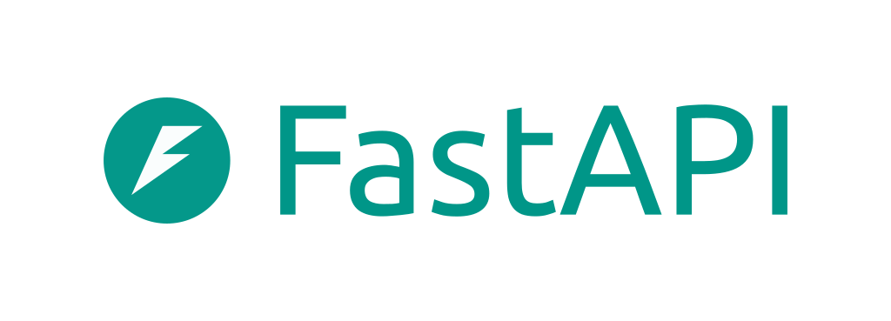

Benchmark Infrastructure
Hardware target
Intel i7 11th Gen, CPU only, reflecting real ward PC constraints
Benchmarking framework
FastAPI backend + web dashboard, reproducible, not one-off numbers
Clean A/B design: PyTorch CPU baseline vs OpenVINO INT8
Methodology
2 warm-up runs + 5 timed runs, eliminates JIT and memory paging bias
p95 tail latency reported, what users actually experience
Notes:
Benchmark – Platform (LIVE DEMO) Hardware target — Intel i7 11th gen CPU only. No GPU.
- The benchmarking framework you built — FastAPI backend with a web dashboard (BENCHMARK_HOWTO.md), not just CLI scripts. Show this is reproducible, not one-off numbers.
- Two backends compared — PyTorch CPU baseline vs OpenVINO INT8. Clean A/B design.
- Why p95 matters — clinical tools can't be "fast on average"; the tail latency is what nurses experience on a bad run.
- Warm-up runs — 2 warm-up + 5 timed. Explain why (JIT compilation, memory paging on first run skew results).

Slide 10

Sof-IA Nurse personal assistant
Real life project adapted for class
Goal: Automatically capture and structure nurses’ spoken notes during patient care in a hospital environment
Main features:
Real-time voice transcription
Automatic extractions of data
Works locally without cloud dependency
Notes:
Nurse speaks
↓
Speech transcription
↓
AI structuring
↓
Clinical cards generated automatically
Why it is a POC
Sof-IA demonstrates a real healthcare use case where:
low latency matters
privacy is critical
AI must run locally on hospital hardware

Slide 11
Why Openvino is relevant ?
Hospital constraints:
No dedicated GPU
No cloud allowed
Real-time processing needed
Openvino solution:
Runs efficiently on Intel CPUs
Fully local inference
Optimized low-latency inference
OpenVINO Advantages in Sof-IA
Faster inference with INT8 optimization
Reduced latency for live transcription
Lower hardware requirements
Efficient CPU usage
Models loaded once and kept in memory
Where is it used?
In the nurse pipeline:
Whisper (Openvino): transcribe audio to text
Phi-3 (Openvino): read text and extract data

Slide 12
Technologies Used
Frontend
React Native — cross-platform mobile app (iOS & Android)
Expo — build toolchain and native APIs
Backend
FastAPI (Python) — REST API and AI pipeline orchestration
AI Inference — powered by OpenVINO
Whisper Medium INT8 — speech-to-text transcription
Phi-3 Mini INT8 — clinical note structuring (SLM on CPU)
Data & Storage
Dexie.js + IndexedDB — local-first web storage
Expo SQLite — offline mobile storage
Notes:
What is Openvino? - Tatiana
Benchmark - Julio
ASR - Julio
SLM - Julio
Platform - Julio
Sof-IA as POC - Tatiana
Technologies - Walter
Data management - Tatiana
UI - Walter
Conclusions about Openvino - Walter

Slide 13
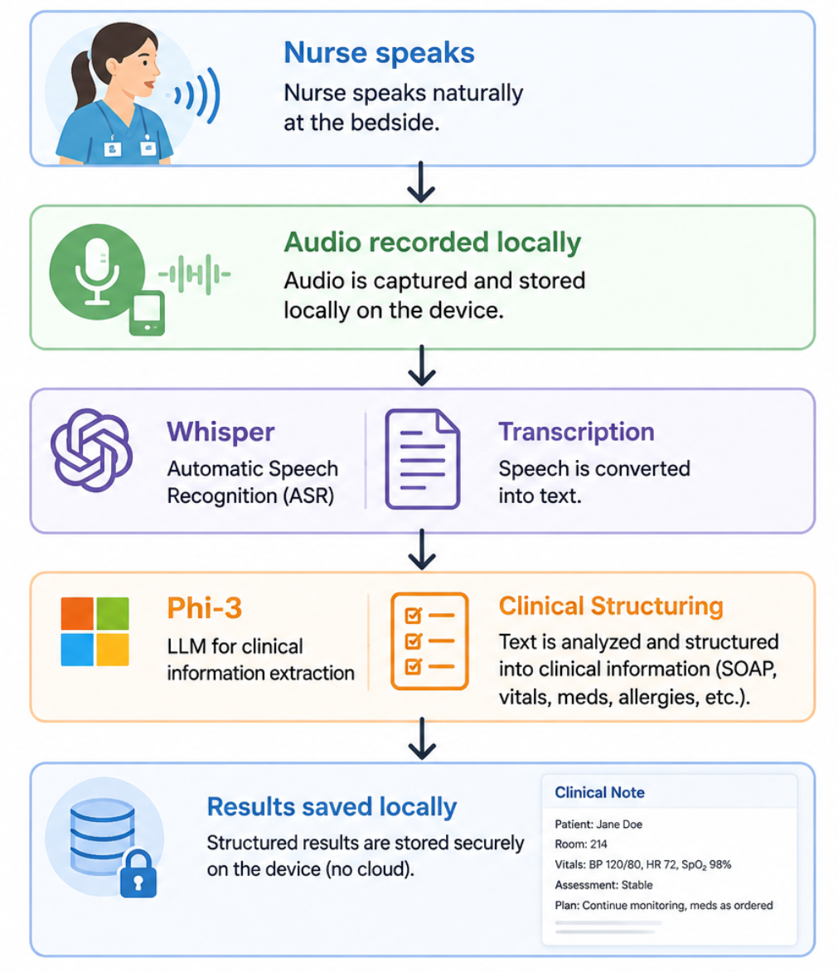
Data Management
Local-first architecture:
All patient data stays on the device
No cloud storage
Backend processes data without saving it
Offline support:
Works without stable internet
Audio chunks stored locally
Automatic retry when connection returns
Automatic cleanup:
Patient data deleted at end of shift
Audio and notes automatically expired
Privacy by design
Dexie.js + IndexedDB for web version
Expo-SQLite for moblie version
Notes:
Dexie.js + IndexedDB (Web)
IndexedDB is a database built into modern browsers
Stores large amounts of structured data locally
Works asynchronously (non-blocking)
Used to store:
sessions
patients
transcriptions
clinical notes
Dexie.js simplifies IndexedDB management
Provides:
cleaner queries
schema versioning
automatic migrations
Expo-SQLite (Mobile)
SQLite is a lightweight relational database
Database stored locally as a .db file on the device
Commonly used in Android and iOS applications
Expo-SQLite allows React Native apps to access SQLite
WAL mode enabled:
improves performance
reduces corruption risks
Safe SQL migrations with automatic rollback on failure
AsyncStorage
Simple key-value storage system
Equivalent of localStorage for mobile
Used only for lightweight preferences:
nurse name
audio settings
session recovery
No clinical or sensitive data stored there

Slide 14
UI
Nurse-facing mobile app built with React Native
One-tap voice recording during patient rounds
Live transcription streamed in real time (Whisper + OpenVINO)
Automatic extraction of clinical data (Phi-3 Mini + OpenVINO)
Structured output: temperature, medication, patient status
Fully local — no data leaves the device
→ Live demo
Notes:
Training teaches the model, while inference is the model using what it learned to give answers quickly.

Slide 15
Conclusions about Openvino
OpenVINO delivers real, measurable speedups on CPU
1.6× faster ASR (Whisper Medium) — zero accuracy loss (0% WER)
3.3× faster SLM inference (Phi-3 Mini) — viable for real-time use
5.4× speedup on Apertus 8B with INT4 — pipeline scales
INT8 quantization is safe
No accuracy regression detected — speed gains are free
Custom model integration is solvable
Requires manual export fixes, but well worth the effort
OpenVINO is the right choice for Sof-IA
Fully local inference on Intel CPUs — no GPU, no cloud required
Notes:
Training teaches the model, while inference is the model using what it learned to give answers quickly.

