Slide 1
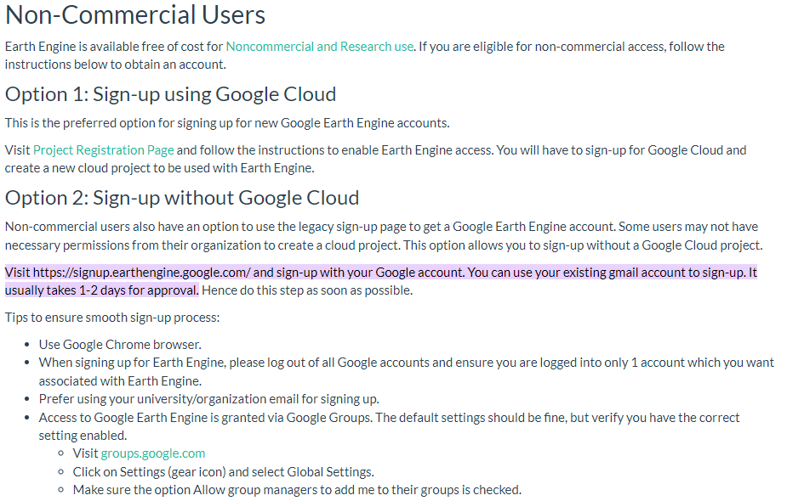
-> https://code.earthengine.google.com/

Slide 2
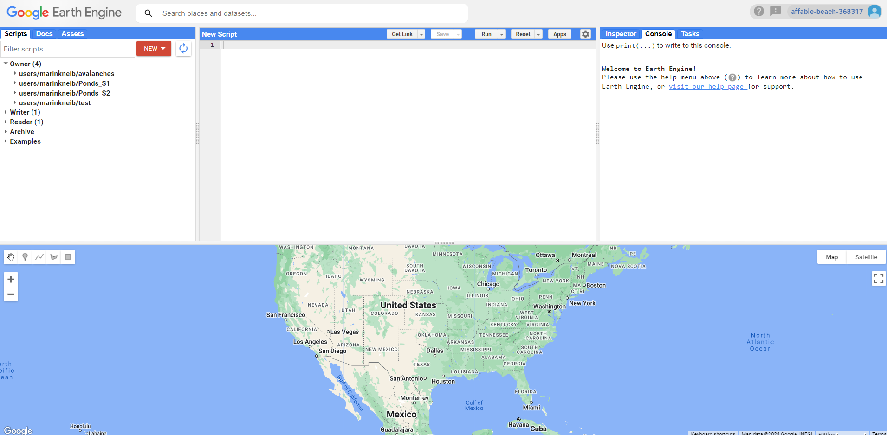

Slide 3
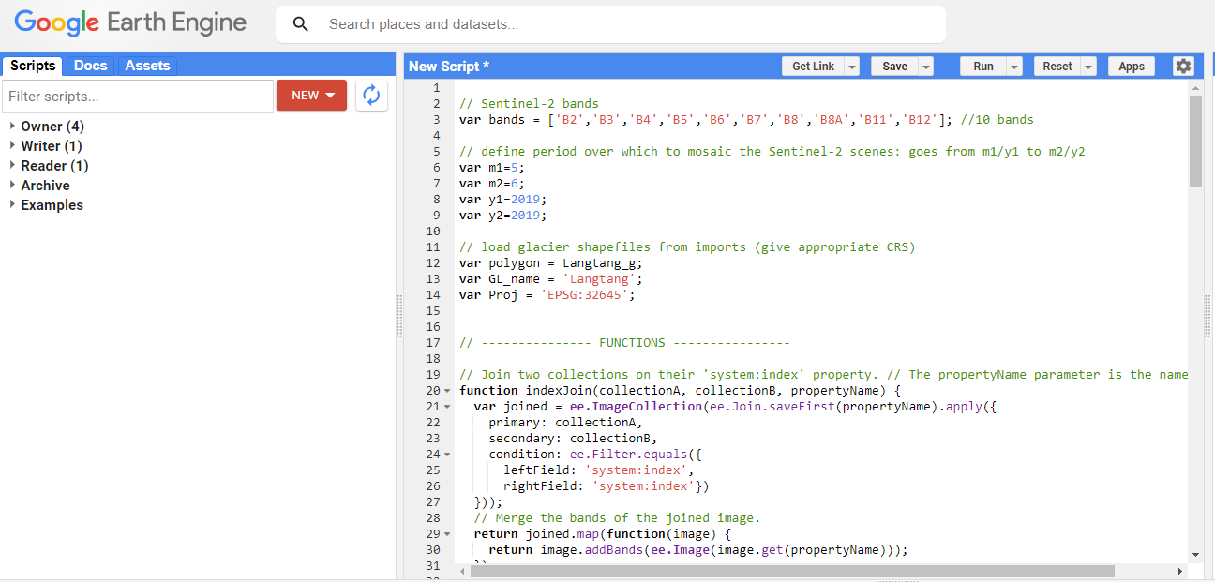
Mapping ponds on debris-covered glaciers with Sentinel-2: example for Khumbu Glaciers
Copy-paste content of txt file in new script and save
Add shapefiles as assets (shp, dbf and shx files)
Transfer assets as variables
Run script

Slide 4
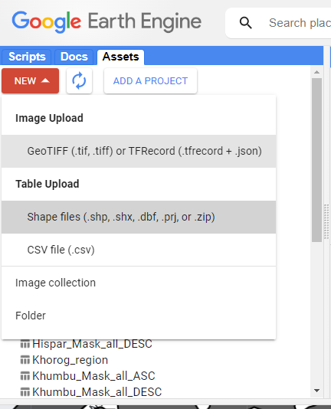
Mapping ponds on debris-covered glaciers with Sentinel-2: example for Khumbu Glaciers
Copy-paste content of txt file in new script and save
Add shapefiles as assets (shp, dbf and shx files)
Transfer assets as variables
Run script

Slide 5
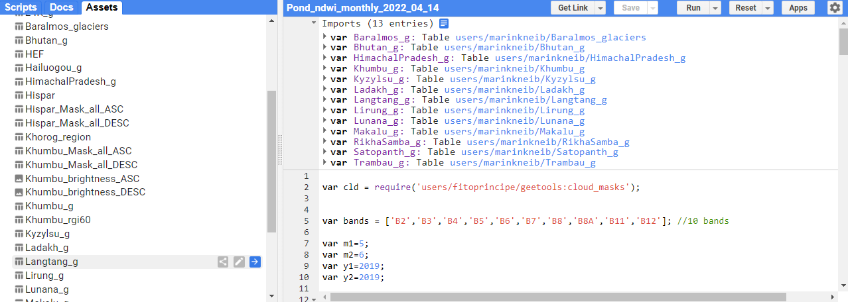
Mapping ponds on debris-covered glaciers with Sentinel-2: example for Khumbu Glaciers
Copy-paste content of txt file in new script and save
Add shapefiles as assets (shp, dbf and shx files)
Transfer assets as variables
Run script

Slide 6
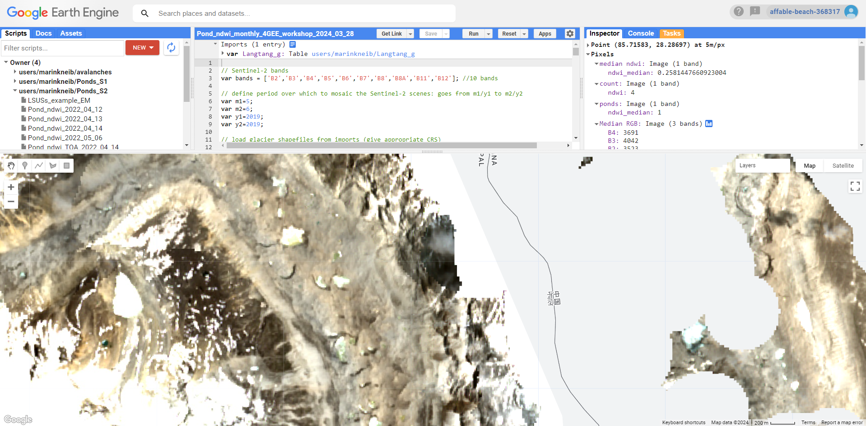
Mapping ponds on debris-covered glaciers with Sentinel-2: example for Khumbu Glaciers
Copy-paste content of txt file in new script and save
Add shapefiles as assets (shp, dbf and shx files)
Transfer assets as variables
Run script

Slide 7
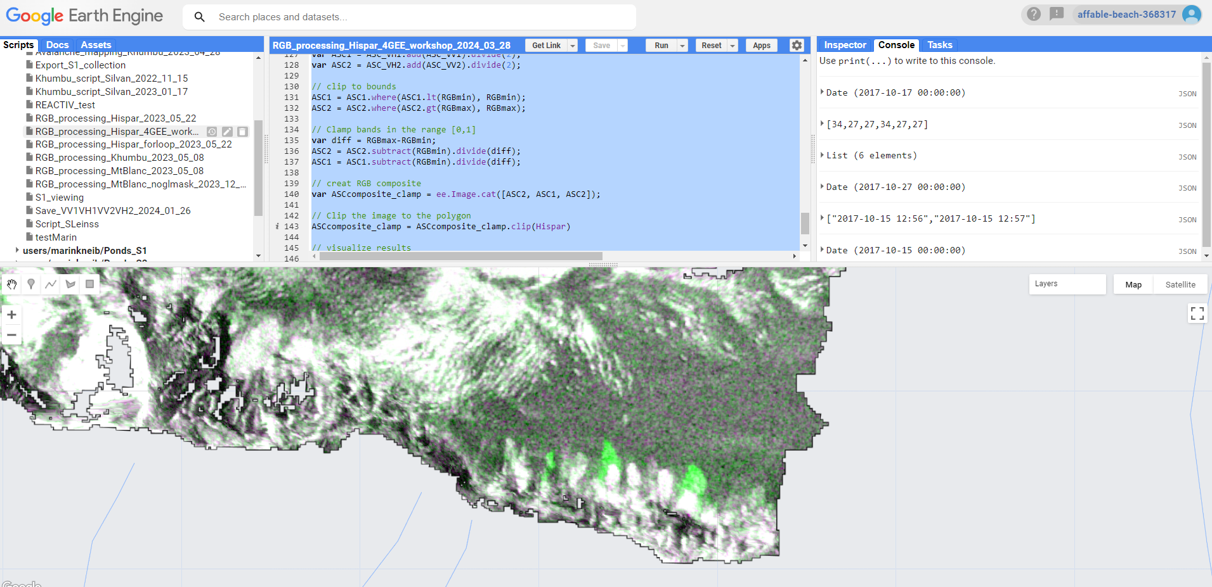
2. Pre-processing of Sentinel-1 GRD images for change detection (application for avalanche mapping)
Copy-paste content of txt file in new script and save
Add shapefiles as assets (shp, dbf and shx files)
Transfer assets as variables
Run script

