Slide 1
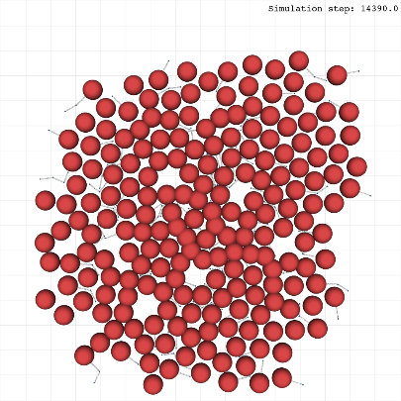
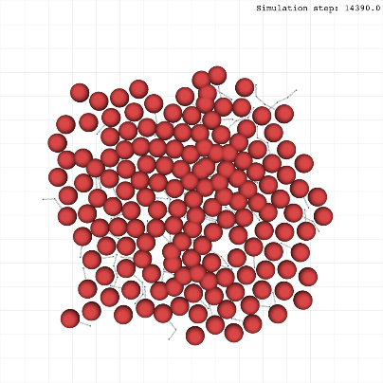
Well-defined Homer-Wright rosettes
Marked as green circles
- At least one neurite inside
and
- Circular structure
and/or
- Contour cells attached to each other
Poorly-defined Homer-Wright rosettes
Marked as yellow circles
- At least one neurite inside
and
- Compromised circular structure
and/or
- Contour cells not attached
True ependymal rosettes
Marked as gray circles
- No neurites inside
and
- Circular structure
and/or
- Contour cells attached to each other
Neurocyticrosettes
Marked as blue ellipses
- At least one neurite inside
and
- Large and elongated structure
and/or
- Contour cells attached to each other
1

