Slide 1

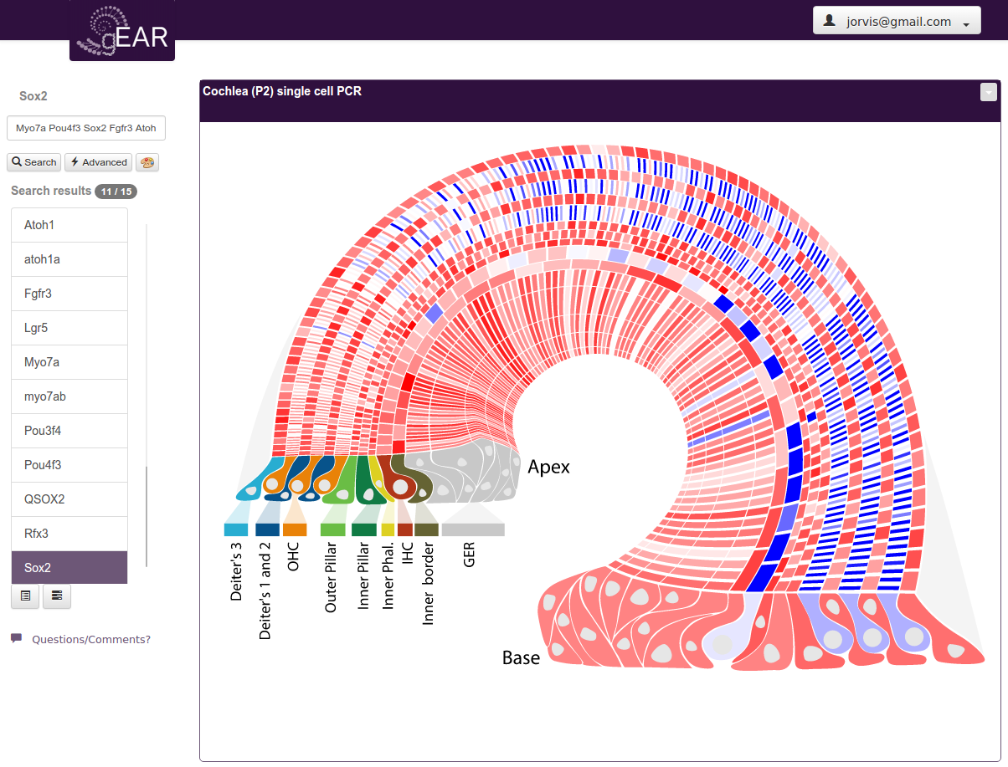
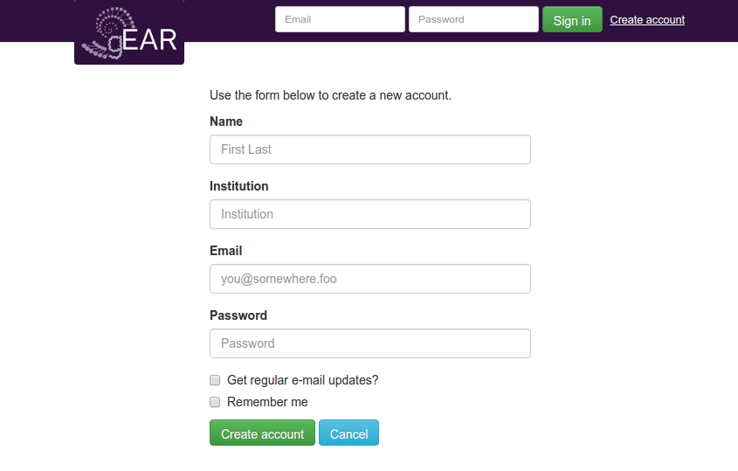
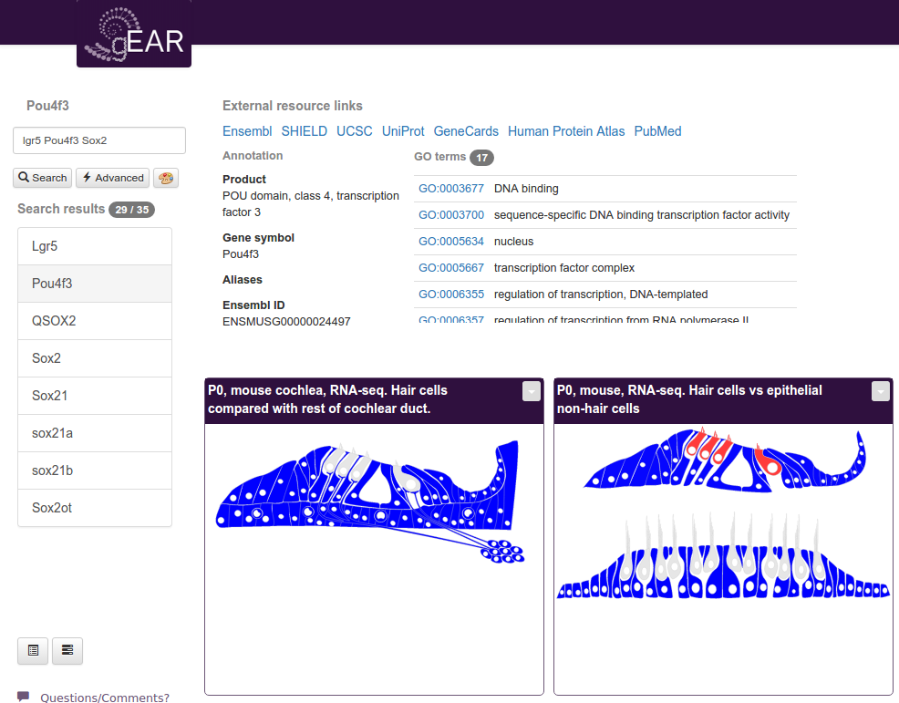

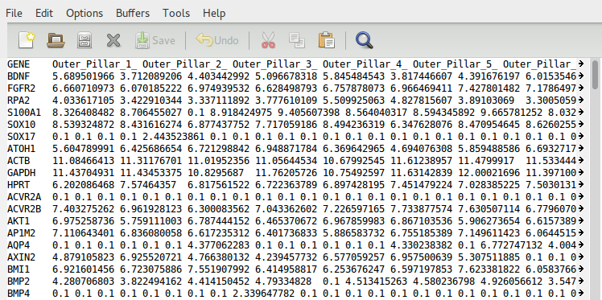
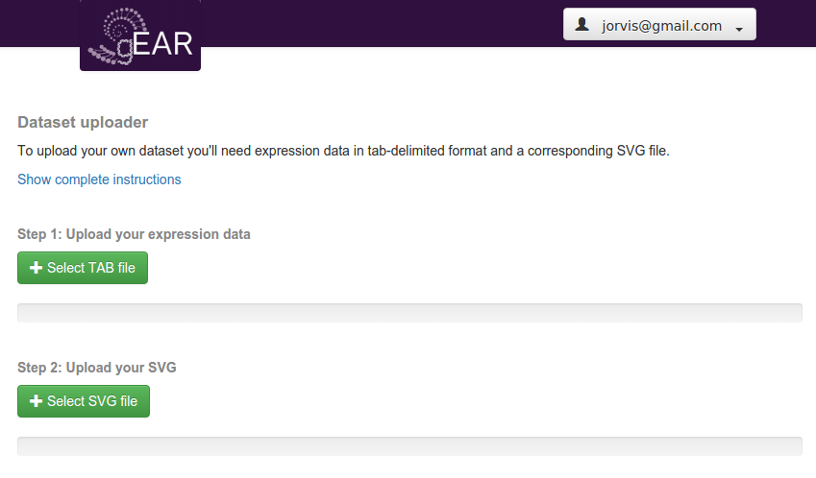
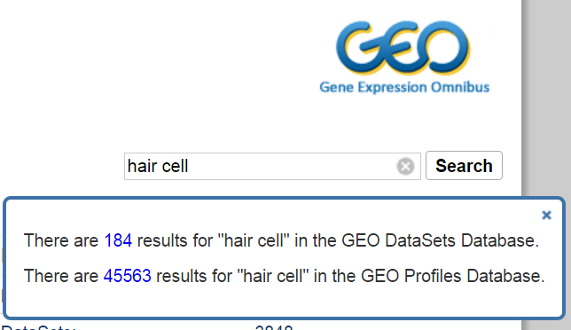

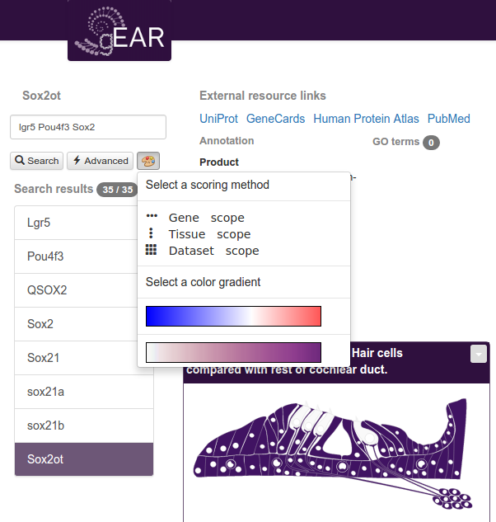
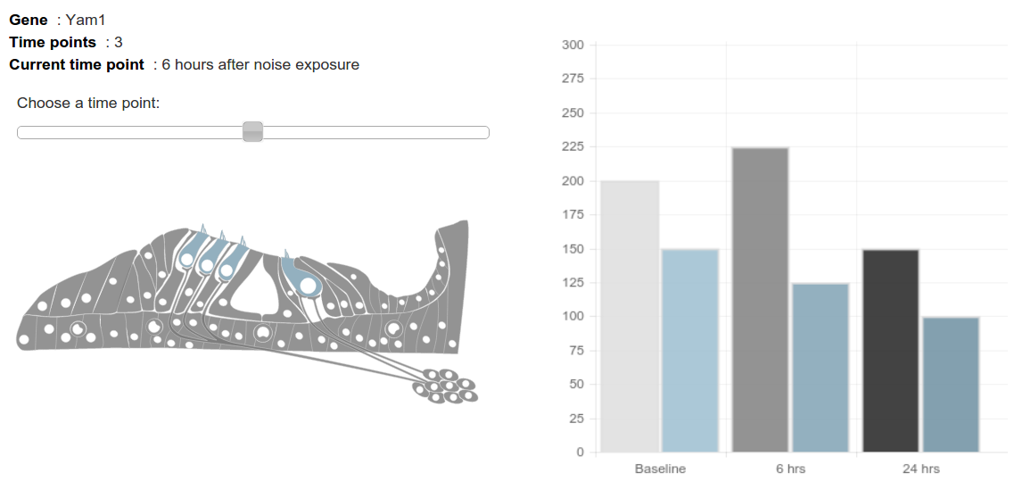
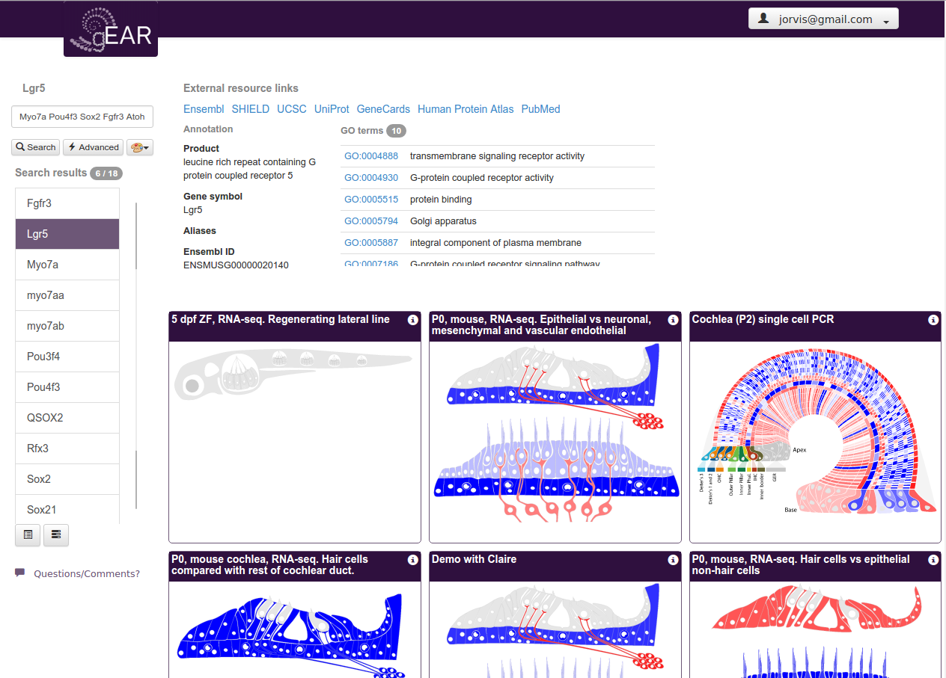
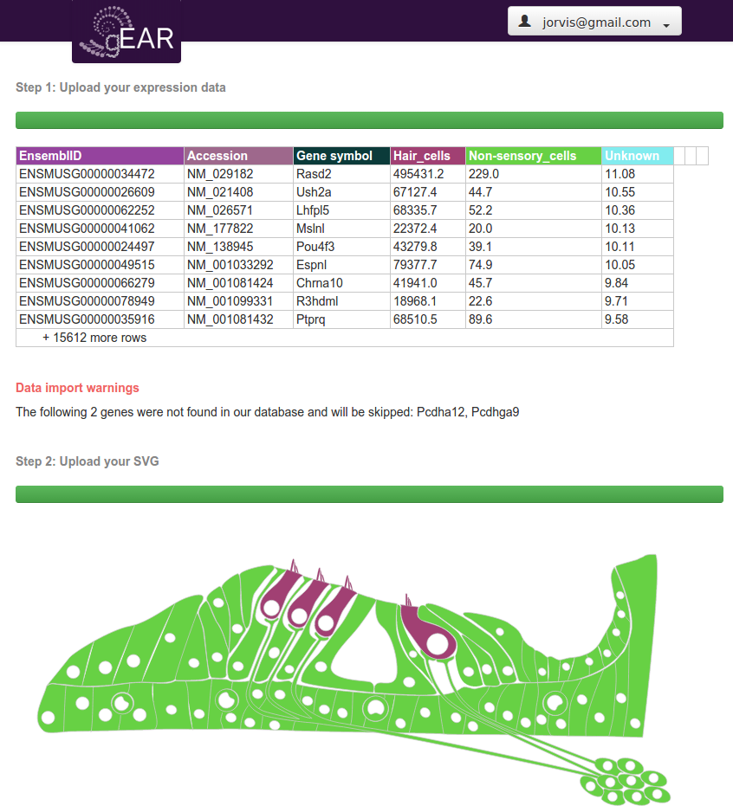
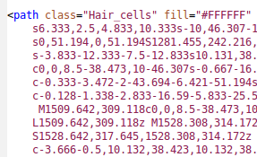
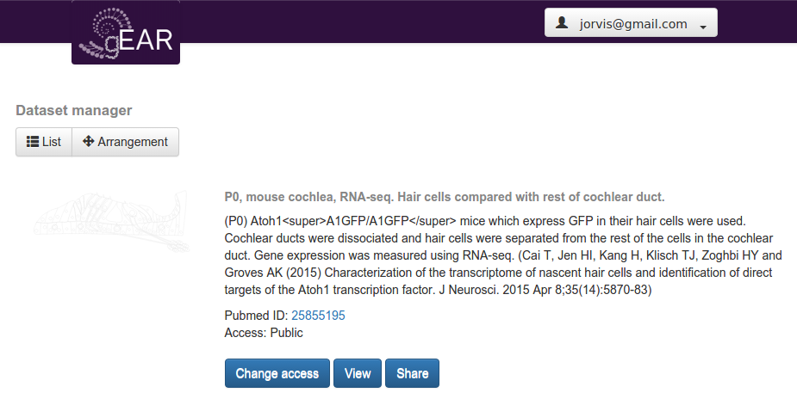
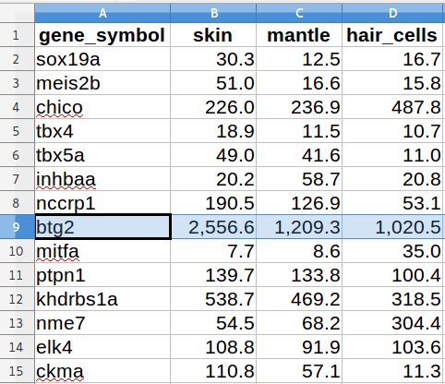
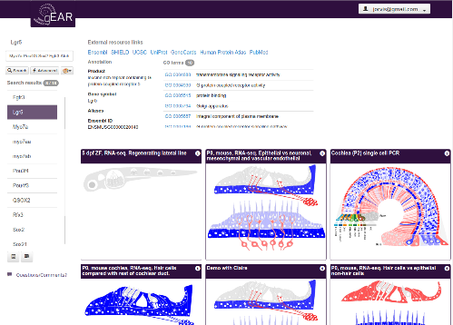
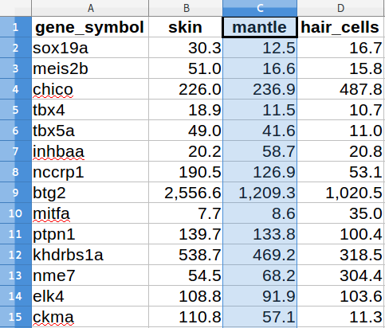
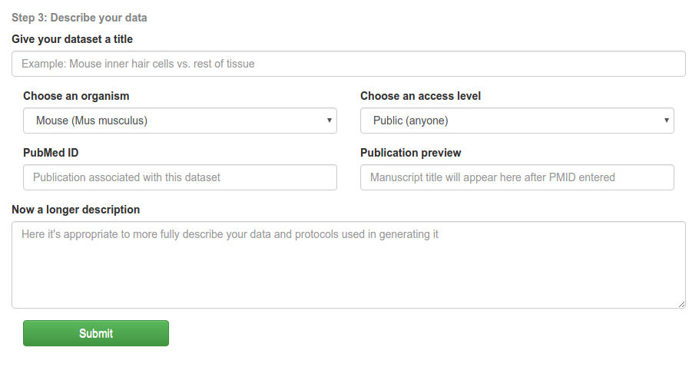
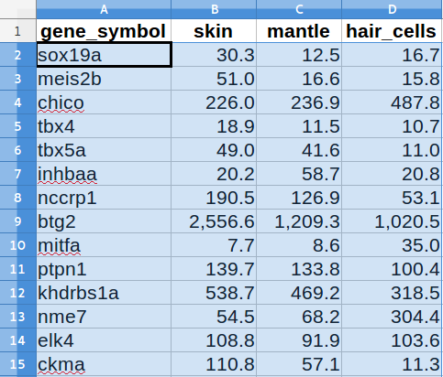
The gEAR portal – gene Expression for Auditory Research
Joshua Orvis¹, Amiel Dror², Beatrice Milon³, Ran Elkon², Anup A. Mahurkar¹, Ronna Hertzano^{1,3,4} Affiliations: ¹Institute for Genome Sciences, University of Maryland School of Medicine;
²Department of Human Molecular Genetics and Biochemistry, Tel Aviv University; ³Departments of Otorhinolaryngology Head & Neck Surgery and ⁴Anatomy and Neurobiolology, University of Maryland School of Medicine.
Next generation sequencing as a tool for recording gene expression has increased in popularity over the past decade. If 2001-2010 were marked by the use of microarray technology as the primary tool for global analysis of gene expression, 2011 marked a general transition to next generation sequencing as the primary tool. In parallel, new approaches have been developed for cell type-specific analysis of the inner ear. These range from flow cytometry to single cell isolation and translatome analysis in a variety of animal models. Together, these developments make next generation sequencing a commonly used tool in most molecular research laboratories. While each experiment is designed to answer a unique investigator-initiated question, the datasets that are generated form a wealth of data, which could be used by the research community at large. However, query, cross-comparison and even presentation of two datasets side by side is a complicated and time-consuming task for most biologists.
The gEAR portal (http://gear.igs.umaryland.edu/) is a website for dissemination, presentation and cross-comparison of cell type-specific gene expression from the auditory and vestibular systems in the public domain. The gEAR is focused on accurate quantitative representation of complex gene expression data in a simple and intuitive graphical format, simplifying access to gene expression data for all researchers in the inner ear community. New features since ARO 2014 include numerous additional datasets, personal accounts for flexible viewing of datasets, self-upload of datasets for personal and/or public viewing, inner ear single-cell RNA-seq data and much more. The gEAR portal is a free online resource. We invite you to use the site, and provide us feedback so we can improve the portal. In addition we urge you to share your data with the larger research community through the gEAR portal.
gEAR Basics – Data Viewing
gEAR Advanced – Data Upload
Single-Cell Expression Data
Site URL:
http://gear.igs.umaryland.edu
3
When you click a search result the gene’s annotation displays here, including numerous links to external resources for the same gene.
Step 1: An account is not required to use the gEAR Portal, but you must create one if you wish to upload your own datasets.
Search
1
Step 2: Access the menu in the upper-right corner to add a new dataset
Start by entering one or more genes separated by spaces.
Scroll
The Challenge
2
As you scroll through search results all datasets shown are instantly colorized to show expression levels.
http://www.ncbi.nlm.nih.gov/geo/
Step 3: Upload a tab-delimited text file of expression data. It is important that it has at least a column with gene symbols. Upload it here, and a preview of it will be shown:
The visualization of individual cells via single-cell expression data is especially compelling. Here, the expression of Sox2 increases in a gradient from the base to apex of outer hair cells.
Raw expression values are stored in the database, but three different scopes of normalization (described below) can be used to colorize the figures. You can change these on the fly while viewing genes and immediately see the difference in expression patterns.
Advanced Options – Time Series
A dramatic increase in the use of microarray and RNA-seq for measuring gene expression, resulted in hundreds of gene expression datasets with relevance to the ear field. These are deposited in the Gene Expression Ombinbus (GEO) and can be browsed one at a time. However, combining information from multiple datasets, and cross-dataset comparisons are difficult. Visualization of more than one dataset in one page, is impossible.
Step 4: Next, you upload an SVG file. These are drawings made up of <path> elements.
After you have uploaded both, the preview windows show the correlation between your data columns and SVG shapes.
This is an example dataset control or experiments with time series data, pending public release. The standard uploader is still used, but column naming convention is used to detect time courses. A single instance of the SVG is shown, but a scroll bar allows manual or automated/rotating changing of time points for that dataset. A bar graph on the right shows all values in the time course.
Scoring options
The Solution
4
Color gradients
5
Two color gradient styles are available. The default shows down-regulated genes shifting blue, neutral ones in white, and up-regulated ones shifting red. A second option is purely linear from white to deep purple.
The combination of one-the-fly options of scoring scope and color gradients allows for powerful customization of visualization.
The gEAR as a tool for Public, Private or Group-Limited Data Sharing
Scoring methodology
Any path shapes with a class attribute matching one of the column headers from your tab file get linked for colorization
The dataset manager allows you to view datasets you’ve uploaded, manage their titles and descriptions, and customize the arrangement of datasets on the front page.
You can also share private datasets with others using only a URL (similar to document sharing in Google Drive or Dropbox.)
It is a challenge to colorize anatomical figures from different organisms, tissues, and experiment types in a way which allows them to be compared directly. Here, values are normalized by overlaying the expression values over a range defined by a color gradient. The min and max values depend on the chosen scoring scope, and the value for the tissue/gene combination is placed within that range.
Gene-level scoring
For every gene the colorization is a function of the gene minimal and maximal values within the dataset.
Here were show the values for btg2 in a mock mini-dataset. The values in mantle cells are lower than in skin and slightly higher than in hair cells.
min:1020
max:2556
A user-friendly website that displays datasets in the form of graphs and/or self colorizing cartoons which correspond to gene expression levels. ₊
btg2 mantle
How it works (This section is for developer geeks)
Step 5: Finally, enter metadata for your dataset and submit. Processing might take a few minutes, but after the new dataset will appear in your dataset grid.
The gEAR – Future Directions
Excel/TAB
User uploads
Snap.svg
Tissue-level scoring
min: 8
max:1209
Colorizes
JQuery
Colorization is dependent on the values of all genes in the dataset, for this cell type. In this example, btg2 is the highest expressed gene in mantle cells.
btg2 mantle
Future development on the gEAR Portal includes:
Cross-dataset/organism comparisons and searching, allowing for much more advanced queries
Integration of epigenetic data
Embedded track showing gene structure alongside expression data
More robust dataset ranking and discovery
Use of 3D models for some datasets over flat SVGs
Full integration/support of time series and experimental replicate data
SVG
MySQL database
JSON data
Reads from
Python3 CGI
A MySQL database is used to store the annotations for several species, including human, mouse and zebrafish. These, along with expression data from different experiment types, are stored in a denormalized manner to enable fast web queries. The HTML5 interface uses Bootstrap and JQueryUI for layout and visual elements. The anatomical drawings are all defined and rendered as Scalable Vector Graphics (SVG). As the user enters one or more gene symbols to search, JQuery is used to call the Python3 back-end, which queries and returns both matching expression and annotation data in JSON format from the database. Javascript (Snap.svg) is then used to colorize all of the SVG shapes corresponding to each cell/tissue according to its expression level.
Dataset-level scoring
Colorization is dependent on the values of all genes in the entire dataset. In this example, the expression of btg2 in mantle cells, is slightly lower than the average expression of all genes.
min: 7
btg2 mantle
max:2556
Funding: The gEAR is supported by the NIDCD/NIH R01DC013817 (R.H.) and the Hearing Health Foundation (Hearing Restoration Project).

