Slide 1

IGSN e.V.
General Assembly 2020
December 18, 2020

Slide 2
Agenda
Opening and Welcome
Appointment of the meeting chairperson
Appointment of the minute taker
Determination of timely invitation and establishment of the quorum
Approval of the agenda
Report by the members of the executive board and discussion
Report of the president
Report of the financial officer
Report of the accounts auditor
Discharge of the executive officers
Appointment of the electoral officer
Election of the members of the executive board (President, Vice-President, Treasurer)
Election of the annual accounts auditor
Budget proposal for 2021 and discussion
Discussion on admission of new members, affiliate members and vote
Discussion (Topics TBD)
Miscellaneous

Slide 3
Report of the President
Status of the IGSN registry
Membership developments
IGSN 2040 Project: Status and Next Steps

Slide 4
>1,7 million IGSNs registered since February 2020
https://dataservices.gfz-potsdam.de/igsnstats/

Slide 5
Status of the IGSN Registry
IGSN Central Registry has been operated at the GFZ German Research Center for Geosciences as an in-kind contribution, with software development & maintenance mostly done by Damian Ulbricht.
Damian Ulbricht left his position at GFZ in September 2020.
The IGSN e.V. ExCom has been working with Uli Harms and Kirsten Elger to ensure uninterrupted operation of the IGSN Central Registry.
ExCom concluded that ideally, IGSN e.V. should establish sovereignty over its infrastructure within the first quarter of 2021.

Slide 6
ACTIONS related to the IGSN Registry
The IGSN e.V. ExCom will establish an alternate contact at GFZ, who has access to the server, on which the IGSN registry is running.
The IGSN e.V. ExCom will set up a task group to develop a plan for migrating the server and sharing the knowledge with other organizations in the IGSN e.V. to broaden our corporate knowledge about this component.

Slide 7
Membership Developments
Since the start of the IGSN 2040 project, the IGSN e.V. has not encouraged new membership, as the organization's structure and membership requirements are likely to change.
The IGSN e.V. has one application for Affiliate Membership (ESS-DIVE).
The Managing Office has addressed Action Items from the General Assembly 2019.
ACTION ITEM 2019/1: The Managing Office will review payments of the last two years and attendance at GAs over the past 3 years, then send two letters of warning (1 month apart) and a letter of termination 2 months after the last letter of warning if no response is received.
ACTION ITEM 2019/2: The Managing Office will set up a spreadsheet to better track payments and GA attendance.

Slide 8
ACTION ITEM 2019/1: Review Engagement & payments
§ 6 Termination of membership
(3) A member may be removed from the register of members by resolution of the Executive Board if it is in arrears with payment of its membership fees despite two formal written warnings. The resolution to effect its removal may be passed only after a period of two months has elapsed following the second formal warning and provided that the warning clearly stated the threat of removal from the register. The member shall be notified of the decision by the Executive Board to remove it from the register.
(4) A member must be removed from the register of members by resolution of the Executive Board if it no longer meets the membership criteria pursuant to § 4.
§ 4 Membership
(3) A member is expected to attend the General Assembly meeting. If any member fails to attend three meetings of the general assembly in a row, then this shall result in removal from the register of members according to §6 (4).

Slide 9
Members Meeting Criteria for Removal from the Register
Arizona State Geological Survey
Boise State University
City College of New York
Oregon State University
Rensselaer Polytechnic Institute
Scripps Institution of Oceanography
University of Minnesota
BSU, CCNY, RPI, and UMN have been contacted.
All agreed to remain Affiliate Members in the IGSN e.V.
SIO is investigating.
OSU is in the process of paying.

Slide 10
ACTION ITEM 2019/2: Set up Better Tracking
The Managing Office contacted all members to provide contact information (member representative and administrative contact).
The Managing Office has set up a new Google sheet to track payments.
The Managing Office is establishing more formal tracking of attendance at the General Assembly.

Slide 11
Project IGSN 2040: “Defining the Future of the IGSN as a Global Persistent Identifier for Material Samples”
PIs: Kerstin Lehnert, Jens Klump, Lesley Wyborn
Project Coordinator: Sarah Ramdeen
Start: August 1, 2018
End (extended): March 31, 2021
Funded by
the Alfred E. Sloan Foundation
“develop a strategic plan and roadmap that will guide the IGSN system in its next chapter so it will be able to fulfill its mission of providing persistent, sustainable, and reliable PID services to the international science community.”

Slide 12
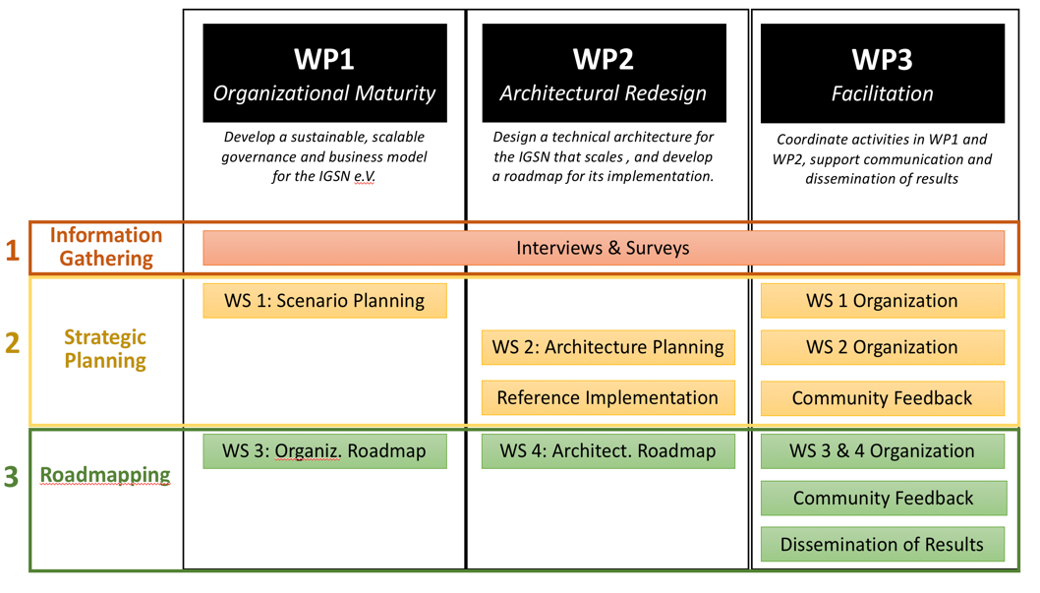
IGSN 2040 Project
Year 1
Year 1: Survey
Tacoma, July ‘19
Canberra, May ‘19
Tacoma, July ‘19
Year 2
3 virtual workshops in Fall 2020,
facilitated by Susan Stickley

Slide 13
IGSN 2040 Project Activities in 2020
Merged technical and organizational SCs
Planned final workshop for May 2020, cancelled due to COVID-19
Organized technical sprint in May 2020 to test components of the new architecture (implementation of sitemaps at Allocating Agents)
Contracted consultant Susan Stickley in July 2020 to help with the final phase of business planning and road-mapping
Held 3 virtual workshops between September and November 2020 to develop recommendations for the future business model
Engaged Laure Haak in further exploring organizational and business models and developing the roadmap (contract w/ Laure Haak under development)

Slide 14
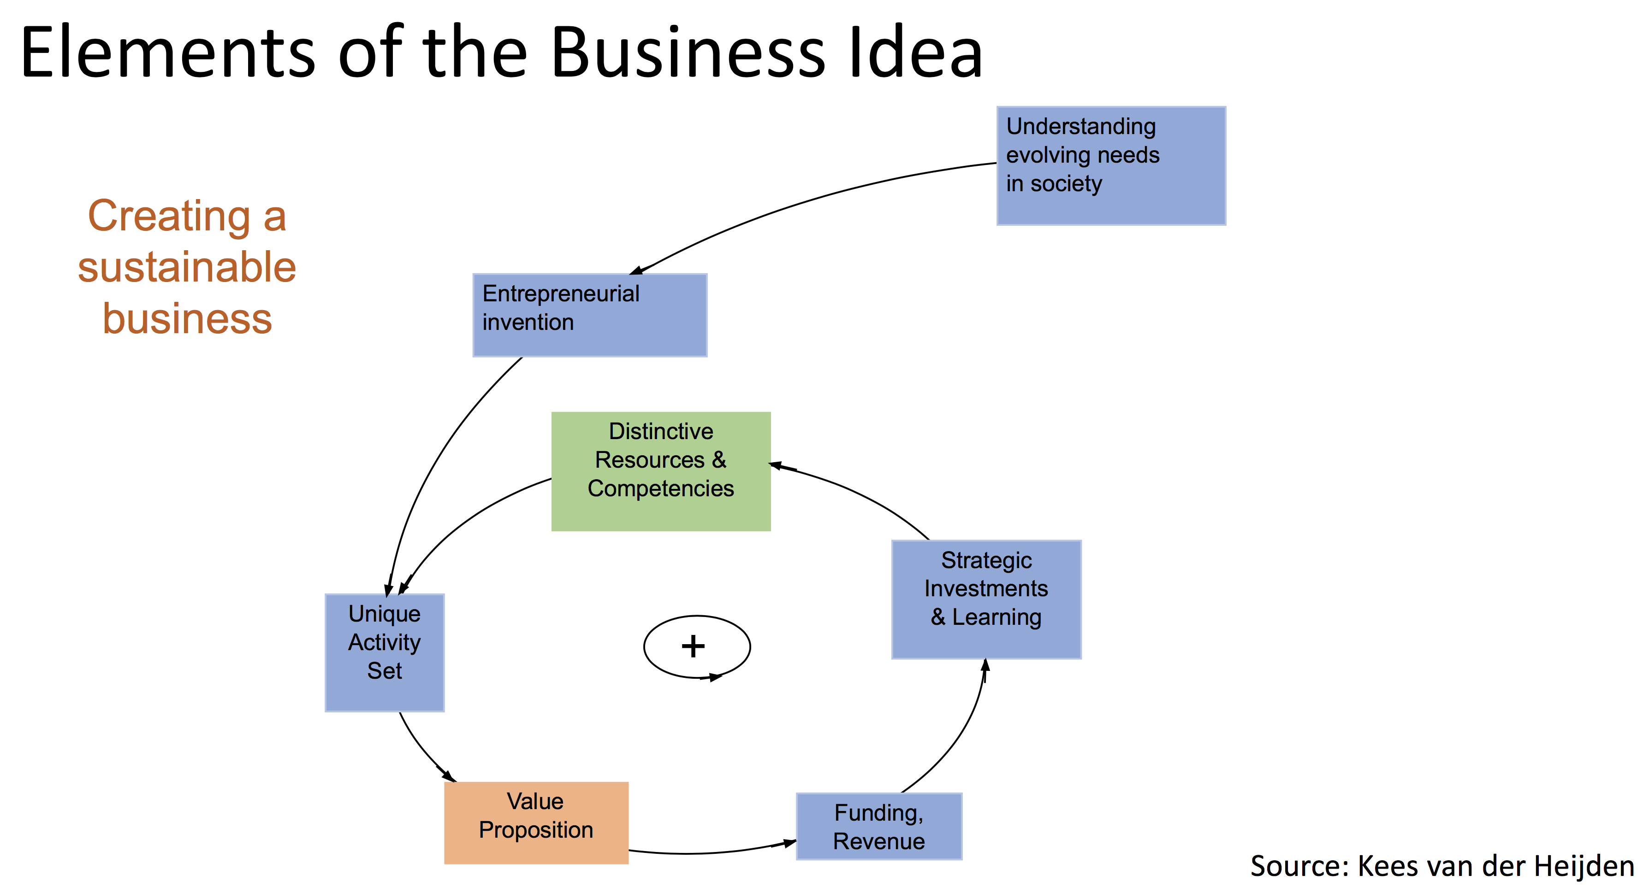
Creating The IGSN e.V. Business Idea

Slide 15
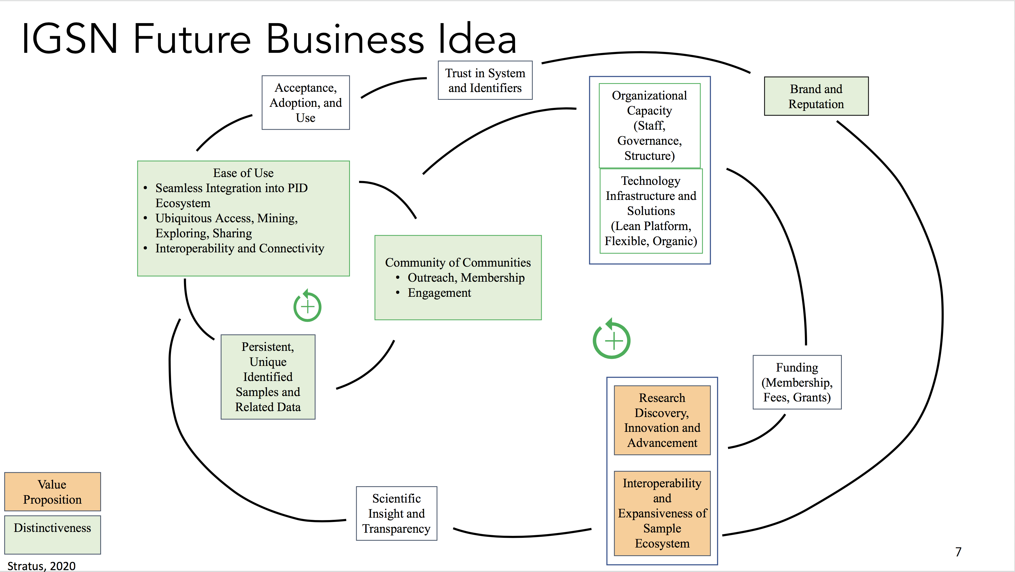

Slide 16
IGSN 2040 Project: Next Steps
Refine business model and explore potential business partnerships (January 2021)
Present proposed business model and potential partnerships to the IGSN e.V. members for discussion (February 2021)
Send out IGSN 2040 draft road map and pre-readings to the IGSN e.V. members
Set up informal meeting of the IGSN e.V. members in February
Present final roadmap to IGSN e.V. members for vote (March 2021)
Formal IGSN e.V. General Assembly, invitation will arrive in early January

Slide 17
Report of the Financial Officer and Accounts Auditor

Slide 18
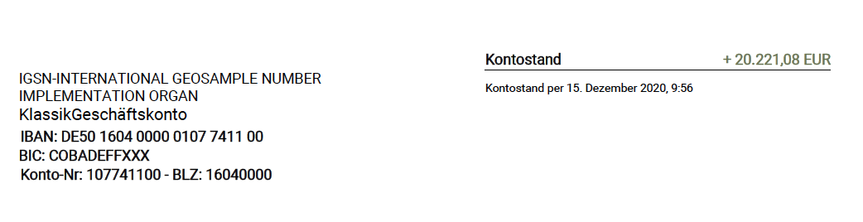
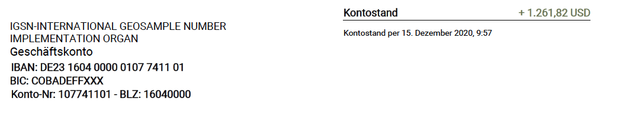

Slide 19
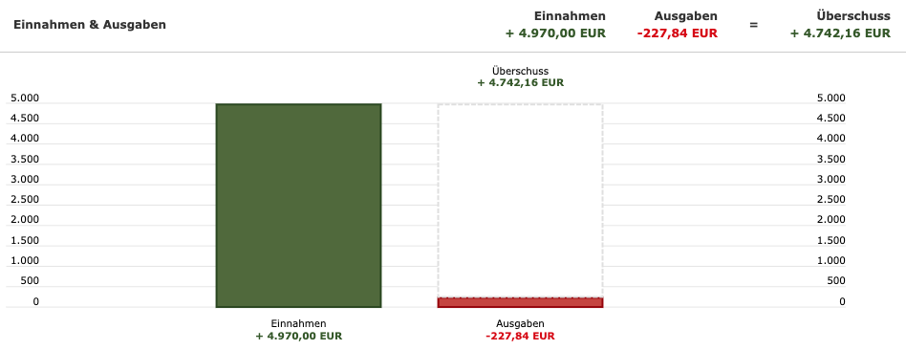

Slide 20
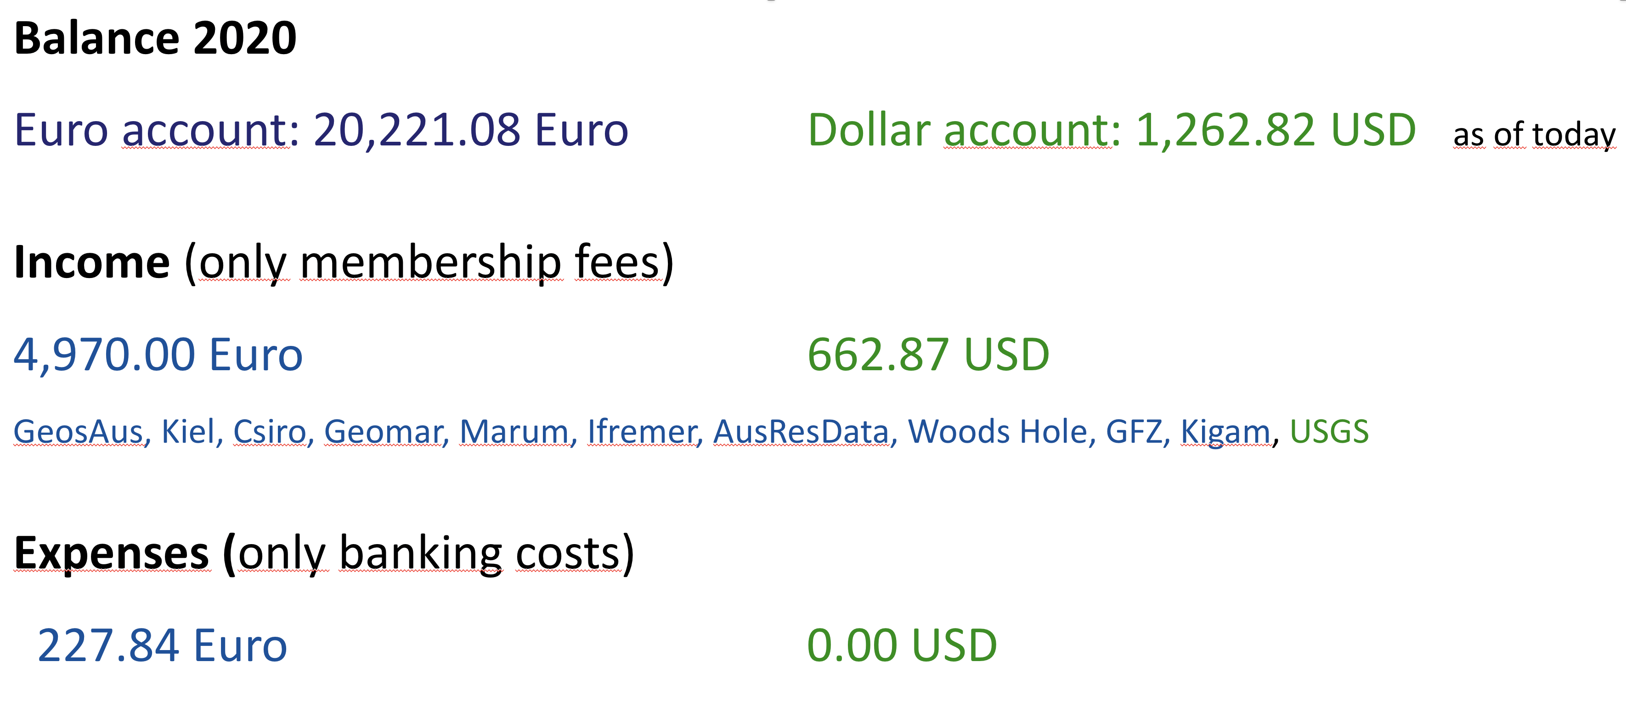
Finance Report 2020 for IGSN e.V.

Slide 21
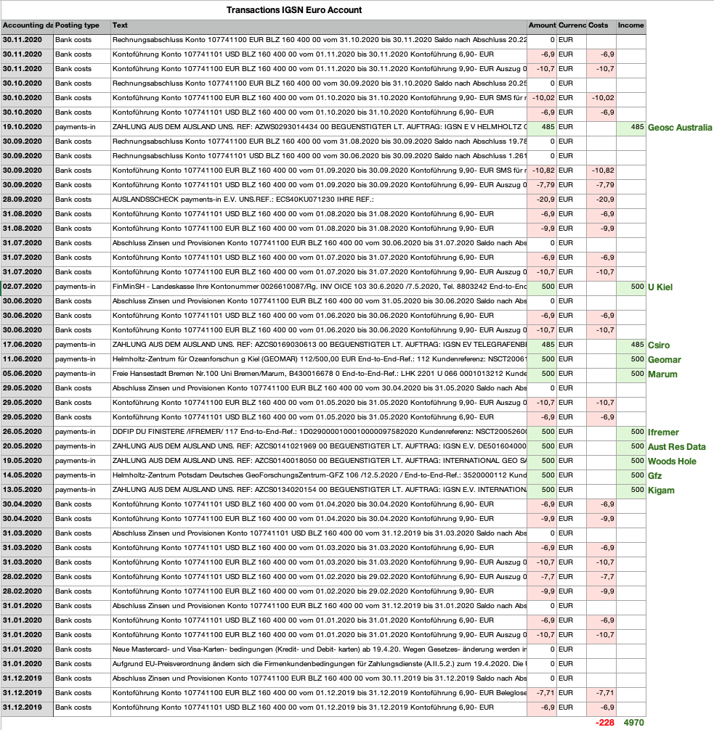

Slide 22
Finance Report 2020 for IGSN e.V.
Non-contributing members (to be addressed in the membership discussion)
21,2000 Euro Surplus (to be addressed in the budget plan discussion)

Slide 23
Thank you
Questions?

Slide 24
Cash Audit (from Dirk Fleischer)
Dear IGSN Board,
I just finished the cash audit for IGSN Nov.2019 to Nov. 2020 and here comes my report just in case I can not attend the Meeting for what ever reason there might be.
The audit went smoothly.
The treasurer provided easy access to all the account activities and there were no irregularities in the account history.
I'm pleased to say that the account is in good order and the balance is +20.238,68 (End Oct. 2020)
I can recommend to the members to relief (Entlasten) the board for the last year.
I will not be available for an additional term as auditor after I have already served two terms in a row and have to step down.

Slide 25
Agenda
Opening and Welcome
Appointment of the meeting chairperson
Appointment of the minute taker
Determination of timely invitation and establishment of the quorum
Approval of the agenda
Report by the members of the executive board and discussion
Report of the president
Report of the financial officer
Report of the accounts auditor
Discharge of the executive officers
Appointment of the electoral officer
Election of the members of the executive board (President, Vice-President, Treasurer)
Election of the annual accounts auditor
Budget proposal for 2021 and discussion
Discussion on admission of new members, affiliate members and vote
Discussion (Topics TBD)
Miscellaneous

Slide 26
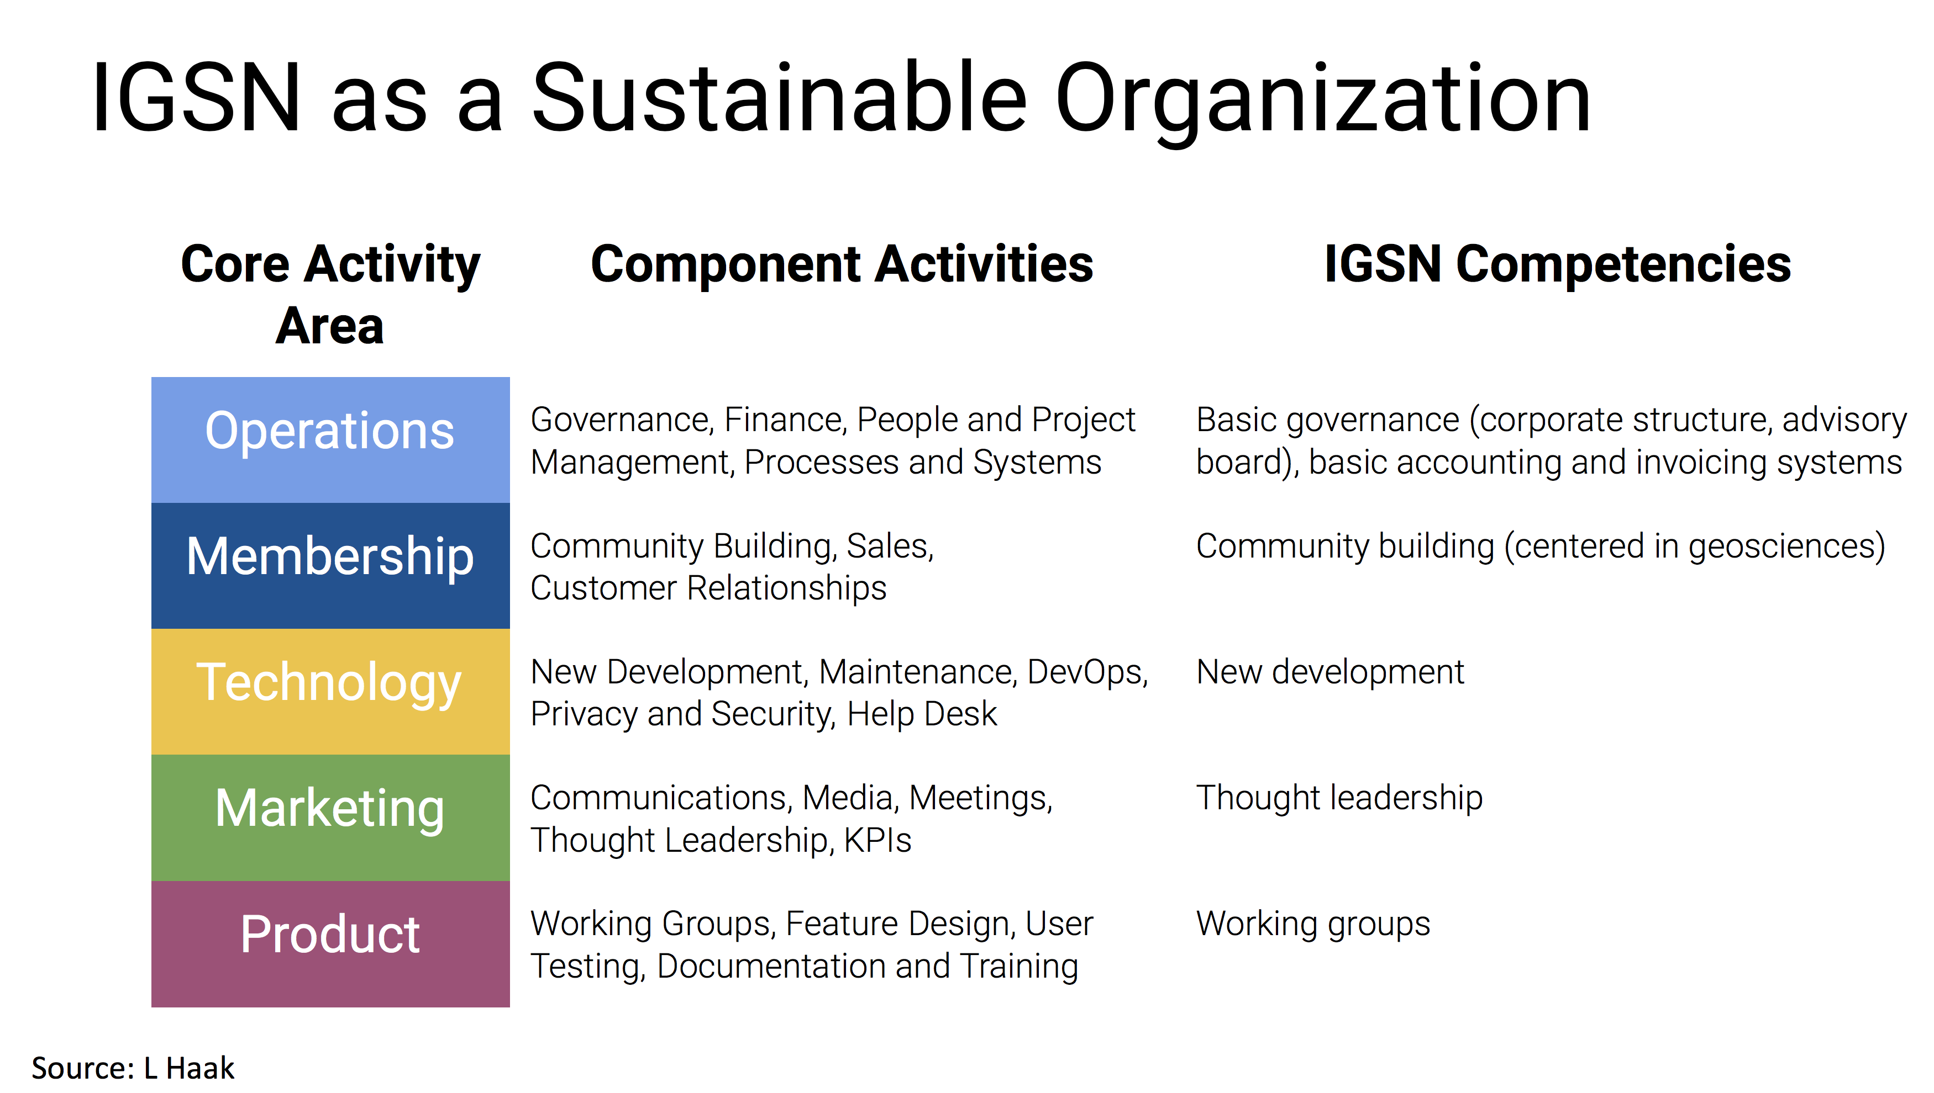

Slide 27
Proposed IGSN e.V. Core Purpose, Vision, Mission
Core purpose: to enable transparent and traceable connections between samples, collections, data, publications, people and organizations through the use of an authoritative and trusted, persistent sample identifier.
Underlying Belief: Adoption and use of IGSN can drive research discovery, innovation, and advances.
Vision: A world where physical samples are valued, uniquely identified and linked into the research ecosystem on a global scale, supporting transparent and reproducible research across disciplines, borders, and time.
Mission: IGSN provides an open, shared and trusted globally unique persistent identifier system for physical samples, specimens, or artifacts in support of the advancement of knowledge.

