Slide 1


CardioGoodFitness

Slide 2

What are we talking about?
Identify the key factors that decide which product customers purchase from CardioGoodFitness over the last 3 months
Identify any actions that can be taken to improve product sales

Slide 3
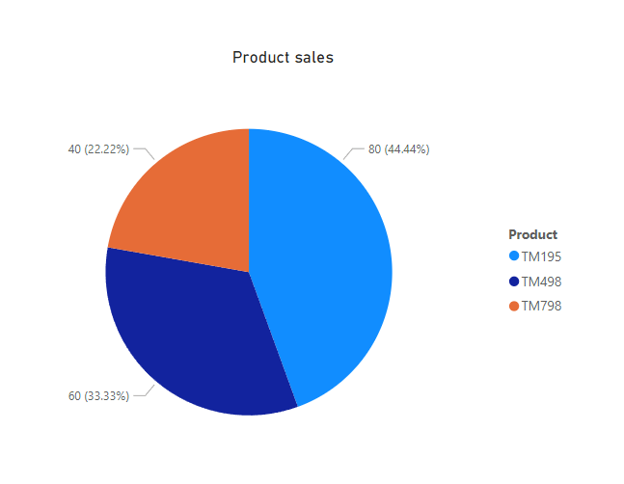
Product sales as a whole
TM195 was the best-selling product over the last three months followed by TM498 and finally TM195
TM195 sold double the amount of TM798 whilst TM498 sold 50% more. Why was this the case?

Slide 4
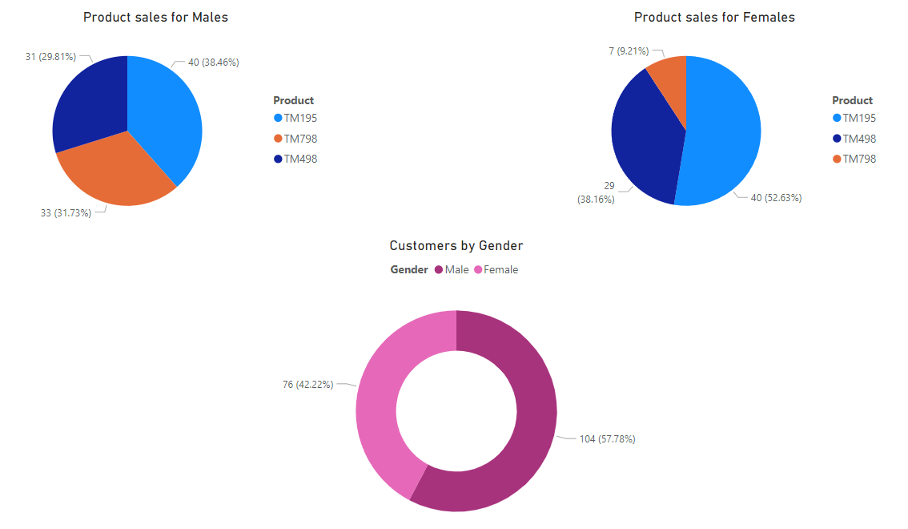
Gender
There were more male customers than female customers for CardioGoodFitness products
Sales of all product types was mostly even for males
However, this was not the case for females as TM195 had an overwhelming market share of more than 52%, followed by TM498 which had just over a 38% and TM195 did very poorly with a market share of just over 9%
Gender may be a factor in determining which product of CardioGoodFitness was bought!

Slide 5
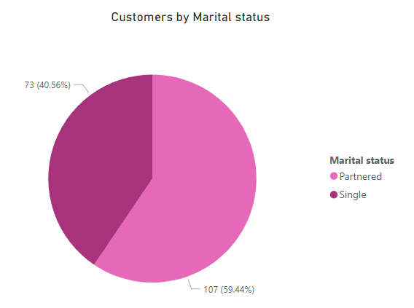
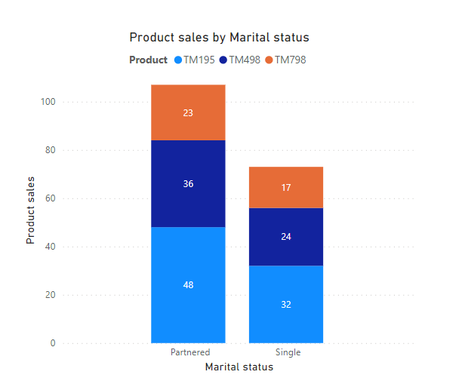
Marital status
Customers of CardioGoodFitness were more likely to be partnered rather than single
However, the distribution of sales between CardioGoodFitness products seemed to be roughly the same for both partnered and single customers
Marital status may not be a factor that affects the sales of CardioGoodFitness products!

Slide 6
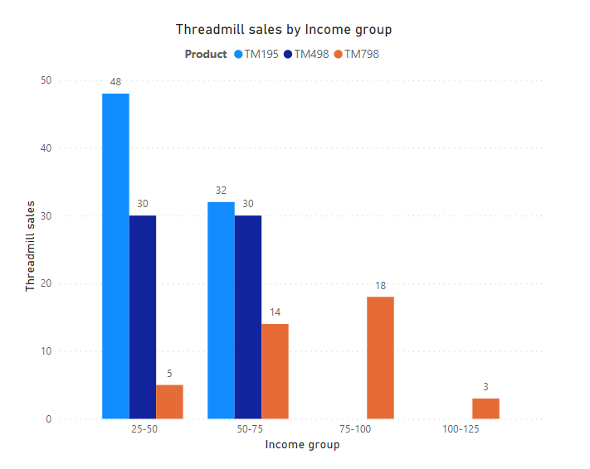
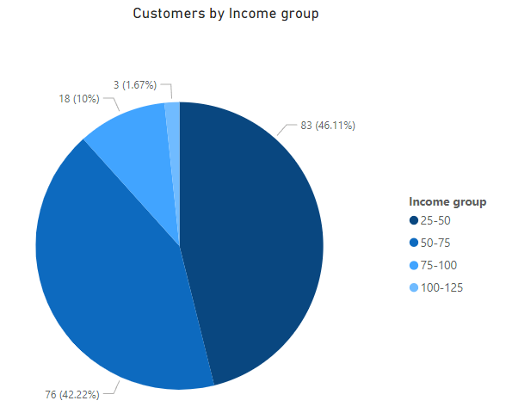
Income
Income data of customers was split into equal sized bins of $25,000 for analysis purposes
A vast majority of CardioGoodFitness customers earned less than $75,000 (around >89% in total!)
TM798 seemed to be preferred by those with a higher income as opposed to other options
Maybe TM798 was marketed/sold as a more premium product with a higher price point than the other two options?

Slide 7
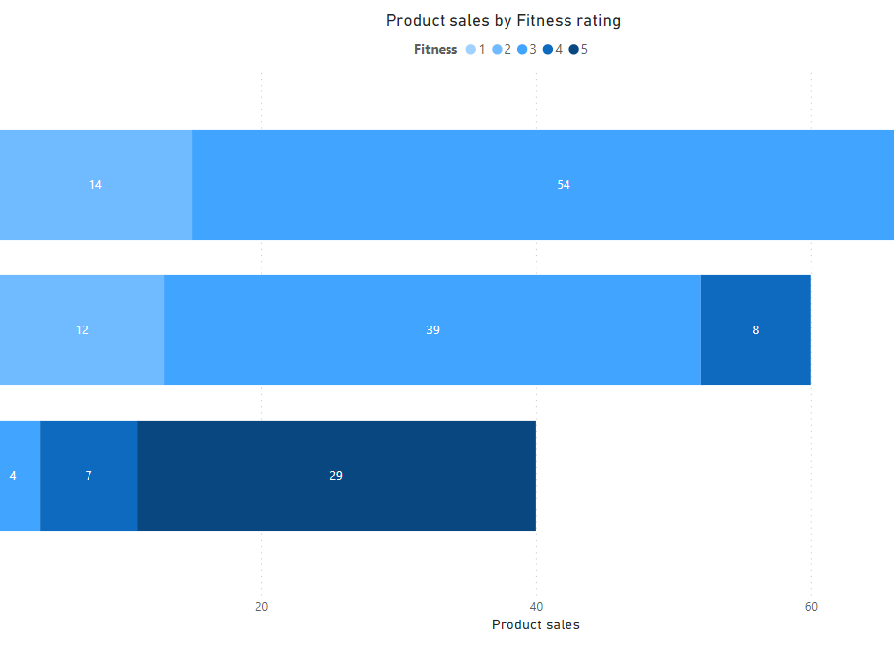
Fitness
A vast majority of customers (97/180) considered themselves moderately fit (fitness rating of 3/5)
TM195 and TM498 had a vast majority of customers with a fitness rating of 3, followed by those with a fitness rating of 2 and below and finally by those who with a fitness rating of 4 and above
This was not the case for TM798, which had a vast majority of its sales towards customers with a fitness rating of 5
Maybe TM798 was more attractive to fitter customers?

Slide 8
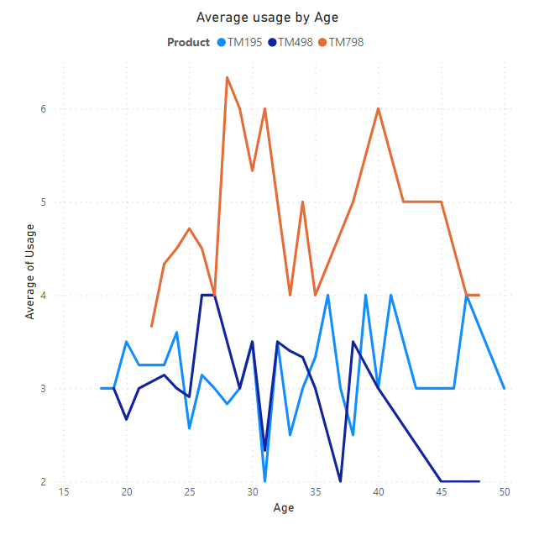
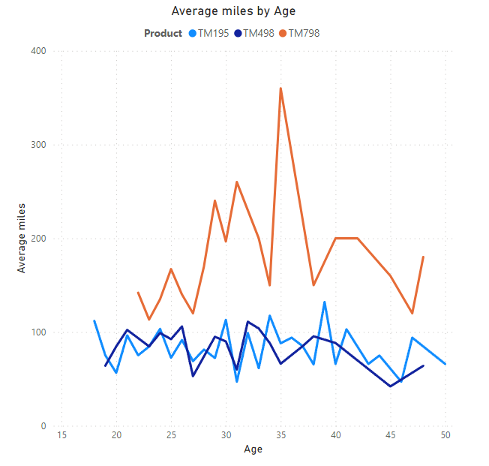

Slide 9
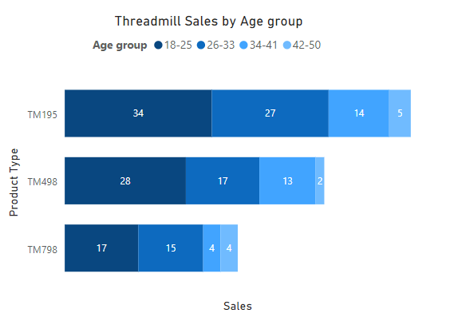
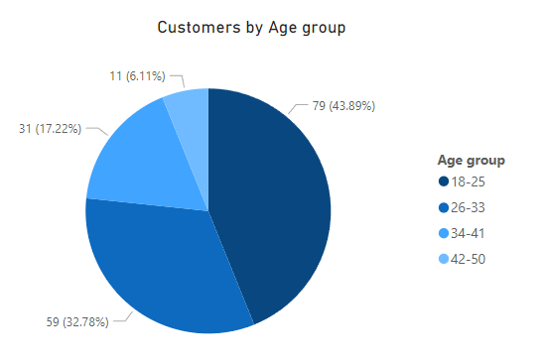
Age
Age data of customers was split into equal sized bins of 8 years for analysis purposes (except for the last bin)
Most customers were aged 18-25 (43.89%), followed by ages 26-33 (32.78%), ages 34-41 (17.22) and finally ages 42-50 (6.11%)
There did not seem to be any meaningful relationship between Age and distribution of product sales?

Slide 10
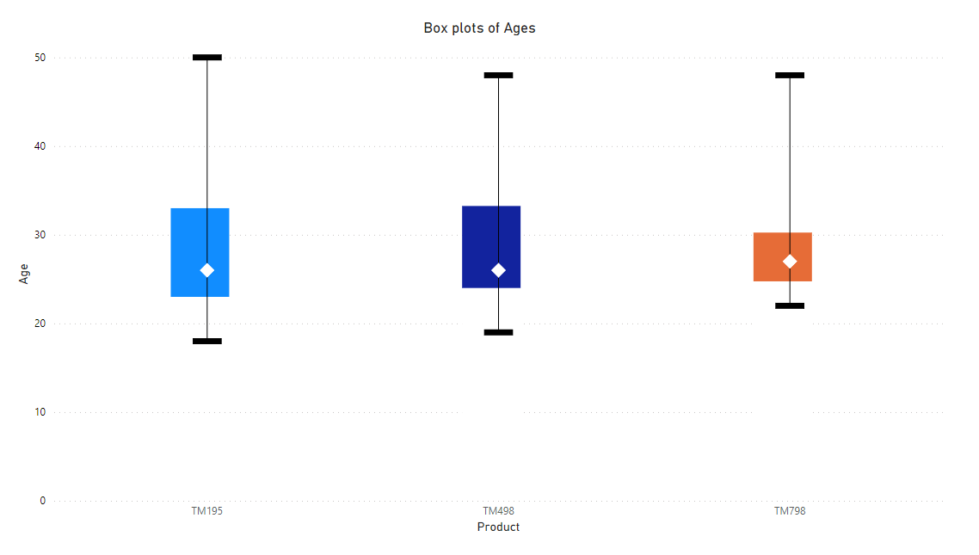

Slide 11
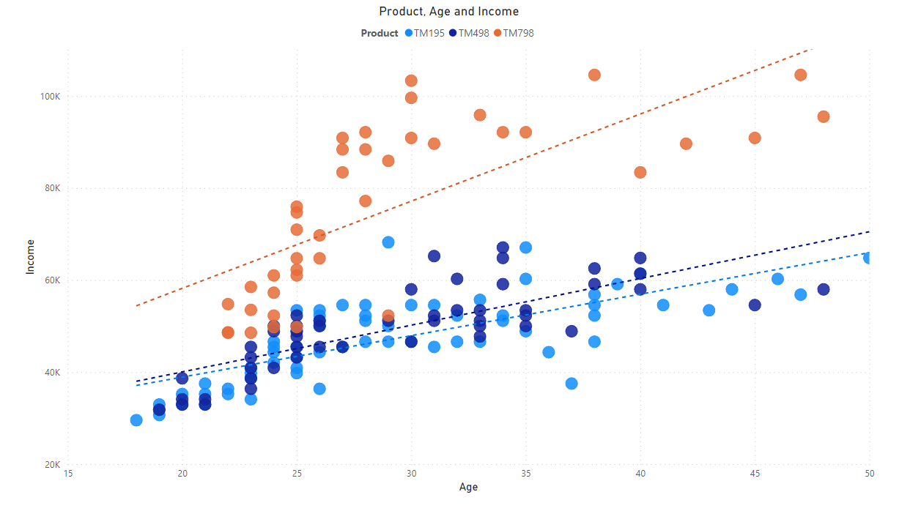

Slide 12
Conclusions
CardioGoodFitness customers were:
More likely to be male than female
More likely to be partnered than single
Most likely to be between the ages of 18-25
TM195 was the most popular product regardless of the age group – Maybe it was viewed to be the most reliable product between all three offerings?
TM498 was the middle child in terms of sales yet statistics of customers did not seem to differ too much from TM195
TM798 seemed to be preferred by more fit and higher income customers

Slide 13

Actions to be taken
Increase sales of products to females – perhaps find a way to promote the products to females more
Increase sales of products to people not in relationships – perhaps through marketing or targeted ads
Increase sales of TM498 by trying to market it towards a different base than TM195 as it seemed to attract the same customer base as TM195
Increase sales of TM798 to less fit and lower income users as it seemed to be marketed as a premium product only suited to more fit users – Maybe through sales/promotions and targeted marketing

