Slide 1
11:18:31
Street Racer
START

Slide 2
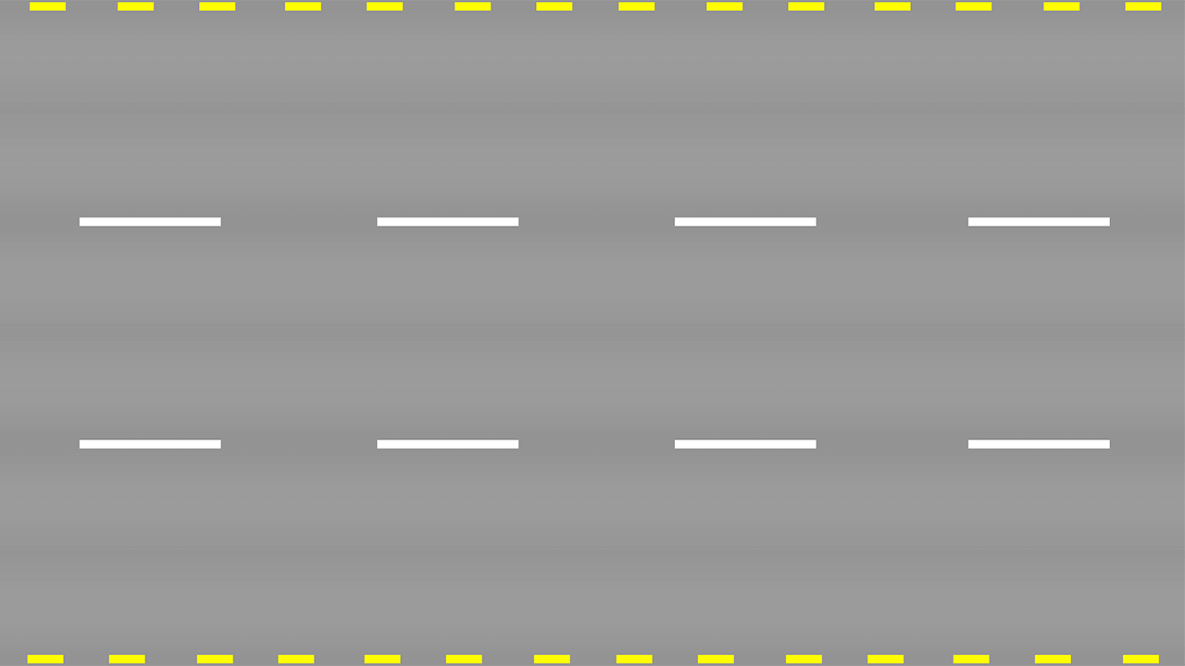
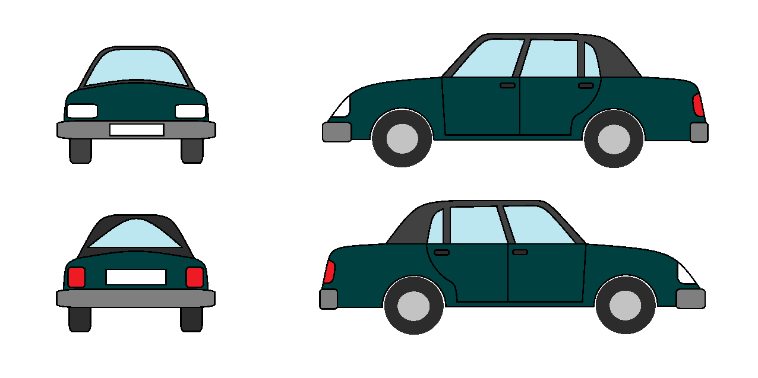
2
11:18:31

Slide 3
3
11:18:31

Slide 4
4
11:18:31

Slide 5
5
11:18:32

Slide 6
end
GAME OVER
11:18:32

Slide 7

fail
11:18:32
Always remember to exercise caution on the road.

Slide 8
GAME OVER

