Slide 1
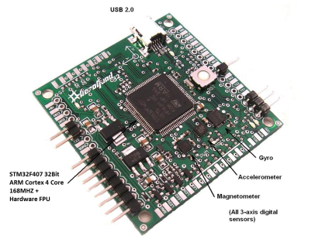
Main GUI
File Based
SubPanel
Configuration
Menu System
Communication System
Serial
MAVLINK
TCP/IP
Customizable
SubPanels
UDP

