Slide 1
Image support
for
suppress-for-release project

Slide 2
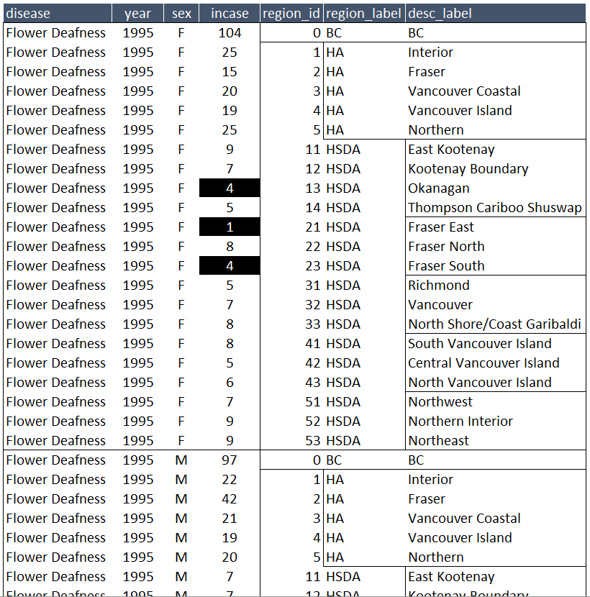
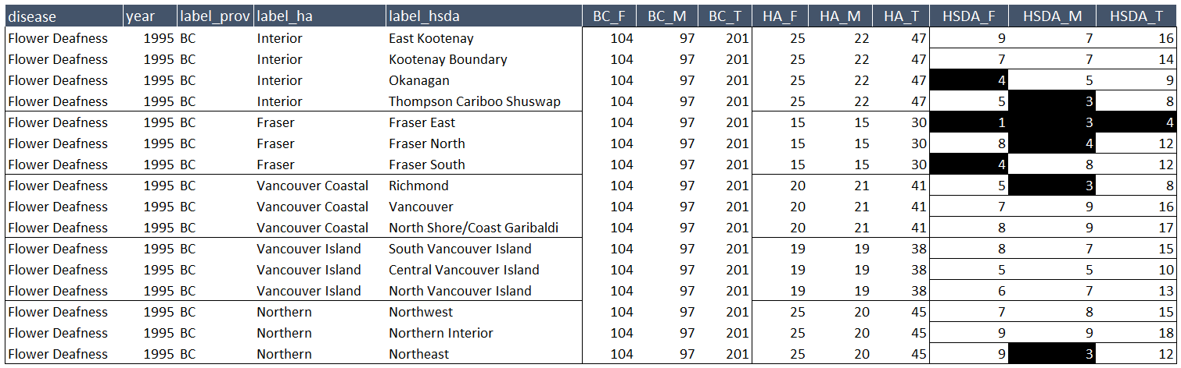
Workflow for `./suppress-for-release/manipulation/`
objective
raw
augmented
greeter
tuner
tester
grapher
Ministry
Of
Health
.csv
0
1
2
3
.csv
dto
raw [L]
meta [L]
target [W]
FRAMED
raw [L]
FRAMED
cleaned [L]
tuned [W]
FRAMED
test 1 [W]
test 2 [W]
test 3 [W]
FRAMED
redacted [L]
plotted [W]
augmented [L]
data transfer object
list object
data frame
graph
PRODUCED
COMPONETNS
[Long]
[Wide]
FRAMED
disease
D₁
D₂
…
D_{N}
Is the cell value smaller than ?
Can re-calculate from gender triplet?
Can re-calculate from higher-order unit?
year
LOGICAL
TESTS
5
Y₁
Y₁
…
Y_{K}
By Andriy Koval, Ph.D. © 2018

Slide 3
Dependency tree of key functions
in assisted redaction of small cells
Raw Long
lookup_meta()
clean_raw()
tidy_frame()
Tidy Wide
detect_small_cells()
detect_recalc_triplet()
detect_single_suppression()
elongate_values()
elongate_labels()
combine_logical_tests()
make_color_scale()
prepare_for_tiling()
make_tile_graph()
print_tile_graph()
By Andriy Koval, Ph.D. © 2018

