Slide 1
Multiple Access Control (MAC) Protocols
Lecture 5
Copyright © The McGraw-Hill Companies, Inc. Permission required for reproduction or display.

Slide 2
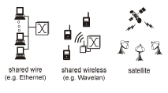
Multiple Access
Broadcast link used in LAN consists of multiple sending and receiving nodes connected to or use a single shared link
Broadcast links Examples

Slide 3

Figure 12.1 Data link layer divided into two functionality-oriented sublayers
Responsible for error and flow control
Link Layer Control (LLC)
Control
MAC
Responsible framing and MAC address and Multiple Access Control

Slide 4
Multiple Access
Problem: When two or more nodes transmit at the same time, their frames will collide and the link bandwidth is wasted during collision
  How to coordinate the access of multiple sending/receiving nodes to the shared link???
Solution: We need a protocol to coordinate the transmission of the active nodes
These protocols are called Medium or Multiple Access Control (MAC) Protocols belong to a sublayer of the data link layer called MAC (Medium Access Control)
What is expected from Multiple Access Protocols:
  Main task is to minimize collisions in order to utilize the bandwidth by:
    Determining when a station can use the link (medium)
    what a station should do when the link is busy
    what the station should do when it is involved in collision

Slide 5
Terms
Throughput: is the amount of data moved successfully from one place to another in a given time period.
propagation delay: is the amount of time it takes for the head of the signal to travel from the sender to the receiver.

Slide 6

For wireless

Slide 7
Random Access
Random Access (or contention) Protocols:
  No station is superior to another station and none is assigned the control over another.
  A station with a frame to be transmitted can use the link directly based on a procedure defined by the protocol to make a decision on whether or not to send.

Slide 8
ALOHA

Slide 9
ALOHA Random Access Scheme
It was developed at the University of Hawaii in the early 1970s to connect computers situated on different Hawaiian islands. The computers of the ALOHA network transmit on the same radio channel whenever they have a packet to transmit.
From time-to-time packet transmission will collide, but these can be treated as transmission errors, and recovery can take place by retransmission. When traffic is very light, the probability of collision is very small, and so retransmissions need to be carried out infrequently.
ALOHA scheme requires stations to use a random retransmission time. (This randomization is intended to spread out the retransmission and reduces the likelihood of additional collisions between stations. )
ALOHA is the father of multiple access protocols.

Slide 10
1 Pure ALOHA
  All frames from any station are of fixed length (L bits)
  Stations transmit at equal transmission time (all stations produce frames with equal frame lengths).
  A station that has data can transmit at any time
  After transmitting a frame, the sender waits for an acknowledgment for an amount of time (time out) equal to the maximum round-trip propagation delay
  Time out= 2* t_{prop}
  If no ACK was received, sender assumes that the frame or ACK has been destroyed and resends that frame after it waits for a random amount of time
  If station fails to receive an ACK after repeated transmissions, it gives up.
  Channel utilization or efficiency or Throughput is the percentage of the transmitted frames that arrive successfully (without collisions)

Slide 11

Critical time for pure ALOHA protocol
T_{fr}= Frame Transmission time
If the frame transmission time is T_{fr}, then the vulnerable time is = 2 T_{fr}.
This means no station should send during the T_{fr} before this station starts transmission and no station should start sending during the T-sec period that the current station is sending.

Slide 12
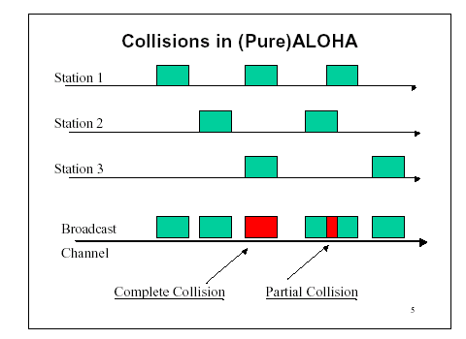
Pure ALOHA
In pure ALOHA, frames are transmitted at completely random times.

Slide 13
2 Slotted ALOHA
Time is divided into slots equal to a frame transmission time (Tfr)
A station can transmit at the beginning of a slot only.
If a station misses the beginning of a slot, it has to wait until the beginning of the next time slot.
A central clock or station informs all stations about the start of a each slot

Slide 14

In danger time for slotted ALOHA protocol

Slide 15
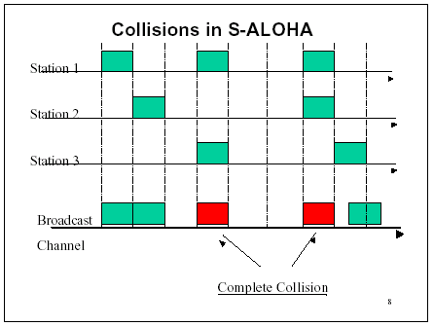
Random Access – Slotted ALOHA

Slide 16
ALOHA
Advantage of ALOHA protocols
  A node that has frames to be transmitted can transmit continuously at the full rate of channel (R bps) if it is the only node with frames
  Simple to be implemented
  No master station is needed to control the medium
Disadvantage
  If (M) nodes want to transmit, many collisions can occur and the rate allocated for each node will not be on average R/M bps
  This causes low channel utilization

Slide 17
Random Access – Carrier Sense Multiple Access (CSMA)

Slide 18
Random Access – Carrier Sense Multiple Access (CSMA)
A user wishing to transmit first listens to the medium to see if another transmission is in progress (carrier sense)
Based on the fact that in LAN propagation time is very small
➔ If a frame was sent by a station, All stations knows immediately so they can wait before start sending
  ➔ A station with frames to be sent, should sense the medium for the presence of another transmission (carrier) before it starts its own transmission
This can reduce the possibility of collision but it cannot eliminate it.
  Collision can only happen when more than one station begin transmitting within a short time (the propagation time period)

Slide 19
Types of CSMA Protocols
  Different CSMA protocols that determine:
  What a station should do when the medium is idle?
  What a station should do when the medium is busy?
    Non-Persistent CSMA
    1-Persistent CSMA
    p-Persistent CSMA

Slide 20
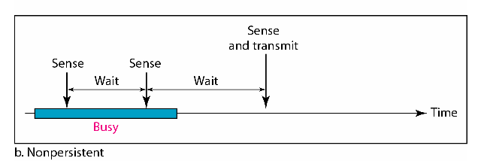
1) Non-persistent CSMA
A station with frames to be sent, should sense the medium:
If medium is idle, transmit; otherwise, go to 2
If medium is busy, (backoff) wait a random amount of time and repeat 1
Performance:
  Random delays reduces probability of collisions because two stations with data to be transmitted will wait for different amount of times.
  Bandwidth is wasted if waiting time (backoff) is large because medium will remain idle following end of transmission even if one or more stations have frames to send
Random Waiting times
Wasted time

Slide 21
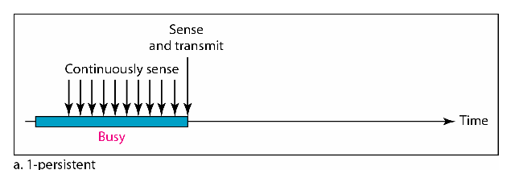
2) 1-persistent CSMA
To avoid idle channel time, 1-persistent protocol used
Station wishing to transmit listens to the medium:
  If medium idle, transmit immediately;
  If medium busy, continuously listen until medium becomes idle; then transmit immediately with probability 1
Performance
  1-persistent stations are selfish
  If two or more stations becomes ready at the same time, collision guaranteed

Slide 22
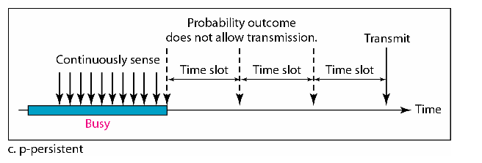
3) P-persistent CSMA
Time is divided to slots where each Time unit (slot) typically equals maximum propagation delay
Station wishing to transmit listens to the medium:
If medium idle,
  transmit with probability (p), OR
  wait one time unit (slot) with probability (1 – p), then repeat 1.
If medium busy, continuously listen until idle and repeat step 1
Performance
  Reduces the possibility of collisions like non-persistent
  Reduces channel idle time like 1-persistent

Slide 23
3) P-persistent CSMA
the time slot is usually set to the maximum propagation delay.
as p decreases, stations wait longer to transmit but the number of collisions decreases
Considerations for the choice of p:
(n x p) must be < 1 for stability, where n is maximum number of stations, i.e.,
p < 1/n

Slide 24
CSMA/CD (Collision Detection)
CSMA (all previous methods) has an inefficiency:
  If a collision has occurred, the channel is unstable until colliding packets have been fully transmitted
CSMA/CD (Carrier Sense Multiple Access with Collision
Detection) overcomes this as follows:
  While transmitting, the sender is listening to medium for collisions.
  Sender stops transmission if collision has occurred reducing channel wastage .
CSMA/CD is Widely used for bus topology LANs (IEEE 802.3, Ethernet).

Slide 25
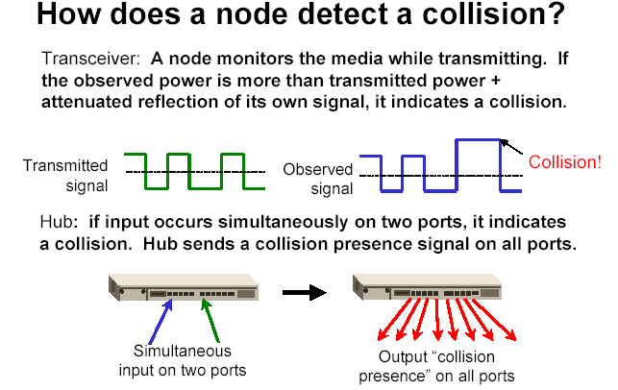
of its own
signal, it means collision occurred

Slide 26
CSMA/CD Protocol
Use one of the CSMA persistence algorithm
(non-persistent, 1-persistent, p-persistent) for transmission
If a collision is detected by a station during its transmission then it should do the following:
  Abort transmission and
  Transmit a jam signal to notify other stations of collision so that they will discard the transmitted frame also to make sure that the collision signal will stay until detected by the furthest station
  After sending the jam signal, backoff (wait) for a random amount of time, then
  Transmit the frame again

Slide 27
Controlled Access or Scheduling

Slide 28
Controlled Access or Scheduling
Provides in order access to shared medium so that every station has chance to transfer (fair protocol)
Eliminates collision completely
Three methods for controlled access:
  Reservation
  Polling
  Token Passing

Slide 29

1-Reservation Access Method
Stations take turns transmitting a single frame at a full rate ( R ) bps
Transmissions are organized into variable length cycles
Each cycle begins with a reservation interval that consists of (N) minislots. One minislot for each of the N stations
When a station needs to send a data frame, it makes a reservation in its own minislot.
By listening to the reservation interval, every station knows which stations will transfer frames, and in which order.
The stations that made reservations can send their data frames after the reservation frame.

Slide 30
2- Polling
Stations take turns accessing the medium
Two models: Centralized and distributed polling
Centralized polling
  One device is assigned as primary station and the others as secondary stations
  All data exchanges are done through the primary
  When the primary has a frame to send it sends a select frame that includes the address of the intended secondary
  When the primary is ready to receive data it send a Poll frame for each device to ask if it has data to send or not. If yes, data will be transmitted otherwise NAK is sent.
  Polling can be done in order (Round-Robin) or based on predetermined order
Distributed polling
  No primary and secondary
  Stations have a known polling order list which is made based on some protocol
  station with the highest priority will have the access right first, then it passes the access right to the next station

Slide 31

Select and poll functions in polling access method
Primary is sending to Secondary
Secondary is sending to Primary

Slide 32
3- Token-Passing network
Station Interface is in two states:
  Listen state: Listen to the arriving bits and check the destination address to see if it is its own address. If yes the frame is copied to the station otherwise it is passed through the output port to the next station.
  Transmit state: station captures a special frame called free token and transmits its frames. Sending station is responsible for reinserting the free token into the ring medium and for removing the transmitted frame from the medium.

Slide 33
Channelization

Slide 34
Channelization
Channelization is a multiple-access method in which the available bandwidth of a link is shared in time, frequency, or through code, between different stations. In this section, we discuss three channelization protocols.

Slide 35

Frequency-division multiple access (FDMA)

Slide 36
FDMA: Frequency Division Multiple Access:
  Transmission medium is divided into M separate frequency bands
  Each station transmits continuously on the assigned band
  A node is limited to an average rate even when it is the only node with frame to be sent

Slide 37

Time-division multiple access (TDMA)

Slide 38
TDMA: Time Division Multiple Access
TDMA: Time Division Multiple Access
  The entire bandwidth capacity is a single channel with its capacity shared in time between M stations
  A node must always wait for its turn until its slot time arrives even when it is the only node with frames to send

Slide 39
CDMA: Code Division Multiple Access
CDMA: Code Division Multiple Access
  In CDMA, one channel carries all transmissions simultaneously
  Each station codes its data signal by a specific codes before transmission
  The stations receivers use these codes to recover the data for the desired station

