Slide 1
Computer Networks
Network Introduction
Peer to Peer (P2P) network
Client/Server network
Hybrid network

Slide 2
Network Introduction
What is a Network?
A network consists of two or more computers that are linked in order to share resources (such as printers and CDs), exchange files, or allow electronic communications. The computers on a network may be linked through cables, telephone lines, radio waves, satellites, or infrared light beams.
Two very common types of networks include:
Local Area Network (LAN)
Wide Area Network (WAN)

Slide 3
Advantage of a network
Resource Sharing : A network enables sharing of data files. Software can be installed on a central server instead of buying licences for every machine. Peripherals such as printers scanners can be shared across an organization. Databases and files can be shared. This reduces cost effectively.
Better Communication : Internet enables better communication through email messaging chat rooms and video conferencing.
Access to remote databases : Internet allows users to access the remote databases like railway reservation universities hotels etc.

Slide 4
Need of Computer Network
Computer networks have become vital in the modern age because they allow interaction as well as sharing of resources among various devices and individuals.
The following is a list of things that we do via computer networks, matters that we benefit from using computer networks, or items that have become achievable or in effect as a result of computer networks.
Easy resource sharing − Computer networks allow users and devices to share resources like printers, documents, and apps easily. This increases efficiency while decreasing the expense of offering resources.
Good communication facility − Computer networks help individuals to communicate with one another regardless of where they are. Individuals can communicate in real-time using networking tools such as instant messaging, email, and video conferencing.

Slide 5
Access information − Networks enable access to a diverse set of services and information, such as the internet, database servers, and cloud-based services for computing. Individuals can now obtain and share data all over the globe.
High security − Networks enable the deployment of security precautions like encrypted connections, firewalls, and access control that help protect sensitive information and data from illicit access and other safety hazards.
Collaboration − Networks enable collaboration among people and groups engaged in the same task, regardless of their geographical location. This encourages collaboration, improves productivity, and fosters creativity.
Centralized management − Networks enable centralized handling of resources, apps, and information.

Slide 6
Peer to Peer (P2P) network/Workgroup
Peer-to-peer refers to the direct sharing of resources and information between devices or users without relying on a central server.
Peer-to-peer (P2P) is defined as a decentralized network architecture in which participants, called peers, interact directly with each other without the need for a central authority or server.
In a P2P network, each participant acts as both a client and a server, enabling them to share resources and services directly with other peers.
A peer-to-peer network is a group of computers or devices(called peers) that share resources and access shared resources without centralized control. In the group, there is no central authority that defines access rules. All group members have equal rights. A member cannot control another member in any form.

Slide 7
Advantages of peer-to-peer networks
A peer-to-peer network is easier to set up. It does not require any special software or operating system. You can set up a peer-to-peer network by using any operating system. Almost all operating systems support peer-to-peer networking and include necessary components to connect an existing peer-to-peer group or to create a new peer-to-peer group.
Since a peer-to-peer network does not require additional components or applications, it does not increase the setup cost. A peer-to-peer network also does not require any special networking knowledge. With basic networking knowledge, anyone can easily set up a simple peer-to-peer network.

Slide 8
Disadvantages of peer-to-peer networks
Peer-to-peer networks provide only basic options for advanced sharing. To use these options, a lot of setups are required. For example, suppose you have 10 computers in your network and want to use this architecture to set up a folder where users can save files.
In this case, first, you have to create 10 local user accounts on the system that holds the shared folder and defines access rules for each user account. Then you have to create the same user accounts with the same passwords on all reaming computers. You have to create and manage 100 user accounts (10x10 = 100) for a simple setup.

Slide 9
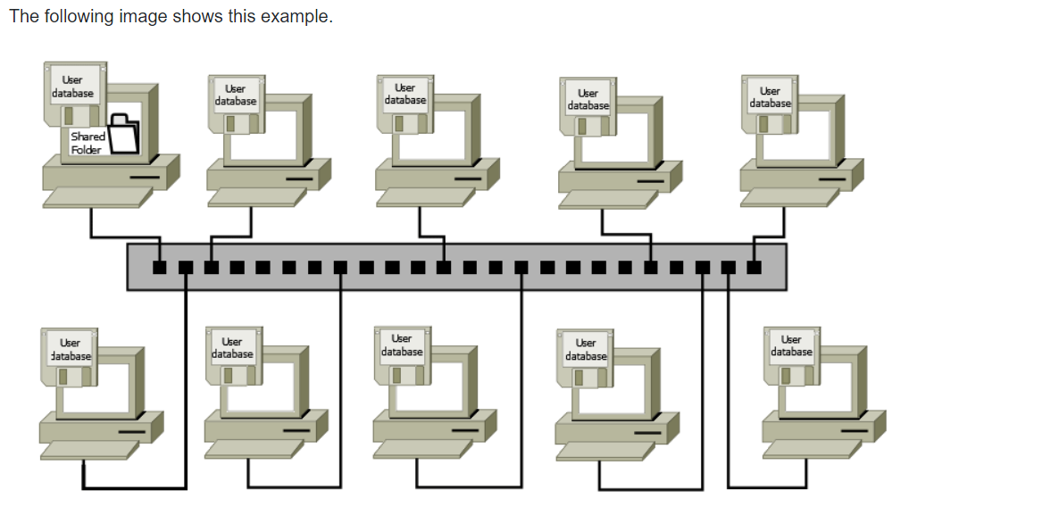
Peer to Peer Network

Slide 10
Since usernames and passwords are stored locally, a user can change them without notifying you. If this happens, the user will not be able to connect to the shared folder. This can be an organizational nightmare.
Since peer-to-peer networks do not use dedicated network operating systems, the performance of these networks is less than client-server networks that use dedicated network operating systems or applications.
Peer-to-peer networks are also not considered secure networks. In a peer-to-peer network, shared resources can be easily discovered and used by unauthorized users.
In this type of network, since data is not stored in a centralized location, backing up critical data is quite a difficult task.

Slide 11
Where should peer-to-peer networking be used?
Peer-to-peer networking is useful in the following conditions.
The number of computers or devices in the network is less than 15.
Networking is mainly required for hardware sharing.
Advanced sharing is not required.
Additional networking features are not required.
The administrator personally knows all users of the network.
Data security is not the top priority.
The above conditions are usually fulfilled in home and small office networks. Thus, peer-to-peer networking is mostly used in home and small office networks.

Slide 12
SCENARIO
To understand better, imagine a group of friends studying together for an exam. In a traditional classroom setting (client-server architecture), there is a teacher who serves as a central authority and provides information to all the students (clients). The students rely on the teacher for the necessary study materials and guidance.
Now, let’s apply the P2P concept to our study group. In this scenario, each student is considered a peer. Instead of relying solely on the teacher, the students can directly interact with each other, exchange study materials, and help each other understand difficult concepts.

Slide 13
For example, if one student has summarized notes for a particular topic, they can share it with the rest of the group by making copies or simply showing it to others. Another student might have found useful online resources or practice questions, which they can share with the group. The students can discuss and explain concepts to each other, asking questions and clarifying doubts.
In this P2P study group, no one student is solely responsible for providing all the information. Instead, each student contributes knowledge and resources, and everyone benefits from the collective effort. If one student is absent, it doesn’t stop the others from studying and sharing information. The study group functions efficiently because the peers are directly interacting and sharing resources without relying on a central authority.

Slide 14
Similarly, in a P2P computer network, each device can act as a peer, sharing files, data, or services directly with other peers in the network. There is no need for a central server to manage and distribute resources. Peers can communicate, exchange information, and collaborate, creating a decentralized network where everyone contributes to the overall functioning of the system.

Slide 15
Client/Server Network
In the client-server network model, shared resources are managed through a centralized database. A centralized database stores all information about the network. Usually, this information includes user accounts, passwords, computer accounts, location of shared resources, access rules, and the hierarchy of the network. The system on which the centralized database is installed is known as the server system.
Depending on the size of the centralized database and hierarchy of the network, the database can be installed on a single server system or multiple server systems. A centralized database can only be installed on a NOS. A NOS (network operating system) is a type of operating system that is mainly designed for applications that are used to perform networking-related tasks. Microsoft Windows Server, Ubuntu Server, and RHEL Server are examples of NOS.

Slide 16
Client systems are used to access shared resources. A client system provides two types of login access: local login and network login. The local login is used to access the resources available on the local system. The network login is used to access the shared resources available on the network.
A client system stores login information of only local user accounts. When a user uses the local user account to log in, the client system authenticates the login. When the user uses the network user account to log in, the client system transfers the credential to the server system. The server system checks the centralized database and grants login access if the supplied username and password are correct.
Since the login information of network user accounts is stored on the server system, a user can use any client system to log in and access his network user account.

Slide 17
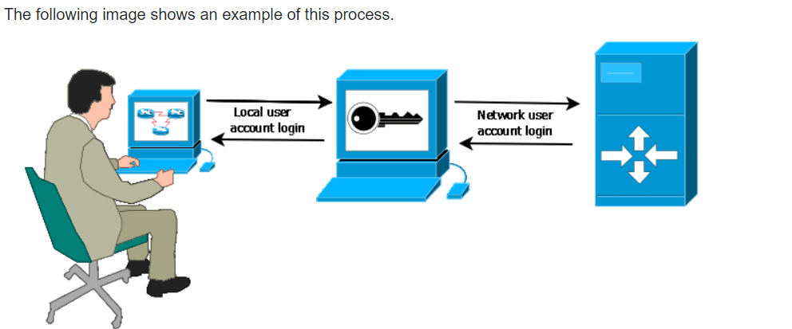
Client/Server network

Slide 18
Typically, a server is used for the following functions:
Authenticating user login
Restricting unauthorized access
Controlling what a user can access
Storing and managing data in a centralized location
Backing up data regularly
Creating network users accounts
Grouping user accounts based on multiple criteria and requirements
Storing locations of shared resources
Mapping user accounts with shared resources
Creating access rules for shared resources
Supplying network applications to client systems
Defining client computers from where a user can log in
To perform the above tasks, a server system requires more processing power, memory, and storage capacity than client systems. For example, a file server may use multiple hard disks to store a large amount of data.

Slide 19
Advantages of the client-server network model
It stores all critical information in a single place which makes it easier to manage and backup.
It allows an administrator to define access rules for each shared object.
It allows an administrator to control the entire network from a single place.
It is the most secure network model among all available network models.
It is scalable. An administrator can easily add and remove clients from the network.
In this model, troubleshooting is easy.

Slide 20
Disadvantages of the client-server network model
Since it stores all information in a single place, it has a single point of failure. If the server fails, the entire network fails.
It requires a network operating system(NOS) and network applications that cost a lot of money. You can easily purchase a top-end desktop computer for the price of a single NOS.
It requires a dedicated and experienced administer for setup and management.
It is not suitable for home and small offices.

Slide 21
Differences between the client-server network model and peer-to-peer network model
The peer-to-peer network model stores user accounts and passwords on the local system. The client-server network model stores user accounts and passwords on a centralized database that can be installed on a single system or a group of systems.
If a device accesses a service and presents a platform to use the accessed service, the device is known as the client. If a device provides a service, the device is known as the server. In the peer-to-peer network model, a device can act as both. It can act as a server to provide a service and act as a client to access a service. In the client-server model, a device has a dedicated role. It can be either a server or a client. It cannot be both.
In the peer-to-peer network model, each device has equal rights. A device cannot control another device in any form. In the client-server network model, the server defines the rights of each client.
The peer-to-peer network model does not require a special operating system and applications. The client-server network model needs a special operating system known as NOS and network applications.

Slide 22
The peer-to-peer network model is easy to set up and does not need an experienced administrator for management. The client-server network model is complex and needs an experienced administrator for management.
The peer-to-peer network is less expensive than the client-server network model.
The peer-to-peer network model provides basic sharing options. The client-server model provides all sharing options.
The peer-to-peer network is mostly used in a home or small office network. The client-server model is mainly used in a business environment.

Slide 23
Hybrid Network
Hybrid networks are the networks that are based on both peer-to-peer & client-server relationship.
• Hybrid networks incorporate the best features of workgroups in peer-to-peer networks with the performance, security and reliability of server-based networks.
• Hybrid networks still provide all of the centralized services of servers, but they also allow users to share and manage their own resources within the workgroup.

Slide 24
Advantages of Hybrid Network
Client Server application are still centrally located and managed.
Users can assign local access to resources in their computers.
Workgroups can manage resources without requiring assistance from network administrator.

Slide 25
Disadvantages of Hybrid Network
Users may need to remember multiple passwords.
Files can be duplicated and changes overwritten between the computers with the shared folder and the Server.
Files saved on the workstation are not backed up.

