Slide 1
Integrating Cancer Reporting
The Integrating Cancer Reporting Team was able to accomplish:
Laboratory able populate and successfully submit CAP electronic Cancer Checklist (eCC) form
Cancer registry able to query for CAP eCC form data, which is returned as FHIR Observations by the Infoway IHE SDC to FHIR Parser service
Example Service Instance: https://infoway.apibox.ca/sdcparser/
GitHub Repo: https://github.com/IHE-SDC-WG/IHE-SDC-FHIR-Parser
Cancer registry able to retrieve discretely mapped electronic pathology FHIR bundle
Able to display SDC form from DocumentReference
Save SDC data submitted inside a DocumentReference to a database

Slide 2
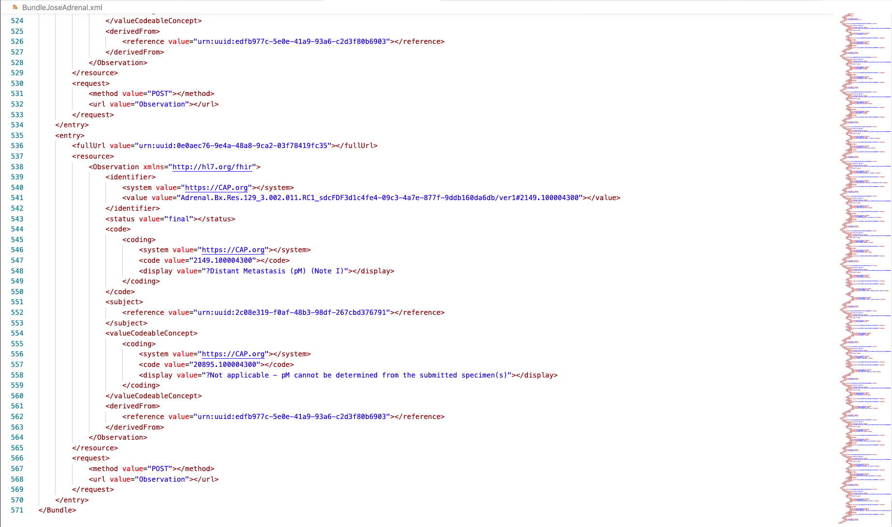
Example FHIR Bundle generated automatically from Infoway IHE SDC to FHIR Parser

