Slide 1
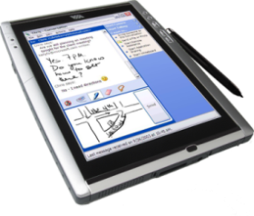
MHD as API to XDS
Patient Identity Source
XDS Document Registry
XDS Document Consumer
MHD Document Responder
MHD Document Recipient
XDS Document Source
XDS Document Repository
MHD Document Source
MHD Document Consumer
Notes:
In order to enable a mobile application to access an XDS environment, bridging code is used to implement an MHD document recipient or Document Responder which can be connected to by an MHD Document Source or Document Consumer on a mobile device.

