Slide 1







Direct Push Sharing Model: Data Flow
Mobile access to Health Documents (MHD)
Document Source
Document Consumer
RESTful push*
Cross-Enterprise Document Reliable Interchange
(XDR)
Document Source
Document Reliable Messaging System
Document Consumer
Cross-Enterprise Document Media Interchange
(XDM)
Document Source
Document Consumer
Write
Read

Slide 2
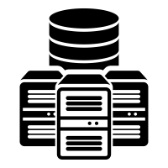
Centralized Discovery & Retrieve Sharing Models: Data Flow
Mobile Health Document
Sharing (MHDS)
Document Source
Query/
Retrieve
Document Consumer
Publish
MHDS Infrastructure (FHIR)
Mobile access to Health Documents (MHD) API:
Publish
Mobile access to Health Documents (MHD) API:
Query/Retrieve
Cross-Enterprise Document Sharing
(XDS)
Document Source
Query/
Retrieve
Document Consumer
Publish
XDS Infrastructure

Slide 3




Cross-Community Access (XCA) &
Cross-Community
Patient Discovery (XCPD)
Federated Communities
Cross-Enterprise Document Sharing
(XDS)
XDS
Community B
Document Consumer
XCA Gateways
XDS
Community C
Mobile Access to Health Documents
(MHD)
XDS
Community D
Document Consumer

