Slide 1
Gregorio Canal (Consorzio Arsenàl.IT)
XDS on FHIR®

Slide 2

Who am I?
Gregorio Canal
Standardization Area Team Leader
Consorzio Arsenàl.IT

Slide 3
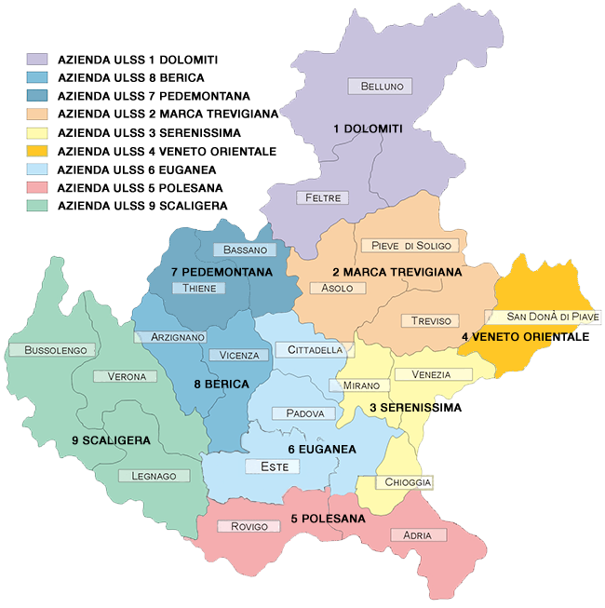
What does Arsenàl.IT?
Veneto Region’s consortium of:
9 Local Health Authorities
2 Hospital Trust
1 Institute of Oncology
We support them in the digital transition
Source: https://www.smettintempo.it/107_5/mappa-ambulatori.ashx

Slide 4
Learning Objectives
Document Sharing – as a given
FHIR® access to Documents
MHD –> XDS on FHIR®
Support profiles: IUA, PDQm, PIXm, etc
Decomposed into Elements/Resources
mXDE + QEDm
Using Provenance – to get back to source documents

Slide 5
XDS – Document Sharing
Document Sharing Registry (XDS)
Based on W3C standards
ebRegistry
SOAP
SAML
Patient Identity Management (PIX, PDQ)
Based on HL7 v2 or v3
Supports Centralized or Distributed Repository
User / Organization Federation
Certificate Authority trust domain
SAML assertions
XDS Registry
ITI-18 Registry Stored Query
XDS Document Consumer
ITI-42 Register Document
Integrated Document Source/Repository
XDS Document Source
ITI-41 Provide and
register document
XDS Repository
ITI-43 Retrieve Document

Slide 6
























IHE Standards-based HIE (XDS) Key Components
Patient ID Manager
PRIMARY CARE PHYSICIANS
Practice Management
EMR
PATIENT
Personal Health Records
Document Registry
Document Repositories
LAB
Results
PUBLIC HEALTH
Registries
PAYERS
Claim Data
PHARMACY/PBMs
RX History
HOSPITAL 2
EMR/PM’s
Lab
PACS Archive
SPECIALTY PRACTICE
Practice Management
EMR
HOSPITAL 1
EMR/PM’s
Lab
PACS Archive
Source: https://ihe.net

Slide 7
Principles of a Document
Persistence – A Document continues to exist in an unaltered state, for a time period defined by local and regulatory requirements. Note documents outlive the servers (and often the syntax), on which they are created.
Stewardship –A document is maintained over its lifetime by a custodian, either an organization or a person entrusted with its care.
Potential for authentication - A clinical document is an assemblage of information that is intended to be legally authenticated.
Context - A clinical document establishes the default context for its contents.
Wholeness - A document is a whole unit of information. Parts of the document may be created or edited separately, or may also be authenticated or legally authenticated, but the entire document is still to be treated as a whole unit.
Human readability – a document is human readable.

Slide 8



Various formats and encodings
XDS/XCA are content agnostic
Metadata enable discovery
CDA, C-CDA, C32, etc
FHIR® Documents
DICOM Documents
PDF/Text
Graphics (JPEG, MPEG, TIFF…)
Special (On-Demand, Delayed)
PDF
CDA
Image
FHIR® Documents

Slide 9
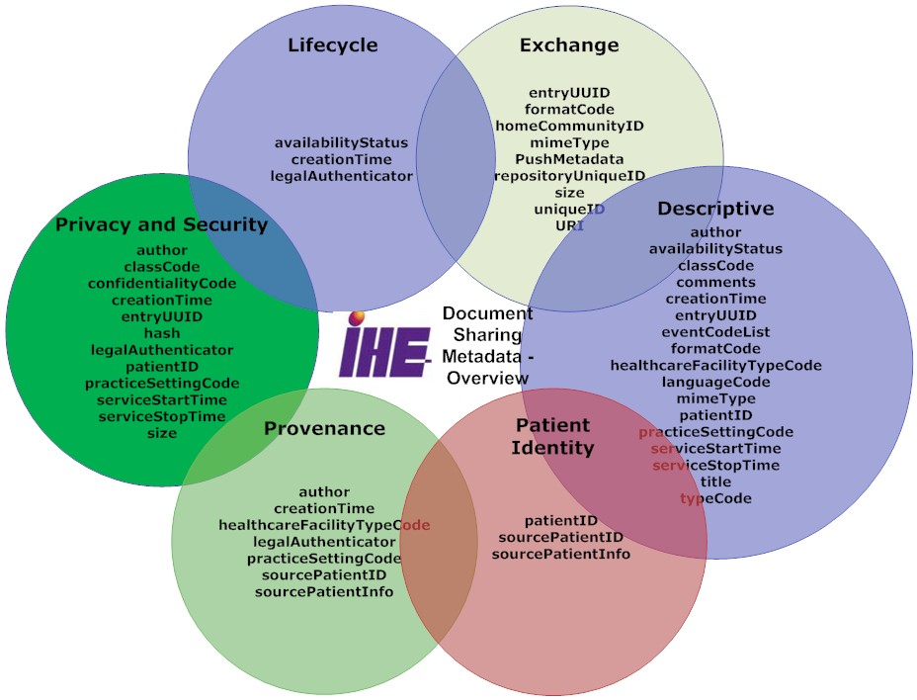
Metadata – enables discovery
Source: https://ihe.net

Slide 10
XDS Data Models
3 types of objects supported by XDS:
SubmissionSet: metadata describing a collection of Folders, DocumentEntries, and Associations submitted together.
Folder: metadata describing a collection of related DocumentEntries.
DocumentEntry: metadata describing a Document.
2 types of Association:
HasMember: represents membership of an object in a collection.
Relationship: represents a relationship(Replace, Transform, Append, Signs, etc) between two Documents (represented by DocumentEntries).

Slide 11
Mobile access to Health Documents (MHD)
Provide FHIR® based methods of publishing and accessing Document Sharing
Enable publication of Documents by Apps
Enable Discovery of available documents by Apps
Retrieval of the Document content
XDS on FHIR®
Details https://profiles.ihe.net/ITI/MHD/index.html
Document Recipient
Document Responder
ITI-65 Provide Document Bundle
ITI-66 Find Document Lists
ITI-105 Simplified Publish
ITI-67 Find Document References
ITI-105 Generate Metadata
ITI-68 Retrieve Document
Document Source
Document Consumer

Slide 12
MHD as API to XDS
Patient Identity Source
XDS Document Registry
XDS Document Consumer
XDS Document Source
XDS Document Repository

Slide 13
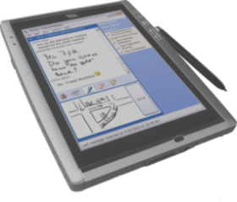
MHD as API to XDS
Patient Identity Source
XDS Document Registry
XDS Document Consumer
XDS Document Source
XDS Document Repository

Slide 14
MHD as API to XDS
Patient Identity Source
XDS Document Registry
XDS Document Consumer
XDS Document Source
XDS Document Repository
MHD Document Consumer

Slide 15
MHD as API to XDS
Patient Identity Source
XDS Document Registry
XDS Document Consumer
MHD Document Responder
XDS Document Source
XDS Document Repository
MHD Document Consumer

Slide 16
MHD as API to XDS
Patient Identity Source
XDS Document Registry
XDS Document Consumer
MHD Document Responder
XDS Document Source
XDS Document Repository
MHD Document Consumer

Slide 17
MHD as API to XDS
Patient Identity Source
XDS Document Registry
XDS Document Consumer
MHD Document Responder
XDS Document Source
XDS Document Repository
MHD Document Source
MHD Document Consumer

Slide 18
MHD as API to XDS
Patient Identity Source
XDS Document Registry
XDS Document Consumer
MHD Document Responder
MHD Document Recipient
XDS Document Source
XDS Document Repository
MHD Document Source
MHD Document Consumer

Slide 19
MHD as API to XDS
Patient Identity Source
XDS Document Registry
XDS Document Consumer
MHD Document Responder
MHD Document Recipient
XDS Document Source
XDS Document Repository
MHD Document Source
MHD Document Consumer

Slide 20
XCA– Cross-Community Access
Cross Community Access (XCA)
Based on W3C standards
ebRegistry
SOAP
SAML
Patient Identity Management (PIX, PDQ)
Based on HL7 v2 or v3
Discovering and Retrieving from another community
Initiating Gateway
ITI-38 Cross Gateway Query
Responding Gateway
ITI-39 Cross Gateway Retrieve

Slide 21
What is Community?
Coupling of facilities/enterprises that have agreed to work together using a common set of policies for the purpose of sharing clinical information via an established mechanism
Facilities/enterprises may host any type of healthcare application such as EHR, PHR, etc
A community is identifiable by a globally unique id called the homeCommunityId
Communities may be XDS Affinity Domains which define document sharing using the XDS Profile or any other communities, no matter what their internal sharing structure.
Initiating Gateway
ITI-38 Cross Gateway Query
Responding Gateway
ITI-39 Cross Gateway Retrieve

Slide 22
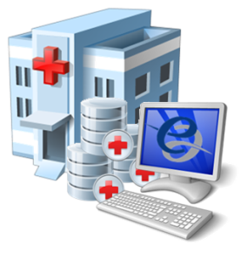
IHE Standards-based HIE (XCA) Community Document Sharing
XCA Gateway
Patient ID Manager
Patient ID Manager
PRIMARY CARE PHYSICIANS
Practice Management
EMR
Document Registry
PATIENT
Personal Health Records
PRIMARY CARE PHYSICIANS
Practice Management
EMR
Document Registry
PATIENT
Personal Health Records
Document Repositories
Document Repositories
LAB
Results
LAB
Results
PUBLIC HEALTH
Registries
PUBLIC HEALTH
Registries
EHR
PAYERS
Claim Data
PAYERS
Claim Data
HOSPITAL 2
EMR/PM’s
Lab
PACS Archive
HOSPITAL 2
EMR/PM’s
Lab
PACS Archive
PHARMACY/PBMs
RX History
SPECIALTY PRACTICE
Practice Management
EMR
HOSPITAL 1
EMR/PM’s
Lab
PACS Archive
PHARMACY/PBMs
RX History
SPECIALTY PRACTICE
Practice Management
EMR
HOSPITAL 1
EMR/PM’s
Lab
PACS Archive
Source: https://ihe.net

Slide 23
MHD as API to XCA
XDS Document Registry
XCA Responding Gateway
XCA Initiating Gateway
XDS Document Repository

Slide 24
MHD as API to XCA
XDS Document Registry
XCA Responding Gateway
XCA Initiating Gateway
MHD Document Responder
XDS Document Repository
MHD Document Consumer

Slide 25

XDS to FHIR: Profiles Mapping
XDS’s support profile | FHIR equivalent | Description | FHIR reference
PDQ v2 v3 | PDQm | patient demographics discovery | https://profiles.ihe.net/ITI/PDQm/index.html
PIX v2 v3 | PIXm | patient identifiers discovery | https://profiles.ihe.net/ITI/PIXm/index.html
XUA | IUA | handling of authentications protocols | https://profiles.ihe.net/ITI/IUA/index.html
ATNA | BALP, RESTful query and feed to ATNA | handling of secure HTTP protocols and events auditing | https://profiles.ihe.net/ITI/BALP/index.html https://www.ihe.net/uploadedFiles/Documents/ITI/IHE_ITI_Suppl_RESTful-ATNA.pdf
DSUB | DSUB for mobile (currently ongoing) | Handling of document subscription and notifications | http://build.fhir.org/ig/IHE/ITI.DSUBm/branches/master/index.html

Slide 26
XDS to FHIR: Object Mapping
DocumentEntry
SubmissionSet
Folder
Association
Document
DocumentReference
List
references
Binary

Slide 27
ITI-65 Provide Document Bundle Transaction (Publication request)
Bundle (Create Transaction)
List (SubmissionSet)
DocumentReference
Binary
DocumentReference
Binary
DocumentReference
Binary
List (Folder)
*Patient*
Publish
Used mostly with XDS Reg/Rep to publish new documents, or replace old documents with new
Push
Used to send documents
Document Source
Document Recipient

Slide 28
ITI-66 & ITI-67 Query Transactions – simply normal FHIR® queries
DocumentReference (DocumentEntry)
Patient – required parameter
classCode, practiceSetting, timeframe, etc
List (SubmissionSet / Folder)
Patient – required parameter
classCode, practiceSetting, timeframe, recipient, etc
Document Responder
Document Consumer

Slide 29
Documents are not optimal for FHIR® clients
MHD eliminates the need to understand SOAP and ebXML . It does enable API use of JSON or simple XML.
But Document format not changed
They are various formats (PDF, DICOM, CDA, etc)
CDA XML is not simple XML
Apps tend to want summary without duplicates
Yet
Apps will eventually need to know the integrity and authenticity of the data
Apps may need to reference the source
Many CDA today are just EHR data dumps – a Current Medical Summary
FHIR® provides nice sized chunks
Note: MHD Retrieve Document could support service that converts the original document to FHIR®-Document

Slide 30
Query for Existing Data for Mobile (QEDm)
Supports queries for clinical data elements (e.g., observations, allergies, etc.) by making the information widely available to other systems within and across enterprises
Aimed at class of systems that are resource- and platform-constrained (e.g., tablets, smartphones, and embedded devices including home-health devices)
Observation,
AllergyIntolerance,
Condition,
DiagnosticReport,
Medication,
MedicationStatement,
MedicationRequest,
Immunization,
Procedure,
Encounter,
Provenance,
OperationOutcome,
Bundle

Slide 31
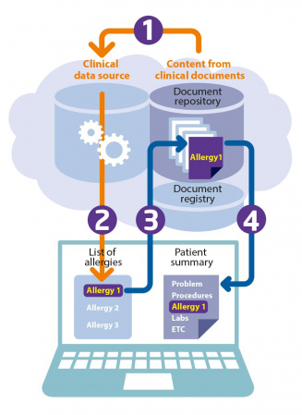
Mobile Cross-Enterprise Document Data Element Extraction (mXDE)
Provides means to access data elements extracted from shared structured documents
Enables the deployment of health data exchange infrastructures where fine-grained access to health data coexists and complements the sharing of coarse-grained documents and the fine-grained data elements they contain
Source: https://ihe.net

Slide 32
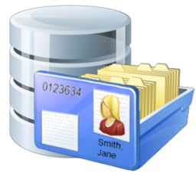

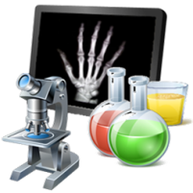


Resources
Shared Documents (XDS)
Observation
Obs 1
Obs 2
Obs 3
Med Summary
EHR
Medication
Med 1
Med 2
Med 3
Episode
2/7/1989
Lab/Rad
Allergy
Al 1
Al 2
Al 3
Discharge
Summary
1/2/2002
…
Immunization
Imm 1
Imm 2
Imm 3
EMR
Etc…
Provenance
Prov 1
Prov 2
Prov 3
Source: https://ihe.net

Slide 33
Using Provenance
Determine how often the issue is referenced (1 document vs all)
Determine who has published the issue
Pull the metadata -- DocumentReference
Pull the Document
Model for Provenance
One Provenance for each Document
Where a data Resource came from many documents, it will have many Provenance.target pointing at it
Provenance.target 🡪 1..* Resources (the resources that came from this document)
Provenance.recorded 🡪 when the decomposition happened (might inform cache)
Provenance.policy == “urn:ihe:pcc:qedm:2017:document-provenance-policy”
Provenance.agent 🡪 the software “ASEMBLER” that decomposed this document into these target Resources
Provenance.entity 🡪 the DocumentReference representing this document

Slide 34
Experiment
IHE-Connectathon tools
http://wiki.ihe.net/index.php/IHE_Test_Tool_Information
Published conformance resources
https://profiles.ihe.net/ITI/MHD/artifacts.html

Slide 35
Bonus Things not in the IHE Profiles
When using MHD, one could retrieve the Binary (Document) and get a better format than was published.
MHD Document Responder
MUST be able to return the Binary in the format given in the DocumentReference
May support negotiate to ‘better’ for the client format
Example when the document is in C-CDA, the C-CDA on FHIR transforms could be used to automatic conversion to FHIR Document http://hl7.org/fhir/us/ccda/history.html
Example when the Document Consumer would prefer a human rendering, the Document Responder could apply a stylesheet and return PDF rendering

Slide 36
Bonus Track- Mobile Health Document Sharing (MHDS)
100% FHIR infrastructure
Document Registry
MHD transactions
Persistence and lifecycle management
Patient Identity Management
Authorization - OAuth
Audit Record Repository
Details: https://profiles.ihe.net/ITI/MHDS/index.html
Document Registry
ITI-65 Provide Document Bundle
Document Recipient
Document Responder
ITI-66 Find Document Lists
ITI-105 Simplified Publish
ITI-67 Find Document References
ITI-105 Generate Metadata
ITI-68 Retrieve Document
Publisher
ITI-20 Record Audit Event
ITI-1 Matain time
Consumer
ITI-78 Mobile Patient Demographic Query
ITI-83 Mobile Patient identifier cross-reference Query
ITI-20 Record Audit Event
ITI-1 Matain time
ITI-78 Mobile Patient Demographic Query
ITI-83 Mobile Patient identifier cross-reference Query
ITI-20 Record Audit Event
ITI-1 Matain time
HIE central infrastructure

Slide 37
What did you learn?
Insights on XDS and XCA
MHD (XDS on FHIR)
Document Metadata Query
Publication of Documents
mXDE & QEDm
Get Decomposed Resources
Get Provenance, so that get source Document
Bonus: MHDS

Slide 38
Contact
During DevDays, you can find / reach me here:
Via Whova App – Speaker’s Gallery
email: gcanal@consorzioarsenal.it

Slide 39
Q&A

