Slide 1
Care Services Discovery
IHE IT Infrastructure Planning Committee
Carl Leitner – IntraHealth International

Slide 2

Agenda
Introduction
Terms Used
Care Services Discovery (CSD)
Comparison with HPD Profile
For More Information

Slide 3
Introduction
IHE has created three profiles for standards-based healthcare-related directories
The PWP profile describes people inside an enterprise
The HPD profile describes public information on people and organizations across enterprises
The CSD profile describes public information on people, organizations, facilities and the services they offer across enterprises
This presentation focuses on the CSD profile

Slide 4

Terms Used
Directory: A type of database, typically with a hierarchal structure, supporting queries to determine a list of matching subjects, or determining attributes about a subject.
Health Worker: The WHO definition of a health worker as all people engaged in the promotion, protection or improvement of the health of the population. This definition includes traditional health care providers such as physicians, medical laboratories, hospitals, dentists, pharmacists, nurses, diagnostic imaging professionals and community health workers. This definition also encompasses health management and support staff.

Slide 5
CSD Introduction
Care Services Discovery Profile (CSD) supports queries across related directories containing data about: organizations, facilities, services and providers.
Queries against an optional “FreeBusy” service are also supported. This FreeBusy determines a list of schedulable time slots for providers or services at specific facilities.

Slide 6
What Problem is Being Solved?
Example consumer-centric service queries:
  Where is the closest youth mental health services clinic?
  When is the earliest time I could schedule an appointment with a physiotherapist near my workplace?
Example health system management queries:
  What are my human resource for health capacities, by facility, by cadre?
  What are all the services offered at this facility?
  Where are all the facilities that offer this specific service?

Slide 7
CSD Scope
Provide access to basic information about the health services offered across an enterprise
  Does not include Protected Health Information
Defines method for querying directory of services
Defines stored and ad-hoc access method for complex queries
Defines attributes of interest

Slide 8
CSD Actors and Transactions
Care Services
InfoManager
Find Matching Services [ITI-73]
Query for Updated Services [ITI-74]
Service Finder
Care Services Directory
Query for FreeBusy [ITI-75]
Service
Availability

Slide 9
CSD Actors
Four Actors
  Care Services Directory– Maintains definitive data regarding one or more of: Organizations, Facilities, Services, or Providers.
  Service Finder– The Service Finder actor queries the Care Services InfoManager to retrieve interrelated content regarding care services.
  Care Services Info Manager– Periodically refreshes cached content from one or more Care Services Directory actors. Executes the inbound queries from Service Finder against its cached content and returns a response document in reply.
  Service Availability – Responds to queries from a Service Finder on “busy” information about a specified Provider or Service entity.

Slide 10
CSD Transactions
Three Transactions
  Find Matching Services– The Find Matching Services transaction is used to express queries regarding locations, times, and kinds of services available at different facilities and from different providers and organizations.
  Query For Updated Services– The Query for Updated Services is used to obtain all directory document content which has been inserted or updated since the specified timestamp.
  Query For FreeBusy– The Query for FreeBusy is used to retrieve the busy scheduling information for a provider or service at a facility. This transaction is optional.

Slide 11
CSD Ad hoc XQuery Option
The Care Services InfoManager and the Service Finder may implement the Ad hoc XQuery option of the Find Matching Services Transaction
The Ad hoc XQuery option is used when a Service Finder needs to access service information maintained by the Care Services InfoManager and for which there is not already a suitable stored query for this purpose.

Slide 12
CSD Data Schema
The CSD data schema is compatible with the following content specifications:
IHE Health Provider Directory (HPD) profile
WHO draft Master Facility List guideline
HL7-OMG Health Services Directory (HSD) Service Functional Model
HL7 Fast Health Interoperability Resources (FHIR) model

Slide 13
CSD Transaction Standards
CSD references the following standards in its transactions:
W3C XML Schema Definition Language (XSD) 1.1
W3C XQuery 1.0
  Used for profile definition. Not required for implementation.
W3C HTTP 1.1
W3C XForms 1.1
W3C SOAP version 1.2
RFC 4791 (CalDAV)

Slide 14
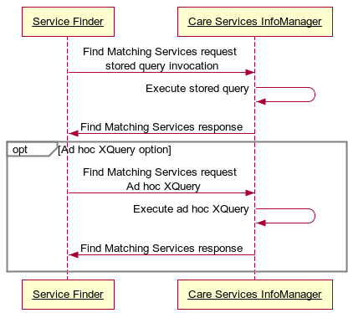
Interaction Diagram: Find Matching Services

Slide 15
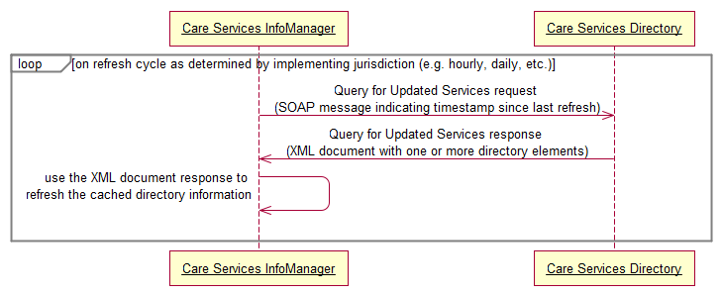
Interaction Diagram: Query For Updated Services

Slide 16
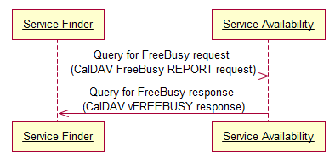
Interaction Diagram: Query for FreeBusy

Slide 17
CSD Security and Privacy
Security and privacy for CSD is established via other mechanisms
  ATNA can optionally be used for node authentication and secure audit logging
  EUA to authenticate users
  XUA for access control
  IT best practices
Regional-specific legal, regulatory, policy, privacy, and security analysis is suggested
See the CSD supplement section 35.5 for a security considerations analysis

Slide 18
CSD References
Status: Trial Implementation
IHE ITI Technical Framework Supplement
  Care Services Discovery

Slide 19
HPD and CSD Comparisons
Attribute | HPD | CSD
IHE Profile Dependency | None | None
Service Interfaces | Web Services | Web Services
Secured By | Optionally secured by TLS, VPN, or ATNA | Optionally secured by TLS, VPN, or ATNA
Cross Enterprise | Yes | Yes
Contains Public Health Worker Information | Yes | Yes
Contains Patient Information | No | No
Contains Organization Information | Yes | Yes
Contains Service Information | No | Yes
Contains Facility Information | No | Yes
Data Model Definition | LDAP | XML
Data Query Language | LDAP expressed as DSML | XForms / XQuery

Slide 20
More Information
IHE Web site: www.ihe.net
  IHE official material
  Technical Framework documents
IHE Wiki site: wiki.ihe.net
  IHE committee pages
  Implementation Notes
  Ongoing committee work
IHE ITI technical committee mailing list
  Instructions on the bottom of :
  http://www.ihe.net/IT_Infra/committees

Slide 21


