Slide 1
Cross-Community: Peer-to-Peer sharing of healthcare information
IT Infrastructure Planning Committee
Karen Witting - IBM

Slide 2

Outline
Defining the Cross-Community vision
Cross-Community Patient Discovery (XCPD) – locating communities for patients and correlating patient identifiers
Cross-Community Access (XCA) – query and retrieve patient data
Other profiles used in a cross-community environment

Slide 3
Timeline of ITI vision for Cross-Community
2006 – initial Cross-Community Vision
  Why is XDS not enough?
  2006 Whitepaper published
  Community defined
  Models of communication
  Future IHE profiles
2007 – Cross-Community Access Profile (XCA)
  Defines query & retrieve peer-to-peer model
2008 – updated Cross-Community Vision
  Whitepaper refining and expanding vision from 2006
2009 – Cross-Community Patient Discovery Profile (XCPD)
  Defines transactions for discovery of patient locations and identification
2010 – Cross-Community use of XDR
  Anecdotal use of XDR in peer-to-peer environments

Slide 4
Why extend XDS?
XDS only addresses document sharing within an XDS Affinity Domain
Cross-Community addresses the questions:
  How to share documents between XDS Affinity Domains?
  How to share documents with non-XDS Affinity Domains?

Slide 5

What is Cross-Community
Community
  Definition: A community is defined as a coupling of facilities/enterprises that have agreed to work together using a common set of policies for the purpose of sharing clinical information via an established mechanism.
  XDS Affinity Domain is an example of a community. Community expands the scope to include sharing of clinical information by a mechanism OTHER than XDS.
Cross-Community
  Transactions that support sharing of clinical information across Community boundaries.
  Cross-Community is a peer-to-peer environment where information is exchanged between gateways which each represent a community.
  Typically a national or regional organizing body defines policies for the exchange.

Slide 6
Cross-Community support Infrastructure
Require method for finding communities of interest
  Local configuration files
  DNS type discovery
  UDDI Registry
  Healthcare Provider Directory (see Provider presentation)
  Patient Specific Health Data Locator (see XCPD)
  Etc.
Require transactions between Community Gateways
  To resolve patient identifiers
  To query by patient identifier
  To retrieve documents
  Etc.
Patterns of communication
  Targeted – initiator knows where to target the request.
  Broadcast – initiator uses a group of communities of interest and sends queries to each

Slide 7
Existing IHE profiles used in XC environments
Cross Community Patient Discovery (XCPD)
  Profiled in 2009
  the means to locate communities which hold patient relevant health data and
  the translation of patient identifiers across communities holding the same patient’s data.
Cross Community Access (XCA)
  Profiled in 2007
  Query and retrieve of patient related clinical information
Cross-Enterprise Document Reliable Interchange (XDR)
  Existing profile applied to Cross-Community environment
  Push of information
Cross-Enterprise Media Interchange (XDM)
  Existing profile applied to Cross-Community environment
  Push of information

Slide 8
XCPD
Cross-Community Patient Discovery

Slide 9
XCPD Introduction
The Cross-Community Patient Discovery (XCPD) profile supports:
  the means to locate communities which hold patient relevant health data and
  the translation of patient identifiers across communities holding the same patient’s data.

Slide 10
XCPD Problem Statements
Multiple primary residences – patients sometimes maintain more than one primary residence and may get care in more than one community. To delivery quality care the communities will need to exchange data about this type of patient.
Patient Move – patients move from one community to another and healthcare data needs to be exchanged.
Vacationer – patients travel away from their primary location for vacation and business reasons. Care may be necessary in another community and healthcare data must be exchanged to facilitate that care.

Slide 11

XCPD Actors and Transactions

Slide 12
XCPD Actors and Transactions Defined
Actors
  Initiating Gateway
    On behalf of internal actors, initiates all transactions leaving the community
    initiates the new XCPD transactions
    does not need to be grouped with XCA Initiating Gateway
  Responding Gateway
    Single contact point for all transactions coming in to the community.
    responds to the new XCPD transactions
    does not need to be grouped with XCA Responding Gateway
Transactions
  Cross Gateway Patient Discovery – discover mutually known patients.
  Patient Location Query – query Responding Gateway which supports Patient Locations for the particular patient for a list of communities which may have relevant health data.

Slide 13
XCPD Options
Health Data Locator – collects locations of health data for selected patients. Provides access to this data by other communities via the Patient Location Query.
Revoke – invalidate cached patient correlations
Asynchronous Web Services Exchange – short term delayed response
Deferred Response – longer term delayed response

Slide 14
XCPD Process Flow
Patterns of XCPD use: (see XCPD Section 27.3.2 for detailed descriptions)
  In response to an event within the community, for instance a patient registration
  As part of responding to ITI-18 Registry Stored Query
  Creating and sharing Health Data Locator
Identifying target Responding Gateways – XCPD does not identify how this is done but some approaches are:
  a static configuration file
  service or provider directory lookup
  known set based on patient identifier

Slide 15
XCPD Process Flow
Event within the community
Community A
Community B
Unspecified Interaction (could be PDQ)
(2) ITI-55 Cross Gateway Patient Discovery
Responding
Gateway
Initiating
Gateway
MPI
(1) Unspecified community Interaction
Community C
Internal
Actor
Responding
Gateway
MPI
Unspecified Interaction (could be PDQ)
Notes:
XCPD Process flow where the Initiating Gateway is processing an internal event and decides to gather remote patient identifiers
(1) An event is processed within the Community, for example a new patient is registered. The event provides demographics for the patient and possibly a local patient identifier
(2) Initiating Gateway identifies target Responding Gateways and sends ITI-55 Cross Gateway Patient Discovery transaction to find the other community’s patient identifier that matches the demographics of the patient. Responding Gateways use the demographics specified in ITI-55 and search their local MPI (using PDQ or equivalent) to find a matching patient. If found, Responding Gateways return their patient identifier for the found patient.
(3) Initiating Gateway saves patient identifier returned from ITI-55 for future use.

Slide 16
XCPD Process Flow
Responding to Registry Stored Query
Community A
Community B
(2) Get demographics for patient (PDQ)
Responding
Gateway
Unspecified Interaction
(could be PDQ)
MPI
(3) ITI-55 Cross Gateway Patient Discovery
Initiating
Gateway
MPI
(4) ITI-38 Cross Gateway Query
Community C
(1) ITI-18 Registry Stored Query
Responding
Gateway
MPI
(5) ITI-18 Registry Stored Query Response
Document
Consumer
Unspecified Interaction
(could be PDQ)
Notes:
XCPD Process flow where the Initiating Gateway is processing an ITI-18 Registry Stored Query transaction and needs remote patient identifiers prior to sending a XCA Cross Gateway Query
(1) Local Document Consumer sends ITI-18 to Initiating Gateway.
(2) Initiating Gateway uses a mechanism within the community, like consultation of an MPI through PDQ or equivalent, to find the demographics for the patient identified in the ITI-18 query.
(3) Initiating Gateway identifies target Responding Gateways and sends ITI-55 Cross Gateway Patient Discovery transaction to find the other community’s patient identifier that matches the XDS Affinity Domain identifier provided in the ITI-18 transaction. Responding Gateways use the demographics specified in ITI-55 and search their local MPI (using PDQ or equivalent) to find a matching patient. If found, Responding Gateways return their patient identifier for the found patient.
(4) Initiating Gateway uses patient identifier returned from ITI-55 in the ITI-38 Cross Gateway Query transaction. If no identifier in ITI-55 is returned, no ITI-38 transaction is sent.
(5) Results from ITI-38 are consolidated into a single response to the ITI-18 request.

Slide 17
XCPD Process Flow
Use of Health Data Locator
(2) ITI-55 Cross Gateway Patient Discovery
Community B
Community A
Responding
Gateway
Initiating/ Responding
Gateway
(supporting Health Data Locator for PID-A)
PID-B
PID-C
PID-A
Responding
Gateway
Community C
(1) PID-A Locator
Community |  | Local (A)
OID | PID | PID
A | PID-A | PID-A
B | PID-B | PID-A
C | PID-C | PID-A
D | PID-D | PID-A
PID-D
(3) ITI-55 Cross Gateway Patient Discovery
(4) ITI-56 Patient Location Query
Initiating
Gateway
Community D
PID-A
See XCPD Section 27.3.2 for detailed workflow
Notes:
XCPD Process flow where the Initiating Gateway is building and sharing Health Data locations for Patient PID-A.
Community A decides to support Health Data Locations for Patient with identifier PID-A. Community A builds a database of locations and primes it with its own information OID=A, PID=PID-A.
Community A contacts the communities it knows about, searching for matches to the demographics associated with PID-A. Community B returns PID-B and Community C returns PID-C. Community A adds two more rows to its database containing OID=B, PID=PID-B and OID=C, PID=PID-C. (in yellow)
Community D, previously unknown to Community A, sends a search by demographics to Community A for a patient matching PID-A. Community A adds Community D to its database (OID=D, PID=PID-D) (in red). In addition to returning PID-A as a matching patient, Community A also returns an indicator that they are acting as a Health Data Locator for this patient.
Community D requests the patient locations for PID-A and Community A returns a table of community OIDs and matching patient PIDs. Community D can now use XCA to request patient records from all the communities known by Community A.

Slide 18
Cross Gateway Patient Discovery Transaction
Mutual discovery of patients - dual purposes:
  Query requesting demographic match
  Feed announcing known patient
Result is patient identifier correlations, potentially in both initiating and responding side
Different modes used in different environments:
  Demographic Query only
  Demographic Query and Feed
  Shared/National Patient Identifier Query and Feed
Includes a revoke message for remove correlations found through this transaction
Supports both asynchronous and synchronous transport

Slide 19
Cross Gateway Patient Discovery Transaction
Standards
Based on HL7 V3 Patient Administration DSTU, Patient Topic
  Patient Registry Query by Demographics
  Patient Registry Find Candidates Response
  Patient Nullify
Design started with PDQ V3 Query (incomplete list of differences with PDQ V3):
  asynchronous web services exchange
  mutual discovery of patient identifier correlations
  special error codes
  requiring name and gender
  supports MothersMaidenName and PrincipalCareProviderId
  specification of homeCommunityId and Community patient id assigning authority.
  Etc.

Slide 20
Patient Location Query
Request for list of communities that may have healthcare data for a specified patient
Request includes a single patient identifier known by the responder
Response includes a list of triples
  homeCommunityId – identifies community which may have data for the patient
  CorrespondingPatientId – identifies the patients identifier within homeCommunityId
  RequestPatientId – same as request parameter
Standards
  Based on Appendix V IHE Web Services
  Content defined by IHE schemas
    Chose not to use HL7 or ebXML because the simplicity of the request/response content did not warrant complex content

Slide 21
XCPD Security/Privacy
ATNA Secure Node required – auditing and secure communication
CT Time Client required – consistency of time in audit log
Implementer must use network protection to guard against denial of service attacks
Policy neutral profile - many policy decision required

Slide 22

XCPD References
Trial Implementation status
Primary Content
  XCPD Supplement
Underlying Technical Framework Content
  ITI TF-2x
    Appendix E – use of II data type for patient identifiers
    Appendix O “HL7 v3 Transmission and Trigger Event Control Act Wrappers”
      Small update within XCPD Supplement
    Appendix V “Web Services for IHE Transactions”
      Small update within XCPD Supplement
Notes:
PIX/PDQ V3 move to final text expected August 2011

Slide 23
XCA
Cross-Community Access

Slide 24
XCA Introduction
The Cross-Community Access (XCA) profile supports:
  the means to query and retrieve patient relevant medical data held by other communities.
Guiding principles and scope:
  Sharing of documents across communities
  Re-use of XDS.b transactions.
  Document Consumer consistency
    Requirements of Document Consumer are the same as for local document query and retrieval
  Out of scope:
    How to identify which communities to interact with
    How to identify the patient id to use when interacting
    XCPD supplies solutions to both of the above

Slide 25
XCA Problem Statements
(same as XCPD)
Multiple primary residences – patients sometimes maintain more than one primary residence and may get care in more than one community. To delivery quality care the communities will need to exchange data about this type of patient.
Patient Move – patients move from one community to another and healthcare data needs to be exchanged.
Vacationer – patients travel away from their primary location for vacation and business reasons. Care may be necessary in another community and healthcare data must be exchanged to facilitate that care.

Slide 26
XCA Transaction Diagram
Notes:
A minimal implementation of XCA supports only the transactions between the Gateways. This implementation assumes the Community uses an internal sharing mechanism that is not XDS.

Slide 27
XCA Transaction Diagram
With XDS Affinity Domain Option
Notes:
The Initiating Gateway may declare the XDS Affinity Domain option in order to support a local XDS Document Consumer to query and retrieve content from outside the community.

Slide 28
XCA Transaction Diagram
Initiating Grouped with Doc Consumer
Notes:
An Initiating Gateway may also group with a Document consumer in order to locate health documents within the local community and consolidate with content from outside the community into a single response to the Document Consumer.

Slide 29
XCA Transaction Diagram
Responding grouped with Doc Consumer
Notes:
If a Responding Gateway groups with a Document Consumer this allows the gateway to represent an XDS Affinity Domain and act as a proxy for the local Registry and Repository.

Slide 30
Cross Community Access
Actors
Initiating Gateway - on behalf of internal actors, initiates all transactions leaving the community
  Receives Registry Stored Query and Retrieve Document Set from Document Consumer
  Propagates transaction to local Document Registry and Repository, if grouped with Document Consumer
  Propagates transaction to other communities by contacting their Responding Gateway and sending: Cross Gateway Query and Cross Gateway Retrieve
    In propagating the transaction the Initiating Gateway must identify a set of Responding Gateways to contact and must translate patient identifiers for each Responding Gateway
  does not need to be grouped with XCPD Initiating Gateway
Responding Gateway
  Single contact point for all transactions coming in to the community.
  Propagates incoming transactions to local actors
  does not need to be grouped with XCPD Responding Gateway

Slide 31
XCA Transactions and Options
New Transactions:
  Cross Gateway Query: from Initiating Gateway to Receiving Gateway, mimics Registry Stored Query
  Cross Gateway Retrieve: from Initiating Gateway to Receiving Gateway, mimics Retrieve Document Set
Document Consumer
  Supports Registry Stored query and Retrieve Document Set
  Supplies the homeCommunityId by propagating it from prior Registry Stored Query response
XDS Affinity Domain
  Initiating Gateways interact with Document Consumers within the XDS Affinity Domain served by the Initiating Gateway.
  Initiating Gateways receive Registry Stored Query transactions
  Initiating Gateways receive Retrieve Document Set (ITI-43) transactions
  If an Initiating Gateway does not support the XDS Affinity Domain option it is expected to be using non-IHE specified interactions to communicate remote community data to systems within its local community. These proprietary interactions are not further described within any IHE profile.
Asynchronous Web Services Exchange
  Support for short term delayed response
  Uses Web Services SOAP headers

Slide 32
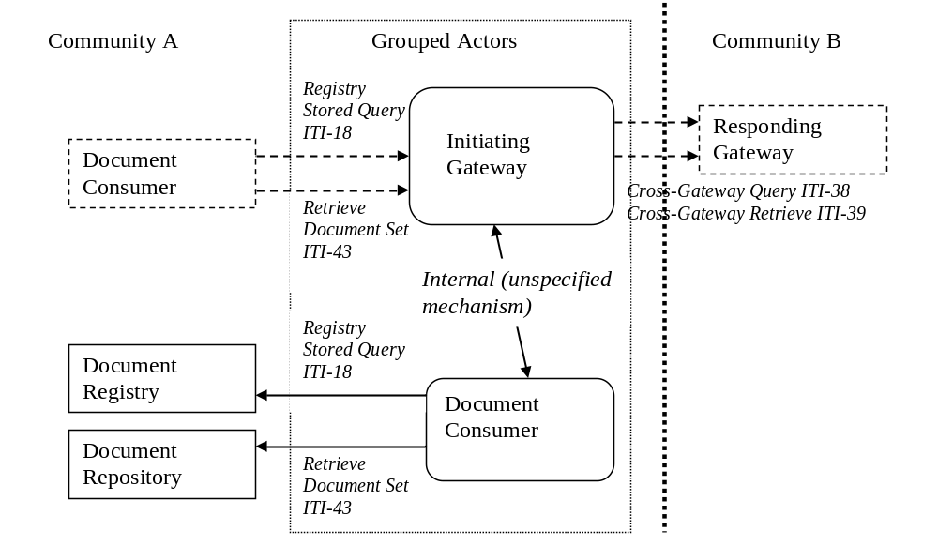
Initiating Gateway grouped with Document Consumer

Slide 33
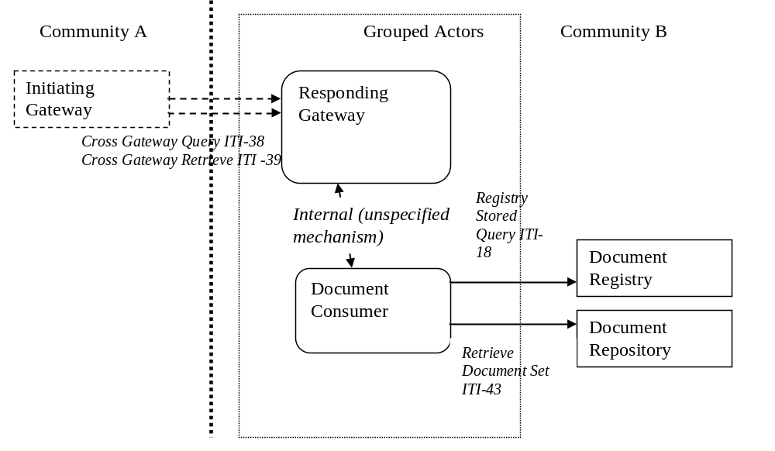
Responding Gateway grouped with Document Consumer

Slide 34
XCA Process Flow
Query with XDS Affinity Domain Option
Prior to sending ITI-38, Initiating Gateway must:
1) Identify target Responding Gateways
2) Translate patient identifiers (see XCPD)
Community B
Responding
Gateway
(4) ITI-18
XDS Registry
Community A
Initiating
Gateway
(2) ITI-18
XDS Registry
(3) ITI-38 Cross Gateway Query
XDS Repository
XDS Repository
(1) ITI-18 Registry Stored Query
Community C
Responding
Gateway
Unspecified Interaction
(5) Return consolidated results
Unspecified
Actor
Document
Consumer
Notes:
XCA Process flow where the Initiating Gateway supports the XDS Affinity Domain Option and is grouped with a Document Consumer
Local Document Consumer send ITI-18 to Initiating Gateway.
(2) Because of grouping with Document Consumer the Initiating Gateway will send an ITI-18 to the local XDS Document Registry. This transaction will use the same XDS Affinity Domain patient identifier as (1)
(3) Prior to sending the ITI-38 transaction the Initiating Gateway will:
a) Identify the list of Responding Gateways to target. Typically this list is identified through either i) a static configuration file ii) service directory lookup iii) known set based on patient identifier
b) For each targeted Responding Gateway, do any necessary Patient Identifier translation. ITI-18 uses a XDS Affinity Domain patient identifier and ITI-38 uses the patient identifier as known by the receiver.
c) Send ITI-38 transaction to targeted Responding Gateway
(4) If the Responding Gateway is grouped with a Document Consumer it will interact with a local Document Registry using ITI-18 to respond to the ITI-38 request. Otherwise the Responding Gateway with use some internal interaction to collect the information required.
(5) Results from (2) and (3) are consolidated into one set of results to the Document Consumer

Slide 35
XCA Process Flow
Retrieve with XDS Affinity Domain Option
Community B
Responding
Gateway
XDS Registry
Community A
Initiating
Gateway
(4) ITI-43
XDS Registry
(2) ITI-43
(3) ITI-39 Cross Gateway Retrieve
XDS Repository
XDS Repository
(1) ITI-43 Retrieve Document Set
Community C
Responding
Gateway
(5) Return consolidated results
Unspecified Interaction
Document
Consumer
Unspecified
Actor
Notes:
XCA Process flow where the Initiating Gateway supports the XDS Affinity Domain Option and is grouped with a Document Consumer
This example is atypical because it shows retrieval of documents from three different sources. The most common example would return only a single document and thus only a single source would be contacted.
Local Document Consumer sends ITI-43 to Initiating Gateway. The Initiating Gateway will use the homeCommunityId value in the ITI-43 transaction to determine which community to target with a retrieve transaction.
(2) If the homeCommunityId indicates the local ID (Community A in our diagram) and the Initiating Gateway is grouped with Document Consumer, the Initiating Gateway will send an ITI-43 to the correct local XDS Document Registry.
(3) If the homeCommunityId indicates a non-local community (either Community B or Community C in our diagram) the Initiating Gateway will send ITI-39 transaction to the appropriate Responding Gateway
(4) If the Responding Gateway is grouped with a Document Consumer it will interact with a local Document Repository using ITI-42 to respond to the ITI-39 request.
(5) Results from (2) and (3) are consolidated into one set of results to the Document Consumer

Slide 36
homeCommunityId
homeCommunityId value is unique and opaque
Used by Initiating Gateway to map to the originator of the data
Returned in ITI-38 Cross Gateway Query and from Initiating Gateway in response to ITI-18 Registry Stored Query
  homeCommunityId corresponds to the ‘home’ attribute defined on the relevant ebRIM 3.0 elements. Example:
  <ExtrinsicObject home=” urn:oid:1.2.3.4” status="urn:oasis:names:tc:ebxml-regrep:StatusType:Approved" >
Optional parameter to stored queries of ITI-18 Registry Stored Query which do not include a patient id.
Optional parameter on ITI-43 Retrieve Document Set transaction

Slide 37
Processing of “home” (homeCommunityId)
Doc Consumer
Initiating GW
Responding GW
(1)
@ GW Address
Query by patient id
GW Address
Home ‘a’
(3)
Home ‘a’
GW Address
(2)
Home ‘a’
Home ‘a’
(4)
Home ‘a’
Query by uuid
GW Address
Home ‘a’
(5)
GW Address
Home ‘a’
Home ‘a’
Retrieve
Notes:
This diagram shows how the homeCommunityId (“Home”) is used to identify the Gateway Web Services End Point (GW Address) during Registry Stored Query and Retrieve Document Set transactions.
The Document Consumer sends a Registry Stored Query transactions specifying a patient identifier and possibly other constraints. No homeCommunityId value is included in this query. The Initiating Gateway uses internal logic (perhaps configuration files or directory search) to determine which Responding Gateways to contact. For each identified Responding Gateway the Web Services End Point Address (GW Address) is found (probably through configuration). The diagram shows contact of a single Responding Gateway.
The Responding Gateway (@ GW Address) receives the Cross Gateway Query and formulates a response. It specifies a homeCommunityId value (Home ‘a’) in the elements of the response.
The Initiating Gateway receives the Cross Gateway Query response and associates the “right” Web Services End Point address with the homeCommunityId value. This “right” address may be the one to which the query was sent or may be another configured value. The Initiating Gateway uses configuration to associated Home ‘a’ with the GW Address. The response is returned to the Document Consumer, including the value of homeCommunityId.
The Document Consumer uses the data returned in the query result, including the homeCommunityId, to initiate a subsequent Registry Stored Query transaction specifying a uuid that was found in the prior query response. The Initiating Gateway uses its configured association between the homeCommunityId (Home ‘a’) and the GW Address to send a Cross Gateway Query to the correct Responding Gateway. The Responding Gateway returns a response to the query which is subsequently returned to the Document Consumer.
The Document Consumer uses the data returned in the query result, including the homeCommunityId, to initiate a Retrieve Document Set transaction. The Initiating Gaeway uses is configured association between the homeCommunityId (Home ‘a’) and the GW Address to send a Cross Gateway Retrieve to the correct Responding Gateway. The Responding Gateway returns the document requested which is returned to the Document Consumer.

Slide 38
XCA Standards
ebRIM - OASIS/ebXML Registry Information Model v3.0
ebRS - OASIS/ebXML Registry Services Specifications v3.0
ITI TF-2x: Appendix V
  WS-I Profiles
  WS-* Specifications

Slide 39
XCA Security/Privacy
ATNA Secure Node required – auditing and secure communication
CT Time Client required – consistency of time in audit log
Use of SHA1 hash used to detect document corruption
Patient Specific Queries only
Policy neutral profile - many policy decision required

Slide 40
XCA References
Final Text status
Primary Content
  ITI TF-1 Section 18
  ITI TF-2b Sections 3.38, 3.39
Underlying Technical Framework Content
  ITI TF-1
    Appendix E.9 XCA Integration with XDS and non-XDS communities
    Appendix E.10 XCA and Patient Identification Management
    Appendix J Content and Format of XDS Documents
    Appendix K XDS Concept Details
  ITI TF-2a
    Section 3.18 Registry Stored query
  ITI TF-2b
    Section 3.43 Retrieve Document Set
  ITI TF-2x
    Appendix V “Web Services for IHE Transactions”
  ITI TF-3
    Section 4.1 XDS Metadata Model

Slide 41
Conclusion
Cross-Community in a larger context

Slide 42
XDR & XDM
XDR and XDM are peer-to-peer push transactions which are useful when a push model of information transfer is desired.
The combination of XCA for query/retrieve and XDR/XDM for push information transfer completes the need for Cross Community sharing of health data.
XDR/XDM are described in detail within the point-to-point HIE presentation.

Slide 43

Cross-Community Peer-to-peer Sharing
Community A
Document
Registry
Community D
XCPD, XCA, XDR, XDM
transactions
Document
Registry
Practice
Practice
Hospitals
Practice
Hospitals
Practice
Hospitals
Gateway
Practice
Hospital
Hospital
Patient ID
services
Hospital
Gateway
Practice
Practice
Hospitals
Practice
Hospitals
Clinic
Practice
Hospitals
Clinic
Clinic
Repository
Patient ID
services
Clinic
Repository
Clinic
Clinic
Repository
Repository
Community B
Gateway
Gateway
Document
Registry
XDS, XDR, XDM, PIX, PDQ transactions
Community C
Non-XDS Community based sharing model
Practice
Practice
Hospitals
Practice
Hospitals
Hospitals
Patient ID
services
Clinic
Repository
Notes:
Cross-Community supports the sharing of patient records across communities. Communities A, B and D use XDS for internal sharing. These communities may also use XDR, XDM, PIX, PDQ. Community C uses a non-XDS model of patient record sharing. Community C may use other IHE profiles like XDR, XDM, PIX, PDQ but does not maintain a central XDS Document Registry. All communities, no matter what their internal model of sharing is, communicate using the same set of peer-to-peer transactions which are: XCPD, XCA, XDR and XDM.

Slide 44




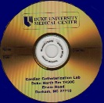

Health Document Exchange Options
Flexible Infrastructure
XDS INFRASTRUCTURE
XCA
Other INFRASTRUCTURE
M8354673993
Query/Retrieve
M8354673993
L-716
14355
A87631
L-716
14355
A87631
Document Sources
Document Consumers/ Recipients
XDS
XDS INFRASTRUCTURE
Publish
M8354673993
Query/Retrieve
L-716
14355
A87631
XDR
Existing Reliable
Messaging System
Send to
Receive
Interchange Media
XDM
Read
Write
Including Email

Slide 45
More Information
IHE Web site: www.ihe.net
  IHE official material
  Technical Framework documents
IHE Wiki site: wiki.ihe.net
  IHE committee pages
  Implementation Notes
  Ongoing committee work
IHE ITI technical committee mailing list
  http://www.ihe.net/IT_infra/committees
  At the bottom of the page is a place to join the mailing list

Slide 46


