Slide 1
Health Information Exchange: Enabling Document Sharing Using IHE Profiles
IT Infrastructure Planning Committee
Karen Witting - IBM

Slide 2
Outline
Introduction
Principles of IHE for Health Document Sharing
Document Sharing Profiles
Patient Identity Management
Common Provider Directory
Security and Privacy

Slide 3
Health Information Exchange: Enabling Document Sharing Using IHE profiles
Published January 2012 by ITI Planning Committee
Authors Karen Witting and John Moehrke
Overview paper: Ties together many threads of detail into one framework paper
References other more detailed material:
ITI Educational Materials http://wiki.ihe.net/index.php?title=Current_Published_ITI_Educational_Materials
Presentation charts and webinars on specific ITI topics
ITI Technical Frameworks Page http://www.ihe.net/Technical_Framework/index.cfm#IT
Template for XDS Affinity Domain Deployment Planning
ITI Volume 1, 2a, 2b, 2x, 3 volumes with Final Text Profiles
ITI Supplements with Trial Implementation Profiles
Audience:
Excellent introduction to IHE’s approach to exchanging healthcare information
Especially useful to those who have experience in one aspect of IHE document sharing but want a high level perspective.
Comments welcome:
http://www.ihe.net/iti/iticomments.cfm

Slide 4
Health Document Sharing Communities
Purpose: increasing the accessibility of patient health information across multiple organizations so that clinicians can make more informed decisions about the care that they provide
Size, nature and scope vary widely
Geographically focused vs. other affinity (example VA)
Organizational structure – single hospital, network of competing hospitals/laboratories/etc.
Scope of content shared – only summaries or labs, vs. more extensive types of content.
Ultimate Goal: to increase the authorized exchange of patient health information across organizations so that clinicians can make more informed decisions about the care that they provide

Slide 5

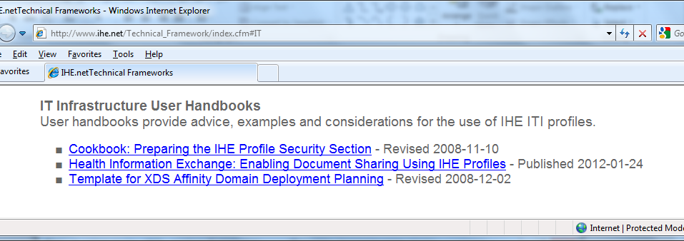
Health Information Exchange:
Enabling Document Sharing using IHE Profiles
User Handbook
http://www.ihe.net/Technical_Framework

Slide 6
Principles of IHE for Health Document Sharing

Slide 7
General Principles and Governance
General IHE Principles
Describes interactions between systems not internal implementation of systems
Supports a wide variety of governance and policy
Assumes general understanding of widely implemented IT standards (XML, TCP/IP, DNS, etc.)
Document Sharing Governance
IHE assumes a governance structure is agreed among sharing partners
IHE does not specify the details but only the areas governance must address
For example, in support of semantic interoperability, IHE Document Sharing assumes there exists a governance structure that specifies:
Format of document content exchanged
Coding systems used within documents
Coding systems within metadata about documents

Slide 8
IHE Document Principle
Use of Documents : IHE Document Sharing Profiles
are content neutral, governance specifies content supported by a particular set of sharing partners
operate independent of the format or information within documents
see documents as any collection of bytes, including proprietary and textual formats
expect documents to be a coherent set of healthcare data that includes enough context to be useful to a practitioner
are supported by IHE and other organizations which have integration profiles which define document content for specific, commonly occurring cases. Most common document content standard that is profiled by IHE is HL7 Clinical Document Architecture (CDA).

Slide 9
Semantic Interoperability through 3 legged stool
Document Content through governance specified content profiles
Value Coding through governance specified coding systems
Interoperable Exchange through IHE document Sharing

Slide 10
Documents
Distinction between Documents and Messages
HL7 distinction: “A document is designed to be persistent for long periods of time, whereas messages are more often expected to be transient. There is a place for both of these constructs in healthcare.”
Document: Persistence, Wholeness, Stewardship, Context, Potential for authentication
Longitudinal Patient Record
Represented by a collection of documents related to the same patient
Document Sharing enables access to Longitudinal Patient by all sharing partners

Slide 11
IHE Metadata Principle
Value of Metadata
common metadata used across all IHE Document Sharing profiles
metadata about the document that aid its identity, discovery, routing, security, provenance, privacy, authenticity and electronic pre-processing
facilitates interoperability, so that receiving systems can manage, route and administer documents even if they are unable to interpret the contents of the document.
Document Relationships – enabled through metadata
Documents – metadata describes attributes of the document
Folders – attributes of folders and document members
Submission Set – groups documents at submission
Document Associations – links documents in support of lifecycle events like: appends, replace, transform

Slide 12
Locating sharing partners
Strongly influenced by governance and policy
Needs vary significantly across environments
IHE supports some building blocks
Alternatives can be broadly categorized:
Locating electronic services
local configuration files
services registry
healthcare provider directories (HPD)
Locating patient specific sources of information
patient specific health data locator (XCPD)
Patient Identity Cross-Reference (PIX) – through implications of PID assigning authority
Patient Demographics Query (PDQ) – through implications of PID assigning authority
Cross-Enterprise Document Sharing (XDS) Query

Slide 13
Document Sharing Profiles

Slide 14
Document Sharing Models
Document Sharing Models:
Three models to support different use case types:
Direct Push – content sent directly to recipient, point-to-point push
Cross-Enterprise Document Reliable Interchange (XDR)
Cross-Enterprise Document Media Interchange (XDM)
Centralized Discovery and Retrieve – community uses common infrastructure to push content to infrastructure and query/retrieve from it
Cross-Enterprise Document Sharing (XDS)
Federated Discovery and Retrieve – content directly pulled from content holder
Cross-Community Access (XCA)
Share common document and metadata definitions
Types of Issues solved through governance largely the same
Some variance in the resolutions based on model
Detailed information regarding these profiles available in the “Publication and Discovery”, “Point-to-Point Transmission of Documents” and “Cross-Community: Peer-to-Peer sharing of healthcare information” slide decks and webinars referenced in the last slide.

Slide 15

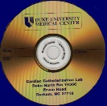
XCA
XDS INFRASTRUCTURE
Other INFRASTRUCTURE
M8354673993
Query/Retrieve
M8354673993
L-716
14355
A87631
L-716
14355
A87631
Document Sources
Document Consumers/ Recipients
XDS
XDS INFRASTRUCTURE
Publish
M8354673993
Query/Retrieve
L-716
14355
A87631
XDR
Existing Reliable
Messaging System
Send to
Receive
Interchange Media
XDM
Read
Write
Including Email

Slide 16
EHRA White Paper: Supporting a Robust Health Information Exchange Strategy with a Pragmatic Transport Framework

Slide 17
EHRA White Paper: Supporting a Robust Health Information Exchange Strategy with a Pragmatic Transport Framework

Slide 18
Patient Identity Management

Slide 19
Patient Identity Management
Patient Centric - a patient is associated with each document shared.
Patient identified within the metadata through Identifiers and/or demographics
Direct Push resolving the patient/document association either:
Carry “enough” demographic data to allow receiving to match with local data
Resolve the patient to a commonly known patient identifier prior to push
Query requires initiating system to resolve the patient to a commonly known patient identifier prior to query

Slide 20
Patient Identity Management Profiles
IHE provides profiles to enable resolution of the patient to a commonly known patient identifier:
Patient Identifier Cross-Referencing (PIX) – supports linking of patient identifiers across multiple patient identifier domains
Patient Demographics Query (PDQ) - to query by demographics
Detailed information regarding these profiles available in the “Patient Identifier Management” slide deck and webinar referenced in the last slide.

Slide 21
Common Provider Directory

Slide 22
Common Provider Directory
Management of data related to healthcare providers
Healthcare Provider Directory (HPD) Profile
Supports both organizational and individual providers
Disambiguate the identifier of providers
Access provider contact information
Detailed information regarding these profiles available in the “Healthcare Provider Directories” slide deck and webinar referenced in the last slide.

Slide 23
Security and Privacy

Slide 24
Security/Privacy
Risk Assessment and Management
IHE profiles are used in combination with
policy, physical environment, procedures, organizational, departmental, functional, and information technology
all in combination support security and privacy requirements
IHE profiles support:
privacy and security audit logging
user and system identification and authentication
access control
Encryption
data integrity
digital signatures
privacy consent management
Detailed information regarding Security/Privacy is available in the “Security and Privacy Overview” slide decks and webinars referenced in the last slide.

Slide 25
IHE Security and Privacy Controls
Security & Privacy Controls IHE Profile | Profile Issued | Audit Log | Identification and Authentication | Data Access Control | Secrecy | Data Integrity | Non-Repudiation | Patient Privacy
Audit Trails and Node Authentication (ATNA) | 2004 | √ | √ | √ | √ | √ | √ | √
Consistent Time (CT) | 2003 | √ | ∙ |  |  |  | √
Enterprise User Authentication (EUA) | 2003 |  | √ | ∙ |  |  | ∙ | ∙
Cross-Enterprise User Assertion (XUA) | 2006 |  | √ | ∙ |  |  | ∙ | ∙
Basic Patient Privacy Consents (BPPC) | 2006 |  |  | ∙ |  |  |  | √
Personnel White Pages (PWP) | 2004 |  | √ | √ |  |  | ∙
Healthcare Provider Directory (HPD) | 2010 |  | √ | ∙ |  |  | ∙
Document Digital Signature (DSG) | 2005 |  | √ |  |  | √ | √
Document Encryption (DEN) | 2011 |  |  | √ | √ | ∙

Slide 26
Conclusion

Slide 27
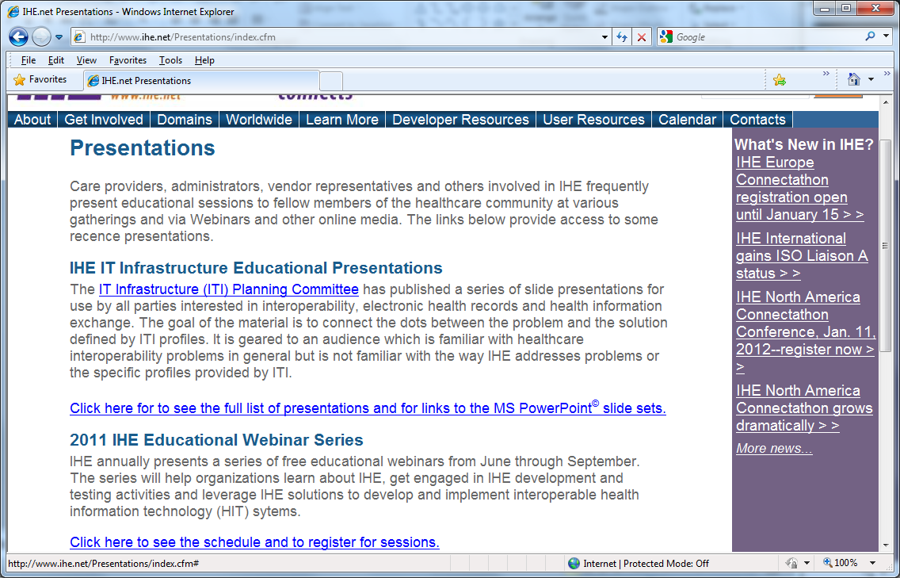
http://www.ihe.net/Presentations

Slide 28
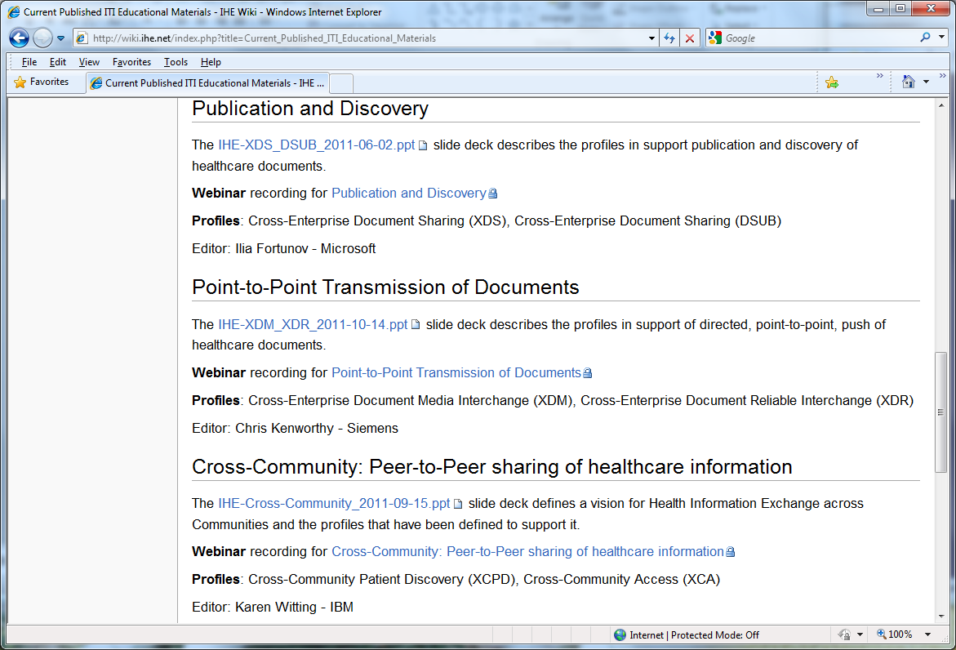


Slide 29
More Information
IHE ITI Educational Presentations
http://wiki.ihe.net/index.php?title=Current_Published_ITI_Educational_Materials
Interoperability, IHE and ITI Introduction
Health Information Exchange: Enabling Document Sharing Using IHE Profiles (this presentation)
Security and Privacy Overview
Publication and Discovery
Point-to-Point Transmission of Documents
Cross-Community: Peer-to-Peer sharing of healthcare information
Patient Identity Management
Healthcare Provider Directories
Cross-enterprise Document Workflow
IHE Web site: www.ihe.net

Slide 30


