Slide 1
Patient Identity Management
IHE IT Infrastructure Planning Committee
Eric Heflin – Medicity/THSA
Notes:
Acknowledgements: The majority of the work done on this presentation was completed while the author was employed by Medicity. The remaining work was completed while the author was employed by the Texas Health Services Authority (THSA). All opinions are the author’s and not necessarily of the organizations he is affiliated with. Should not be construed as legal advice.

Slide 2
Agenda
Introduction
The Patient ID Problem
The IHE Solution
For More Information
Notes:
Audience
Senior healthcare IT technical executives
Architects
Implementers seeking a broad overview
Scope
Broad context and guidance about the use of IHE standard profiles for patient identifier management across organizational boundaries
Purpose
Provide reusable educational content

Slide 3
IHE Patient Identity Management Introduction

Slide 4
Introduction
IHE has created six profiles for standards-based patient management
Some profiles target patients inside an enterprise
Other profiles target patients across enterprises
This presentation introduces and compares five of these six profiles (XCPD is covered in detail elsewhere)

Slide 5
What Problem is Being Solved?
Problem statement:
How can we correctly identify and manage patients across boundaries (with different demographics/identifiers in different systems) to accommodate the exchange of health information using a standards-based approach with a high degree of assurance that the information is about the correct patient?

Slide 6
IHE Profiles
IHE has created six profiles designed to solve different aspects of this problem, using existing industry standards
PIX – Patient Identifier Cross-Referencing
PIXv3 – Patient Identifier Cross-Referencing HL7 V3
PDQ – Patient Demographics Query
PDQv3 – Patient Demographics Query HL7 V3
*XCPD – Cross-Community Patient Discovery
PAM – Patient Administration Management
*XCPD is discussed in detail in the Cross-Community
presentation

Slide 7
PIX, PDQ, XCPD and PAM integrated model
Administration and Service Functions
PIX Notification Service
PIX Query Service
Patient Identity Feed (PIX) and Management (PAM) Services
HL7
XCPD/PDQ Service
HL7
Enhanced PDQ Service
Master Patient ID Domain
Patient Identity Source
MPI Service
Service defined in IHE Technical Framework
Higher level services (leveraging base services)
Service out of IHE scope
7

Slide 8
Patient Identity Cross-Referencing (PIX) and Patient Identifier Cross-Referencing HL7 V3 (PIXv3)

Slide 9
PIX Introduction
The PIX profile supports the cross-referencing of patient identifiers from multiple Patient Identifier Domains. These cross-referenced patient identifiers can then be used by “identity consumer” systems to correlate information about a single patient from sources that “know” the patient by different identifiers. This allows a clinician to have more complete view of the patient information.
This integration profile does not define any specific enterprise policies or cross-referencing algorithms
PIX is supported on two HL7 messaging levels: HL7 V2 messaging (PIX) AND HL7 V3 messaging (PIX V3). Identical purpose, different underlying standards.

Slide 10
PIX Introduction
The Patient Identifier Cross-referencing Integration Profile (PIX) is targeted at healthcare enterprises of a broad range of sizes (hospital, a clinic, a physician office, etc.). It supports the cross-referencing of patient identifiers from multiple Patient Identifier Domains via the following interactions:
The transmission of patient identity information from an identity source to the Patient Identifier Cross-reference Manager.
The ability to access the list(s) of cross-referenced patient identifiers either via a query / response or via update notification.

Slide 11
PIX Introduction
The Patient Identifier Cross-Referencing Integration Profile supports two types of domains:
A Patient Identifier Domain is defined as a single system or a set of interconnected systems that all share a common identification scheme (an identifier and an assignment process to a patient) and issuing authority for patient identifiers.
The Patient Identifier Cross-reference Domain embodies the following assumptions about agreement within the group of individual Patient Identifier Domains:
They have agreed to a set of policies that describe how patient identities will be cross-referenced across participating domains;
They have agreed to a set of processes for administering these policies;
They have agreed to an administration authority for managing these processes and policies.

Slide 12
PIX Use Case
Multiple Identifier Domains within an Enterprise.
Clinician seeks to monitor data across Intensive Care and hospital’s laboratory system
Essentially two different patient identifier domains
Hospital ADT system (acts as the Patient Identity Source) provides Patient Identity Feed (PIX Feed) to the PIX Manager
Intensive Care system would also send a PIX Feed to the PIX Manager
Subsequently any authorized system could use the PIX Manager to determine alternate identifiers
Notes:
UC 1: A clinician in the Intensive Care Unit at General Hospital is reviewing a patient chart on the
Intensive Care information system and wishes to review or monitor the patient‘s glucose level,
which is included in a laboratory report stored in the hospital‘s main laboratory system. The
Intensive Care system needs to map its own patient ID, which it generates internally, to the patient‘s
medical record number (MRN), which is generated from the hospital‘s main ADT system and is
used as the patient identity by the lab system. In this case the Intensive Care system is essentially in
a different identifier domain than the rest of the hospital since it has its own notion of patient
identity.
In this scenario, the hospital‘s main ADT system (acting as a Patient Identity Source) would provide a Patient Identity Feed (using the patient‘s MRN as the identifier) to the Patient Identifier Cross-reference Manager. Similarly, the Intensive Care system would also provide a Patient Identity Feed
to the Patient Identifier Cross-reference Manager using the internally generated patient ID as the
patient identifier and providing its own unique identifier domain identifier.
Once the Patient Identifier Cross-reference Manager receives the Patient Identity Feed transactions,
it performs its internal logic to determine which, if any, patient identifiers can be ―linked together
as being the same patient based on the corroborating information included in the Feed transactions it
has received. The cross-referencing process (algorithm, human decisions, etc.) is performed within
the Patient Identifier Cross-reference Manager and is outside the scope of IHE. (See ITI TF-2a:
3.9.4.2.2.6 for a more complete description of the scope of the cross-referencing logic boundary).
The Intensive Care system wants to get lab information associated with a patient that the Intensive
Care system knows as patient ID = ‗MC-123‘. It requests the lab report from the lab system using
its own patient ID (MC-123) including the domain identifier/ assigning authority. Upon receipt of
the request, the lab system determines that the request is for a patient outside of its own identifier
domain (ADT Domain). It requests a list of patient ID aliases corresponding to patient ID = ‗MC-123
(within the ―Intensive Care domain‖) from the Patient Identifier Cross-reference Manager.
Having linked this patient with a patient known by medical record number = ‗007‘ in the ‗ADT
Domain‘, the Patient Identifier Cross-reference Manger returns this list to the lab system so that it
may retrieve the lab report for the desired patient and return it to the Intensive Care system.

Slide 13
Patient Identifier Cross-Referencing (PIX)
Administration and Service Functions
PIX Notification Service
PIX Query Service
Patient Identity Feed (PIX)
HL7
HL7
Master Patient ID Domain
Patient Identity Source
MPI Service
Service defined in IHE Technical Framework
Service out of IHE scope

Slide 14
PIX Transaction Diagram

Slide 15
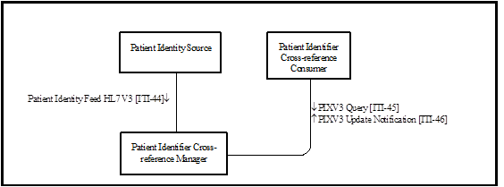
PIX V3 Transaction Diagram

Slide 16
PIX Actors
Actors
Patient Identity Source – Provides notification to the Patient Identifier Cross-reference Manager for any patient identification related events including: creation, updates, merges, etc.
Patient Identifier Cross-reference Consumer – Allows a system in a Patient Identifier Domain to determine the identification of a patient in a different Patient Identifier Domain by using the services of a Patient Identifier Cross-Reference Manager Actor.
Patient Identifier Cross-reference Manager – Serves a well-defined set of Patient Identification Domains. Based on information provided in each Patient Identification Domain by a Patient Identification Source Actor, it manages the cross-referencing of patient identifiers across Patient Identification Domains.

Slide 17
PIX Transactions
Transactions
Patient Identity Feed [ITI-8] (HL7 V3 [ITI-44]) – Communicates patient information, including corroborating demographic data, after a patient’s identity is established, modified or merged or after the key corroborating demographic data has been modified.
Patient Identity Management HL7 V2.5 [ITI-30] - Registers or updates a patient and their associated demographic information.
PIX Query [ITI-9] (HL7 V3 [ITI-45]) – Request by the Patient Identifier Cross-reference Consumer Actor for a list of patient identifiers that correspond to a patient identifier known by the consumer.
PIX Update Notification [ITI-10] (HL7 V3 [ITI-46]) – The Patient Identifier Cross-reference Manager Actor provides notification of updates to patient identifier cross-reference associations to Patient Identifier Cross-reference Consumers that have registered their interest in receiving such notifications.

Slide 18
PIX Options
Options
PIX Update Notification – indicates support for ITI-10/ITI-46 by the PIX Consumer
Pediatric Demographics – indicates support for enhanced pediatric demographics

Slide 19
PIX to eMPI Relationship
PIX is designed to be compatible with enterprise master patient index systems (eMPI)
PIX does not replace an eMPI
PIX supports both “federated” and “master” topologies
An HL7 v2/v3 ADT stream can act as the Patient Identity Source Actor
The eMPI query function can act as the Patient Identifier Cross-reference Manager actor

Slide 20
PIX IHE Profile Grouping
Each actor implementing PIX shall be grouped with the Time Client Actor
Required to manage and resolve conflicts in multiple updates

Slide 21








PIX Manager supports XDS Registry
Content
Consumers
Physician
Portal
Radiology
System
EHR’s
PHR’s
XDS Registry
PIX Manager
XDS Registry
HIE ID: IHI12345
Name: William Johnson
Documents: -----
Location: ----
HIE ID:
IHI12345
Global ID: IHI12345
Name: William Johnson
Documents: -----
Location: ----
Supports HL7 messages
Links all records with HIE AA ID
Updates XDS Registry
Answers queries about patients
HIE ID: 789
Name: Mary Johnston
Documents: -----
Location: ----
Global ID: 789
Name: Mary Johnston
Documents: -----
Location: ----
Local ID:1208XYZ
Local ID:ABC789
HIE Core Services
HIE ID: IHI12345
Name: William Johnson
Documents: -----
Location: ----
HIE
Assigning
Authority
ATNA –Audit Trail Repository
PIX/PDQ Events
Content
Creators
Registration
System
Radiology
System
LAB
System
???
System

Slide 22
PIX Security and Privacy
Paired with IHE Audit Trail and Node Authentication (ATNA) profile
Provides for audit logging and secure transmission
Creates “Query” Event IDs

Slide 23
PIX References
Status: Final Text
IHE IT Infrastructure Technical Framework, Volume 1 (ITI TF-1)
Section 5 – PIX Overview
Section 23 – PIX V3 Overview
IHE IT Infrastructure Technical Framework, Volume 2a (ITI TF-2a)
Section 3.8 Patient Identity Feed
Section 3.9 PIX Feed
Section 3.10 PIX Update Notification
IHE IT Infrastructure Technical Framework, Volume 2b (ITI TF-2b)
Section 3.30 Patient Identity Management
Section 3.44 Patient Identity Feed HL7 V3
Section 3.45 PIXV3 Query
Section 3.46 PIXV3 Update Notification
IHE IT Infrastructure Technical Framework, Volume 2x (ITI TF-2x)
Appendix C.1 - HL7 Message Profiling Convention
Appendix E - Usage of the CX Data Type in PID-3-Patient Identifier List
Appendix O - HL7 v3 Transmission and Trigger Event Control Act Wrappers
Appendix R - Mapping of HL7v2.5 to HL7v3 for PIX and PDQ
Appendix V - Web Services for IHE Transactions

Slide 24
Patient Demographics Query (PDQ) and Patient Demographics Query HL7 V3 (PDQV3)

Slide 25
PDQ Introduction
The Patient Demographics Query (PDQ) Integration Profile lets applications query a central patient information server for a list of patients and retrieve a patient’s demographic and visit information.
PDQ is supported on two HL7 messaging levels: HL7 V2 messaging (PDQ) AND HL7 V3 messaging (PDQ V3). Identical purpose, different underlying standards.

Slide 26
PDQ Introduction
PDQ provides a very simple means for enquiring to receive demographic information, based on:
Partial or complete patient name (printed on the patient record or told by the patient)
Patient ID (this may be obtained from printed barcode, a bed-side chart, etc.)
Partial ID entry or scan
Date of birth / age range
Bed ID

Slide 27
PDQ Use Cases
Use Case 1: Patient Information Entering at Bedside
Patient is admitted with partial demographics
Nurse searches for partial or complete name, patient ID, date of birth, bed ID
System returns list of patients for demographic confirmation and selection of correct patient
Notes:
An admitted patient is assigned to a bed. The patient may or may not be able to provide
positive ID information. The nurse needs to enter patient identity information into some 1395
bedside equipment to establish the relationship of the assigned bed to the patient. The
equipment issues a query for a patient pick list to a patient demographics supplier that
provides data for a patient pick list. Search criteria entered by the nurse might include one
or more of the following:
• Partial or complete patient name (printed on the patient record or told by the patient) 1400
• Patient ID (this may be obtained from printed barcode, a bed-side chart, etc.)
• Partial ID entry or scan.
• Date of birth / age range
• Bed ID
The system returns a list of patients showing the MRN, full name, age, sex, room/bed, and 1405
admit date, and displays the list to the nurse. The nurse then selects the appropriate record to
enter the patient identity information into the bedside equipment application.

Slide 28
PDQ Use Cases
Use Case 2: Patient Demographics Query in an Enterprise with Multiple Patient ID Domains
Laboratory technician seeks to select correct patient for use by laboratory software application (for use by the lab internal workflow, for billing, and for results distribution)
Lab tech enters basic demographics into laboratory application
The lab software uses PDQ to query central facility patient registry for demographics
The lab software also retrieves alternate patient identifiers used by other software
The lab tech selects the proper patient and then the lab software application updates its internal records to reflect the correct patient identifiers, and demographics, for subsequent use (internal workflow, billing, and results delivery)
Notes:
A lab technician enters some basic demographics data (e.g., patient name) into a lab
application to query a patient demographics supplier to identify a patient for his lab exams.
As the application also needs the patient identifier in another Patient ID Domain in the
enterprise for results delivery, the application is configured to receive patient IDs from other
domains in the query response.

Slide 29
Patient Demographics Query(PDQ)
Administration and Service Functions
HL7
PDQ Service
HL7
Enhanced PDQ Service
Master Patient ID Domain
MPI Service
Service defined in IHE Technical Framework
Service out of IHE scope
Notes:
Left side indicates the various registration authorities, feeding into an MPI. In the middle is MPI matching. On the right are the various services leveraging something like an MPI. On right notification, query, and xref.

Slide 30
PDQ integrated with PIX
Administration and Service Functions
PIX Notification Service
PIX Query Service
Patient Identity Feed (PIX)
HL7
PDQ Service
HL7
Enhanced PDQ Service
Master Patient ID Domain
Patient Identity Source
MPI Service
Service defined in IHE Technical Framework
Service out of IHE scope

Slide 31
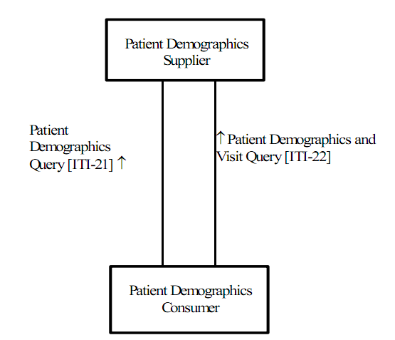
PDQ Transaction Diagram

Slide 32
PDQ Actors
Patient Demographics Consumer – Requests a list of patients matching some demographics (e.g., ID or partial name).
Patient Demographics Supplier – Returns demographics for all patients matching the demographic criteria.

Slide 33
PDQ Transactions
Patient Demographics Query [ITI-21] and Patient Demographics Query HL7 V3 [ITI-47] – A request by the Patient Demographics Consumer to the Patient Demographics Supplier for information about a patient specified by demographics information. The Patient Demographics Supplier returns demographic information for matching patients.
Patient Demographics and Visit Query [ITI-22] – A request from the Patient Demographics Consumer to the Patient Demographics Supplier for matching a patient specified by demographics and visit information. The Patient Demographics Supplier returns demographic and visit information for matching patients.

Slide 34
PDQ Options
Pediatrics Demographics option - Adds additional fields such as mother’s maiden name, home telephone number [ITI-21], and adds multiple birth indicator and birth order [ITI-22]
Continuations Option – For ITI-47 (HL7 V3) only. Allows the Patient Demographics Consumer to get the full set of responses in several increments, as opposed to in one single response. ITI-21 requires continuation support rather than specifying as an option.

Slide 35
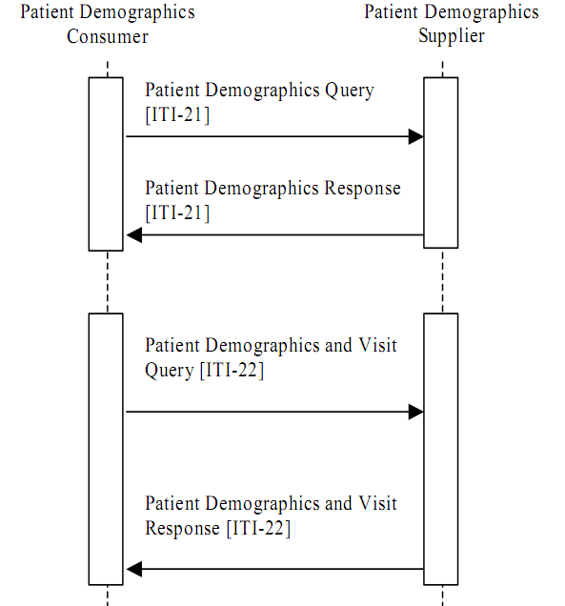
PDQ Workflow

Slide 36
PDQ Attributes
Some relevant PDQ attributes:
Patient Identifier List
Patient Name
Date/Time of Birth
Administrative Sex
Patient Address
Patient Account Number
Patient Class
Attending Doctor
Referring Doctor
Consulting Doctor
Hospital Service
Admitting Doctor
Visit Number
Assigned Patient Location

Slide 37
PDQ Security and Privacy
Paired with IHE Audit Trail and Node Authentication (ATNA) profile
Provides for audit logging and secure transmission
Creates “Query” Event IDs

Slide 38
PDQ References
Status: Final Text
IHE IT Infrastructure Technical Framework, Volume 1 (ITI TF-1)
Section 8 – Patient Demographics Query (PDQ)
Section 24 - Patient Demographics Query HL7 V3 (PDQV3)
IHE IT Infrastructure Technical Framework, Volume 2a (ITI TF-2a)
3.21 - Patient Demographics Query
3.22 – Patient Demographics and Visit Query
IHE IT Infrastructure Technical Framework, Volume 2b (ITI TF-2b)
3.47 – Patient Demographics Query HL7 V3
IHE IT Infrastructure Technical Framework, Volume 2x (ITI TF-2x)
Appendix E - Usage of the CX Data Type in PID-3-Patient Identifier List
Appendix M - Using Patient Demographics Query in a Multi-Domain Environment
Appendix O - HL7 v3 Transmission and Trigger Event Control Act Wrappers
Appendix V - Web Services for IHE Transactions

Slide 39
Cross-Community Patient Discovery (XCPD)

Slide 40
XCPD Introduction
The Cross-Community Patient Discovery (XCPD) profile supports:
the means to locate communities which hold patient relevant health data and
the translation of patient identifiers across communities holding the same patient’s data.
For details refer to the Cross-Community presentation at:
http://wiki.ihe.net/index.php?title=Current_Published_ITI_Educational_Materials
Cross-Community: Peer-to-Peer sharing of healthcare information

Slide 41
XCPD vs. PDQV3
XCPD uses the same underlying HL7 V3 message as PDQV3. It is optimized for the cross-community use case. Some significant differences from PDQV3 are:
XCPD supports several interaction modes: synchronous, asynchronous and deferred response
Supports a health data locator option
Supports an error code to request additional demographic information

Slide 42
Cross-Community Patient Discovery
HL7
XCPD Service
XCPD Service
Service defined in IHE Technical Framework
Service out of IHE scope

Slide 43
Patient Administration Management (PAM)

Slide 44
PAM Introduction
The Patient Administration Management Integration Profile establishes the continuity and integrity of patient data, and additional information such as related persons (primary caregiver, guarantor, next of kin, etc.).
It coordinates the exchange of patient registration and update information among systems that need to be able to provide current information regarding a patient’s encounter status and location.

Slide 45
PAM Introduction
This profile supports ambulatory and acute care use cases including patient identity feed, admission and discharge, and transfer and encounter management, as well as explicit and precise error reporting and application acknowledgment.
The PAM profile supports two scenarios:
Single central patient registration system serving the entire institution, or
Multiple patient registration systems collaborating as peers serving different clinical settings in an institution.

Slide 46
PAM Use Case Example
Patient Encounter Mgmt
Patient Alan Alpha arrives for an annual exam at a clinic. The registration system sends the patient registration information to the local ancillary systems, and the affiliated hospital's ADT system.
Alan Alpha’s exam reveals a serious condition. Alan Alpha is referred to the affiliated hospital where he is pre-admitted in the hospital for relevant diagnostic tests. The tests confirm the condition, and he is admitted to the hospital's ICU. The hospital’s ADT system sends update information to the hospital’s ancillary systems.
Alan Alpha’s improves, and he is transferred to a regular bed. The nurse recording the transfer makes a mistake, and enters the wrong room and bed. After discovering the error, the transfer is canceled, and the correct transfer is recorded.
The patient is now recovered and about to leave the hospital. According to the hospital's procedures, he is transferred to an outpatient unit for administering follow-up tests. The patient is registered in the Hospital Outpatient Registration System.
The outpatient encounter of Alan Alpha is completed; based on satisfactory test results, he is discharged from the hospital and the Outpatient Registration system. In this use case, two patient encounter management systems (the hospital ADT system and the hospital Outpatient Registration system) cooperate as peers.
Notes:
Patient Alan Alpha arrives for an annual exam at a clinic. The registration system sends the patient registration information to the local ancillary systems, and the affiliated hospital's ADT system.
The exam of Alan Alpha reveals a serious condition, and an immediate hospital admission is recommended. Alan Alpha is referred to the affiliated hospital for admission. He is pre-admitted in the hospital for relevant diagnostic tests. The tests confirm the condition, and the patient is admitted in the hospital's ICU. During the stay in the ICU, the patient's insurance is verified, and the updated information is sent from the hospital’s ADT system to the hospital’s ancillary systems.
After a day in the ICU, Alan Alpha’s condition has improved, and he is transferred to a regular bed. The nurse recording the transfer makes a mistake, and enters the wrong room and bed. After discovering the error, the transfer is canceled, and the correct transfer is recorded. The patient is now recovered and about to leave the hospital. According to the hospital's procedures, he is transferred to an outpatient unit for administering follow-up tests. The patient is registered in the Hospital Outpatient Registration System.
The outpatient encounter of Alan Alpha is completed; based on satisfactory test results, he is discharged from the hospital and the Outpatient Registration system. In this use case, two patient encounter management systems (the hospital ADT system and the hospital Outpatient Registration system) cooperate as peers.

Slide 47
Patient Administrative Management (PAM)
Administration and Service Functions
Patient Adminstration Management (PAM)
HL7
Master Patient ID Domain
MPI Service
Service defined in IHE Technical Framework
Service out of IHE scope

Slide 48
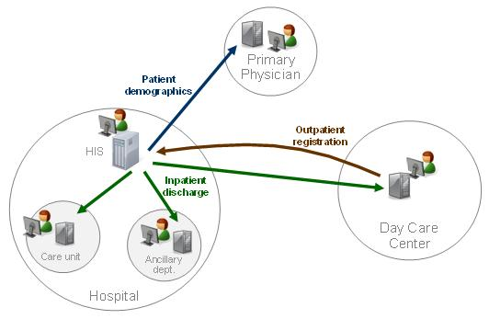
A PAM Process Flow Diagram

Slide 49
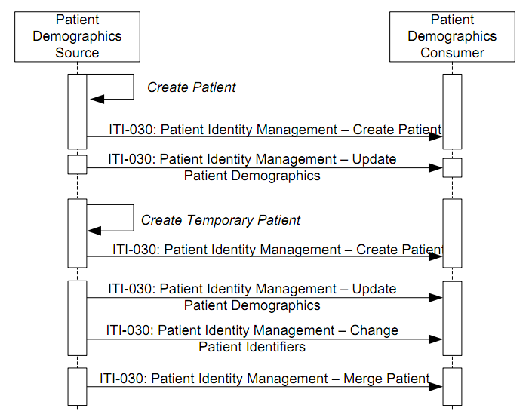
A PAM Process Flow Diagram

Slide 50
PAM Transaction Diagram
Patient Identity Management (ITI-30)
Patient Demographics Supplier
Patient Demographics Consumer
Patient Encounter Supplier
Patient Encounter Consumer
Patient Encounter Management (ITI-31)

Slide 51
PAM Actors
Actors
Patient Demographics Supplier – A system responsible for adding, updating and maintaining demographics about a patient, and additional information such as related persons (primary caregiver, guarantor, next of kin, etc.). It supplies new and updated information to the Patient Demographics Consumer.
Patient Demographics Consumer – Uses demographic information provided by the Patient Demographics Supplier about a patient.
Patient Encounter Supplier – A system responsible for adding, updating and maintaining encounter information about a patient. It supplies new and updated information to the Patient Encounter Consumer.
Patient Encounter Consumer – A system that uses patient encounter information provided by the Patient Encounter Source about a patient.

Slide 52
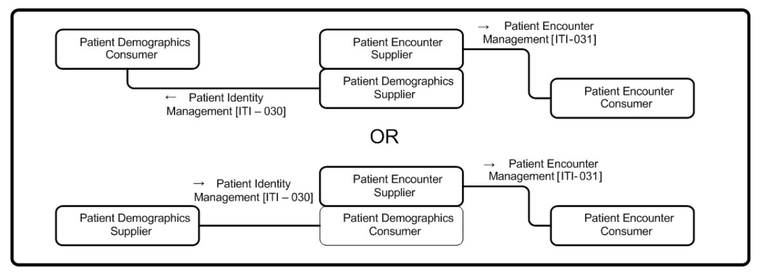
PAM IHE Actor Grouping

Slide 53
PAM Transactions
The PAM profile specifies two transactions to fulfill two key missions among applications cooperating in healthcare:
Patient Identity Management [ITI-30] – Maintain consistency of patient demographics (i.e. patient identification, full identity and persons related to the patient) across applications operating in acute care settings as well as in the ambulatory environment.
Patient Encounter Management [ITI-31] – Coordinate the exchange of patient account, encounter and location information within and between acute care settings.

Slide 54
PAM Options
Merge - Defines the information exchange needed to manage the merging of patient identifiers
Link / Unlink - Defines the information exchanges needed to manage the linking and unlinking of patient identifiers, respectively
Inpatient / Outpatient Encounter Management - Extends the basic patient encounter management functions by defining the information exchanges needed for pre-admitting a patient and for transferring a patient from one location to another location in the enterprise, as well as for changing patient class

Slide 55
PAM Options (Cont.)
Pending Event Management - Defines the information exchanges needed for supporting pending events, e.g., admission, transfer, and discharge
Advanced Encounter Management - Defining a set of messages for handling patient temporary absence, handling attending doctor in an encounter, and moving accounts among different patient identities
Temporary Patient Transfer Tracking - Defines the information exchange needed for tracking a temporary leave / return of a patient from / to a care facility
Historic Movement - Extends the basic patient encounter management functions, as well as the following options, to provide a means to uniquely identify any movement event conveyed in the underlying information exchange:
Inpatient / Outpatient Encounter Management
Pending Event Management
Advanced Encounter Management Options.

Slide 56
IHE PAM Profile Grouping
Large number of IHE profile groupings is anticipated
PDQ Patient Demographics Supplier
SWF Order Placer / Order Filler
Notes:
The PAM profile provides an infrastructure in a healthcare enterprise or across a number of enterprises to distribute the patient identity, demographics, and encounter information, in order to enable various clinical functions in clinical settings. The PAM actors can be grouped with actors in
other IHE Integration Profiles.
One possible grouping is between the Patient Demographics Supplier actor in the PDQ profile and
either the Patient Demographics Supplier actor or the Patient Demographics Consumer actor in this profile, to add query support defined in the Patient Demographics Query transaction to the same set of patient information managed in the PAM profile.
Furthermore, the Patient Demographics Supplier actor in the PDQ profile can be grouped with the Patient Encounter Supplier actor of this profile. Due to the required grouping of the Patient Encounter Supplier actor (see ITI TF-1: 14.4.1), such a grouping can provide query support defined in both the Patient Demographics Query and Patient Demographics and Visit Query transactions to the same set of patient and encounter information that is managed in the PAM profile.
These are some examples of possible grouping of the PAM actors with other IHE actors. Many other possibilities may be useful (either to provide additional values or to allow profile structure simplification). For example, in the radiology scheduled workflow (SWF) profile, the Order Placer
3220 and Order Filler actors can be grouped with the Patient Encounter Consumer actor.

Slide 57
PAM Security and Privacy
No mandatory grouping
ATNA and CT groupings may be of use
PAM is generally an inside-the-enterprise profile where corporate IT security is often applicable

Slide 58
PAM References
Status: Final Text
IHE IT Infrastructure Technical Framework, Volume 1 (ITI TF-1)
Section 14 – Patient Administration Management
IHE IT Infrastructure Technical Framework, Volume 2b (ITI TF-2b)
3.30 – Patient Identity Management
3.31 – Patient Encounter Management
IHE IT Infrastructure Technical Framework, Volume 2x (ITI TF-2x)
Appendix C HL7 Profiling Conventions
Standards Used
HL7 v2

Slide 59
More Information
IHE Web site: www.ihe.net
IHE official material
Technical Framework documents
IHE Wiki site: wiki.ihe.net
IHE committee pages
Implementation Notes
Ongoing committee work
IHE ITI technical committee mailing list
Instructions on the bottom of :
http://www.ihe.net/IT_Infra/committees

