Slide 1
Healthcare Provider Directories
IHE IT Infrastructure Planning Committee
Eric Heflin – Medicity/THSA
Notes:
The majority of this presentation was created while the author was employed by Medicity. The remaining work was completed while he was employed by the THSA (Texas Health Services Authority). All opinions are the author’s own, and don’t necessarily reflect those of the organizations he is affiliated with. Should not be construed as legal advice.

Slide 2

Agenda
Introduction
Terms Used
Personnel White Pages (PWP)
Healthcare Provider Directories (HPD)
Cross-Enterprise User Assertions (XUA)
Relationships Between HPD and PWP
For More Information

Slide 3
Introduction
IHE has created two profiles for standards-based healthcare-related directories
One profile targets people inside an enterprise
The second profile targets people and organizations across enterprises
This presentation introduces and compares both profiles

Slide 4
Terms Used
Directory: A type of database, typically with a hierarchal structure, supporting queries to determine a list of matching subjects, or determining attributes about a subject.
Healthcare Provider: Medical information entities such as physicians, medical laboratories, hospitals, dentists, pharmacists, nurses, diagnostic imaging professionals etc.
  This includes both individuals as well as organizations.
  In countries where Provider has a legal definition, IHE does not restrict itself to the legal definition, but expands to include any person or organization holding or receiving medical information.

Slide 5
Personnel White Pages (PWP)

Slide 6
PWP Introduction
Personnel White Pages Profile (PWP) provides access to basic human workforce user directory information.
This information has broad use among many clinical and non-clinical applications across the healthcare enterprise.
The information can be used to enhance the clinical workflow (contact information), enhance the user interface (user friendly names and titles), and ensure identity (digital certificates).

Slide 7
What Problem is Being Solved?
PWP Problem Statement: The healthcare industry needs a standards-based method, within the enterprise, to access basic directory information on human workforce members.

Slide 8
PWP Scope
Provide access to basic information about the human workforce members
  Does not include Patients
Defines method for finding the PWP directory
Defines query/access method
Defines attributes of interest
Leverages an ISO standard

Slide 9
PWP Value Proposition
Single Authoritative Knowledge Base
  Reduce duplicate and unconnected user info database
  Single place to update
    Name Changes
    New Phone Number
    Additional Addresses
Enhance Workflow and Communications
  Providing information necessary to make connections
    Phone Number
    Email Address
    Postal Address

Slide 10
PWP Selected Use Cases
Username query to determine user’s full name
Determine a user’s organization identification
Determine a user’s email address
Determine a user’s name given his/her initials
Determine a user’s name given his/her provider ID
Notes:
Clinical user logs into an acquisition device. The clinical application queries the directory using the user’s username and displays the user’s full name.
The system further supports the display of the user’s Asian complexes
A Clinical application queries for user’s organization identification to embed in a new data report.
The user needs to send a report to the email address of a colleague. The application allows the user to search for that user’s information, and selects the target user’s email address.
The user reviews an existing report and finds initials. The system queries on the initials found in the report and displays the displayable name.
The user is reviewing a structured report with an embedded author’s universal provider ID. This universal provider ID is used in a query to find the author of the report. The user calls the author on the phone to review the report details.

Slide 11
PWP Actor Diagram
Personnel
White Pages
Consumer
Find Personnel White Pages
[ITI-23]
Query Personnel White Pages
[ITI-24]
DNS Server
Personnel White Pages
Directory

Slide 12
PWP Actors and Transactions
Three Actors
  Personnel White Pages Consumer – Requests location information for the directory and requests information about human workforce members in the directory.
  DNS Server – Provides locating information about the Personnel White Pages Directory.
  Personnel White Pages Directory – Provides information about one or more human workforce members.
Two Transactions
  Find Personnel White Pages [ITI-23] – Locates the Personnel White Pages directory.
  Query Personnel White Pages [ITI-24] – Retrieves information from the Personnel White Pages directory.
No Options

Slide 13
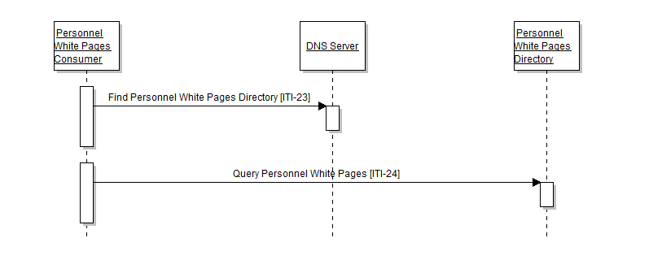
PWP Process Flow

Slide 14
PWP Security and Privacy
Security and privacy for PWP is established via other mechanisms
  ATNA can optionally be used for node authentication and audit logging
  SSL/TLS can optionally encrypt the communication channel
  EUA to authenticate users
  IT best practices
  LDAP authentication for attribute protection
Regional-specific legal, regulatory, policy, privacy, and security analysis is suggested

Slide 15
PWP References
Status: Final Text
IHE ITI Technical Framework Profile
  Vol. 1 - Section 11 – Personnel White Pages
  Vol. 2a - 3.23 Find Personnel White Pages
  Vol. 2a - 3.24 Query Personnel White Pages
Standards Used
  LDAP
  DNS
  ISO/TS 17090

Slide 16
Healthcare Provider Directory (HPD)

Slide 17
HPD Introduction
HPD supports queries against, and management of, healthcare provider information that may be publicly shared in a directory structure. HPD directory structure is a listing of the following two categories of healthcare providers that are classified by provider type, specialties, credentials, demographics and service locations.
  Individual Provider: A person who provides healthcare services, such as a physician, nurse, or pharmacist.
  Organizational Provider: Organization that provides or supports healthcare services, such as a hospital, Healthcare Information Exchange (HIE), Managed Care, Integrated Delivery Network (IDN), and Association.
Notes:
PWP vs HPD

Slide 18
What Problem is Being Solved?
HPD Problem Statement: The industry needs a standards-based method to support queries against, and management of, healthcare provider information that may be publicly shared in a directory structure.

Slide 19
HPD Scope
Designed to maintain a structured list of attributes for both organizations (such as clinics) and people (such as physicians)
Allows extensibility
Leverages ISO standard (21091)
Designed to enable cross organizational directory access

Slide 20
HPD Value Proposition
Single Authoritative Knowledge Base
  Reduce duplicate and unconnected user info database
  Single place to update
    Name Changes
    New Phone Number
    Additional Addresses
Enhance Workflow and Communications
  Providing information necessary to make connections
    Phone Number
    Email Address
    Postal Address
Common data model supports semantic interoperability
Contributes to Identity Management
  Additional methods of identity cross verification
    Name, address, phone number, email
    Cross reference with Enterprise User Authentication identity
  Can contain certificates

Slide 21
HPD Selected Use Cases
Yellow pages lookup
Query providers and their associations for Social Services Disability Determination
Emergency Responders Identification in planning for an emergency event
Provider Authorization and lookup during an emergency event
Forwarding of Referral Documents to a Specialist
Certificate Retrieval
Language Retrieval
Potentially could be used by USA “Direct Project”
Notes:
Yellow Pages Lookup: A patient is referred to an endocrinology specialist for an urgent lab
test. The referring physician needs to get the contact data of close-by endocrinologists in order to
ask whether one of them can perform this test in their own lab. The patient prefers a female
endocrinologist who can converse in Spanish regarding medical information.
Current Situation: The physician has a card catalog with names of local endocrinology
specialists. Office staff calls each in turn to ask if they are available to run the test. Each is
questioned regarding their availability and ability to speak Spanish. Presumably the card catalog
name would indicate the Gender of the physician.
Use of HPD: As a Provider Information Consumer, a computer application running in the office
of physician is used to lookup provider information. The office staff enters the specialty,
geographic indicators like zip code, city or state, language and gender. The application sends a
query request to the Provider Information Directory which returns information about every
provider satisfying the search, in particular the physical and electronic address, and contact
information. An appropriate endocrinologist is chosen based on the attributes included in the
response, an appointment is made, and the referral documentation is electronically sent to the
physician using the electronic address specified.
Query providers and their associations for Social Services Disability Determination: A
citizen, as a claimant, applies for disability benefits from the Social Services Department. This
disability is due to a medical condition. In order to receive benefits, an application must be
made, medical evidence must be provided, and a determination made on the claim.
The claimant, in the claim, includes a list of the providers seen (names or practices) and other
medical services he has obtained, related to his disability. The Social Services department needs
to gather medical evidence from all the reported providers, and wants to direct their queries to
the specific providers mentioned. For that purpose, the Social Services department needs to
obtain the provider‘s contact information, electronic address, and provider‘s relationship with
other organizations such as HIE, for each of the providers supplied by the claimant.
Current Situation: The Claims Processor searches through an electronic file or card catalog of
providers to look up providers that the claimant has named. If the Claims Processor finds a
provider in the file, or catalog, the Claims Processor faxes a request for medical evidence along
with a release form signed by the patient. Often research has to be done before a fax number can
be determined (phone calls need to be made, or additional contact information needs to be
identified). If the Claims Processor does not find a provider in the file, or catalog, extensive
research may need to be done before the correct provider is identified. This must be done for
every provider on the claim.
Because limited or outdated information is often given by the claimant, identifying the provider
can take quite a long time, substantially delaying the process and the disability determination.
Use of HPD: The disability software application collects healthcare services provider data from
a list of filed claims. Acting as Provider Information Consumer, this application sends a query
request to the Provider Information Directory for each provider on the claim. The Provider
Information Directory returns information about the providers, in particular, the electronic
address where the Medical Evidence Requests (MERs) are serviced for that provider. Working
with the System Directory for Document Sharing (SDDS) profile to identify the appropriate
electronic end point, an appropriate MER request is sent to the physician
Emergency Responders Identification in planning for an emergency event: Emergency
response planning requires the identification of potential providers who can assist in an
emergency. Providers must meet specific credentialing criteria and must be located within a
reasonable distance of the emergency event.
Current Situation: The planners of the emergency event search for potential provider
participants by manually initiating searches on the internet, contacting associations for
candidates, and looking through the local yellow pages. Once phone number contact information
for these providers is identified, contact is initiated.
Use of HPD: Using HPD, an emergency planning team member can initiate a single search for a
list of providers based on specialty, geographic indicators like zip code, city or state, and other
criteria. The Provider Information Directory returns information about every provider satisfying
the search, including e-mail addresses. An e-mail can be generated to all identified providers
requesting participation
Provider Authorization and lookup during an emergency event: During Hurricane Katrina,
health care volunteers were turned away from disaster sites because there was no means
available to verify their credentials. At an emergency site, the Provider Information Directory
Certificate Retrieval: National regulations in many European countries require that an
electronically transmitted doctor‘s letter be encrypted in a way that only the identified receiver is
able to decrypt. In order to encrypt the letter, the sender has to discover the encryption certificate
of the receiver.
Language Retrieval: An individual who only speaks Italian requires healthcare services at an
Outpatient Clinic. That individual would like to be able to communicate with the Clinic
personnel, if at all possible. The individual or his caregiver needs to determine which clinic
supports Italian and provides the service that is required

Slide 22
HPD Actor Diagram
Provider Information Feed
[ITI-59]
Provider Information
Source
Provider Information
Directory
Provider Information
Query
[ITI-58]
Provider Information
Consumer

Slide 23
HPD Actors
Three Actors
  Provider Information Directory – Processes queries to search for providers based on criteria received from the Provider Information Consumer actor and processes management operations based on actions received from the Provider Information Source actor.
  Provider Information Consumer – Initiates query requests.
  Provider Information Source – Initiates management commands consisting of Add, Update, or Delete requests.

Slide 24
HPD Transactions & Options
Two Transactions
  Provider Information Query [ITI-58] – Sends query commands.
  Provider Information Feed [ITI-59] – Sends management commands.
One Option
  Provider Information Feed – Used to specify when the optional Provider Information Feed transaction is supported by the Provider Information Directory.

Slide 25
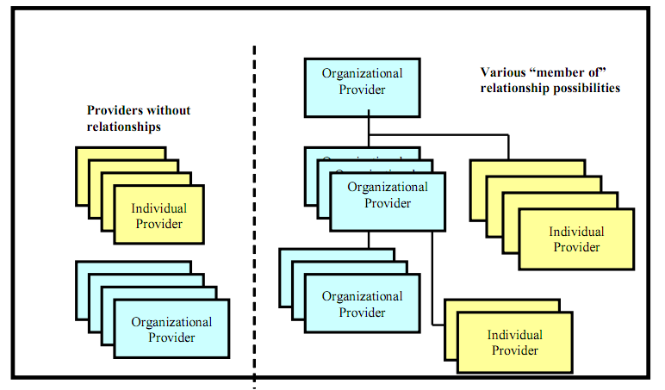
HPD Relationships

Slide 26
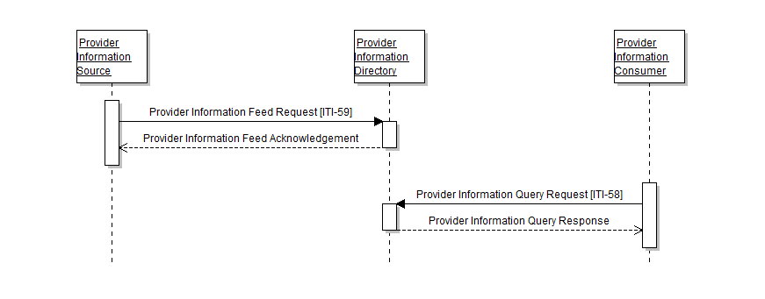
HPD Process Flow

Slide 27
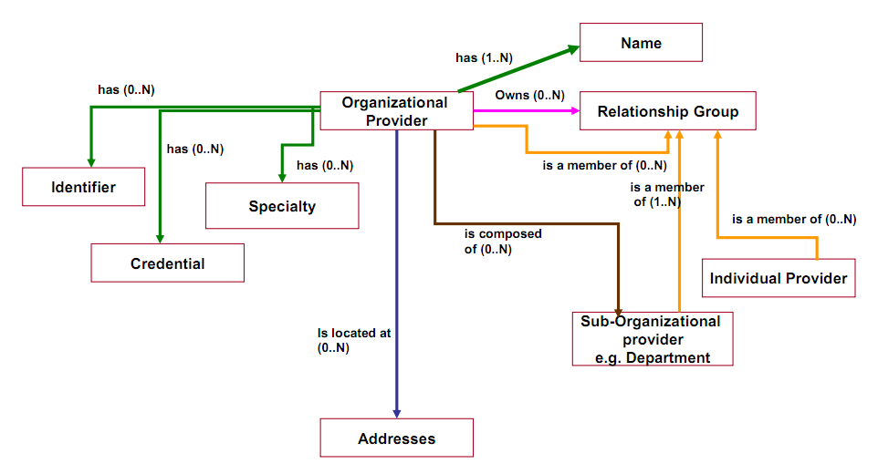
HPD Organizational Provider

Slide 28
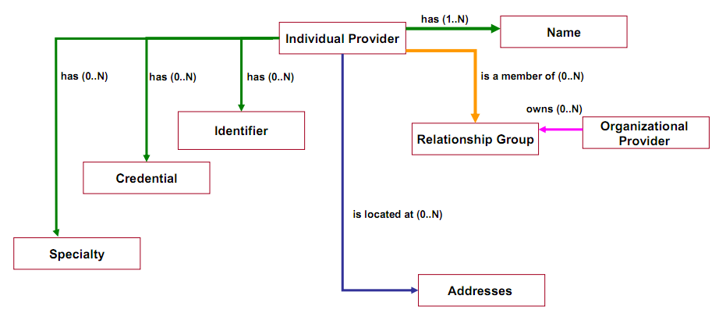
HPD Individual Provider

Slide 29
HPD Security and Privacy
Security and privacy for HPD is established via other mechanisms
  ATNA can optionally be used for node authentication and secure audit logging
  EUA to authenticate users
  XUA for access control
  PWP for system users identification
  IT best practices
  LDAP authentication for attribute protection
Regional-specific legal, regulatory, policy, privacy, and security analysis is suggested
See the HPD supplement section 28.4 for a security considerations analysis

Slide 30
HPD References
Status: Trial Implementation
IHE IT Infrastructure Technical Framework Supplement Healthcare Provider Directory (HPD) – Primary Content
Standards Used
  LDAP
  DSML
  ISO/TS 21091

Slide 31
Cross-Enterprise User Assertion (XUA)

Slide 32
XUA PWP/HPD Relationship
XUA allows exchange of key end-user identity attributes across domains
Health care organizations are responsible for end-user identity proofing, authenticating, managing credentials, and authorizing appropriate access compliant with local policy
End-user attributes can be represented in PWP and HPD directories
PWP and HPD attributes can be dynamically obtained and expressed in XUA for the purposes of audit logging and access policy determination

Slide 33
XUA
A complete discussion of XUA can be found in the Security and Privacy Part 1 Overview presentation.

Slide 34
Summary

Slide 35
HPD/PWP Comparisons
Attribute | HPD | PWP
IHE Profile Dependency | None | None
Other Dependencies | LDAP, DSML | LDAP
Service Interfaces | Web Services | LDAP API
Secured By | Channel (TLS, VPN, ATNA) | VLAN, LDAP authentication, TLS, ATNA
Cross Enterprise | Yes | No
Contains human information | Yes | Yes
Contains organization information | Yes | No
Contains patient information | No | No
LDAP based | Yes | Yes
Directory location determination | Pre-Configured | DNS Query for LDAP Dirs

Slide 36
More Information
IHE Web site: www.ihe.net
  IHE official material
  Technical Framework documents
IHE Wiki site: wiki.ihe.net
  IHE committee pages
  Implementation Notes
  Ongoing committee work
IHE ITI technical committee mailing list
  Instructions on the bottom of :
  http://www.ihe.net/IT_Infra/committees

Slide 37


