Slide 1
Security and Privacy Overview Part 1
IHE IT Infrastructure Planning Committee
John Moehrke – GE Healthcare

Slide 2
Agenda
Overall Security and Privacy controls
Consistent Time (CT)
Audit Trails and Node Authentication (ATNA)
Enterprise User Authentication (EUA)
Cross-Enterprise User Assertion (XUA)
Document Digital Signature (DSG)
Basic Patient Privacy Consents (BPPC)
Document Encryption (DEN)
Access Control
Conclusion
Part 1
Part 2

Slide 3
Layers of Policies
Examples
International
OECD Guidelines on Transborder Flows
Country-Specific
US-HIPAA; EU-EC95/46; JP-Act 57 - 2003
Profiles enables / enforces
Horizontal Industry
Medical Professional Societies
Enterprise
Backup and Recovery
Notes:
Before any technology can be applied to enforcing Security or Privacy, an organization must define the Security and Privacy Policies that they are going to need enforced. The Profiles from IHE are designed to be policy agnostic, meaning they can enforce almost any policy. In this way there is no constraint to implement a single policy.
These policies are built up of many layers of external policies. Starting with the highest level policies in the International community, such as the Organization for Economic and Co-operation and Development (OECD). This highest layer should also respect human rights, ethics, and norms.
The next layer down are those of the country, such as HIPAA in the USA, EC95/46 in Europe, and Act 57 in Japan.
The next layer is those policies from the specific industry domain, in this case Healthcare. Some of the sources for this layer comes from the country, but they also come from medical professional societies.
And finally the Enterprise needs to consider good organizational policies such as backup and recovery policies.
This is clearly an overview of all the potential influences on policies, but the important thing to take away is that policies must be created and written before technology is discussed. This is not to ignore the very fact that sometimes technology limits the policies, such as we will get into later in this presentation around Privacy Consents.

Slide 4
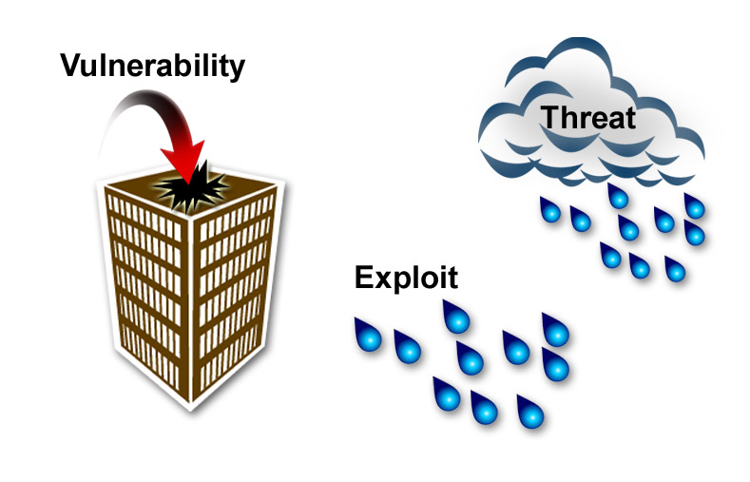
Risk Scenario
In this scenario:
The vulnerability is the hole in the roof
The threat is the rain cloud
Rain could exploit the vulnerability
The risk is that the building and equipment in the building could be damaged as long as the vulnerability exists and there is a likely chance that rain will fall.
Notes:
Security is best approached using a Risk Assessment model. That is to determine the risks to security; that is risks to Confidentiality, Integrity and Availability. As part of a Risk Assessment the Risk level is measured in terms of a combination of the likelihood of occurrence (probability) and degree of impact (positive or negative) of an anticipated event. Imagine a “hole in the roof” scenario, the risk is that weather (the threat) could cause damage to components inside the building as well as the building itself. As long as the weather report shows that there is little chance of precipitation, our risk level is low. However, this risk increases as the likelihood of precipitation increases. Since we cannot control the threat of precipitation, we mitigate our risk by changing the vulnerability; we fix the hole in the roof. The cost of fixing the vulnerability is much less, in this case, than the damage rain or snow would cause.
Examples of Threats -- natural disaster, random accident, disgruntled employee, employee snooping, external indiscriminate hacker, external motivated hacker, external highly motivated and highly funded)
Examples of Vulnerabilities – access without user identification, access without user authentication, user accessing data that they don’t need to know for their job, open network interface,
Likelihood is an assessment of how likely that threat is going to exploit that vulnerability. Typically a gross assessment of High, Medium, and Low
Impact is an assessment of how much damage (harm) would result if that threat exploited that vulnerability (regardless of how unlikely). Typically a gross estimate of High, Medium, Low

Slide 5
Security Mis-Use-Cases
Prevent Indiscriminate attacks (worms, DOS)
Patient asks for Accounting of Disclosures
Protect against malicious neighbor doctor
Patient that retracts consent to publish
Provider Privacy
Malicious Data Mining
Access to Emergency data set
VIP (movie star, sports figure)
Domestic violence victim
Daughter with sensitive tests hidden from Parent
Sensitive topics: mental health, sexual health
Legal Guardian (cooperative)
Care-Giver (assists w/ care)
Lost/Stolen mobile memory
Notes:
Here are some ready made Risks that are typically thought of in Healthcare. Clearly not a complete list, clearly missing a large amount of information. The list is given as a sample of Risks across the spectrum of what an Interoperability Profile can address (Note risk of electrical failure is not something an interoperability profile can address, but clearly is a risk that the organization must address)

Slide 6
Accountability Models
Access Control model – Prevention
Strong controls on User Identification and Authentication
Strict Role-Based-Access-Control
No one is given any more access rights than they minimally need
Typical in a Bank
Audit Control model – Reaction
Strong control on User Identification and Authentication
Relaxed Role-Based-Access-Control
Emphasis on Training and Awareness of oversight
Told what you are normally allowed to do
Empowered to do what is right when necessary
Audit Logs are inspected regularly
Abuse is detected and acted upon
Healthcare: Typically mixture w/ emphasis on Patient Safety
Notes:
Another thing that varies from organization to organization is the policy they apply to accountability. There are two different types of accountability models that usually are mixed.
In the Access Control Model the users are simply prevented from doing anything that they should not do.
In the Audit Control Model the user is empowered to go beyond what they are minimally to do for their job, because there are situations where they may be called upon to do more.
For example where doctors should only access the patients records that they are assigned to, but are given access to all patients so that they can more quickly assist with a consult, urgent care, or even an emergency.
In healthcare there is typically a mixture that is more Audit Controls centric.
In all models, the janitor is still prevented from seeing clinical data as there is no reasonable expectation that the janitor will ever need to.

Slide 7
Profiles mapped to Security & Privacy Controls
Security & Privacy Controls IHE Profile | Profile Issued | Audit Log | Identification and Authentication | Data Access Control | Secrecy | Data Integrity | Non-Repudiation | Patient Privacy
Audit Trails and Node Authentication | 2004 | √ | √ | √ | √ | √ | √ | √
Consistent Time | 2003 | √ | ∙ |  |  |  | √
Enterprise User Authentication | 2003 |  | √ | ∙ |  |  | ∙ | ∙
Cross-Enterprise User Assertion | 2006 |  | √ | ∙ |  |  | ∙ | ∙
Basic Patient Privacy Consents | 2006 |  |  | ∙ |  |  |  | √
Personnel White Pages | 2004 |  | √ | √ |  |  | ∙
Healthcare Provider Directory | 2010 |  | √ | ∙ |  |  | ∙
Document Digital Signature | 2005 |  | √ |  |  | √ | √
Document Encryption | 2011 |  |  | √ | √ | ∙
Notes:
This table shows how the IHE Security and Privacy Profiles affect the security and privacy domain. Where a checkmark is a strong contribution by the Profile and a dot is a minor contribution (or supporting relationship).
The first 5 Profiles will be further discussed in this presentation.
PWP and HPD are discussed elsewhere
Document Encryption are not yet final so are not discussed here
Which control should we use to prevent the wrong people from looking at PHI?
Which profiles would you use in an investigation of a potential incident?
Which profiles would inform an accounting of disclosures?

Slide 8
CT
Consistent Time

Slide 9
Introduction and Standards
Meet a basic security requirement
System clocks and time stamps of the many computers in a network must be synchronized.
Lack of consistent time creates a “security hole” for attackers.
Synchronization ±1 second is generally sufficient.
Achieve cost savings/containment
Use the Network Time Protocol (NTP) standard defined in RFC 1305.
Leverage existing Internet NTP services, a set-up option for mainstream operating systems.

Slide 10
Transaction Diagram
Time Server
Maintain Time [ITI-1]↑
Time Client
Notes:
Typically the Time Server is a dedicated system that is synchronized with a reliable time source outside the organization.
The Time Client is often grouped with other IHE Actors, such as in ATNA

Slide 11
ATNA
Audit Trail and Node Authentication

Slide 12
Audit Trail and Node Authentication (ATNA) Profile
Secure Node or Secure Application
Access Controls
Functional – can be shown to enforce policies
Audit Controls
SYSLOG + IHE/DICOM/RFC3881 Audit Message
Auditable Events
Network Controls
Mutually Authenticated TLS
Or S/MIME or WS-Security or physical isolation
Audit Record repository
Records, Forwards, and Reports

Slide 13
ATNA: Actors / Transactions
Notes:
Time Server – From the Consistent Time Profile – provides a consistent time for all audit logs in a given organization
Secure Node – a complete hardware and software system that is considered a in whole to be one
may be made up of multiple computers, but is one distinguishable system
Example: MRI – made up of many components and computers, may even be made up of discrete physical cabinets
Example: EHR – whole system considered as one including all workstations and supporting servers
Example: EKG device – single small medical device
Secure Application – a software component that is expected to be integrated into a larger system. Where this software component is responsible for securing any communications it is controlling, initiating, receiving; responsible for any controlling access that it is responsible for; and responsible for logging any security events that it is in control of
Note this means that it is simply not responsible for something that is out of it’s control (for example: auditing of the system startup event, or user-login event)
Example: a network service that requires to be integrated into a database farm
Example: A software application that must be installed onto a workstation
Audit Record Repository – Receives the Record Audit Event transaction. A system implementing this actor will typically process, report, record, alert, forward, and in any other way process the security events.

Slide 14
ATNA: Authenticate Node Transaction
Mutually Authenticate all network communications of Sensitive Information
Encrypt and Integrity Protect
Standards
X.509 Digital Certificate
RSA Authentication
AES Encryption
SHA Integrity
Transport Layer Security (TLS) RFC 2246
Web-Services Security
S/MIME

Slide 15

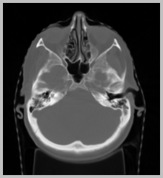

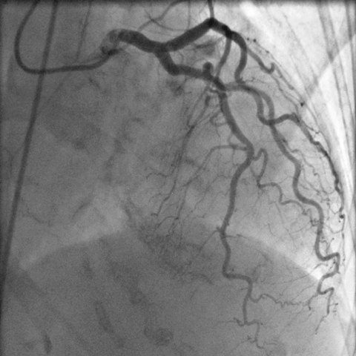
ATNA Authenticate Node
Secured Node
Dual Authenticated Links
EHR System
Physician Office
Secured Node
ED Application
XDS Document Repository
PACS
XDS Document Registry
XDS Document Repository
EHR System
PACS
Provide & Register Docs
Lab Info. System
Teaching Hospital
Community Clinic
Secured Node
Secured Node
Notes:
The diagram shows an example of a Health Information Exchange (HIE) using the XDS Profile. This could be any set of network connected ‘Secure Nodes’. Each Secure
The Secure Node is identified by the Red Circles.
The Red Lines show the ‘Authenticate Node’ Transaction – the trust relationships
The Authenticate Node transaction creates a secure connection between the Secure Nodes. The secure communications takes place inside these secure connections (aka Tunnel).
For example: The XDS Registry Transaction is carried out inside the TLS connection that is established when needed.

Slide 16
Audit Log - Accountability
Mitigation against unauthorized use
Investigate Audit log for patterns and behavior outside policy. Enforce policy
Secure Node requires appropriate Access Controls to enforce at the enterprise by XDS Source and Consumers
Investigation of patient complaints
Investigate Audit log for specific evidence
ATNA Audit Repositories can filter and auto-forward
Support an Accounting of Disclosures
ATNA Report is informed by XDS-Export + XDS-Import
Notes:
The ATNA audit log includes enough information to detect a potential problem. Where enough information is not available in ATNA, the results can be used to enable forensic logs if they are available.
The ATNA Audit Repository must protect the audit log appropriately, and provide the necessary tools to enable the necessary functionality and reporting.

Slide 17
Centralized Accountability
HIE boundary
EHR System
PMS
Physician Office
ED Application
XDS Document Repository
XDS Document Registry
PACS
XDS Document Repository
Query Document
Register Document
EHR System
PACS
Retrieve Document
Provide & Register Docs
Lab Info. System
Maintain Time
Maintain
Time
Teaching Hospital
Maintain
Time
ATNA Audit record repository
CT Time server
Community Clinic
Notes:
This is an example of a centralized single Audit Record Repository.
Explain the link between audit logs and accountability.
Thin lines are all the systems periodically checking with the authoritative time source and adjusting their system clock
Thick Black lines are sample transactions, in this case XDS workflow starting on the right with a “Provide and Register”
Thick Orange lines are the Record Audit Event transaction that is caused by the XDS transactions shown.
Most network transactions will cause at least two Audit events to be logged. One from each side of the transaction.
More events may be logged based on what is done with the data once it is transferred, or is needed to do to prepare the data to transfer it.

Slide 18
Distributed Accountability
Teaching Hospital
State run HIE
EHR System
PMS
Physician Office
ED Application
XDS Document Repository
XDS Document Registry
PACS
XDS Document Repository
Query Document
Register Document
EHR System
PACS
Retrieve Document
Provide & Register Docs
Lab Info. System
Maintain Time
ATNA Audit record repository
Maintain
Time
Maintain
Time
ATNA Audit record repository
CT Time server
Community Clinic
ATNA Audit record repository
HIE boundary
Notes:
This diagram shows a use-case where there are multiple Audit Record Repositories distributed across an XDS environment.
This would be a common configuration where each organization in an HIE has decided to maintain their own Audit Record Repository independent from the HIE. In this way the Audit Record Repository in any one organization would manage the audit log entries for that organization and would forward copies of any audit log entry that is a result of a transaction with the HIE (the dotted orange lines).
A good example of why this is important is the basic XDS Document Retrieve transaction. If this transaction does not force an XUA assertion then the Document Repository can only record the document unique ID that was requested and the system identity that requested it. This is not enough information for the organization hosting the Document Repository to fully report an account of disclosures, but is sufficient information to trace the specific event back to a specific Document Consumer system where the further details can be found.
When this transaction includes an XUA assertion the audit log on the Document Repository would include the user identity and likely purpose of use, but would require extra processing to determine the patient (this extra processing could take place during the transaction, could be known through other means, or could be looked up during audit analysis and reporting)

Slide 19
Example: Audit Log Cascade
Clinic A
EMR
Sjfldjlsdj a
Kdjldsj
Lsjldjl
jfjfjlslkjln
Lslasdjj;ask;sls
Sflksdjfl;saf
Salasaska
Faslskf;sf
Slsjlsdjlsdjf
Lsjflsdjldsjfs
Slkfjsdlfjldsf
lsjfldsjfldsfj
Audit
HIE Infrastructure
Sjfldjlsdj a
Lslasdjj;ask;sls
Faslskf;sf
lsjfldsjfldsfj
1) Many audit events, both internal and external
Audit
2) Local Audit Repository Service filters out events correlating to HIE interactions
3) HIE Audit Record combines with others for total HIE view
Notes:
This diagram shows in more detail how the Audit Record Repository within Clinic A will record all the events detected and recorded by the EMR within that clinic. This Audit Record Repository system will filter out the audit log events that are associated with the HIE and forward them to the Audit Record Repository in the HIE to be combined with all the other events forwarded and detected within the HIE.

Slide 20
ATNA: References
Status: Final Text
IHE ITI Technical Framework
Vol. 1 - Section 9
Vol. 2a - Sections 3.19, 3.20
“Security Considerations” section found in other Profiles may specialize how ATNA is applied
The Audit Event Message typically specialized in Vol 2 at the Transaction level
PIX QueryTransaction : See section Vol 2a:3.9.5.1
XDS Register Document Set-b: See section Vol 2b:3.42.7.1

Slide 21
EUA
Enterprise User Authentication

Slide 22
EUA Introduction
Support a single enterprise governed by a single set of security policies and having a common network domain.
Establish one name per user to be used for all IT applications and devices.
Facilitate centralized user authentication management.
Provide users with single sign-on.

Slide 23
Value Proposition
Meet a basic security requirement
User authentication is necessary for most applications and data access operations.
Achieve cost savings/containment
Centralize user authentication management
Simplify multi-vendor implementations
Provide workflow improvement for users
Increase user acceptance through simplicity
Decrease user task-switching time.
More effective security protection
Consistency and simplicity yields greater assurance.

Slide 24
Key Attributes
Limited network overhead
Kerberos is network-efficient, developed at a time when high-speed networks were rare.
Kerberos work with any user authentication technology
Tokens, biometric technologies, smart cards, …
Specific implementations require some proprietary components, e.g., biometric devices.
Once user authentication is complete, network transactions are the same for all technologies.

Slide 25
EUA Transaction Diagram
Notes:
There are no special requirements on any of these Actors. IHE expects off-the-shelf implementations to be used.
Kerberos Authentication Server – This is usually implemented by a system that is the authority for all user identity. Typically this is a centralized resource within an organization.
Microsoft Active directory is an example
Client Authentication Agent – This is the agent that is responsible for prompting the user for their credentials and using the “Get User Authentication” transaction to confirm that they are correct.
This Agent may be built into the operating system (e.g. Windows XP or Linux)
This Agent could also be integrated into clinical software to enable more smooth workflows while maintaining patient context
Kerberized Server – This is the agent that can receive Kerberos service tickets through the Kerberized Communications transaction
An example is the use of HTTP with the Negotiate authentication method
The Yellow boxes represent any other IHE actor that might be grouped with actors from EUA.
An example is the grouping between EUA and RID.

Slide 26
EUA: References
Status: Final Text
IHE ITI Technical Framework
Vol 1: Section 4
Vol 2a: Section 3.2, 3.3, 3.4
Standards Used
Kerberos v5 (RFC 1510)
Stable since 1993,
Widely implemented on current operating system platforms
Successfully withstood attacks in its 10-year history
Fully interoperable among all platforms
Minimal Application Changes
Eliminate application-specific, non-interoperable authentication
Replace less secure proprietary security techniques

Slide 27
XUA
Cross-Enterprise User Assertion

Slide 28
What Problem is Being Solved?
XUA Problem Statement: The industry needs a standards-based method to provide the initiating user’s identity in cross-enterprise transactions in a way that the responder can make access decisions and proper audit entries.

Slide 29
Value Proposition
Extend User Identity across organizations
Users include Providers, Patients, Clerical, etc
Must supports cross-enterprise transactions (e.g XDS, XCA), can be used inside enterprise
Distributed or Centralized Identity management (Directories)
Provide information necessary so that receiving actors can make Access Control decisions
Authentication mechanism used
Attributes about the user (roles)
Enables but does not include Access Control mechanism
Provide information necessary so that receiving actors can produce detailed and accurate Security Audit Trail

Slide 30
Technical Solution
Initial scope to XDS.b Stored Query and Retrieve
Relies on Web-Services
Easily extended to any Web-Services transactions
Leverage WS-I Basic Security Profile 1.1
Use SAML 2.0 Identity Assertions
Does not constrain ‘how’ the Assertion was obtained
Supporting Kantara Initiative (formerly Liberty Alliance)
May be obtained using WS-Trust or SAML
Define grouping behavior with EUA and ATNA

Slide 31
XUA: Attribute Extension supplement
User Role
To support Role Based Access Control
Consent / Authorization
To support use-cases where the requesting party has explicit consent
Purpose Of Use
Carry an indicator of what the reason for the transaction is and what will be done with the result

Slide 32
XUA encoded in Web-Services
Who is Authority?
How/Why to Trust?
Constraints (time)?
HTTP
HTTP
HTTP
TLS - HTTP
SOAP Envelope
SOAP Envelope
SOAP Envelope
SOAP Envelope
SOAP Header
SOAP Header
SOAP Header
SOAP Header
Security
Security
Security
WS-Security
Assertion
Assertion
Assertion
SAML 2.0 Assertion
Authentication
Who is User?
How they were authenticated?
Authentication
Authentication
Authentication
Statement
Statement
Statement
Statement
Attribute
Attribute
Attribute
Attribute
Statement
Statement
Statement
Statement
Authorization
What Roles apply?
What is the Purpose?
Authorization
Authorization
Authorization
Decision
Decision
Decision
Decision
Statement
Statement
Statement
Statement
Assertion
SecurityTokenReference
SecurityTokenReference
Signature
Original Transaction
SOAP Header
What Consent applies?
Security Signature
Security Token
SOAP Body
SOAP Body
Reference
Original Transaction
SOAP Body
SOAP Body
Notes:
SAML Assertion contains claims about the user and the session the transaction initiates in:
The addition of the SAML assertion is contained within the additional WS-Security header
This does not affect the original soap header or body.

Slide 33
Level of Identity Assurance
Increased $ Cost
Multi-
Factor Token
PKI/ Digital Signature
Knowledge-
Based
Kerberos
Very
High
Username - Password
High
PIN/User ID
Medium
Low
Access to
Summary of
Clinical research
Access to
Local
EHR/EMR
Verification
Of Data
Transcription
Remote
Clinical
Entry
Increased Need for Identity Assurance
Notes:
Slide c/o David Temoshok and GSA
The SAML assertion does not carry a simple Level Of Assurance such as described in NIST SP800-63 “Electronic Authentication”. There is still a need for Policy and Vocabulary definition.
The SAML assertion does carry an identifier of the method that was used to authenticate the user
Outlined by green oval
From this identifier of the method used to authenticate the relying party can determine the relative Level of Assurance in the view of the relying party organization.

Slide 34
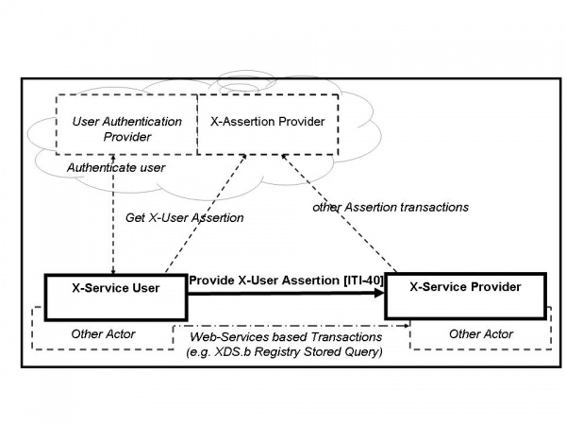
XUA Actors
Notes:
There is only one formal transaction (ITI-40), and this transaction is a modification of <any> web-services based transaction. The X-Service User is grouped with <any> other Actor that is a SOAP requester. The X-Service Provider is grouped with <any> other Actor that is a SOAP responder. In that ITI-40 requires that the WS-Security header be added to the SOAP message and contain a Binary token of that is the SAML 2.0 Identity Assertion.
The User Authentication Provider is shown as there needs to be some actor that does the user authentication. When EUA or PWP are used to authenticate the user their specific Authentication Provider actor fits here.
The X-Assertion-Provider is a virtual actor that provides the Assertion to the X-Service User. This Actor is typically tightly coupled with the User Authentication Provider through proprietary means. The Get X-User Assertion transaction is not profiled in the XUA profile as there is no special behavior required; this could be implemented through internal transactions, SAML 2.0 Protocol, or WS-Trust. The “other Assertion transactions” is shown as some X-Service Providers may choose to use SAML 2.0 Protocols or WS-Trust; but there is no special behavior for the XUA profile here.

Slide 35
Implementation Example
EHR
(ATNA Secure Node)
XDS Registry
XDS Consumer
(ATNA Secure Node)
Patient
Data
X-Service
User
Audit
user auth
provider
X-Identity
Provider
XUA =
Web-Services Security
+ SAML Assertions
Audit
Log
User
Auth
Key:
Original Transaction
TLS Protections
XUA Assertion
Notes:
First Display: An EHR that has local Patient Data, Local Audit Log, Local User Authentication and implements a XDS Consumer. The XDS Registry is shown with an ATNA audit record repository.
On Click: Add the XUA Transaction, which modifies the original XDS Consumer to include the SAML Assertion describing the user and their local context relevant to the transaction. This SAML Assertion is derived from the original User Authentication. At the XDS Registry the Audit log entry now would include the user identity, and access controls may be enhanced.

Slide 36
XUA: References
Status: Final Text
IHE ITI Technical Framework
Vol 1: Section 13
Vol 2b: Section 3.40
Standards Used
SAML 2.0 Identity Assertions
Web-Services Security header
WS-I Basic Security Profile

Slide 37
Profiles mapped to Security & Privacy Controls
Security & Privacy Controls IHE Profile | Profile Issued | Audit Log | Identification and Authentication | Data Access Control | Secrecy | Data Integrity | Non-Repudiation | Patient Privacy
Audit Trails and Node Authentication | 2004 | √ | √ | √ | √ | √ | √ | √
Consistent Time | 2003 | √ | ∙ |  |  |  | √
Enterprise User Authentication | 2003 |  | √ | ∙ |  |  | ∙ | ∙
Cross-Enterprise User Assertion | 2006 |  | √ | ∙ |  |  | ∙ | ∙
Basic Patient Privacy Consents | 2006 |  |  | ∙ |  |  |  | √
Personnel White Pages | 2004 |  | √ | √ |  |  | ∙
Healthcare Provider Directory | 2010 |  | √ | ∙ |  |  | ∙
Document Digital Signature | 2005 |  | √ |  |  | √ | √
Document Encryption | 2011 |  |  | √ | √ | ∙
Notes:
This table shows how the IHE Security and Privacy Profiles affect the security and privacy domain. Where a checkmark is a strong contribution by the Profile and a dot is a minor contribution (or supporting relationship).
The first 5 Profiles will be further discussed in this presentation.
PWP and HPD are discussed elsewhere
Document Encryption are not yet final so are not discussed here
Which control should we use to prevent the wrong people from looking at PHI?
Which profiles would you use in an investigation of a potential incident?
Which profiles would inform an accounting of disclosures?

Slide 38
Agenda
Overall Security and Privacy controls
Consistent Time (CT)
Audit Trails and Node Authentication (ATNA)
Enterprise User Authentication (EUA)
Cross-Enterprise User Assertion (XUA)
Document Digital Signature (DSG)
Basic Patient Privacy Consents (BPPC)
Document Encryption (DEN)
Access Control
Conclusion
Part 1
Part 2

Slide 39
More Information
IHE Web site: www.ihe.net
IHE official material
Technical Framework documents
IHE Wiki site: wiki.ihe.net
IHE committee pages
Implementation Notes
Ongoing committee work
IHE ITI technical committee mailing list
Instructions on the bottom of :
http://www.ihe.net/IT_Infra/committees

Slide 40


