Slide 1
XDM / XDR
Point-to-Point Push of Documents
IT Infrastructure Planning Committee
Chris Kenworthy - Siemens

Slide 2

Outline
Introduction
XDM
XDR
Summary
References

Slide 3

Introduction
Point-to-Point Push of Documents refers to:
  Cross-Enterprise Document Media Interchange (XDM)
  Cross-Enterprise Document Reliable Interchange (XDR)
Based on XDS
  XDM = push of XDS metadata and documents on media/email
  XDR = push of XDS metadata and documents over SOAP
  Maximal re-use of XDS objects & meta-data
As with XDS both are “document content agnostic”
  Provides a framework for use of content profiles (e.g., XDS-MS, XD-Lab, XPHR, etc.)
When to use
  When document sharing infrastructure not in place
  Where XDS is not desirable or available to one of the participants
  Complementary to sharing documents via XDS

Slide 4
XDM
Cross-Enterprise Document Media Interchange

Slide 5
XDM
Documents and metadata shared using standard media types (e.g., email, CD, USB)
Intended to be easy to implement using:
  Existing email clients
  CD burners
  USB ports
Meant for person-to-person communication
  In pocket media
  Send via email
Imposes common file and directory structure

Slide 6
XDM
Supports transfer of data about multiple patients within one exchange
  Multiple submission sets
Requires recipient to support human intervention to control importing of data
  Manual operation
Works with XDS
  XDS Query/Retrieve can feed XDM transmission
  Point-to-point push via XDM can feed XDS submission

Slide 7
XDM
Use Cases
  Physician to Patient to Specialist
    Test result and referral information given to patient on CD-R to be taken to specialist of his choice.
  Patient Visiting ED
    Patient maintains copy of his EHR at home and brings a memory stick with him to the ED.
  Physician to Physician
    Primary physician emails zip file attachment about his patient to specialist

Slide 8
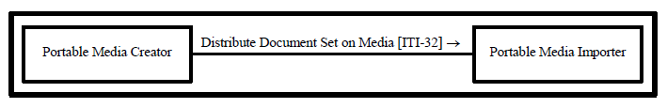

XDM
Actors & Transaction
Portable Media Creator
    Assemble the media content and store it on the media to be distributed
  Portable Media Importer
    Read the Document Submission Set content in order to access the document(s) and metadata; and perform import of the documents. This actor may have to create or convert metadata that was not included on the media.

Slide 9
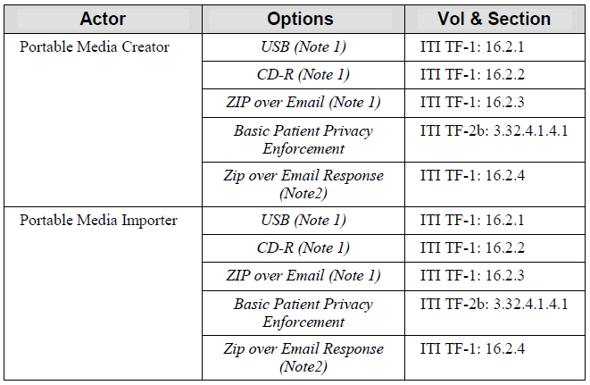
XDM
Options
    Note 1: At least one of these options is required. To enable better interoperability, it is highly recommended that the actors support all the options
    Note 2: This requires the ZIP over Email option.

Slide 10

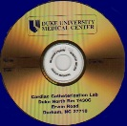


XDM
XDM Push of Health Information
Home
Hospital
Read
Write
Interchange
Media
Discharge summary + Lab report
Discharge summary +Lab report
Including Email
Read
Physician
Office

Slide 11
XDM
Standards
  DICOM PS 3.10 Media Storage and File Format for Data Interchange (DICOM file format). http://dicom.nema.org/
  DICOM PS 3.12 Media Formats and Physical Media for Data Interchange, Annex F - 120mm CD-R media, Annex R - USB Connected Removable Devices, Annex V - ZIP File Over Media, and Annex W - Email Media. http://dicom.nema.org/
  XHTML™ 1.0 The Extensible HyperText Markup Language (Second Edition). A Reformulation of HTML 4 in XML 1.0. W3C Recommendation 26 January 2000, revised 1 August 2002. http://www.w3.org/TR/xhtml1.
  XHTML™ Basic. W3C Recommendation 19 December 2000. http://www.w3.org/TR/xhtm-basic.
  MDN: RFC 3798 Message Disposition Notification. http://www.rfc-editor.org/rfc/rfc3798.txt

Slide 12
XDM
Security & Privacy
  The Portable Media Importer should check the hash value and size as found in the XDS metadata to detect corruption within the metadata or media.
  Basic Patient Privacy Enforcement Option
  In the case the media used is the ZIP file over Email, the transaction should be secured by S/MIME (see IHE ATNA) and comply with the security process as defined in the DICOM Part 15 Appendix (Secure Use of ZIP File Media over Email)
  Portable Media Importers/Exporters that import/export media should generate one or more ATNA “Import”/”Export” events into the audit trail to describe the media event.
  Document Encryption Supplement includes both Document encryption and XDM media encryption.

Slide 13
XDM References
Primary
  ITI TF-1 Section 16 Cross-Enterprise Document Media Interchange (XDM)
Underlying Technical Framework Content
  ITI TF-2b
    Section 3.32 Distribute Document Set on Media
  ITI TF-2x
    Appendix T Use of eMail (Informative)
  ITI TF-3
    Section 4.1 XDS Metadata Model
Supplement supporting Limited Metadata
  Support for Metadata-Limited Document Sources

Slide 14
XDR
Cross-Enterprise Document Reliable Interchange

Slide 15
XDR
Documents and metadata pushed using a SOAP protocol
Permits directed push between EHRs, PHRs, and other health IT systems in the absence of XDS or XCA infrastructure
Allows for transfer of documents for a single patient (one submission set)
Supports the reuse of the Provide and Register Document set (ITI-41) with web services as transport
Complementary to XCA’s point-to-point query infrastructure by providing directed push mechanism using the same underlying standard.

Slide 16
XDR
More like XDS than XDM
  Direct transfer between source and recipient
  No registry or repository actors involved
Works with XDS
  XDS Query/Retrieve can feed XDR transmission
  Point-to-point push via XDR can feed XDS submission

Slide 17
XDR
Use Cases
  Primary Physician to Specialist
    Referral information for patient sent to specialist ahead of visit
  Hospital to Long-term Care
    Patient summary information sent to long-term care facility upon patient transfer from hospital
  Physician to Physician
    Patient MRI test results sent from physician in specialized care facility to another specialist for consultation

Slide 18
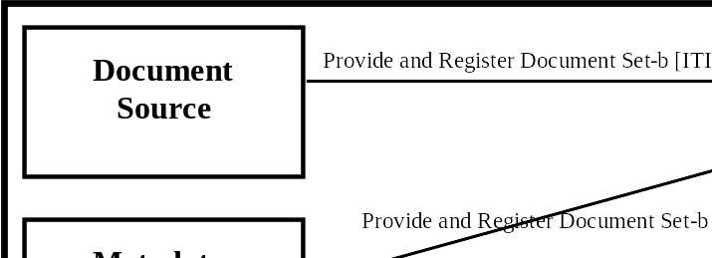
XDR – Actors & Transactions
Document Source
  A system that submits documents and associated metadata to a Document Recipient
Metadata Limited Document Source
  A system that submits documents and associated metadata similar to a Document Source but is limited in the quantity of metadata it is able to provide.
Document Recipient
  A system that receives a set of documents and makes it available to the intended recipient (who can choose to view it or integrated it into the EHR)

Slide 19
XDR - Options
Actor | Options | Vol & Section
Document Source | Basic Patient Privacy Enforcement | ITI-TF-2b: 3.41.4.1.3.1
Metadata-Limited Document Source | Basic Patient Privacy Enforcement | ITI-TF-2b: 3.41.4.1.3.1
Document Recipient | Basic Patient Privacy Enforcement Accepts Limited Metadata | ITI-TF-2b: 3.41.4.1.3.1 ITI TF-1:15.2.3

Slide 20
XDR
XDR Exchange of Health Information
Physician
Office
Specialist
Office
Send
Over Web Services
Receive
A referral summary
A referral summary

Slide 21
XDR
Standards
  ebRIM - OASIS/ebXML Registry Information Model v3.0
  ebRS- OASIS/ebXML Registry Services Specifications v3.0
  ITI TF-2x: Appendix V Web Services for IHE Transactions. Contains references to all Web Services standards and requirements of use
  MTOM - SOAP Message Transmission Optimization Mechanism http://www.w3.org/TR/soap12-mtom/
  XOP - XML-binary Optimized Packaging http://www.w3.org/TR/2005/REC-xop10-20050125/

Slide 22
XDR
Security & Privacy
  Basic Patient Privacy Enforcement Option
  ATNA Secure Node required for both actors
  Management of patient identification in order to perform patient reconciliation correctly upon importation of documents.
  Relevant XDS Affinity Domain security considerations are discussed in the XDS Security Considerations Section (see ITI TF-1: 10.7)

Slide 23
XDR References
Primary
  ITI TF-1
    Section 15 Cross-Enterprise Document Reliable Interchange (XDR)
Underlying Technical Framework Content
  ITI TF-1
    Appendix J Content and Format of XDS Documents
    Appendix K XDS Concept Details
  ITI TF-2b
    Section 3.41 Provide and Register Document Set-b
  ITI TF-2x
    Appendix V “Web Services for IHE Transactions”
  ITI TF-3
    Section 4.1 XDS Metadata Model
Supplement supporting Metadata-Limited Document Sources
  Support for Metadata-Limited Document Sources

Slide 24



Health Document Exchange Options
Flexible Infrastructure
XDS INFRASTRUCTURE
XCA
Other INFRASTRUCTURE
M8354673993
Query/Retrieve
M8354673993
L-716
14355
A87631
L-716
14355
A87631
Document Sources
Document Consumers/ Recipients
XDS
XDS INFRASTRUCTURE
Publish
M8354673993
Query/Retrieve
L-716
14355
A87631
XDR
Existing Reliable
Messaging System
Send to
Receive
Interchange Media
XDM
Read
Write
Including Email

Slide 25



Combining XDM / XDR
1
Primary refers patient to specialist (XDR)
Specialist sends summary report back (XDR)
Primary Care
2
Specialist
5
3
Remote advice (XDM using Email)
Summary report to Primary (XDM using media)
Hospital sends discharge summary back (XDR)
Primary refers patient to hospital (XDR)
4
8
6
Patient Transfer to Extended Care Facility
(XDM using media)
7
Hospital
Extended Care

Slide 26
More Information
IHE Web site: www.ihe.net
  IHE official material
  Technical Framework documents
IHE Wiki site: wiki.ihe.net
  IHE committee pages
  Implementation Notes
  Ongoing committee work
IHE ITI technical committee mailing list
  http://www.ihe.net/IT_infra/committees
  At the bottom of the page is a place to join the mailing list

Slide 27


