Slide 1
Workflow Management for a Referral Process
XDW (Cross-Enterprise Document Workflow)
&
XBeR-WD (Cross-Enterprise Basic eReferral Workflow Definition)
ftp://ftp.ihe.net/IT_Infrastructure/iheitiyr11-2013-2014/Planning_Cmte/EducMaterial/
IT Infrastructure Planning Committee
Charles Parisot (GE)
Mauro Zanardini (Arsenàl.IT)

Slide 2
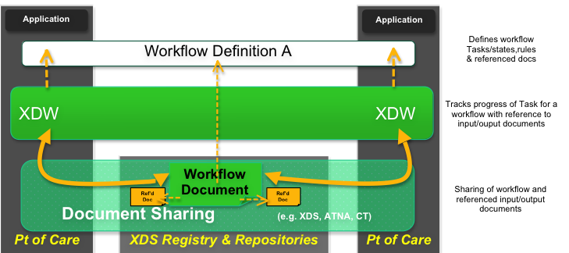
XDW Workflow management infrastructure
Workflow Document in XDW:
Specified by XDW is generic across specific workflow content
Manages workflow specific status with relationship to input/output documents
Tracking the current/past steps of the workflow and engaged health care entities

Slide 3
XDW technical approach
The detailed description of the technical approach used by XDW:
Educational material:
ftp://ftp.ihe.net/IT_Infrastructure/ITI_EducationalMaterials/CurrentPublished/IHE-XDW_2012-03-06.ppt
XDW Content Profile:
http://www.ihe.net/Technical_Framework/upload/IHE_ITI_Suppl_XDW.pdf

Slide 4
OVERVIEW OF THE
BASIC REFERRAL WORKFLOW DEFINITION PROFILE

Slide 5
XBeR-WD potentialities:
Flexibility for a wide variety of use-cases:
Any health professional involved in the Referral process can contribute adding information to the clinical process identifying other actors involved in subsequent steps (e.g. Targeted Referral process)
The target of the referral can be a specific clinician or a Health Service
The Patient is the center of the clinical process. The patient decisions can affect the evolution of clinical workflow in accordance with domain policies.

Slide 6
From the use-case to a Workflow Definition profile
To define for a Workflow Definition profile:
Actors involved: any participant with specific role that can condition the evolution of the process changing the status of the workflow:
  Participant: an health professional that adds information to the clinical process
  Actor: an health professional that can complete clinical tasks
Workflow tasks: a structured action that describes process steps in a simple and standardized way
Allowed evolutions of the process: any workflow path that can be followed in response to specific triggers.
Documents produced during the process: clinical information shared between actors involved

Slide 7
eReferral Workflow Actors
Any participant that affects the evolution of the process:
GP: acts as Referral Requester, starting the process with a referral request
HCP: acts as Referral Scheduler, scheduling the visit
Specialist: acts as Referral Performer, starting and completing the visit
Process Oversight: acts as Workflow Monitor, managing exceptions
Start
Referral Requester
eReferral Process Flow between Workflow Actors
Workflow
Monitor
Referral Requested
(COMPLETED)
Referral Scheduler
Referral Referred
(COMPLETED)
Referral Scheduled
(COMPLETED)
The Workflow Monitor can read the status of the task at any time
Referral Referred
(IN_PROGRESS)
Stop
Referral Performer

Slide 8
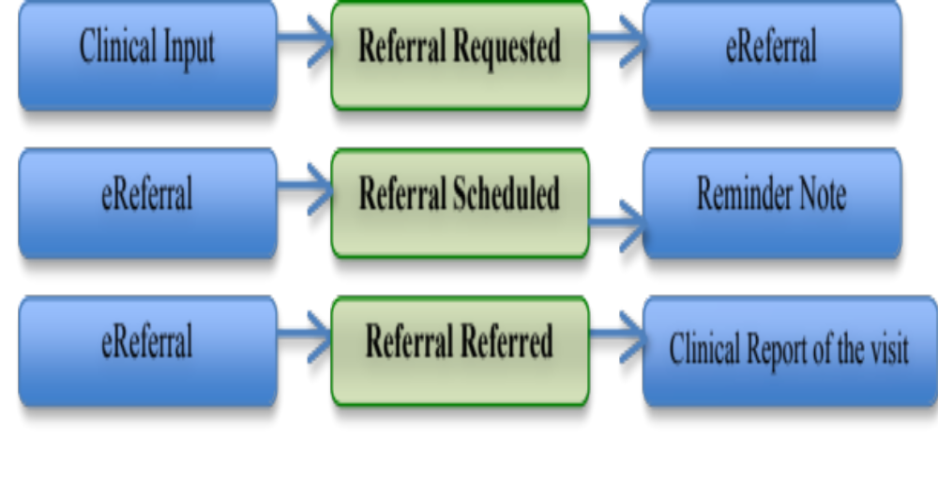
eReferral workflow Tasks
Any simple/complex action performed by an enterprise that needs to be externally “visible”:
Referral Requested: a type of task that tracks the request for a referral process.
Referral Scheduled: a task type that tracks the taking in charge of the eReferral by an HCP.
Referral Referred: a task type that tracks the progress and the completion of the referral.

Slide 9
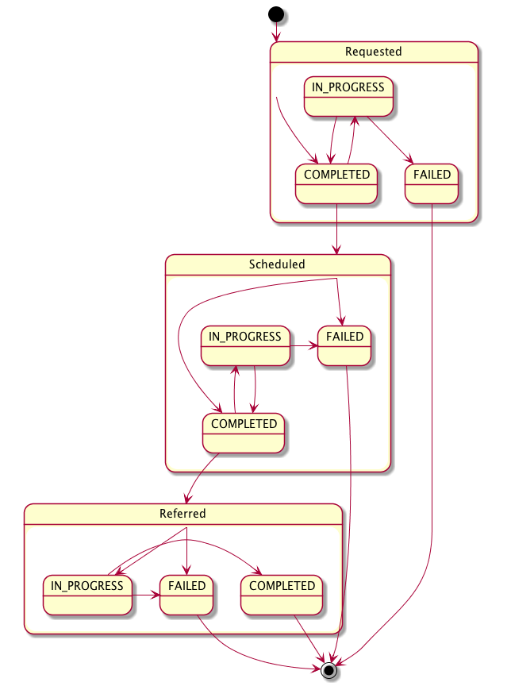
eReferral process evolution
Identify events that affects the evolution of the process as triggers:
Completion of Request (Task “Referral Requested” in status COMPLETED)
Completion of Scheduling (Task “Referral Scheduled” in status COMPLETED)
Start of the consultation (Task “Referral Referred” in status IN_PROGRESS)
Completion of the Referral (Task “Referral Referred” in status COMPLETED)
Notes:
Mauro: Note: check if the figure should add an arrow to go from Referred directly to COMPLETED

Slide 10
Documents Referenced
Any clinical or administrative information conveyed between actors involved:
eReferral: document that describe the referral requested and probably the reason for the request
Clinical Input: clinical information tracked to justify the request
Exception Report: document produced in case of exception situation
Reminder Note: document that tracks information reated to the scheduling of the visit
Clinical Report of the visit: document that tracks results of the specialist's consultation
Label used in XDW Workflow Document | Example of content profile
eReferral | XDS-SD
Clinical Report of the Visit | XDS-SD EDR PPOC XD-LAB ECDR CIRC DRPT APSR
Exception Report | XDS-SD
Clinical Input | XDS-SD PPOC XD-LAB ECDR CIRC DRPT APSR
Reminder Note | XDS-SD
Notes:
“Label used in XDW WD”, Documents Referenced

Slide 11
Workflow Definition profiles specific features:
Define alternative paths and rules, and suggest the use of other profiles to define sharing infrastructure and content of shared documents:
Workflow Options: can be selected by a specific project implementation, and allows the profile to be more flexible through different local scenarios. (e.g. the Referral process in a specific implementation can evolve without the scheduling phase. In this case a specific option is selected and rules for transition between tasks are changed. Options selected is not an information conveyed between actors but a “foundation” upon which any actor is created inside the specific project implementation)
Grouping of actors: used to require:
  Specific document sharing infrastructures (e.g. XDW, XDS, XDM, XDR)
  Including referenced content in standardized way (e.g. XDS-SD, XD-LAB, XDS-I, XPHR, XDS-MS)

Slide 12

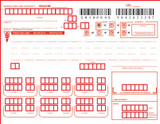
1) Referral Request (1/2)
The GP’s software, as Referral Requester, produces the eReferral Document and the related Workflow Document characterized by:
WorkflowDefinitionReference= 1.3.6.1.4.1.19376.1.5.3.1.5.1
WorkflowStatus=OPEN
Only one task “Referral Referred” created in status COMPLETED
This “eReferral” document is attached to the Workflow Document
Workflow Document
eReferral Doc
Referral Requested
Input: --
Output: eReferral doc
COMPLETED

Slide 13

1) Referral Request (2/2)
Workflow Document
Ver.1
APPROVED
eReferral document
XDS infrastructure
Documents produced are submitted to the XDS Infrastructure
The eReferral document is now available, along with its related status tracked by the Workflow Document, to all organizations

Slide 14


2) Scheduling the Referral (1/2)
The patient calls for appointment. Administrative person on Hospital System, as Referral Scheduler, checks the status of the eReferral workflow by consuming the Workflow Document :
Workflow Document
Referral Requested
Reminder Note
COMPLETED
  Visit needs to be scheduled (task “Referral Requested” status COMPLETED)
Use the “eReferral” document as input
  Set appointment (producing “Reminder Note” for patient)
  Add a new task “Referral Scheduled” in status COMPLETED
  Updates the Workflow Document
Referral Scheduled
Input: eReferral doc
Output: Reminder Note
COMPLETED
Notes:
Another possibility is to have a task Scheduled in status FAILED…

Slide 15
2) Scheduling the Referral (2/2)
eReferral document
Workflow Document
Ver.2
APPROVED
Workflow Document
Ver.1
DEPRECATED
Reminder Note
The visit can be cancelled by an administrative person, changing the status of the task “Referral Scheduled” to:
  IN_PROGRESS: needs to re-schedule the visit (same Provider)
  FAILED: eReferral is released by the Health Care Provider

Slide 16

3) Start of the consultation (1/2)
The patient visits the specialist. The specialist’s software, as Referral Performer, checks the status of the workflow.
Workflow Document
By consuming the Workflow Document
Sees that the visit has been scheduled (task “Referral Scheduled” in status COMPLETED)
Reviews the eReferral document related.
Referral Performer starts the visit process updating the Workflow Document
Adding a new task “Referral Referred” in status IN_PROGRESS
Referral Requested
COMPLETED
Referral Scheduled
COMPLETED
Referral Referred
Input: eReferral doc
Output: --
IN_PROGRESS

Slide 17
3) Start of the consultation (2/2)
Workflow Document
Ver.3
APPROVED
eReferral document
Workflow Document
Ver.2
DEPRECATED
Workflow Document
Ver.1
DEPRECATED
The visit process is in execution.

Slide 18

4) End of the consultation (1/2)
The specialist’s software, as Referral Performer, completes the visit process producing the “Clinical Report Of The Visit” and closes the Referral process completing the Referral Referred task:
Workflow Document
Referral Requested
COMPLETED
Referral Scheduled
COMPLETED
Set the task “Referral Referred” status to COMPLETED
Close the workflow by setting the WorkflowStatus to CLOSED
Reference the “Clinical Report of the Visit” document as output of the Referral Referred task
Referral Referred
Input: eReferral doc
Output: Clinical Report of the visit
IN_PROGRESS
COMPLETED

Slide 19

4) End of the consultation (2/2)
Workflow Document
Ver.4
APPROVED
eReferral document
Workflow Document
Ver.3
DEPRECATED
Workflow Document
Ver.2
DEPRECATED
Workflow Document
Ver.1
DEPRECATED
Clinical Report of the Visit
The Referral process is completed
The Referral Requester actor can be notified for the publication of the Report (e.g. using a DSUB notification system)

Slide 20
XDW e XBeR-WD references
XDW supplement:
Trial Implementation status
Good feedbacks for the first testing session in EU Connectathon
First testing planned for US Connectathon - Jan 2013
XBeR-WD supplement:
Trial Implementation status
First product announced at RSNA December 2012
Adoption is strictly related to XDW dissemination

Slide 21


