Slide 1





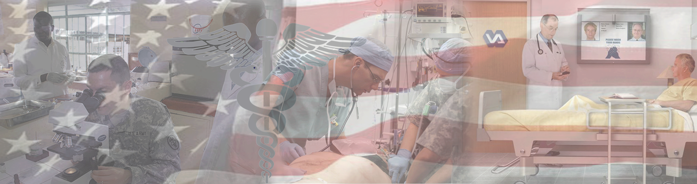

By Light Professional IT Services LLC
www.bylight.com
IHE on FHIR
John Moehrke
<John.Moehrke@byLight.com>
Co-Chair: IHE ITI Planning Committee, HL7 Security WG
FHIR Foundation founding member
FHIR Management Group, FHIR Facilitator

Slide 2

Architect: Healthcare Informatics Standards
- Interoperability, Privacy, and Security
CyberPrivacy – Enabling authorized communications
while respecting Privacy
IHE Co-Chair IT Infrastructure Planning & Technical Committee
HL7 Co-Chair Security WG, FHIR FMG, FHIR facilitator, and
FHIR Foundation founding member
HITRUST Certified CSF Practitioner
Employee of ByLight Professional IT Services -- Contractor to VHA MyHealtheVet
JohnMoehrke@gmail.com | M +1 920-564-2067 | John.Moehrke@bylight.com
https://www.linkedin.com/in/johnmoehrke |
https://healthcaresecprivacy.blogspot.com
Courtney's third law: There are no technical solutions to management problems, but there are management solutions to technical problems.
Interoperability Exchange, Privacy, and Security in Healthcare - CyberPrivacy. XDS/XCA/MHD, mHealth, Patient Identity, Provider Directories, FHIR, Consent, Access Control, Audit Control, Accounting of Disclosures, Identity, Authorization, Authentication, Encryption, Digital Signatures, Transport/Media Security, De-Identification, Pseudonymization, Anonymization, and Blockchain.

Slide 3
IHE Domains
Cardiology
Dental
Eye Care
IT Infrastructure (ITI)
Pathology and Laboratory Medicine
Patient Care Coordination
Patient Care Devices
Pharmacy
Quality, Research and Public Health
Radiation Oncology
Radiology
Mammography
Nuclear Medicine
* Marked in red are domains using FHIR
Source: https://www.ihe.net/IHE_Domains/

Slide 4
Mobile
Most profiles from IHE that leverage FHIR have the word “Mobile” in their title.
Indicates FHIR was used
Usually only used when historic use-case is re-evaluated using FHIR
Does NOT restrict the use to non-Mobile use

Slide 5
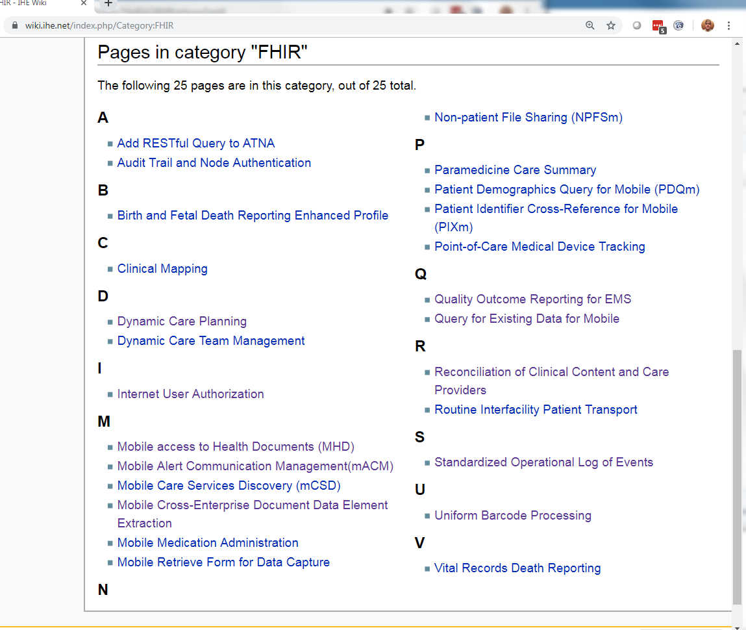
https://wiki.ihe.net/index.php/Category:FHIR

Slide 6
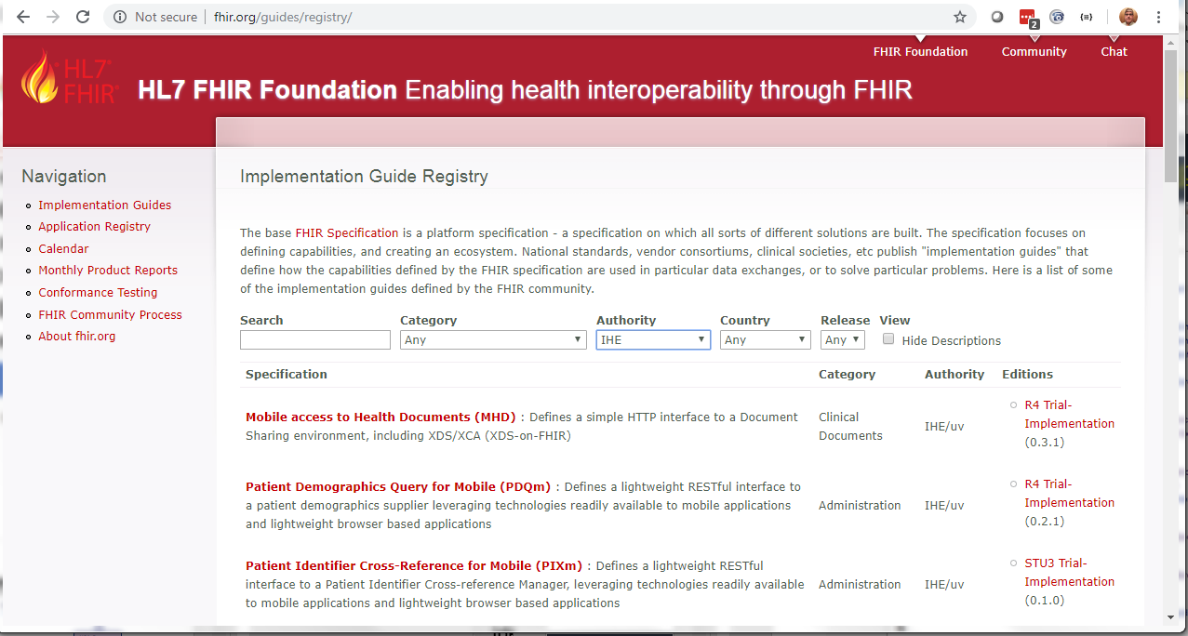
Registered on fhir.org

Slide 7
ITI Profiles on FHIR
Mobile Access to Health Documents (MHD)
Audit Trail and Node Authentication (ATNA) - Query
Mobile Alert Communication Management (mACM)
Mobile Care Services Discovery (mCSD)
Healthcare Provider Directory
Mobile Cross-Enterprise Doc Data Element Extraction (mXDE)
Non-patient File Sharing (NPFS)
Patient Identifier Cross-reference for Mobile (PIXm)
Patient Demographic Query for Mobile (PDQm)
Internet User Authentication (IUA) – Special Mention
Patient Identity Management

Slide 8
Appendix Z on FHIR
Common text for all IHE Domains to re-use
Introduction to FHIR profiling concepts
Common query parameter clarifications
Relationship between CapabilityStatement and IHE Integration Statement
Pointer to library of conformance resources
Mapping of FHIR Identifier datatype to HL7 v3 root, and XDS Cxi
Security Considerations

Slide 9
Patient Care Coordination Profiles on FHIR
Clinical Mapping (CMAP)
Dynamic Care Planning (DCP)
Dynamic Care Team Management (DCTM)
Point of Care Medical Device Tracking (PMDT)
Query for Existing Data for Mobile (QEDm)
Reconciliation of Clinical Content and Care Providers (RECON)
Routine Interfacility Patient Transport (RIPT)
Paramedicine Care Summary (PCS)
Assessment Curation and Data Collection (ACDC)

Slide 10
Pharmacy Profiles on FHIR
Mobile Medication Administration (MMA)
Uniform Barcode Processing (UBP)

Slide 11
QRPH Profiles on FHIR
Mobile Retrieve Form for Data Capture (mRFD)
Vital Records Death Reporting (VRDR)
Birth and Fetal Death Reporting – Enhanced (BFDE)
Quality Outcome Reporting for EMS (QORE)
Mobile Aggregate Data Exchange (mADX)
Prescription Repository Query (PRQ)

Slide 12
Radiology Profiles on FHIR
Standardized Operational Log of Events (SOLE)
Special mention as these use compatible DICOM web
Web Image Capture (WIC)
Web Image Access (WIA) formerly called MHD-I
Invoke Image Display (IID) - Special mention

Slide 13
Move to FHIR R4
All profiles are expected to be revised to use FHIR R4
IHE Governance prevents normative until underlying standard is normative
Priority set of Profiles are updated to R4 and are in Public Comment
Mobile Access to Health Documents (MHD)
Mobile Care Services Discovery (mCSD)
Patient Demographic Query for Mobile (PDQm)
Query for Existing Data for Mobile (QEDm)
Appendix Z
Mobile Cross-Enterprise Doc Data Element Extraction (mXDE)
Equivalent to US-Core

Slide 14
IHE on FHIR
26 Profiles and growing
IT Infrastructure (ITI) - 8
Patient Care Coordination - 9
Pharmacy - 2
Quality, Research and Public Health - 6
Radiology - 1
https://wiki.ihe.net/index.php/Category:FHIR
http://www.ihe.net
Blog – John Moehrke’s Healthcare Exchange Standards
https://healthcaresecprivacy.blogspot.com

Slide 15

Questions?
John Moehrke
Gmail JohnMoehrke
Twitter JohnMoehrke
Skype johnmoehrke
Blog healthcareSecPrivacy.blogspot.com

