Slide 1



Sharing of IPS (sIPS)
John Moehrke
<JohnMoehrke@gmail.com>
Co-Chair: IHE ITI Technical Committee

Slide 2
Agenda
Foundation of IPS
Foundation of Document Sharing
Specifics of this Profile
Other IHE relevant Profiles

Slide 3
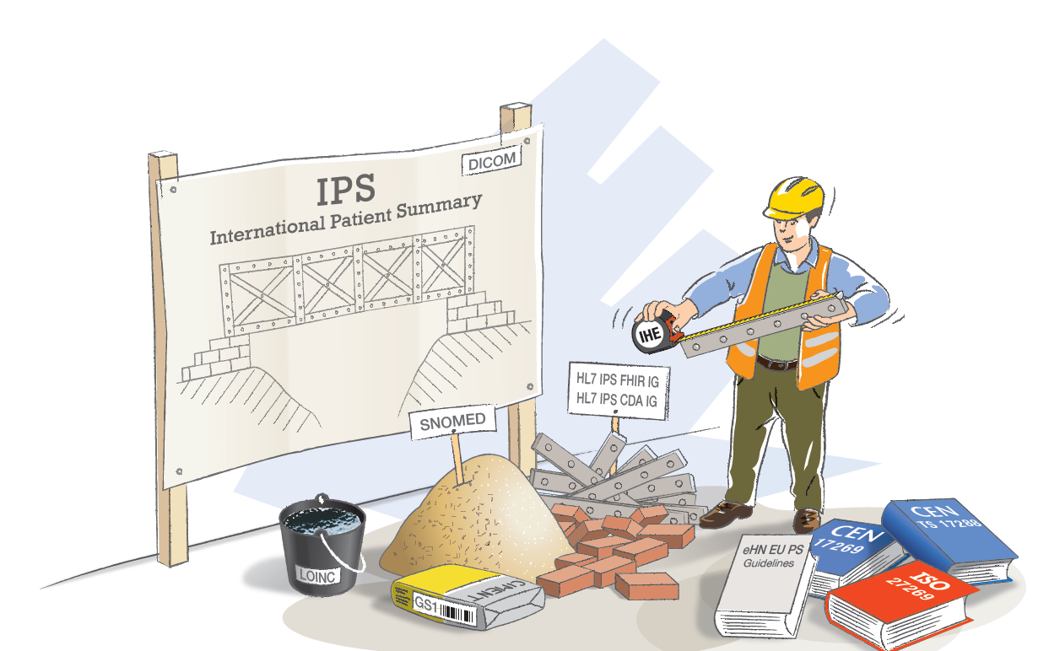



IPS: A Cross-SDO Initiative

Slide 4
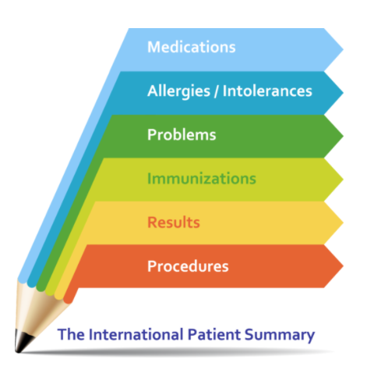
What is the IPS?
A standardized set of basic clinical data
Includes most important health and care related facts
A summarized version of a patient’s clinical data provides health professionals the essential information needed for care
The International Patient Summary is a minimal and non-exhaustive set of basic clinical data of a patient, specialty-agnostic, condition-independent, but readily usable by all clinicians for the unscheduled (cross-border) patient care.

Slide 5
International Patient Summary IPS
Scoped
Snapshot in time of a subject of care’s health information and healthcare
International
generic solutions for global application beyond a particular region or country.
Designed for Unscheduled (cross-border) care
…but it provides a base-line usable also within other scheduled or planned care cases.
Health record extract

Slide 6
IHE Document Sharing

Slide 7
























IHE Standards-based HIE (XDS) Key Components
Patient ID Manager
PRIMARY CARE PHYSICIANS
Practice Management
EMR
PATIENT
Personal Health Records
Document Registry
Document Repositories
LAB
Results
PUBLIC HEALTH
Registries
PAYERS
Claim Data
HOSPITAL 2
EMR/PM’s
Lab
PACS Archive
PHARMACY/PBMs
RX History
SPECIALTY PRACTICE
Practice Management
EMR
HOSPITAL 1
EMR/PM’s
Lab
PACS Archive
Notes:
See http://healthcaresecprivacy.blogspot.com/p/topics.html#HIE

Slide 8

IHE Standards-based HIE (XCA) Community Document Sharing
XCA Gateway
Patient ID Manager
PRIMARY CARE PHYSICIANS
Practice Management
EMR
Patient ID Manager
PRIMARY CARE PHYSICIANS
Practice Management
EMR
Document Registry
PATIENT
Personal Health Records
Document Registry
PATIENT
Personal Health Records
Document Repositories
Document Repositories
LAB
Results
LAB
Results
PUBLIC HEALTH
Registries
PAYERS
Claim Data
PUBLIC HEALTH
Registries
PAYERS
Claim Data
EHR
PHARMACY/PBMs
RX History
HOSPITAL 2
EMR/PM’s
Lab
PACS Archive
PHARMACY/PBMs
RX History
HOSPITAL 2
EMR/PM’s
Lab
PACS Archive
SPECIALTY PRACTICE
Practice Management
EMR
HOSPITAL 1
EMR/PM’s
Lab
PACS Archive
SPECIALTY PRACTICE
Practice Management
EMR
HOSPITAL 1
EMR/PM’s
Lab
PACS Archive
Notes:
See http://healthcaresecprivacy.blogspot.com/p/topics.html#HIE

Slide 9
Principles of a Document
Persistence – A Document continues to exist in an unaltered state, for a time period defined by local and regulatory requirements. Note documents outlive the servers (and often the syntax), on which they are created.
Stewardship –A document is maintained over its lifetime by a custodian, either an organization or a person entrusted with its care.
Authenticatable -- Potential for authentication - A clinical document is an assemblage of information that is intended to be legally authenticated.
Context - A clinical document establishes the default context for its contents
Wholeness - A document is a whole unit of information. Parts of the document may be created or edited separately, or may also be authenticated or legally authenticated, but the entire document is still to be treated as a whole unit.
Human readability – a document is human readable
Notes:
See https://healthcaresecprivacy.blogspot.com/2013/11/distinction-between-documents-and.html
True of both CDA documents and FHIR documents

Slide 10
Various Formats and Encodings
XDS/XCA are content agnostic
Metadata enable discovery
CDA, C-CDA, C32, etc
FHIR Documents
DICOM Documents
PDF/Text
Graphics (JPEG, MPEG, TIFF…)
Special (On-Demand, Delayed)
EMR
CCDA
2.1
CCDA
1.1
C32
PDF
FHIR
Notes:
See https://healthcaresecprivacy.blogspot.com/2015/10/ihe-formatcodes-are-mandatory.html

Slide 11
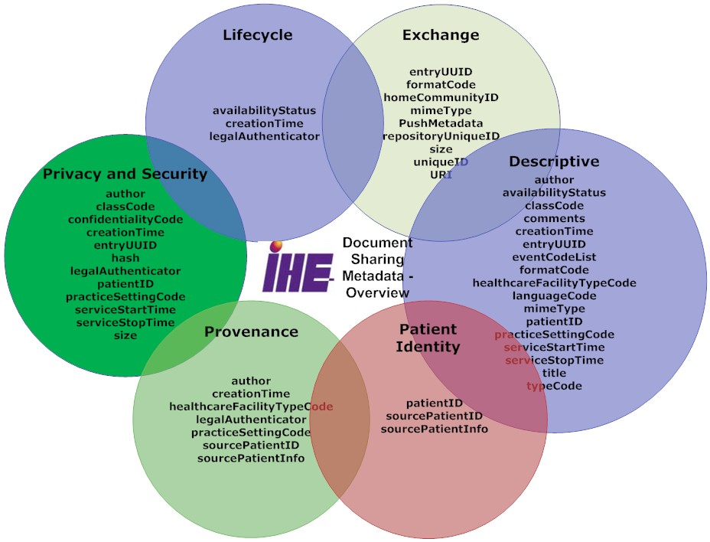
Metadata – enables discovery

Slide 12
Supporting Infrastructure
Security & Privacy
ATNA, XUA, CT, SeR,
DSG, DEN
BPPC, APPC, PCF
IUA, BALP
Patient Identity
PDQ, PIX, PAM
XCPD
PMIR, PDQm, PIXm
Provider Identity
HPD, CSD, PWP, mCSD
Workflow
XDW

Slide 13
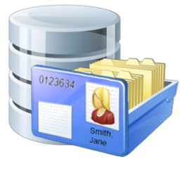



mXDE – Consuming Documents as Resources
Resources
Shared Documents (XDS)
Observation
Obs 1
Obs 2
Obs 3
Med Summary
1
2
EHR
Episode
2/7/1989
Medication
Med 1
Med 2
Med 3
3
Lab/Rad
Allergy
Al 1
Al 2
Al 3
Discharge
Summary
1/2/2002
…
Immunization
Imm 1
Imm 2
Imm 3
EMR
Etc…
Provenance
Prov 1
Prov 2
Prov 3
4

Slide 14
Sharing of IPS

Slide 15
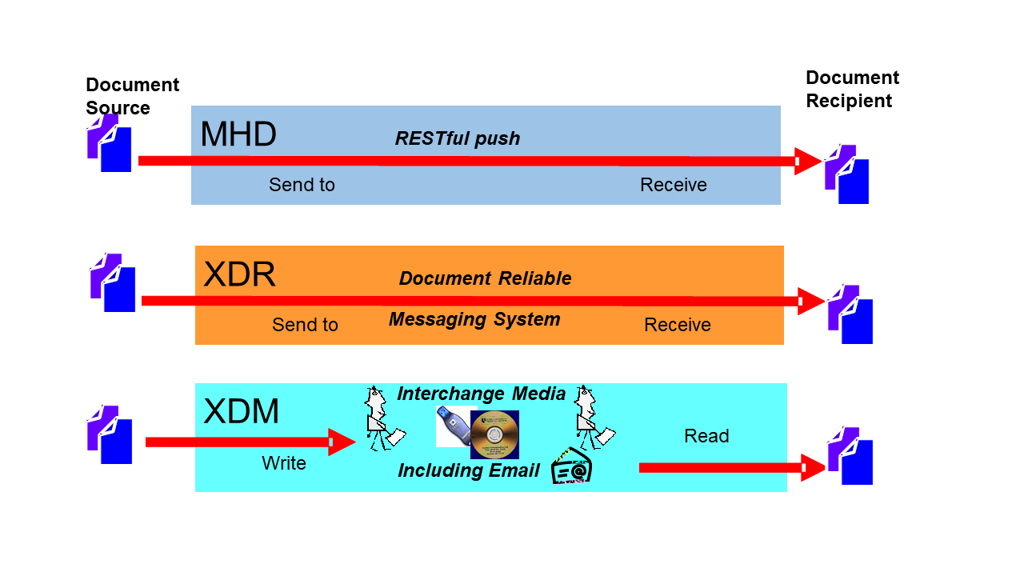





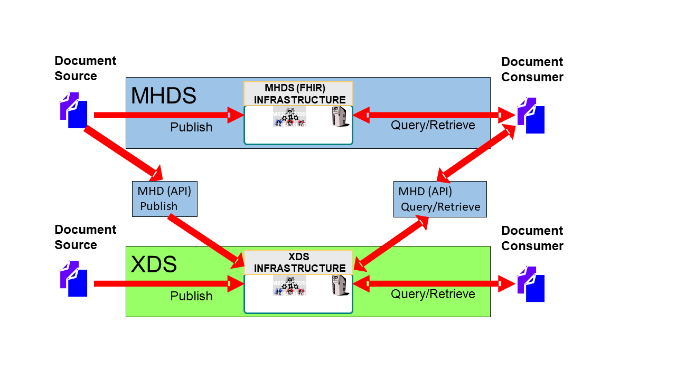







IHE Sharing of IPS
Content
Creators
Document (IPS)
Transports
IHE
Delivery
IHE/HL7
Content
Consumers
System of Record
IPS Document
IPS Document
PUSH
Clinician
HIE Exchange
mXDE
Resources
Observation
Obs 1
Obs 2
Obs 3
PUSH
Medication
Med 1
Med 2
Med 3
IPA
Allergy
Al 1
Al 2
Al 3
Patient
Immunization
Imm 1
Imm 2
Imm 3
XCA
Federated
Provenance
Prov 1
Prov 2
Prov 3

Slide 16
Detailed Requirements in sIPS
Content Creators must make IPS document conformant to HL7 IPS
Defined FormatCode that identifies that the document is conformant to HL7 IPS encoding specification.
Content Creators and Content Consumers must be grouped with one of the IHE Document Sharing Transports (XDS, XCA, XDR, XDM, MHD, MHDS, etc)
IHE Integration Statement must be published
Content Consumers must have some use of the content (view, import, etc)

Slide 17
Other IHE Profiles leveraging IPS
sIPS is simply about communicating IPS over Document Sharing
Other use-cases will use IPS as is in some broader workflow
EMS/EMT – want to consume IPS so as to use as input during EMS/EMT event
Derivation
Occupational Data for Health Option – adds Social History section to IPS

Slide 18
IHE Connectathon
1. Testing IPS conformant to HL7 IPS, using the HL7/Mitre validation tooling
2. Testing Document Sharing, using IHE Gazelle/NIST testing tools
3. Testing that the IPS can be queried, retrieved, published, and/or pushed
1+2=3
4. Higher Level Use-cases:
- Transfer of Care
- EMS support and transport
- Maternal Health
- Plan-of-Care
- etc…
5. Regional Specializations – USA, Netherlands, Switzerland, Italy, etc…
Notes:
IHE Connectathon is about testing both at the Profile level, but also at the overall workflow.

Slide 19
Questions?
JohnMoehrke@gmail.com

