Slide 1


IHE Scheduling Profile (access to and booking of appointments for patients) https://profiles.ihe.net/ITI/Scheduling
Presented by John Moehrke
19 December 2024

Slide 2
Agenda
Legacy from Argonaut
Use-Cases
Actors
Transactions
Questions

Slide 3
History and Acknowledgment:
Based on the Argonaut Scheduling Implementation Guide.
The following are some of the major differences from the Argonaut IG:
The IHE Profile is based on FHIR R4
The IHE Profile is intended for international use, and it does not have required bindings or any dependencies to national profiles
The operations described are $find, $hold, and $book
A separate transaction describes the use of FHIR Search for the Appointment resource
The operation parameters use explicit data types, and support only POST transactions
Notes:
Coordinated transition from Argonaut to IHE
Argonaut is only STU3 based

Slide 4
Scope
The Scheduling Profile is a vendor agnostic specification providing FHIR APIs and guidance for access to, and booking of, appointments for patients by both patient and practitioner end users, including cross-organizational workflows.
FHIR R4: Schedule, Slot, and Appointment resources.
This workflow profile defines transactions that allow a scheduling client to obtain information about possible appointment opportunities based on specific parameters and based on that information, allow the client to book an appointment.

Slide 5
Profiling Goal
Support Servers that are not natively FHIR
Use of Operations for most transactions
No use of Schedule and Slot explicitly
User can be Patient, Related Person, or external Practitioner
Cross-Organizational or Patient initiated
Patient is identified to a common Patient – PDQm
Security and Privacy – ATNA, IUA, BALP, PCF
Discovery of Scheduling Service - mCSD
Notes:
The profile will work with a system that is natively FHIR and does use Schedule and Slots.
Additional feature of use of Operations is that the server can change internal state, including re-arranging schedules to enable new Appointments for urgent needs.

Slide 6
Use-Cases
Post Hospital Discharge – Schedule follow-up at PCP
Scheduling aware of other appointments that the patient has
Patient scheduling an appointment
Notes:
Post-discharge PCP Visit Use Case Description
Ms. Philips is being discharged from Green Valley General Hospital. One of the steps of the discharge process includes scheduling a follow-up appointment with Dr. Spears, Ms. Philip's primary care provider. Dr. Spears' practice is part of a different healthcare organization, which necessitates cross-organizational scheduling of the follow-up appointment.

Slide 7
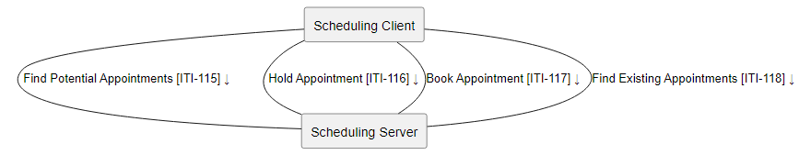
Actors / Transactions
Find Potential Appointments
Book Appointment
Optional (Client probes Server capabilities)
Hold Appointment
Find Existing Appointments
Notes:
Find Potential Appointments - searches for availability for one or more future appointments using the Find Appointments operation.
Book Appointment - books a new appointment, cancel an already existing appointment, or reschedule an existing appointment.
Hold Appointment - request for a hold on a selected Appointment
Find Existing Appointments - searches for existing appointments for the patient
Note there should likely be a named Option to indicate a Server does support the Find Existing Appointments, and maybe the Hold Appointments transactions.

Slide 8
Find Potential Appointments [ITI-115]
Input
start dateTime
end dateTime
specialty
visit-type
practitioner
organization
location (string or reference)
Patient (reference or resource)
reason
timing
insurance- (InsurancePlan)
Output
Bundle of potential Appointment
Notes:
Server finds the best possible response(s). No defined definition of what best is, or what the effort expectation is. Simply that the Output are declared matches by the Server, and the Client can use those Output Appointments as potentially available. Note they might not be available due to other activities, such as another client taking an Appointment.

Slide 9
Hold Appointment [ITI-116]
Input
Appointment-reference [1..1]
Output
Bundle
Appointment
OperationOutcome
OPTIONAL transaction:
Used to “hold” an appointment for a server defined amount of time.
Often needed when a few minutes are need such as while a user is filling out forms.

Slide 10
Book Appointment [ITI-117]
Input
Appointment (reference or resource)
Patient resource
Comment
Output
Bundle
Appointment
OperationOutcome
Book an Appointment,
Modify, or
Cancel and existing appointment
Notes:
Modify and Cancel – must provide Appointment Resource (not reference), which is used like a RESTful update.
Theory this can be used to cancel a hold, so Cancel may be cancel an appointment or hold?

Slide 11
Find Existing Appointment [ITI-118]
RESTful Search on Appointment resource
identifier
patient
date
practitioner
status
location
specialty
appointment-type

Slide 12
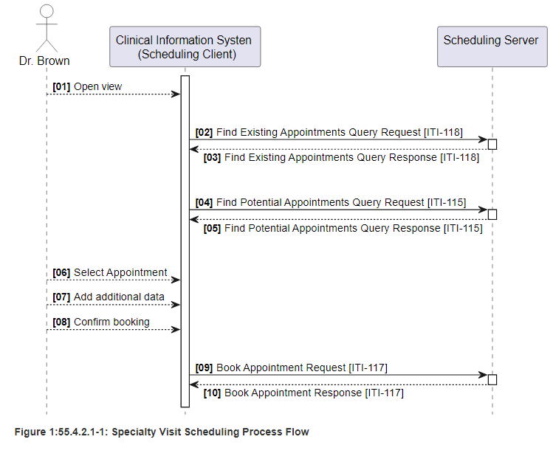
Typical Flow

Slide 13
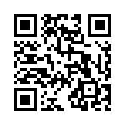
IHE Scheduling Profile
Now in Trial Implementation
https://profiles.ihe.net/ITI/Scheduling
Feedback can be submitted at
https://www.ihe.net/ITI_Public_Comments/
https://github.com/IHE/ITI.Scheduling/issues

