Slide 1


Sharing of IPS (sIPS) https://profiles.ihe.net/ITI/sIPS
John Moehrke
<JohnMoehrke@gmail.com>
Co-Chair: IHE ITI Technical Committee

Slide 2
Agenda
Foundation of IPS
Foundation of Document Sharing
Specifics of this sIPS Profile
Other IHE relevant Profiles and Testing

Slide 3
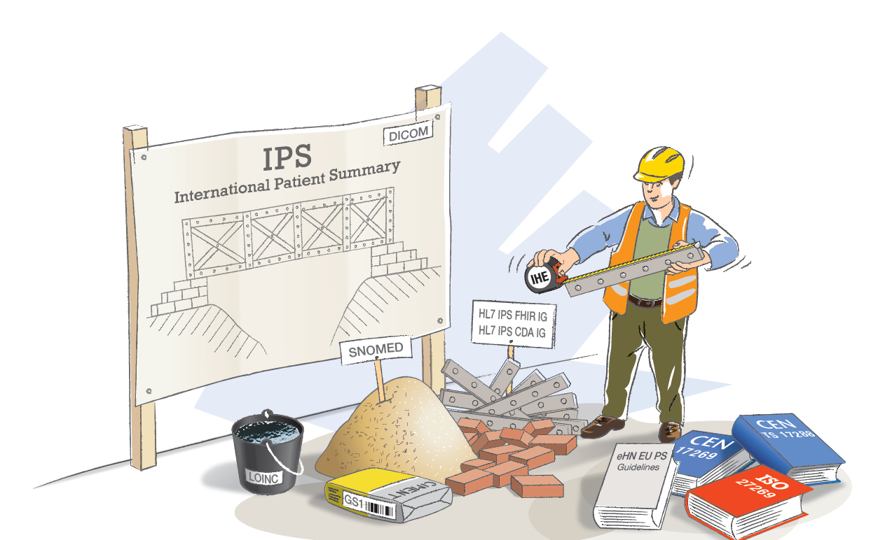



IPS: A Cross-SDO Initiative
https://international-patient-summary.net/
Notes:
SDO’s had unprecedented collaboration on this initiative, each provided standards artefacts designed to be complementary, and highlighting the strengths of each SDO. CEN and ISO provide specifications that define the data model and IPS content; HL7 contributed 2 implementation guides designed to assist implementers with both FHIR and CDA implementations. SNOMED International supplied a free IPS terminology set with accompanying hierarchical ontology. And IHE supplied profiles designed to further address implementation and allow for rigorous conformance testing.

Slide 4
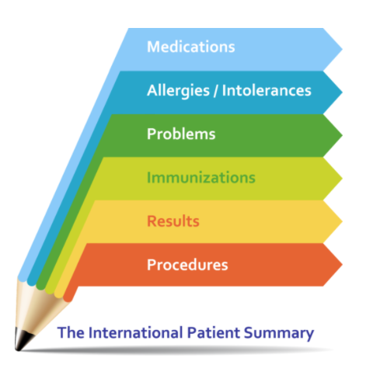
What is the IPS?
A standardized set of basic clinical data
Includes most important health and care related facts
A summarized version of a patient’s clinical data provides health professionals the essential information needed for care
The International Patient Summary is a minimal and non-exhaustive set of basic clinical data of a patient, specialty-agnostic, condition-independent, but readily usable by all clinicians for the unscheduled (cross-border) patient care.
Notes:
A standardized set of basic clinical data
Includes most important health and care related facts, such as Medications, Allergies, Problems, Immunizations, Results and Procedures
A summarized version of a patient’s clinical data provides health professionals the essential information needed for care
The International Patient Summary is a minimal and non-exhaustive set of basic clinical data of a patient, specialty-agnostic, condition-independent, but readily usable by all clinicians for the unscheduled (cross-border) patient care.

Slide 5
International Patient Summary IPS
Scoped
Snapshot in time of a subject of care’s health information and healthcare
International
generic solutions for global application beyond a particular region or country.
Designed for Unscheduled (cross-border) care
…but it provides a base-line usable also within other scheduled or planned care cases.
Health record extract
https://international-patient-summary.net/
Notes:
The IPS is a Health record extract, a snapshot in time of a subject of care’s health information and current healthcare
It is international in scope so a generic specification, with expected regional or country specializations expected
Although originally designed for cross-border unscheduled care, the IPS has also been implemented to support both scheduled and unscheduled care within a particular country, crossing other boundaries such as provinces, states, cities, and even organizations. Although designed to ensure global adoption across national borders, the IPS has been recognized as a useful tool to support care across any geographic or organizational boundary.

Slide 6
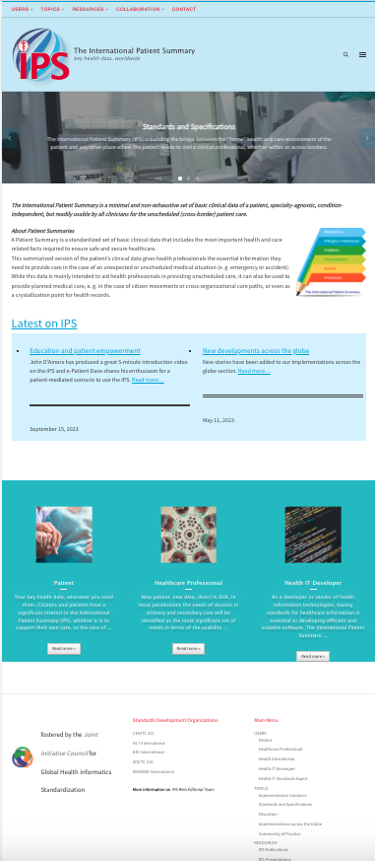
IPS Website
Launched December 2021
Supported by the Joint Initiative Council and participating SDOs
Authoritative source for:
Specifications
Educational resources
Implementations
Stakeholder benefits
http://international-patient-summary.net/
Notes:
Final Draft International Standard, passed the ballot
Several organization are looking at these standard
WHO for the recently started Immunization card specification based on FHIR
Some EU funded project as InteropEHRate; Smarthealth; Gatekeeper,
EU cross border services eHN/eHDSI (analysis path to migrate to IPS; some IPS solution has been adopted)
National eHEalth project (e.g. New Zealand,Argentina)

Slide 7
IHE Document Sharing

Slide 8
























IHE Standards-based HIE (XDS) Key Components
Patient ID Manager
PRIMARY CARE PHYSICIANS
Practice Management
EMR
PATIENT
Personal Health Records
Document Registry
Document Repositories
LAB
Results
PUBLIC HEALTH
Registries
PAYERS
Claim Data
HOSPITAL 2
EMR/PM’s
Lab
PACS Archive
PHARMACY/PBMs
RX History
SPECIALTY PRACTICE
Practice Management
EMR
HOSPITAL 1
EMR/PM’s
Lab
PACS Archive
Notes:
See http://healthcaresecprivacy.blogspot.com/p/topics.html#HIE

Slide 9
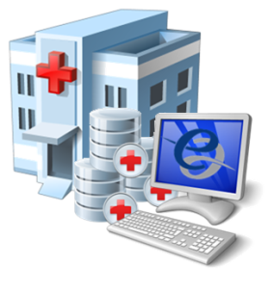
IHE Standards-based HIE (XCA) Community Document Sharing
XCA Gateway
Patient ID Manager
PRIMARY CARE PHYSICIANS
Practice Management
EMR
Patient ID Manager
PRIMARY CARE PHYSICIANS
Practice Management
EMR
Document Registry
PATIENT
Personal Health Records
Document Registry
PATIENT
Personal Health Records
Document Repositories
Document Repositories
LAB
Results
LAB
Results
PUBLIC HEALTH
Registries
PAYERS
Claim Data
PUBLIC HEALTH
Registries
PAYERS
Claim Data
EHR
PHARMACY/PBMs
RX History
HOSPITAL 2
EMR/PM’s
Lab
PACS Archive
PHARMACY/PBMs
RX History
HOSPITAL 2
EMR/PM’s
Lab
PACS Archive
SPECIALTY PRACTICE
Practice Management
EMR
HOSPITAL 1
EMR/PM’s
Lab
PACS Archive
SPECIALTY PRACTICE
Practice Management
EMR
HOSPITAL 1
EMR/PM’s
Lab
PACS Archive
Notes:
See http://healthcaresecprivacy.blogspot.com/p/topics.html#HIE

Slide 10
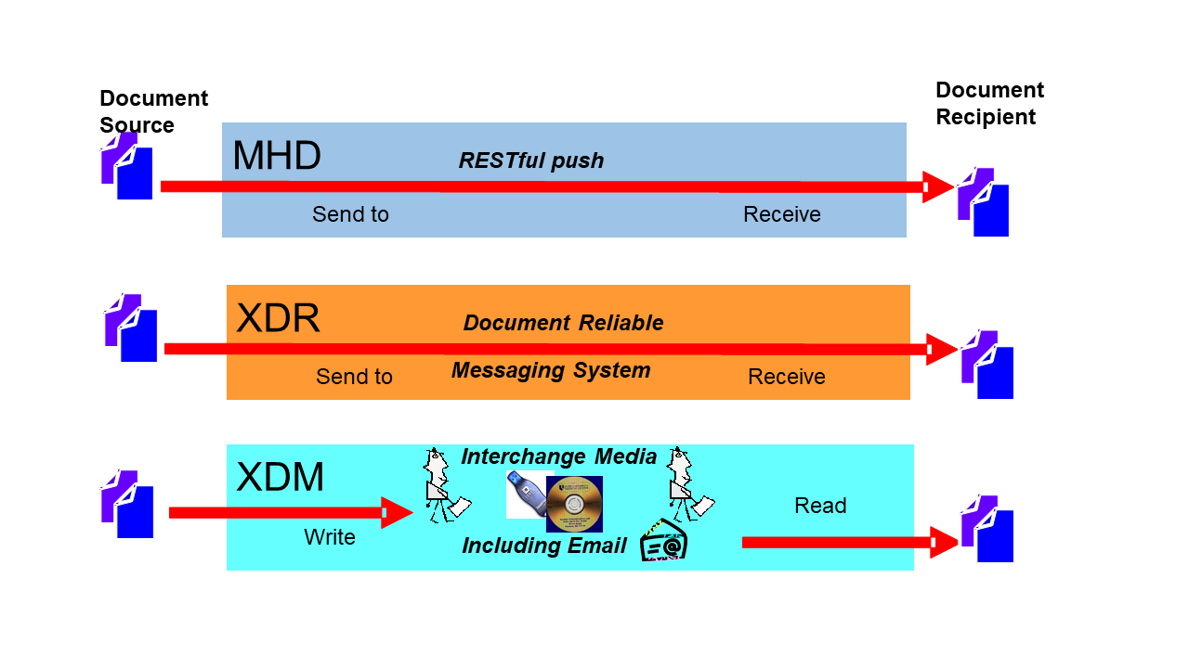
Push

Slide 11
Principles of a Document
Persistence – A Document continues to exist in an unaltered state, for a time period defined by local and regulatory requirements. Note documents outlive the servers (and often the syntax), on which they are created.
Stewardship –A document is maintained over its lifetime by a custodian, either an organization or a person entrusted with its care.
Authenticatable -- Potential for authentication - A clinical document is an assemblage of information that is intended to be legally authenticated.
Context - A clinical document establishes the default context for its contents
Wholeness - A document is a whole unit of information. Parts of the document may be created or edited separately, or may also be authenticated or legally authenticated, but the entire document is still to be treated as a whole unit.
Human readability – a document is human readable
Notes:
See https://healthcaresecprivacy.blogspot.com/2013/11/distinction-between-documents-and.html
True of both CDA documents and FHIR documents

Slide 12
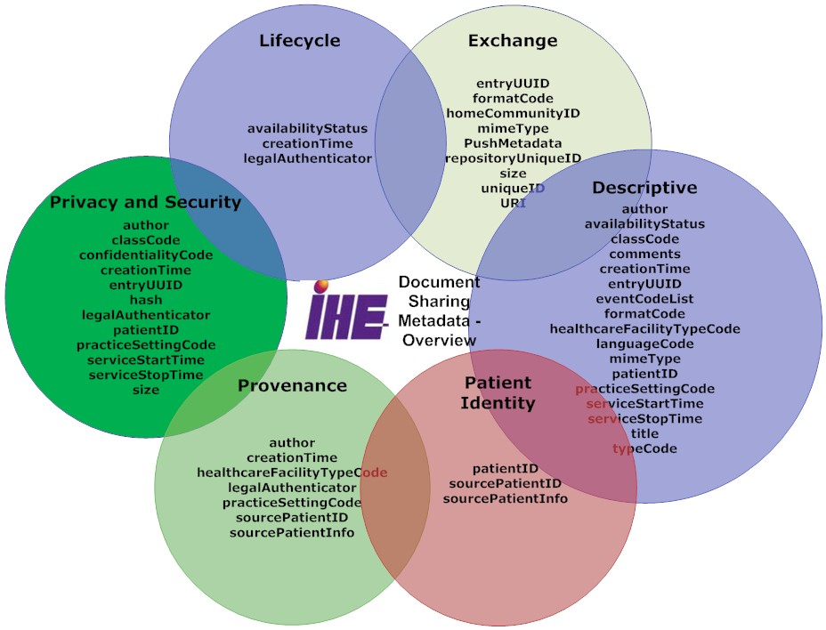
Metadata – enables discovery

Slide 13
Various Formats and Encodings
EMR
Content agnostic
Metadata enable discovery
CDA, C-CDA, C32, etc
FHIR Documents
DICOM Documents
PDF/Text
Graphics (JPEG, MPEG, TIFF…)
Document Relationships
Transforms
Signs
Replaces
Special
On-Demand Document
Delayed Document Assembly
FHIR IPS
C-CDA
CDA-IPS
C32
PDF
Notes:
See https://healthcaresecprivacy.blogspot.com/2015/10/ihe-formatcodes-are-mandatory.html

Slide 14
Supporting Infrastructure Profiles
Security & Privacy
ATNA, XUA, CT, SeR,
DSG, DEN
BPPC, APPC, PCF
IUA, BALP
Patient Identity
PDQ, PIX, PAM
XCPD
PMIR, PDQm, PIXm
Provider Identity, Services Discovery
HPD, CSD, PWP, mCSD
Workflow
XDW
https://profiles.ihe.net/ITI

Slide 15
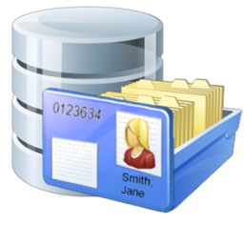




mXDE – Consuming Documents as Resources
Resources
Shared Documents (XDS)
Observation
Obs 1
Obs 2
Obs 3
Med Summary
1
2
EHR
Episode
2/7/1989
Medication
Med 1
Med 2
Med 3
3
Lab/Rad
Allergy
Al 1
Al 2
Al 3
Discharge
Summary
1/2/2002
…
Immunization
Imm 1
Imm 2
Imm 3
EMR
Etc…
Provenance
Prov 1
Prov 2
Prov 3
4

Slide 16
Sharing of IPS (sIPS)

Slide 17





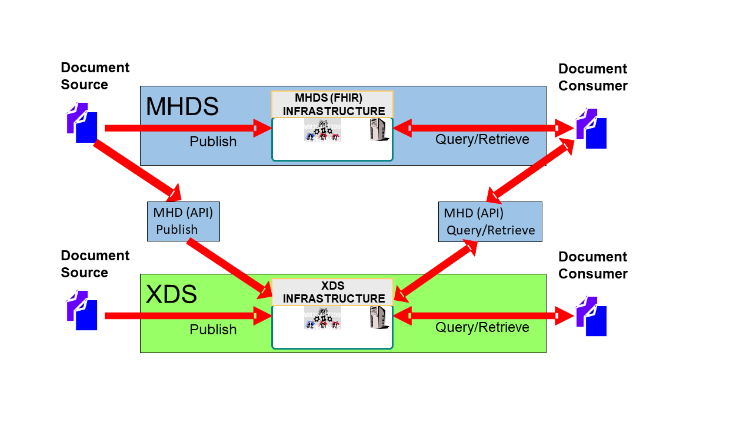







IHE Sharing of IPS (sIPS)
Content
Creators
Document (IPS)
Transports
IHE
Delivery
IHE/HL7
Content
Consumers
System of Record
IPS Document
IPS Document
PUSH
Clinician
HIE Exchange
mXDE
Resources
Observation
Obs 1
Obs 2
Obs 3
PUSH
Medication
Med 1
Med 2
Med 3
IPA
Allergy
Al 1
Al 2
Al 3
Patient
Immunization
Imm 1
Imm 2
Imm 3
XCA
Federated
Provenance
Prov 1
Prov 2
Prov 3

Slide 18
Source
Systems
Recipient
Systems
IPS Document
IHE-based Transports
Clinician
1
PUSH IPS to recipient system:
MHD (RESTful push)
XDR (document reliable messaging)
XDM (reliable media, including email)
Clinician
Source
System
IPS
Document
(MHD)
Document
Source
(MHD)
Document
Recipient
Recipient
System
Content
Creator
2
Recipient system PULLs IPS from HIE:
XDS (Query/Retrieve)
MHD (Query/Retrieve)
XCA (Federated Query/Retrieve)
Content
Consumer
HIE as Source
System
PHR
System
Document
Repository
HIE(s)
Document
Repository
(MHD)
Document
Consumer
(MHD)
Document
Recipient
(MHD)
Document
Responder
Patient
Responding
Gateway
Initiating
Gateway
On-demand IPS
Document
On-demand Document
Source
3
Recipient system PULLs On-Demand IPS from HIE (as Source System)
which plays the role of a Content Creator.
Notes:
John – it seems to me that there are 3 main paradigms, here: (1) direct push of IPS, (2) query/retrieve of IPS, and (3) query/retrieve of on-demand IPS.
I’ve tried to leverage a graphical language that shows how systems play the roles of actors.
I’m not super-happy that (to be symmetrical) I’ve had to list Document Repository twice… or that it really didn’t add anything to the “story” to list Document Registry, so I left it off.
But… the graphic should tell a story. It’s a cartoon… not an engineering diagram..
I don’t know if you’re planning to record a video, or give the presentation live, or what. But… in my experience… using successive slides that “tell” the story is always a help when there’s a LOT of content (as is the case, here).
So… I’ve created a few slides (following) that can be leveraged to progressively tell the story around these workflows. It makes it all seem less busy and confusing…

Slide 19
Source
Systems
Recipient
Systems
IPS Document
IHE-based Transports
Clinician
1
PUSH IPS to recipient system:
MHD (RESTful push)
XDR (document reliable messaging)
XDM (reliable media, including email)
Clinician
Source
System
IPS
Document
(MHD)
Document
Source
(MHD)
Document
Recipient
Recipient
System
Content
Creator
Content
Consumer
PHR
System
Patient
Notes:
Option-1… direct push

Slide 20
Source
Systems
Recipient
Systems
IPS Document
IHE-based Transports
Clinician
Clinician
Source
System
IPS
Document
(XDS)
Document
Source
Recipient
System
Content
Creator
2
Recipient system PULLs IPS from HIE:
XDS (Query/Retrieve)
MHD (Query/Retrieve)
XCA (Federated Query/Retrieve)
Content
Consumer
PHR
System
Document
Repository
HIE(s)
Document
Repository
XDS
Document
Consumer
Patient
Notes:
Option-2… XDS

Slide 21
Source
Systems
Recipient
Systems
IPS Document
IHE-based Transports
Clinician
Clinician
Source
System
IPS
Document
(MHD)
Document
Source
Recipient
System
Content
Creator
2
Recipient system PULLs IPS from HIE:
XDS (Query/Retrieve)
MHD (Query/Retrieve)
XCA (Federated Query/Retrieve)
Content
Consumer
PHR
System
Document
Repository
HIE(s)
Document
Repository
(MHD)
Document
Consumer
(MHD)
Document
Recipient
(MHD)
Document
Responder
Patient
XDS or MHDS
Notes:
Option-2… FHIR-based IPS document

Slide 22
Source
Systems
Recipient
Systems
IPS Document
IHE-based Transports
Clinician
Clinician
Source
System
IPS
Document
(MHD)
Document
Source
Recipient
System
Content
Creator
2
Recipient system PULLs IPS from HIE:
XDS (Query/Retrieve)
MHD (Query/Retrieve)
XCA (Federated Query/Retrieve)
Content
Consumer
PHR
System
Document
Repository
HIE(s)
Document
Repository
(MHD/XCA)
Document
Consumer
(MHD)
Document
Recipient
(MHD)
Document
Responder
Patient
Responding
Gateway
Initiating
Gateway
Notes:
Option-2: XCA (either FHIR based or not…)

Slide 23
Source
Systems
Recipient
Systems
IPS Document
IHE-based Transports
Clinician
Recipient
System
Content
Creator
Content
Consumer
HIE as Source
System
PHR
System
(MHD)
Document
Consumer
Patient
On-demand IPS
Document
On-demand Document
Source
3
Recipient system PULLs On-Demand IPS from HIE (as Source System)
which plays the role of a Content Creator.
Notes:
Option-3: the IPS is not created by a human… it is built on-demand from content in the HIE

Slide 24
Detailed Requirements in sIPS
Content Creators must make IPS document conformant to HL7 FHIR IPS Implementation Guide
Defined FormatCode that identifies that the document is conformant to HL7 IPS encoding specification.
Content Creators and Content Consumers must be grouped with one of the IHE Document Sharing Transports (XDS, XCA, XDR, XDM, MHD, MHDS, etc)
IHE Integration Statement must be published
Content Consumers must have some use of the content (view, import, etc)

Slide 25
Other IHE Profiles leveraging IPS
sIPS is simply about communicating IPS over Document Sharing
Other use-cases will use IPS as is in some broader workflow
EMS/EMT – want to consume IPS so as to use as input during EMS/EMT event
Derivation
Occupational Data for Health Option – adds Social History section to IPS
Maternal Health – Antipartum Summary

Slide 26
IHE Connectathon
1. Testing to the IPS data model specification by ISO, and to the FHIR Implementation Guide supplied by HL7, using the HL7/Mitre validation tooling
2. Testing Document Sharing, using IHE Gazelle/NIST testing tools
3. Testing that the IPS can be queried, retrieved, published, and/or pushed
1+2=3
4. Higher Level Use-cases:
- Transfer of Care
- EMS support and transport
- Maternal Health
- Plan-of-Care
- etc…
5. Regional Specializations – USA, Netherlands, Switzerland, Italy, etc…
Notes:
IHE Connectathon is about testing both at the Profile level, but also at the overall workflow.

Slide 27
Questions?
https://profiles.ihe.net/ITI/sIPS
JohnMoehrke@gmail.com

