Slide 1


Sharing of IPS (sIPS) https://profiles.ihe.net/ITI/sIPS
John Moehrke
<JohnMoehrke@gmail.com>
Co-Chair: IHE ITI Technical Committee

Slide 2
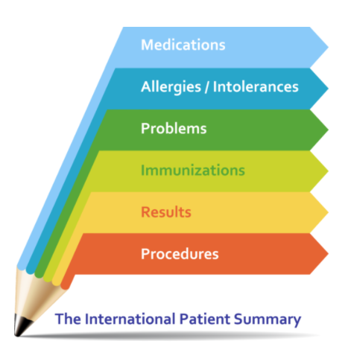
What is the IPS?
Cross-SDO collaborative
A standardized set of basic clinical data
Includes most important health and care related facts
A summarized version of a patient’s clinical data provides health professionals the essential information needed for care
The International Patient Summary is a minimal and non-exhaustive set of basic clinical data of a patient, specialty-agnostic, condition-independent, but readily usable by all clinicians for the unscheduled (cross-border) patient care.
Notes:
A standardized set of basic clinical data
Includes most important health and care related facts, such as Medications, Allergies, Problems, Immunizations, Results and Procedures
A summarized version of a patient’s clinical data provides health professionals the essential information needed for care
The International Patient Summary is a minimal and non-exhaustive set of basic clinical data of a patient, specialty-agnostic, condition-independent, but readily usable by all clinicians for the unscheduled (cross-border) patient care.

Slide 3
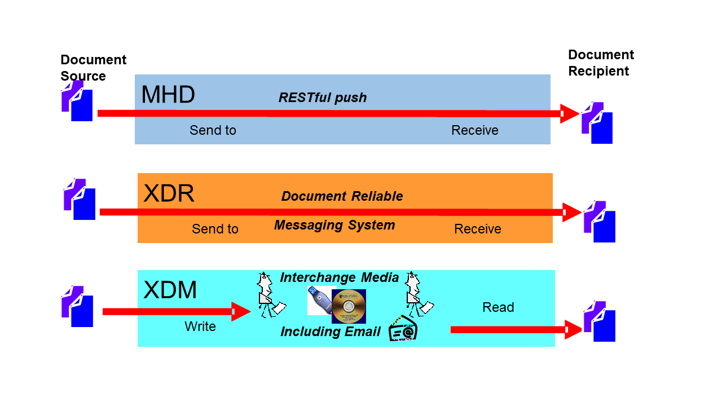





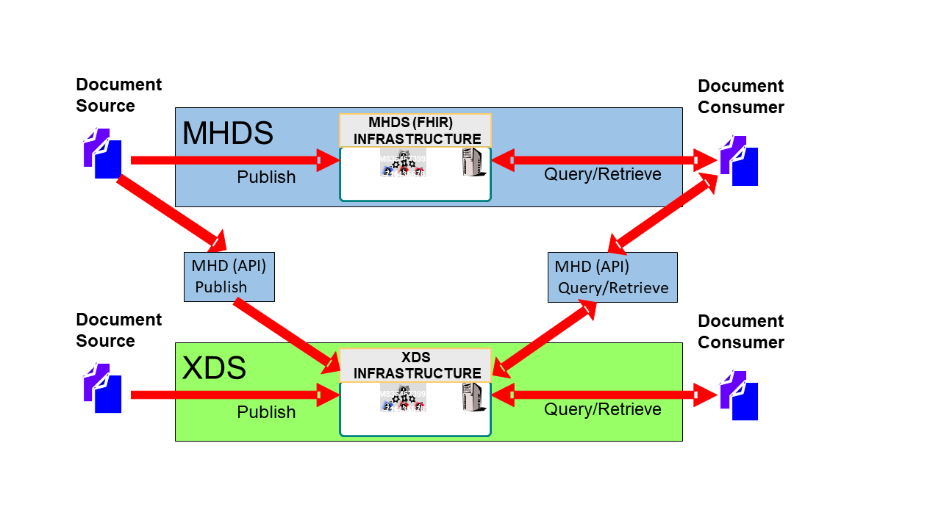








IHE Sharing of IPS (sIPS)
Content
Creators
Document (IPS)
IHE Document Sharing
Transports
Delivery
IHE/HL7
Content
Consumers
System of Record
IPS Document
IPS Document
PUSH
Clinician
HIE Exchange
mXDE
Resources
Observation
Obs 1
Obs 2
Obs 3
PUSH
Medication
Med 1
Med 2
Med 3
IPA
Allergy
Al 1
Al 2
Al 3
Patient
Immunization
Imm 1
Imm 2
Imm 3
XCA
Federated
Provenance
Prov 1
Prov 2
Prov 3

Slide 4
Source
Systems
Recipient
Systems
IPS Document
IHE-based Transports
Clinician
1
PUSH IPS to recipient system:
MHD (RESTful push)
XDR (document reliable messaging)
XDM (reliable media, including email)
Clinician
Source
System
IPS
Document
(MHD)
Document
Source
(MHD)
Document
Recipient
Recipient
System
Content
Creator
2
Recipient system PULLs IPS from HIE:
XDS (Query/Retrieve)
MHD (Query/Retrieve)
XCA (Federated Query/Retrieve)
Content
Consumer
HIE as Source
System
PHR
System
Document
Repository
HIE(s)
Document
Repository
(MHD)
Document
Consumer
(MHD)
Document
Recipient
(MHD)
Document
Responder
Patient
Responding
Gateway
Initiating
Gateway
On-demand IPS
Document
On-demand Document
Source
3
Recipient system PULLs On-Demand IPS from HIE (as Source System)
which plays the role of a Content Creator.
Notes:
John – it seems to me that there are 3 main paradigms, here: (1) direct push of IPS, (2) query/retrieve of IPS, and (3) query/retrieve of on-demand IPS.
I’ve tried to leverage a graphical language that shows how systems play the roles of actors.
I’m not super-happy that (to be symmetrical) I’ve had to list Document Repository twice… or that it really didn’t add anything to the “story” to list Document Registry, so I left it off.
But… the graphic should tell a story. It’s a cartoon… not an engineering diagram..
I don’t know if you’re planning to record a video, or give the presentation live, or what. But… in my experience… using successive slides that “tell” the story is always a help when there’s a LOT of content (as is the case, here).
So… I’ve created a few slides (following) that can be leveraged to progressively tell the story around these workflows. It makes it all seem less busy and confusing…

Slide 5
Source
Systems
Recipient
Systems
IPS Document
IHE-based Transports
Clinician
1
PUSH IPS to recipient system:
MHD (RESTful push)
XDR (document reliable messaging)
XDM (reliable media, including email)
Clinician
Source
System
IPS
Document
(MHD)
Document
Source
(MHD)
Document
Recipient
Recipient
System
Content
Creator
Content
Consumer
PHR
System
Patient
Notes:
Option-1… direct push

Slide 6
Source
Systems
Recipient
Systems
IPS Document
IHE-based Transports
Clinician
Clinician
Source
System
IPS
Document
(XDS)
Document
Source
Recipient
System
Content
Creator
2
Recipient system PULLs IPS from HIE:
XDS (Query/Retrieve)
MHD (Query/Retrieve)
XCA (Federated Query/Retrieve)
Content
Consumer
PHR
System
Document
Repository
HIE(s)
Document
Repository
XDS
Document
Consumer
Patient
Notes:
Option-2… XDS

Slide 7
Source
Systems
Recipient
Systems
IPS Document
IHE-based Transports
Clinician
Clinician
Source
System
IPS
Document
(MHD)
Document
Source
Recipient
System
Content
Creator
2
Recipient system PULLs IPS from HIE:
XDS (Query/Retrieve)
MHD (Query/Retrieve)
XCA (Federated Query/Retrieve)
Content
Consumer
PHR
System
Document
Repository
HIE(s)
Document
Repository
(MHD)
Document
Consumer
(MHD)
Document
Recipient
(MHD)
Document
Responder
Patient
XDS or MHDS
Notes:
Option-2… FHIR-based IPS document

Slide 8
Source
Systems
Recipient
Systems
IPS Document
IHE-based Transports
Clinician
Clinician
Source
System
IPS
Document
(MHD)
Document
Source
Recipient
System
Content
Creator
2
Recipient system PULLs IPS from HIE:
XDS (Query/Retrieve)
MHD (Query/Retrieve)
XCA (Federated Query/Retrieve)
Content
Consumer
PHR
System
Document
Repository
HIE(s)
Document
Repository
(MHD/XCA)
Document
Consumer
(MHD)
Document
Recipient
(MHD)
Document
Responder
Patient
Responding
Gateway
Initiating
Gateway
Notes:
Option-2: XCA (either FHIR based or not…)

Slide 9
Source
Systems
Recipient
Systems
IPS Document
IHE-based Transports
Clinician
Recipient
System
Content
Creator
Content
Consumer
HIE as Source
System
PHR
System
(MHD)
Document
Consumer
Patient
On-demand IPS
Document
On-demand Document
Source
3
Recipient system PULLs On-Demand IPS from HIE (as Source System)
which plays the role of a Content Creator.
Notes:
Option-3: the IPS is not created by a human… it is built on-demand from content in the HIE

Slide 10




mXDE – Consuming Documents as Resources
Resources
Clinician
Shared Documents (XDS)
Observation
Obs 1
Obs 2
Obs 3
3
Med Summary
1
2
Recipient
System
EHR
Episode
2/7/1989
Medication
Med 1
Med 2
Med 3
HL7 IPA IG
PHR
System
Lab/Rad
Allergy
Al 1
Al 2
Al 3
Discharge
Summary
1/2/2002
…
Immunization
Imm 1
Imm 2
Imm 3
Patient
EMR
Etc…
Provenance
Prov 1
Prov 2
Prov 3
4

Slide 11
Detailed Requirements in sIPS
Content Creators must make IPS document conformant to HL7 FHIR IPS Implementation Guide
Defined FormatCode that identifies that the document is conformant to HL7 IPS encoding specification.
Content Creators and Content Consumers must be grouped with one of the IHE Document Sharing Transports (XDS, XCA, XDR, XDM, MHD, MHDS, etc)
IHE Integration Statement must be published
Content Consumers must have some use of the content (view, import, etc)

Slide 12
IHE Connectathon
1. Testing to the IPS data model specification by ISO, and to the FHIR Implementation Guide supplied by HL7, using the HL7/Mitre validation tooling
2. Testing Document Sharing, using IHE Gazelle/NIST testing tools
3. Testing that the IPS can be queried, retrieved, published, and/or pushed
1+2=3
4. Higher Level Use-cases:
- Transfer of Care
- EMS support and transport
- Maternal Health
- Plan-of-Care
- etc…
5. Regional Specializations – USA, Netherlands, Switzerland, Italy, etc…
Notes:
IHE Connectathon is about testing both at the Profile level, but also at the overall workflow.

Slide 13
Questions?
https://profiles.ihe.net/ITI/sIPS
JohnMoehrke@gmail.com

