Slide 1
IHE and HL7 Working Together

Slide 2

Common Vision
A world in which everyone can securely access and use the right health data when and where they need it
Enable seamless and secure access to health information that is usable whenever and wherever needed

Slide 3
Common Mission
To provide standards that empower global health data interoperability
IHE improves healthcare by providing specifications, tools and services for interoperability. IHE engages clinicians, health authorities, industry, and users to develop, test, and implement standards-based solutions to vital health information needs

Slide 4
Volunteer Structure
Domains and Technical/Planning Committees
Conformity Assessment processes and tools
3 Annual IHE Connectathons (USA, Europe, Asia)
Coordinates use of standards such as HL7 and DICOM for specific needs
National deployment committees in 17 countries
Work groups and Steering Committees
Conformance statements for HL7 Standards
3 Annual FHIR Connectathons (preceding HL7 Working Group Meetings)
Develops standards that are often used in IHE profiles (with DICOM, X.12 . . .)
HL7 Affiliates in 55 countries
Both conduct “testing, education, outreach, collaboration with local health agencies”

Slide 5
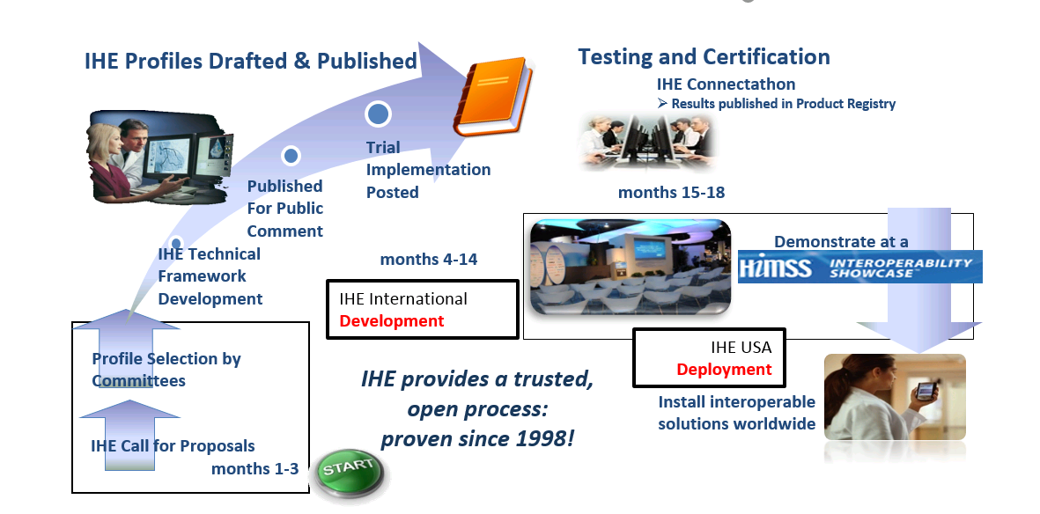
IHE Profile Development Process
Notes:
Each domain follows its own development schedule, some are aligned (ITI, PCC, QRPH)

Slide 6
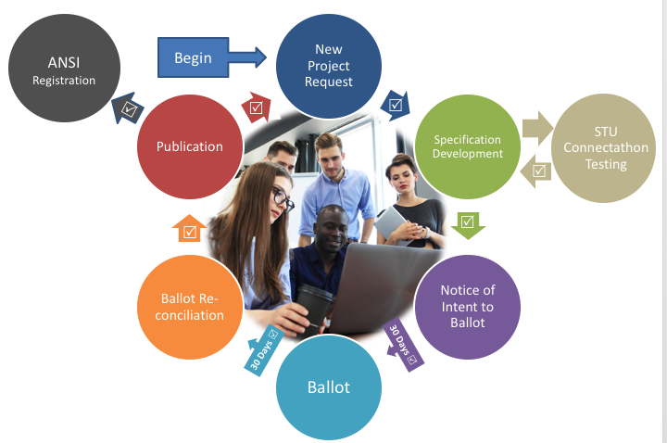
HL7 ANSI-Accredited Standards Process
HL7 work groups meet via conference call and at annual Working Group Meetings (WGMs)
All meetings are open, run under Robert’s rules, with minutes available
STUs and Connectathons allow for ongoing testing of specifications by implementers
ANSI rules govern openness, transparency, balance of interests, due process, appeals.

Slide 7
Profiles vs Implementation Guides
IHE creates and maintains implementation guidelines called IHE Profiles, which are published in a domain-specific set of specifications called the IHE Technical Frameworks.
IHE Profiles provide a common language for purchasers and vendors to discuss the integration needs of healthcare sites and the integration capabilities of health IT products.
HL7 FHIR Profiles define a group of StructureDefinitions (Constraints or Extensions), Value Sets, and examples associated with a FHIR resource for a specific problem or use case.
A FHIR Implementation Guide is a set of rules about how FHIR resources are to be used to solve a specific problem.
HL7 EHR Functional Profiles define functional requirements for use cases such as Behavioral Health, Child Health, Long Term Care . . .

Slide 8
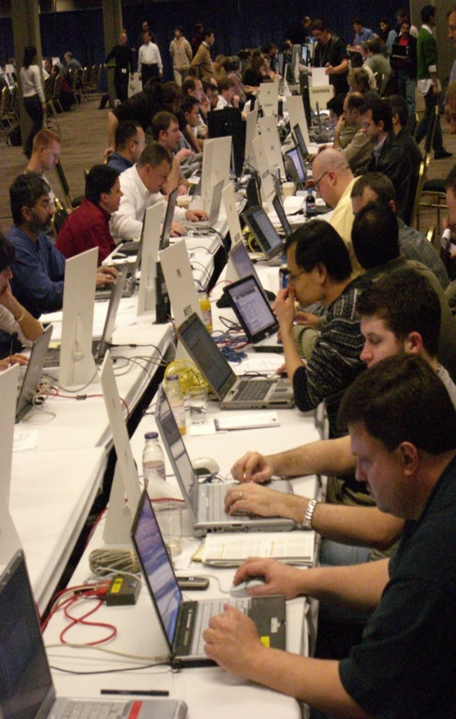
What is a Connectathon?
Cross-vendor, live, supervised, structured testing event
All participating vendors’ products tested together in the same place/time
Experts from each vendor available for immediate problem resolution… fixes are done in minutes, not months!!
Each vendor tests with multiple trading partners (actual product to actual product)
Testing of real-world clinical scenarios

Slide 9
Connectathon – IHE vs HL7 FHIR
HL7 FHIR Connectathons help implementers assess, test and explore new opportunities for applying the FHIR specifications.
Testing as part of an HL7 Connectathon is a pre-requisite for progressing resources and implementation guides within the FHIR Maturity Model
IHE Connectathons provide a rigorous, detailed testing and implementation process for products and systems to enable standards-based interoperability.
Systems exchange information in a structured and supervised peer-to-peer testing environment, performing transactions required for the roles they perform in carefully defined interoperability use cases (profiles).

Slide 10

IHE USA ONC Cooperative Agreement
The Ask:
Identify potential gaps that may inhibit the RESTful exchange of health information using FHIR®
Identify potential ways for IHE USA and ONC to collaborate with HL7, IHE Members, and industry partners to promote and sustain the rapid adoption of the FHIR® standard
The Deliverables:
Environmental scan and Gap Analysis of IHE profiles that support or complement RESTful exchange of health data
Collaborative implementation plan based on feedback from ONC and findings of Environmental Scan and Gap Analysis

Slide 11
Additional Resources
FHIR Profiles https://wiki.ihe.net/index.php/Category:FHIR
MHD - YouTube - https://www.youtube.com/watch?v=ZpQrHI3VVxY
mXDE - YouTube - https://www.youtube.com/watch?v=o24WQgxiYVI
Guidance for IHE profile authors on profiling FHIR
https://wiki.ihe.net/index.php/Guidance_on_writing_Profiles_of_FHIR
IHE FHIR conformance resources - https://github.com/IHE/fhir
Introduction to IHE -https://healthcaresecprivacy.blogspot.com/2019/10/introduction-to-ihe.html
HL7 – www.hl7.org
IHE – www.ihe.net
IHE USA – www.iheusa.org

