Slide 1


IHE and HL7 working together
John Moehrke
<JohnMoehrke@gmail.com>
<John.Moehrke@byLight.com>
Co-Chair: IHE ITI Planning and Technical Committees
https://HealthcareSecPrivacy.blogspot.com/

Slide 2
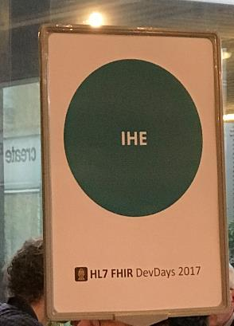
Tutorial Objectives
You should understand:
the role of IHE in interoperability
the role of HL7 in interoperability
the IHE specification development process
IHE Connectathon
FHIR Connectathon
Notes:
9:15

Slide 3

Common Vision
A world in which everyone can securely access and use the right health data when and where they need it.
Enable seamless and secure access to health information that is usable whenever and wherever needed.

Slide 4
Common Mission
To provide standards that empower global health data interoperability.
IHE improves healthcare by providing specifications, tools and services for interoperability. IHE engages clinicians, health authorities, industry, and users to develop, test, and implement standards-based solutions to vital health information needs.

Slide 5
Domains and Technical/Planning Committees
Conformity Assessment processes and tools
3 Annual Connectathons (USA, Europe, Asia)
Coordinates use of standards such as HL7 and DICOM for specific needs
IHE national deployment committees in 17 countries
Work groups and Steering Committees
Conformance statements for HL7 Standards
3 Annual FHIR Connectathons (preceding HL7 Working Group Meetings)
Develops standards that are often used in IHE profiles (with DICOM, X.12 . . .)
HL7 Affiliates in 55 countries
Both conduct “testing, education, outreach, collaboration with local health agencies”

Slide 6
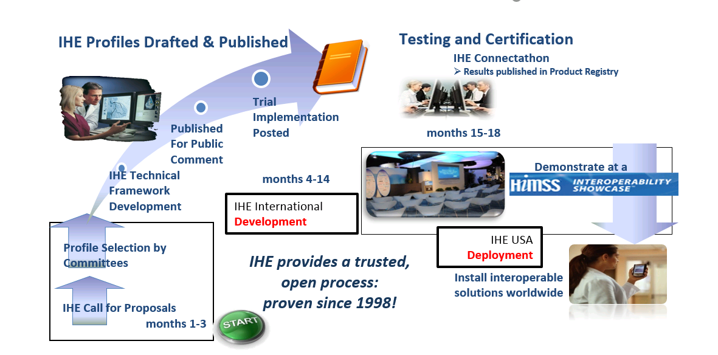
IHE Profile Development: A Proven 1-year Quality Management Cycle
Notes:
Each domain follows its own development schedule, some are aligned (ITI, PCC, QRPH)

Slide 7
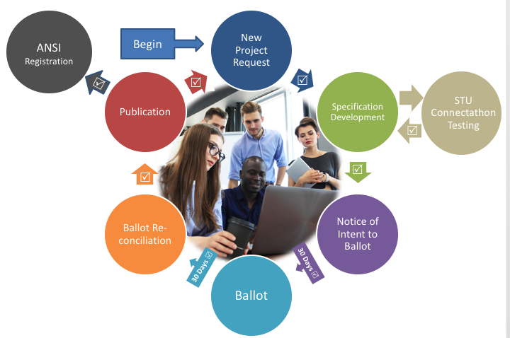
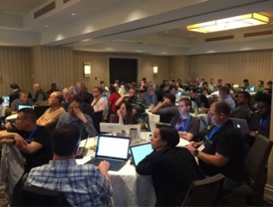
HL7 ANSI-Accredited Standards Process
HL7 work groups meet via conference call and at annual Working Group Meetings (WGMs)
All meetings are open, run under Robert’s rules, with minutes available
STUs and Connectathons allow for ongoing testing by implementers
ANSI rules govern openness, transparency, balance of interests, due process, appeals.

Slide 8
Profiles vs Implementation Guide
IHE creates and maintains implementation guidelines called IHE Profiles, which are published in a set of documents called the IHE Technical Frameworks. IHE Profiles provide a common language for purchasers and vendors to discuss the integration needs of healthcare sites and the integration capabilities of healthcare IT products
HL7 FHIR Profiles define a group of StructureDefinitions (Constraints or Extensions), Value Sets, and examples associated with a FHIR resource for a specific problem or use case
A FHIR Implementation Guide is a set of rules about how FHIR resources are to be used to solve a specific problem
HL7 EHR Functional Profiles define functional requirements for use cases such as Behavioral Health, Child Health, Long term care . . .

Slide 9
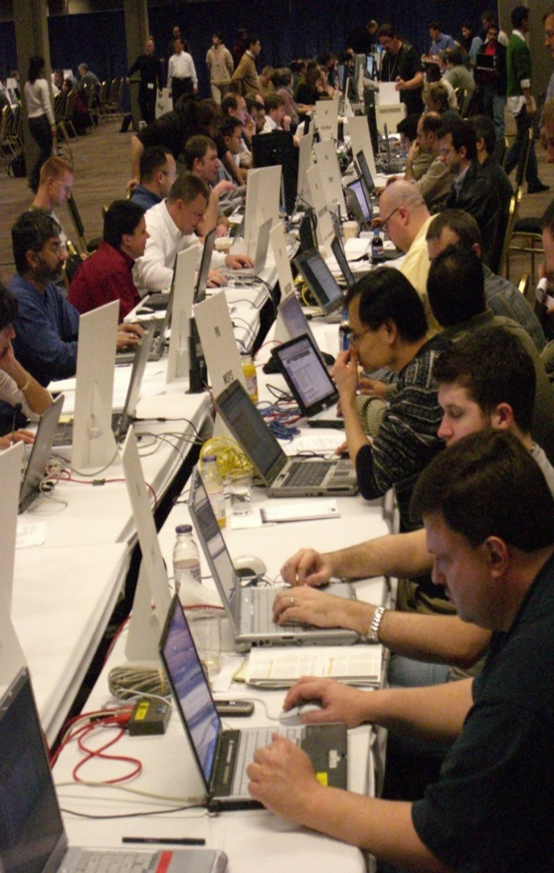
What is a Connectathon?
Cross-vendor, live, supervised, structured testing event
All participating vendors’ products tested together in the same place/time
Experts from each vendor available for immediate problem resolution… fixes are done in minutes, not months!!
Each vendor tests with multiple trading partners (actual product to actual product)
Testing of real-world clinical scenarios

Slide 10
Connectathon – IHE vs FHIR
HL7 FHIR Connectathons help implementers assess, test and explore new opportunities for applying the FHIR specification.
Testing as part of a connectathon is a pre-requisite for progressing resources and implementation guides up the FHIR Maturity Model
IHE Connectathons provide a detailed implementation and testing process to enable standards-based interoperability.
Here systems exchange information in a structured and supervised peer-to-peer testing environment, performing transactions required for the roles that perform in carefully defined interoperability use cases (profiles).

Slide 11

Process

Slide 12
IHE: Framework for Interoperability
A common framework for harmonizing and implementing multiple standards
“Meta-Standards” – standards for standards
Profiling existing standards to address specific use cases in healthcare
Promotes unbiased selection and coordinated use of established healthcare and IT standards to address specific clinical needs
Amongst other initiatives, IHE develops profiles that enable seamless health information movement within and between enterprises, regions, nations
Profiles in IHE are equivalent to a FHIR Implementation Guide
E.g., they take a specific use-case, define Actors, define Transactions, and define Options
Source: https://www.ihe.net/FAQ/

Slide 13
IHE Terminology
Integration Profiles
Describe workflow use cases, standards and the overall relationships to achieve transparent interoperability
Integration Statements
Tell customers the IHE Profiles supported by a specific release of a specific product
Technical Frameworks
The documents for each “domain” that specify the Integration Profiles and the associated systems (actors) and transactions
Connectathons
Neutral testing events with multiple vendors in one room, consisting of developers and testers (no marketing or sales / no customers), promoting rapid and robust interoperability testing
Source: https://www.ihe.net/FAQ/

Slide 14
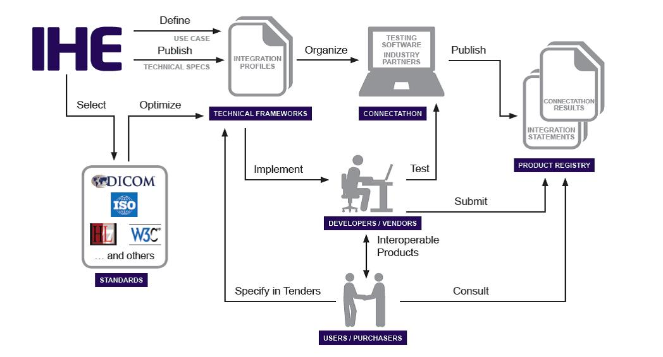
IHE Process
Source: https://www.ihe.net/uploadedImages/Content/About_IHE/IHE_process_flowchart.jpg

Slide 15
IHE Process
Identify Interoperability issues
Develop Integration Profiles
Connectathon Testing
Publish Integration Statements
Vendors list tested profiles
Actors and Transactions
Workflow
Gather relevant standards
{
Profile Proposal
Public Comment
Trial Implementation
Final Text

Slide 16
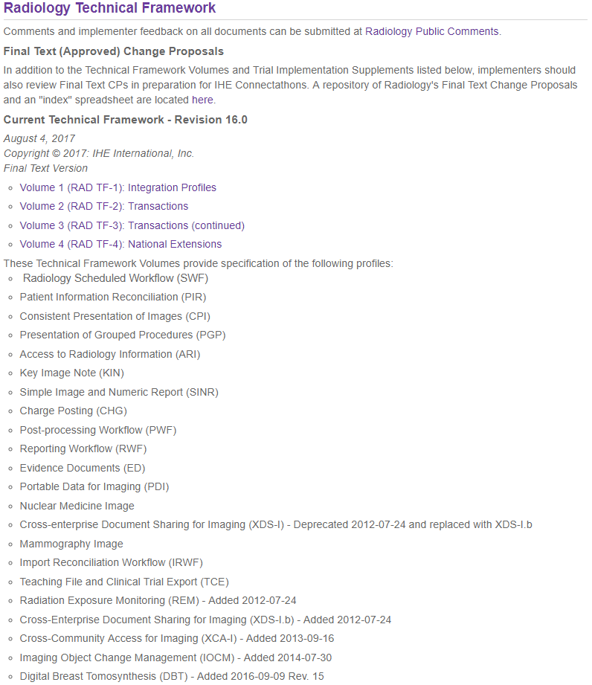
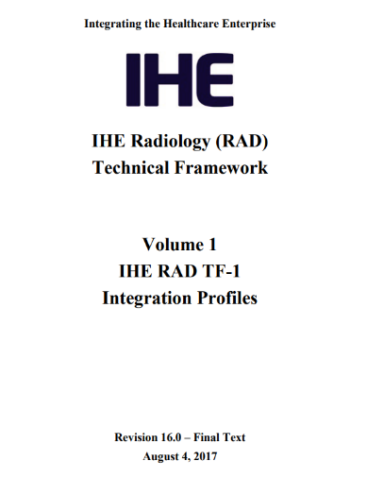
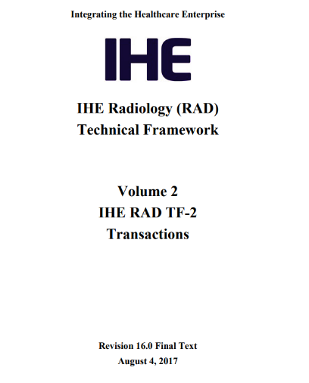
Technical Frameworks
Source: https://www.ihe.net/Technical_Frameworks/

Slide 17
Organization of the Technical Framework
Integration Profile
Integration Profile
Actor
Actor
Actor
Actor
Transaction
{
Roles
Referenced Standards
Detailed Messaging Info
…
Transaction
…
…
Transaction
Transaction
Transaction
Transaction
Transaction
Transaction
Transaction
Transaction
Source: https://www.ihe.net/FAQ/#What_is_the_IHE_Technical_Framework?

Slide 18

Connectathons
Neutral testing events with multiple vendors in one room, consisting of developers and testers (no marketing or sales / no customers), promoting rapid and robust interoperability testing
Benefit is that means that if your code fails on day 1 of Connectathon, you can hack it that night, and come back with something that only exists on the developers laptop, and try again on day 2
Whereas IHE Connectathons are organized testing with predefined test cases against published formal specifications, FHIR Connectathons have been traditionally more ad-hoc "hackathon“ organized around specific tracks
Source: https://www.ihe.net/connectathon.aspx

Slide 19
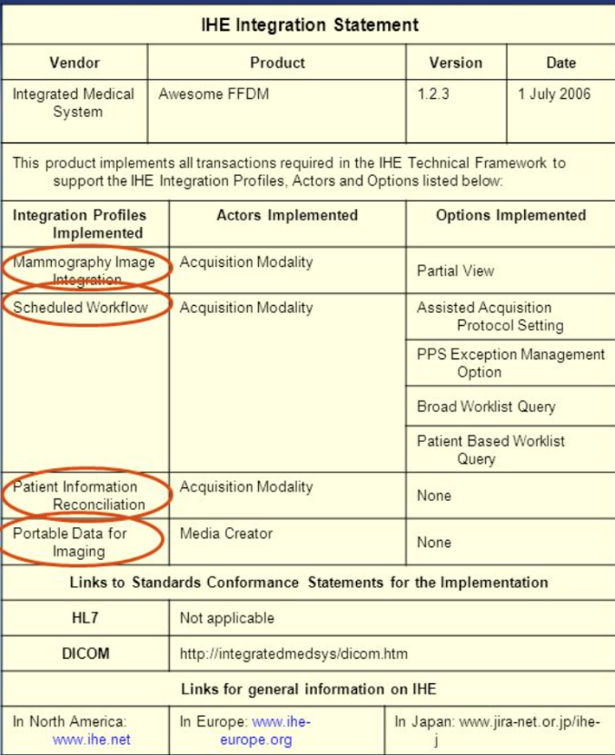
Publishing Integration Statements
End users use IHE integration statements as a way to know that a system is compliant, e.g., when evaluating an RFP response
Vendors publish integration statements that are usually available from their websites
IHE also voluntarily maintains a product registry
Source: https://www.ihe.net/FAQ/

Slide 20
IHE Domains
Cardiology
Dental
Eye Care
IT Infrastructure (ITI)
Pathology and Laboratory Medicine
Patient Care Coordination
Patient Care Devices
Pharmacy
Quality, Research and Public Health
Radiation Oncology
Radiology
Mammography
Nuclear Medicine
Source: https://www.ihe.net/IHE_Domains/

Slide 21
Who is IHE? Organization Sponsors …
American Academy of Ophthalmologists (AAO)
American College of Cardiology (ACC)
American College of Clinical Engineering (ACCE)
American College of Physicians (ACP)
American Heart Association (AHA)
American Society for Therapeutic Radiology and Oncology (ASTRO)
Healthcare Information and Management Systems Society (HIMSS)
Radiological Society of North America (RSNA)
Society for Imaging Informatics in Medicine
European Association of Radiology (EAR)
European Congress of Radiologists (ECR)
Coordination Committee of the Radiological and Electromedical Industries (COCIR)
Deutsche Röntgengesellschaft (DRG)
EuroPACS Association
Groupement pour la Modernisation du Système d'Information Hospitalier (GMSIH)
Société Francaise de Radiologie (SFR)
Società Italiana di Radiologia Medica (SIRM)
British Institute of Radiology (BIR)
College of Radiographers
Institute of Physics and Engineering in Medicine
NHS Information Authority
Royal College of Radiologists (RCR)
Ministry of Economy, Trade, and Industry (METI)
Ministry of Health, Labor, and Welfare
MEDIS-DC
Japan Industries Association of Radiological Systems (JIRA)
Japan Association of Healthcare Information Systems Industry (JAHIS)
Japan Radiological Society (JRS)
Japan Society of Radiological Technology (JSRT)
Japan Association of Medical Informatics (JAMI)
… and more
In addition to these sponsoring organizations, IHE also has more than 135 member organizations
Source: https://www.ihe.net/Member_Organizations/

Slide 22
Get Involved
Join IHE by visiting: https://www.ihe.net/
IHE Deployment Committees Worldwide
North America
Canada
USA
South America
Brazil
Asia Pacific
Australia
China
Japan
Korea
Taiwan
Middle East
Saudi Arabia
Europe
Austria
Belgium
Czech Republic
Europe
Finland
France
Germany
Italy
Luxembourg
Netherlands
Spain
Switzerland
Turkey
UK

Slide 23
More background on IHE
IHE-USA intro - YouTube - https://www.youtube.com/watch?v=BaN1DuVY3go
General overview - YouTube - https://www.youtube.com/watch?v=hAgjlMmiaLY
General Introduction to IHE - https://www.ihe.net/resources/technical_frameworks/#GenIntro
Actors, Transactions, Namespaces, Glossary, Profiling, and Integration Statements
Connectathon - YouTube - https://www.youtube.com/watch?v=ozHb9gm1nws
Governance Process - https://wiki.ihe.net/index.php/Process
Continuous Development Process - https://wiki.ihe.net/index.php/ITI_Continuous_Development
Committees - https://wiki.ihe.net/index.php/Committees
Profiles - https://wiki.ihe.net/index.php/Profiles
Notes:
https://healthcaresecprivacy.blogspot.com/2019/10/introduction-to-ihe.html

Slide 24
More on IHE Document Sharing
Document Sharing - YouTube -- https://www.youtube.com/watch?v=VG1oF5FEijY
Metadata handbook - https://wiki.ihe.net/index.php/Metadata_Handbook
All the Document Sharing profiles https://wiki.ihe.net/index.php/Category:DocShare
White-Paper Enabling doc sharing through IHE Profiles
White-Paper XDS Affinity Domain Template
White-Paper HIT Standards for HIM Practices
White-Paper Access Control
My Blog topic on Document Sharing
Notes:
https://healthcaresecprivacy.blogspot.com/2019/10/introduction-to-ihe.html

Slide 25
More on IHE on FHIR
FHIR Profiles https://wiki.ihe.net/index.php/Category:FHIR
MHD - YouTube - https://www.youtube.com/watch?v=ZpQrHI3VVxY
mXDE - YouTube - https://www.youtube.com/watch?v=o24WQgxiYVI
Guidance to IHE profile authors when profiling FHIR
https://wiki.ihe.net/index.php/Guidance_on_writing_Profiles_of_FHIR
IHE FHIR conformance resources - https://github.com/IHE/fhir
My Blog topic on FHIR
Notes:
https://healthcaresecprivacy.blogspot.com/2019/10/introduction-to-ihe.html

Slide 26
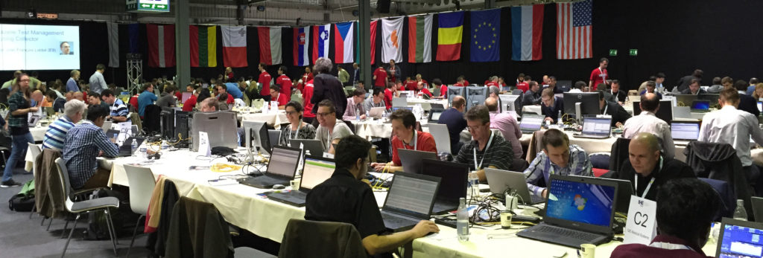
Questions?
Gmail JohnMoehrke
Twitter JohnMoehrke
Skype johnmoehrke
Blog healthSecPrivacy.blogspot.com

