Slide 1


Document Sharing on FHIR
John Moehrke
<JohnMoehrke@gmail.com>
Co-Chair: IHE ITI Planning and Technical Committee

Slide 2
Agenda - Using FHIR to get to published Documents
Document Sharing
FHIR access to Documents
MHD –> XDS on FHIR
Support profiles: IUA, PDQm, PIXm, mCDS, …
MHDS as a full FHIR stack solution
Consuming Elements/Resources
mXDE + QEDm
Add Provenance – to get back to source documents
MHD
Conclusion

Slide 3
Document Sharing

Slide 4
























Document Sharing HIE
Patient ID Manager
PRIMARY CARE PHYSICIANS
Practice Management
EMR
PATIENT
Personal Health Records
Document Registry
Document Repositories
LAB
Results
PUBLIC HEALTH
Registries
PAYERS
Claim Data
HOSPITAL 2
EMR/PM’s
Lab
PACS Archive
PHARMACY/PBMs
RX History
SPECIALTY PRACTICE
Practice Management
EMR
HOSPITAL 1
EMR/PM’s
Lab
PACS Archive
Notes:
Patient Identity Management
Trust Framework
Document Registry
Distributed Repository – or centralized
Documents – may formally be documents or not
Metadata – defined to enable management and discovery
Scale from small department, large community, or special needs like research

Slide 5
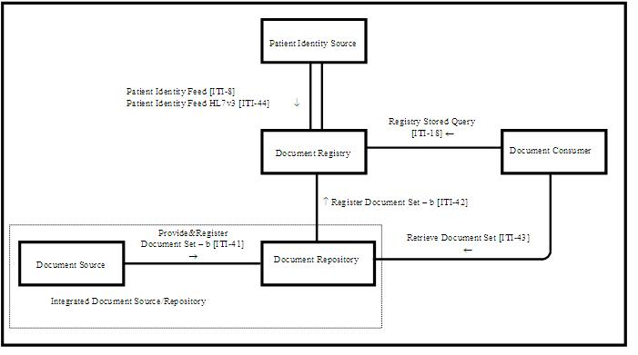
XDS – Document Sharing
Document Sharing Registry (XDS)
Based on W3C standards
ebRegistry
SOAP
SAML
Patient Identity Management (PIX, PDQ)
Based on HL7 v2 or v3
Supports Centralized or Distributed Repository
User / Organization Federation
Certificate Authority trust domain
SAML assertions

Slide 6

XCA Federation of Document Sharing
XCA Gateway
Patient ID Manager
PRIMARY CARE PHYSICIANS
Practice Management
EMR
Patient ID Manager
PRIMARY CARE PHYSICIANS
Practice Management
EMR
Document Registry
PATIENT
Personal Health Records
Document Registry
PATIENT
Personal Health Records
Document Repositories
Document Repositories
LAB
Results
LAB
Results
PUBLIC HEALTH
Registries
PAYERS
Claim Data
PUBLIC HEALTH
Registries
PAYERS
Claim Data
EHR
PHARMACY/PBMs
RX History
HOSPITAL 2
EMR/PM’s
Lab
PACS Archive
PHARMACY/PBMs
RX History
HOSPITAL 2
EMR/PM’s
Lab
PACS Archive
SPECIALTY PRACTICE
Practice Management
EMR
HOSPITAL 1
EMR/PM’s
Lab
PACS Archive
SPECIALTY PRACTICE
Practice Management
EMR
HOSPITAL 1
EMR/PM’s
Lab
PACS Archive
Notes:
See http://healthcaresecprivacy.blogspot.com/p/topics.html#HIE
Note not yet defined how an MHDS would participate in XCA Federation

Slide 7
Mobile Health Document Sharing (MHDS)
100% FHIR infrastructure
Document Registry
MHD transactions
Persistence and lifecycle management
Patient Identity Management
Authorization - OAuth
Consent Management
Trust Framework – Certificate Authority
Vocabulary Management
Audit Record Repository
Provider Directory
Central Support Services
Systems that Publish Documents
Systems that Consume Documents
Document Registry

Slide 8
Details of Document Sharing

Slide 9
Principles of a Document
Persistence – A Document continues to exist in an unaltered state, for a time period defined by local and regulatory requirements. Note documents outlive the servers (and often the syntax), on which they are created.
Stewardship –A document is maintained over its lifetime by a custodian, either an organization or a person entrusted with its care.
Potential for authentication - A clinical document is an assemblage of information that is intended to be legally authenticated.
Context - A clinical document establishes the default context for its contents
Wholeness - A document is a whole unit of information. Parts of the document may be created or edited separately, or may also be authenticated or legally authenticated, but the entire document is still to be treated as a whole unit.
Human readability – a document is human readable
Notes:
See https://healthcaresecprivacy.blogspot.com/2013/11/distinction-between-documents-and.html
True of both CDA documents and FHIR documents

Slide 10
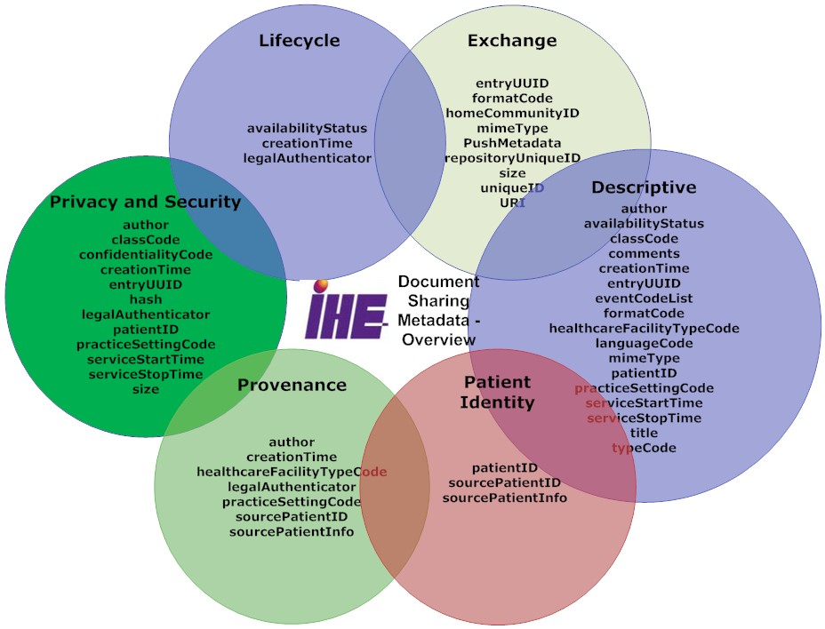
Metadata – enables discovery

Slide 11
Various Formats and Encodings
XDS/XCA are content agnostic
Metadata enable discovery
CDA, C-CDA, C32, etc
FHIR Documents
DICOM Documents
PDF/Text
Graphics (JPEG, MPEG, TIFF…)
Special (On-Demand, Delayed)
EMR
CCDA
2.1
CCDA
1.1
C32
PDF
FHIR
Notes:
See https://healthcaresecprivacy.blogspot.com/2015/10/ihe-formatcodes-are-mandatory.html

Slide 12
FHIR access to Document Sharing

Slide 13
Mobile access to Health Documents (MHD)
Provide FHIR based methods of publishing and accessing Document Sharing
Enable publication of Documents by Apps
Enable Discovery of available documents by Apps
Retrieval of the Document content
XDS on FHIR
Details https://wiki.ihe.net/index.php/MHD
Superset alignment with US Core – DocumentReference
http://build.fhir.org/ig/HL7/US-Core/StructureDefinition-us-core-documentreference.html
All these requirements are consistent with MHD, they are a subset of MHD requirements

Slide 14
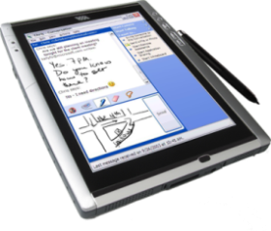
MHD as API to XDS
MHD as API to XDS
Patient Identity Source
XDS Document Registry
XDS Document Consumer
MHD Document Responder
MHD Document Recipient
XDS Document Source
XDS Document Repository
MHD Document Source
MHD Document Consumer
Notes:
In order to enable a mobile application to access an XDS environment, bridging code is used to implement an MHD document recipient or Document Responder which can be connected to by an MHD Document Source or Document Consumer on a mobile device.

Slide 15
MHD as API to XCA
MHD as API to XCA
XCA Responding Gateway
XCA Initiating Gateway
MHD Document Responder
XDS Document Registry
XDS Document Repository
MHD Document Consumer

Slide 16
FHIR Support Profiles
PDQm, PIXm – Patient lookup
Proxy to PDQ, PIX, or XCPD
IUA – an Oauth profile complementary to SMART-on-FHIR
Proxy to XUA (SAML)
ATNA – secure http specification, and AuditEvent specification
Similar functionality in both worlds
Audit Logging by either FHIR AuditEvent or DICOM/SYSLOG AuditMessage
mCSD – Directory of Provider, Organization, and Health Services
Proxy to HPD, CSD, PWP, or a uddi based management

Slide 17
Provide Document Bundle Transaction (Publication request)
Publish
Used mostly with XDS Reg/Rep
to publish new documents, or
replace old documents with new
Push
Used to send documents
Bundle (Create Transaction)
DocumentManifest
DocumentReference
Binary
DocumentReference
Binary
DocumentReference
Binary
List (Folder)
*Patient*
Document Source
Document Recipient
Notes:
DocumentManifest – Why is this group being Pushed or Published? – Why, To Whom, From Whom, When
DocumentReference – metadata about the document – what kind of document, author, service timeframe, based on, mimeType, formatCode
Binary – The document bits.
List – Folder
*Patient* - maybe present. In XDS is usually a reference to a Patient

Slide 18
Query Transactions – simply normal FHIR queries
DocumentReference
Patient – required parameter
classCode, practiceSetting, timeframe
Others
DocumentManifest
Patient – required parameter
classCode, practiceSetting, timeframe
recipient
Document Responder
Document Consumer

Slide 19
MHDS – Document Sharing
HIE Central Infrastructure
PMIR Patient Identity Mgr
SVCM Terminology Repos
System that publishes documents
mCSD Care Services Selective Supplier
System that consumes
documents
CT Time Server
MHD Document Source
MHD Document Consumer
ATNA Audit Record Repos
IUA Authorization Client
IUA Authorization Client
PDQm or PIXm Consumer
PDQm or PIXm Consumer
Document Registry
SVCM Terminology Cons.
SVCM Terminology Cons.
mCSD Care Serv Select Cons
mCSD Care Serv Select Cons
CT Time Client
ATNA Secure Node/App
ATNA Secure Node/App
CT Time Client
mCSD – Care Services Selective Consumer
IUA – Resource Server
SVCM – Consumer
IUA – Authorization Service
ATNA – Secure Node
MHD - Document Responder
CT – Time Client
MHD – Document Recipient
PMIR – Patient Identity Consumer

Slide 20
FHIR Conformance Resources
Available on GitHub
http://Ihe.github.com
CapabilityStatement(s)
StructureDefinition(s)
CodeSystem
ValueSet
Examples
Also developing an Implementation Guide Publication Package

Slide 21
Which Infrastructure to use?
Already have XDS?
YES
XDS +MHD
Already have XCA?
YES
XCA +MHD
Need Async backbone?
NO
YES
Single Community?
YES
Need End-to-End Security?
YES
XDS Document Source/Consumer?
YES
MHDS
21
No Current Infrastructure
Notes:
In the past XDS was used when one wanted to create a Document Sharing HIE, and XCA was used to federate XDS Document Sharing HIE and add in EHR based Document publications. Now IHE has the MHDS infrastructure, so the question is likely to come up.
Mostly if you have XDS clients, you need to continue to use XDS or XCA.
If you have MHD clients, then you can add MHD to XDS or XCA.
If you have no legacy, then it is possible that MHDS is the right platform for you.
There is likely future IHE projects that will federate MHDS, enable connection of MHDS to XCA federations, and add XDS api to MHDS. All of these are unusual configurations, so will need market demand to come to the table to make it clear they are needed, vs simply being academic gaps.

Slide 22
Consuming Fine-Grain Resources

Slide 23
Consuming Documents is hard
MHD eliminates the need to understand SOAP and ebXML. It enable API use of JSON or simple XML.
But Document content and format is not changed
They are various formats (PDF, DICOM, CDA, CCR, etc)
CDA XML is not simple XML
Better
Consume fine-grain FHIR Resources (Observation, AllergyIntolarance, Immunization, Medication, etc)
Yet
Use of data will eventually need to know the integrity and authenticity of the data
Clinicians decisions based on fine-grain FHIR Resources will need to reference the source and thus clinical context of data – cross-enterprise adds emphasis of need for Provenance
Notes:
Documents are good at documenting facts of an encounter or episode or summary from an organization perspective
Fine-Grain FHIR Resources are more easy to get to the point, less noise
But, imagine you are a clinian and have come to a diagnosis based on a set of data including some fine-grain FHIR Resources derived from documents; The Provenance would allow you to go see how many documents and to see the document content to fully understand the context of that data. Medical Records integrity and authenticity

Slide 24
Query for Existing Data for Mobile (QEDm)
Supports queries for clinical data elements by making the information widely available to other systems within and across enterprises
Aimed at class of systems that are resource- and platform-constrained (e.g., tablets, smartphones, and embedded devices including home-health devices)
Observation,
AllergyIntolerance,
Condition,
DiagnosticReport,
Medication,
MedicationStatement,
MedicationRequest,
Immunization,
Procedure,
Encounter,
Provenance,
OperationOutcome,
Bundle

Slide 25
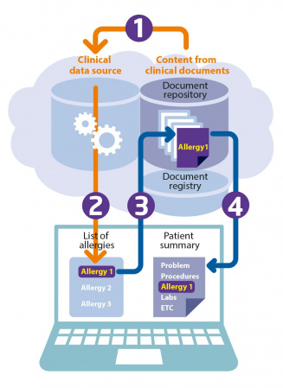
Mobile Cross-Enterprise Document Data Element Extraction (mXDE)
Provides means to access data elements extracted from shared structured documents
Enables the deployment of health data exchange infrastructures where fine-grained access to health data coexists and complements the sharing of coarse-grained documents and the fine-grained data elements they contain
Observation, AllergyIntolerance, Condition, DiagnosticReport, Medication, MedicationStatement, MedicationRequest, Immunization, Procedure, Encounter, Provenance, OperationOutcome, Bundle
Source: https://wiki.ihe.net/index.php/Mobile_Cross-Enterprise_Document_Data_Element_Extraction

Slide 26
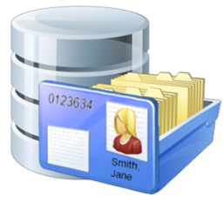



Resources
Shared Documents (XDS)
Observation
Obs 1
Obs 2
Obs 3
Med Summary
EHR
Medication
Med 1
Med 2
Med 3
Episode
2/7/1989
Lab/Rad
Allergy
Al 1
Al 2
Al 3
Discharge
Summary
1/2/2002
…
Immunization
Imm 1
Imm 2
Imm 3
EMR
Etc…
Provenance
Prov 1
Prov 2
Prov 3

Slide 27
Using Provenance
Determine how often the issue is referenced (1 document vs all)
Determine who has published the issue
Pull the metadata -- DocumentReference
Pull the Document
Model for Provenance
One Provenance for each Document
Where a data Resource came from many documents, it will have many Provenance.target pointing at it
Provenance.target → 1..* Resources (the resources that came from this document)
Provenance.recorded → when the decomposition happened (might inform cache)
Provenance.policy == “urn:ihe:pcc:qedm:2017:document-provenance-policy”
Provenance.agent → the software “ASEMBLER” that decomposed this document into these target Resources
Provenance.entity → the DocumentReference representing this document

Slide 28
Conclusion

Slide 29
Conclusion
Enabling technology for FHIR accessibility of Document Sharing
Document Metadata Query
Publication of Documents
Get Decomposed Resources
Get Provenance, so that get source Document

Slide 30
Questions?
John Moehrke
Consultant with By Light
Gmail JohnMoehrke
Twitter JohnMoehrke
Skype johnmoehrke
Blog healthSecPrivacy.blogspot.com

Slide 31
Bonus – Things not in the IHE Profiles
When using MHD, one could retrieve the Binary (Document) with http negotiate only indicating FHIR resources.
Using C-CDA on FHIR http://hl7.org/fhir/us/ccda/history.html
Automatic conversion of a well formed C-CDA to FHIR Document
Use of Subscription to get Async API giving more responsive App environment, while backend deals with very slow response from nationwide partners (slowness due to scale of the network, and slowness of some partners)

Slide 32
Open Source
https://oehf.github.io/ipf-docs/

Slide 33
MHDS Client detailed transactions
MHDS Document Registry
MHD Document Recipient
MHD Document Responder
System that consumes
documents
[ITI-66] or [ITI-67] or [ITI-68]
[ITI-71] Get Authorization Token
IUA Authorization Server
MHD Document Consumer
[ITI-72] Incorporate Authorization Token
IUA Resource Server
IUA Authorization Client
HIE Central Infrastructure
PMIR Patient Identity Consumer
[ITI-93] Mobile Patient Identity Feed
PDQm or PIXm Consumer
[ITI-78] or [ITI-83] PDQm or PIXm Query
PMIR Patient Identity Source
SVCM Terminology Consumer
SVCM Terminology Cons.
mCSD Care Serv Select Cons
[ITI-93] Mobile Patient Identity Feed
mCSD Care Services Selective Consumer
[ITI-xx] SVCM Qry
[ITI-xx] SVCM Qry
CT Time Client
[ITI-90] Find … Services
PMIR Patient Identity Mgr
[ITI-90] Find Matching Care Services
CT Time Client
ATNA Secure Node/App
SVCM Terminology Repos
… ITI-19] Authenticate
Node
ATNA Secure Node
[ITI-1]
Maintain
Time
mCSD Care Services Selective Supplier
… ITI-19] Authenticate
Node
CT Time Server
[ITI-1]
[ITI-20] Record Audit Event
ATNA Audit Record Repos
[ITI-20] Record Audit Event

Slide 34
MHD/XCA Proxy Infrastructure
XCA Infrastructure
MHD Document Responder
MHD System that
Consumes documents
[ITI-18] or [ITI-43]
XCA Initiating Gateway
XDS Document Consumer
[ITI-66] or [ITI-67] or [ITI-68]
IUA Authorization Server
[ITI-40] Provide X
XUA Service Provider
MHD Document Consumer
[ITI-71] Get AuthZ
XUA Service User
IUA Resource Server
IUA Authorization Client
[ITI-72] Incorp AuthZ
PDQm or PIXm service
…
PDQm or PIXm Consumer
[ITI-78] or [ITI-83] PDQm or PIXm Query
PDQ or PIX client
XCPD Initiating Gateway
SVCM Terminology Cons.
[ITI-21] or [ITI-9]
[ITI-xx] SVCM Qry
SVCM Terminology Repos
mCSD Care Serv Select Cons
[ITI-90] Find … Services
SVS Terminology Repos
SVS Terminology Repos
[ITI-48]
CT Time Client
mCSD Care Services Selective Supplier
[ITI-1]
Maintain Time
ATNA Secure Node/App
[ITI-58]
HPD Consumer
CSD or HPD Provider Dir
[ITI-19] Auth Node
[ITI-1]
CT Time Server
CT Time Server
[ITI-20] Record Audit Event
[ITI-19]
ATNA Audit Record Repos
[ITI-20]
ATNA Audit Record Repos

