Slide 1

Nationwide Patient Identity Lookup
Presented by John Moehrke
January 11, 2024

Slide 2
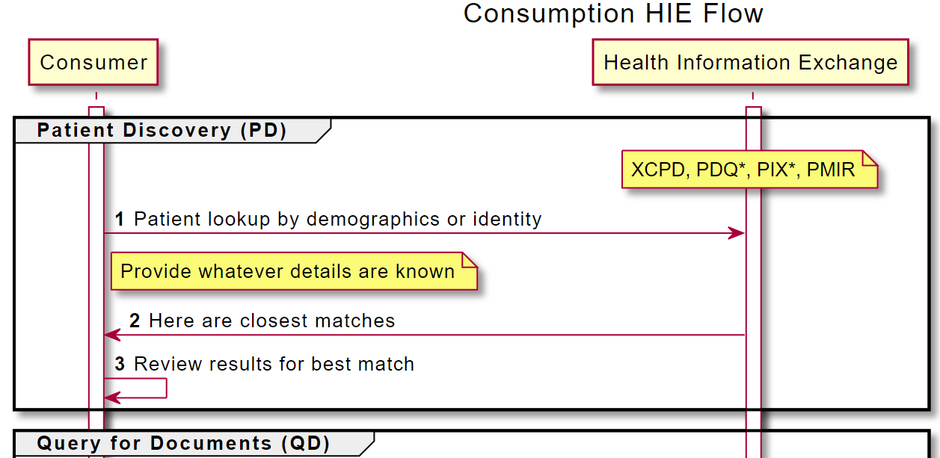
EMS Overall - starting

Slide 3
Patient Identity Background
TEFCA / QHIN – provide a nationwide health information network
First Step is Security/Privacy
Second Step is patient identity lookup
Third Step is finding data available for that patient
EMS Need available patient medical history
Have some portions of demographics about the patient

Slide 4
TEFCA / QHIN
Accepted solution for Patient Identity lookup is
IHE XCPD - Future working toward FHIR
IHE XCPD
Based on HL7 v3 patient identity lookup standard
Profiled to reduce options and make the request/response defined
Profiled to support multi-hop federation to support a network of networks.
Returns matches and locations that have health information
Complicated technical stack with SOAP and HL7 v3
Solutions
EHR and Infrastructure solutions are readily available
Open-Source implementations available

Slide 5
XCPD Example
<?xml version="1.0" encoding="UTF-8"?>
<s:Envelope xmlns:s="http://www.w3.org/2003/05/soap-envelope" xmlns:a="http://www.w3.org/2005/08/addressing" xmlns:xcpd="urn:ihe:iti:xcpd:2009"
xmlns:xsi="http://www.w3.org/2001/XMLSchema-instance"
xsi:schemaLocation="urn:ihe:iti:xcpd:2009">
<s:Header>
<a:Action s:mustUnderstand="1">urn:hl7-org:v3:PRPA_IN201305UV02:CrossGatewayPatientDiscovery</a:Action>
<a:MessageID>urn:uuid:a02ca8cd-86fa-4afc-a27c-16c183b2055</a:MessageID>
<a:ReplyTo>
<a:Address>http://www.w3.org/2005/08/addressing/anonymous</a:Address>
</a:ReplyTo>
<a:To s:mustUnderstand="1">http://servicelocation/IHEXCPDRespondingGateway</a:To>
<!--Recommend a 7 day cache for correlations resulting from this request. -->
<xcpd:CorrelationTimeToLive>P0Y0M7D</xcpd:CorrelationTimeToLive>
</s:Header>
<s:Body>
<PRPA_IN201305UV02 xmlns:xsi="http://www.w3.org/2001/XMLSchema-instance"
xsi:schemaLocation="urn:hl7-org:v3 ../../schema/HL7V3/NE2008/multicacheschemas/PRPA_IN201305UV02.xsd"
xmlns="urn:hl7-org:v3"
ITSVersion="XML_1.0">
<id root="1.2.840.114350.1.13.0.1.7.1.1" extension="35423"/>
<creationTime value="20090417150301"/>
<interactionId root="2.16.840.1.113883.1.6" extension="PRPA_IN201305UV02"/>
<processingCode code="P"/>
<processingModeCode code="T"/>
<acceptAckCode code="AL"/>
<receiver typeCode="RCV">
<device classCode="DEV" determinerCode="INSTANCE">
<id root="1.2.840.114350.1.13.999.234"/>
<telecom value="http://servicelocation/IHEXCPDRespondingGateway"/>
</device>
</receiver>
<sender typeCode="SND">
<device classCode="DEV" determinerCode="INSTANCE">
<id root="1.2.840.114350.1.13.999.567"/>
<!-- Used to carry the homeCommunityId -->
<asAgent classCode="AGNT">
<representedOrganization classCode="ORG" determinerCode="INSTANCE">
<!-- homeCommunityId=urn:oid:1.2.3.928.955 -->
<id root="1.2.3.928.955"/>
</representedOrganization>
</asAgent>
</device>
</sender>
<controlActProcess classCode="CACT" moodCode="EVN">
<code code="PRPA_TE201305UV02" codeSystem="2.16.840.1.113883.1.6"/>
<!-- Identifies one of LivingSubjectID for use by responder in XCA Query
- provisioning the opposite direction -->
<authorOrPerformer typeCode="AUT">
<assignedDevice>
<id root="1.2.840.114350.1.13.99997.2.3412"/>
</assignedDevice>
</authorOrPerformer>
<queryByParameter>
<queryId root="1.2.840.114350.1.13.28.1.18.5.999" extension="18204"/>
<statusCode code="new"/>
<responsePriorityCode code="I"/>
<responseModalityCode code="R"/>
<matchCriterionList>
<minimumDegreeMatch>
<value xsi:type="INT" value="75"/>
<semanticsText>MinimumDegreeMatch</semanticsText>
</minimumDegreeMatch>
</matchCriterionList>
<parameterList>
<livingSubjectAdministrativeGender>
<value code="M"/>
<semanticsText>LivingSubject.administrativeGender</semanticsText>
</livingSubjectAdministrativeGender>
<livingSubjectBirthTime>
<value value="19630804"/>
<semanticsText>LivingSubject.birthTime</semanticsText>
</livingSubjectBirthTime>
<livingSubjectName>
<value>
<given>Jimmy</given>
<family>Jones</family>
</value>
<semanticsText>LivingSubject.name</semanticsText>
</livingSubjectName>
<LivingSubjectId>
<value root="1.2.840.114350.1.13.99997.2.3412" extension="1234"/>
<semanticsText>LivingSubject.id</semanticsText>
</LivingSubjectId>
<LivingSubjectId>
<value root="2.16.840.1.113883.4.1" extension="58910"/>
<semanticsText>LivingSubject.id</semanticsText>
</LivingSubjectId>
</parameterList>
</queryByParameter>
</controlActProcess>
</PRPA_IN201305UV02>
</s:Body>
</s:Envelope>

Slide 6
XCPD important parts
<parameterList>
<livingSubjectAdministrativeGender>
<value code="M"/>
<semanticsText>LivingSubject.administrativeGender</semanticsText>
</livingSubjectAdministrativeGender>
<livingSubjectBirthTime>
<value value="19630804"/>
<semanticsText>LivingSubject.birthTime</semanticsText>
</livingSubjectBirthTime>
<livingSubjectName>
<value>
<given>Jimmy</given>
<family>Jones</family>
</value>
<semanticsText>LivingSubject.name</semanticsText>
</livingSubjectName>
<LivingSubjectId>
<value root="1.2.840.114350.1.13.99997.2.3412" extension="1234"/>
<semanticsText>LivingSubject.id</semanticsText>
</LivingSubjectId>
<LivingSubjectId>
<value root="2.16.840.1.113883.4.1" extension="58910"/>
<semanticsText>LivingSubject.id</semanticsText>
</LivingSubjectId>
</parameterList>
Male
Birth Date
Name
Other identifiers Such as Drivers License

Slide 7
Intermediaries

Slide 8
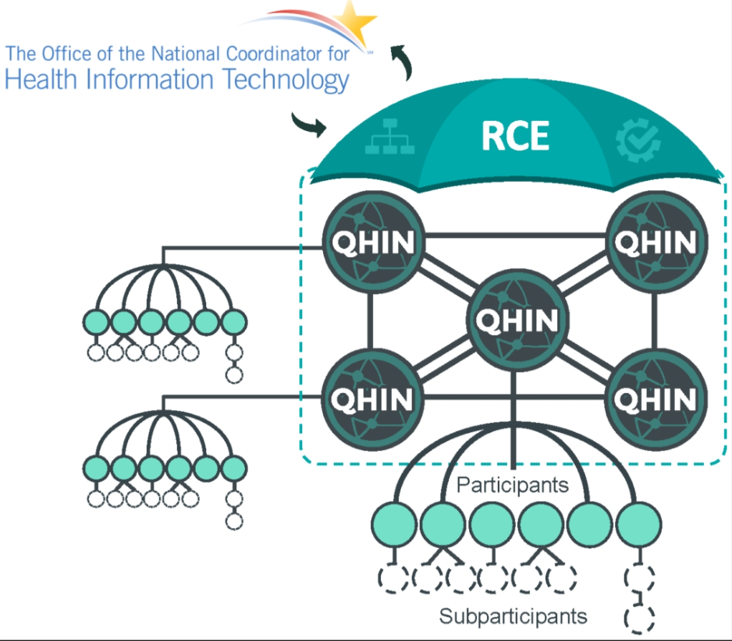
Fitting into TEFCA
XCPD used in the QHIN network
QHIN provides services to their network
QHIN might use FHIR

Slide 9

PDQm
IHE Profile for demographics lookup of Patient
FHIR query
Results are those Patient resources that match
Intermediary can translate this to XCPD and return results

Slide 10
PDQm using $match
Uses an Operation
$match operation is given the data the client has
Server uses algorithms to find best match
Returns one best matching result
"identifier" : [
{
"system" : "http://example.org/exampleSystem",
"value" : "8675309"
}
],
"name" : [
{
"family" : "Schmidt",
"given" : [
"John"
]
}
],
"gender" : "other",
"birthDate" : "1923-07-25",
"address" : [
{
"state" : "WI",
"country" : "USA"

Slide 11
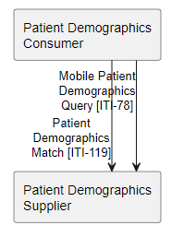
Patient Search vs $match Use Cases
Patient Search
$match
Searches for a group with a common property
Predictable Search Workflows
Identifier Based Lookup
Retrieval by known Identifier
Patient Demographics Supplier as Matching Authority
Automated workflows (e.g. backend)
Client has little to no selection logic
Heuristic Based Lookup Based on Multiple Demographics
Allowance for demographic errors

Slide 12

Patient Demographics Query for mobile Version 3
Public Comment Open Through 12 January 2024
https://profiles.ihe.net/ITI/PDQm/3.0.0-comment/index.html
Feedback can be submitted at
https://www.ihe.net/ITI_Public_Comments/
https://github.com/IHE/ITI.PDQm/issues
Notes:
Thank you for taking the time to learn about the recent enhancements to PDQm. The public comment period for these changes is now open though January 12th, 2024. We hope you will find this enhanced version useful in accomplishing your healthcare interoperability goals, and we await your feedback on this work. Thank you!

