Slide 1
IHE Document Sharing using FHIR platform: Mobile Health Document Sharing (MHDS)
John Moehrke – IHE IT-Infrastructure co-chair
By Light Consulting
1

Slide 2

Architect: Healthcare Informatics Standards - Interoperability, Privacy, and Security
CyberPrivacy – Enabling authorized communications while respecting Privacy
IHE Co-Chair IT Infrastructure Planning & Technical Committee
HL7 Co-Chair Security WG, FHIR Management Group, FHIR facilitator, and
FHIR Foundation founding member
Employee of ByLight Professional IT Services -- Contractor to VHA MyHealtheVet
JohnMoehrke@gmail.com
https://www.linkedin.com/in/johnmoehrke |
https://healthcaresecprivacy.blogspot.com
Twitter: @JohnMoehrke
Courtney's third law: There are no technical solutions to management problems, but there are management solutions to technical problems.
John Moehrke

Slide 3
Core business functions provided by MHDS Profile:
Publication of Document based information
Content agnostic but CDA® and FHIR® preferred
Persistence and lifecycle management of Documents, DocumentReference, and List resources
Enabling centralized document storage, or distributed document storage at a service identified at the source
Patient Identity Management
specifically, a golden patient identity for use within the domain, cross-reference to other identities, and lifecycle of updates
Appropriate comprehensive handling of patient identity updates including merge
Participant Organizations management
Enabling use of mCSD directory for author identity management
Authorization management
Consent
User Role-Based-Access-Control (RBAC) or Attribute-Based-Access-Control (ABAC)
Application
PurposeOfUse
Encryption and Integrity requirements
Audit Log Management
Consumption side can be further refined using mXDE and QEDm

Slide 4
Support Publications
ITI Technical Framework: Vol. 3 - Section 4.0 Metadata used in Document Sharing
Health Information Exchange: Enabling Document Sharing Using IHE Profiles
Document Sharing Metadata Handbook
Template for XDS Affinity Domain Deployment Planning

Slide 5
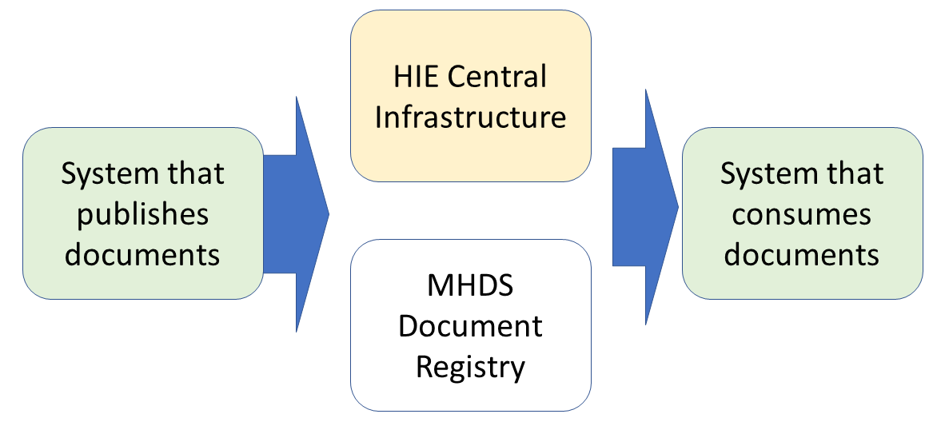
High Level View of components of MHDS

Slide 6
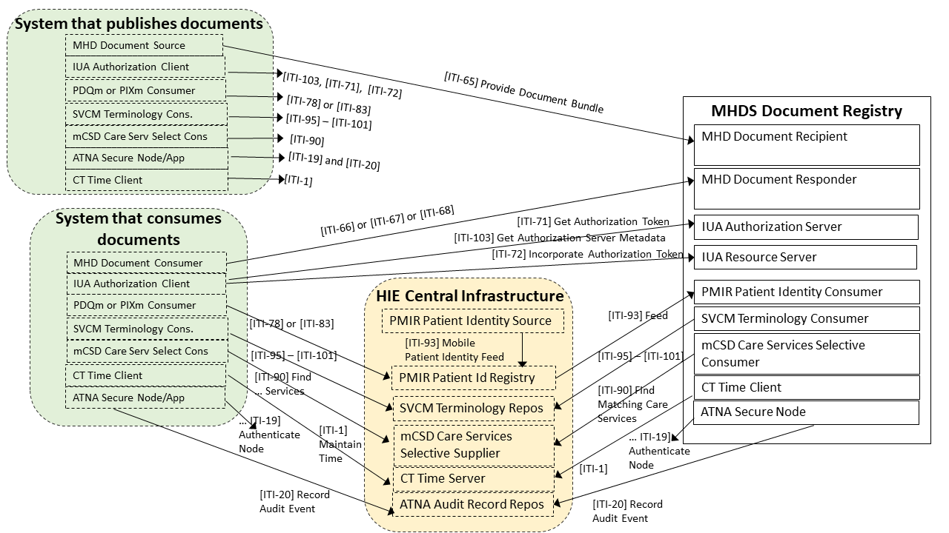
The MHDS Document Registry

Slide 7
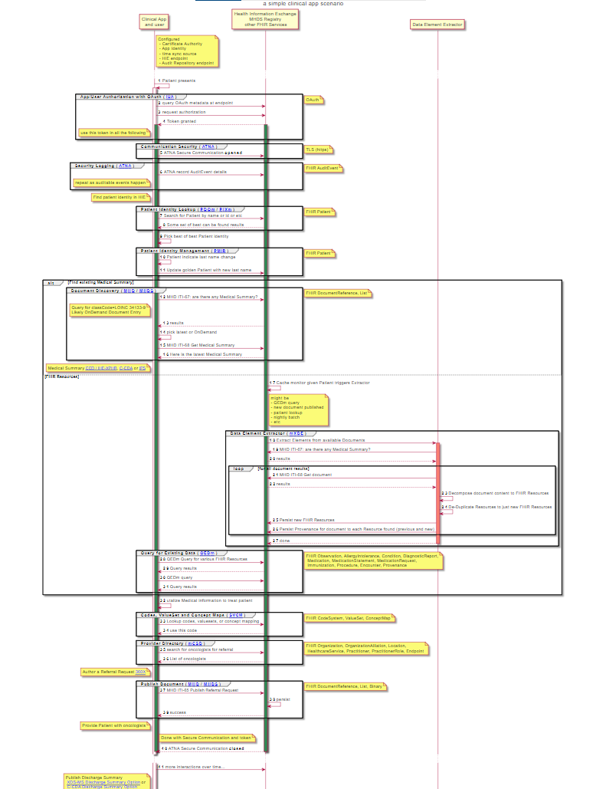
Sample Use-Case
Flow

Slide 8
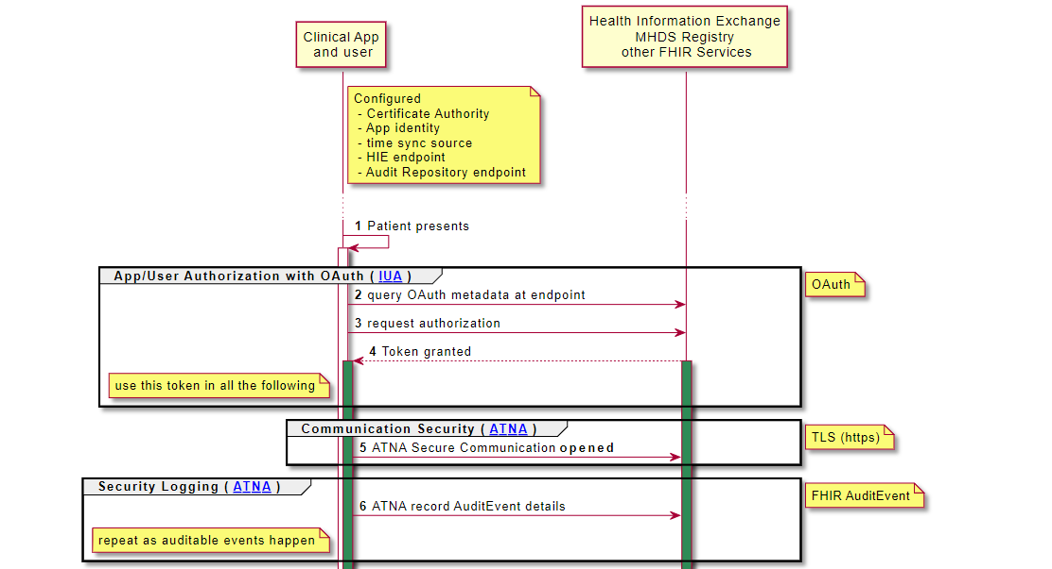
Configuration, Security, and Privacy
Configuration
Directory
Time Sync
Code Conformance Rules
App / User Identity
Oauth
Secure Communication
TLS (https)
Audit Logging
FHIR AuditEvent

Slide 9
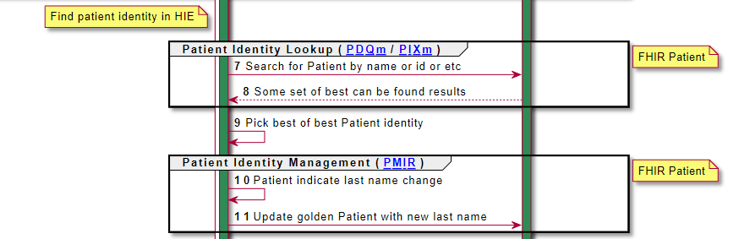
Patient Identity
PDQm or PIXm to lookup patient
PMIR if necessary to update the golden patient identity

Slide 10
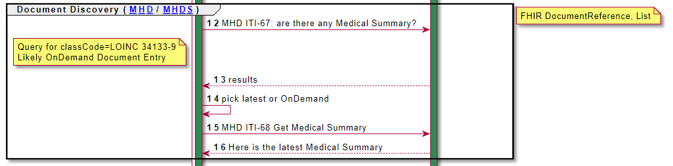
Alternative 1: Retrieve Documents
MHD: Document Consumer -> Document Responder
ITI-67 – Find DocumentReference
ITI-66 – Find Lists (SubmissionSets or Folders)
ITI-68 – Retrieve Document

Slide 11
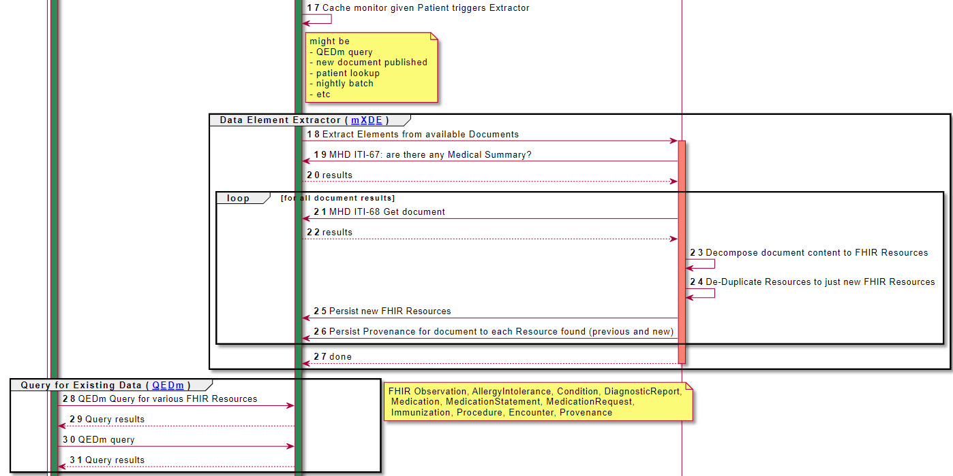
Alternative 2: Retrieve FHIR Resources

Slide 12
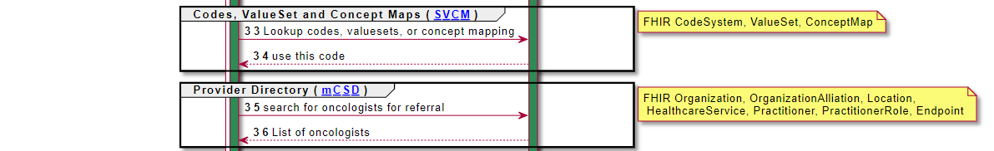
Codes and Organization
SVCM – to retrieve commonly managed codes, valuesets, and concept maps
mCSD – to retrieve organizational information

Slide 13
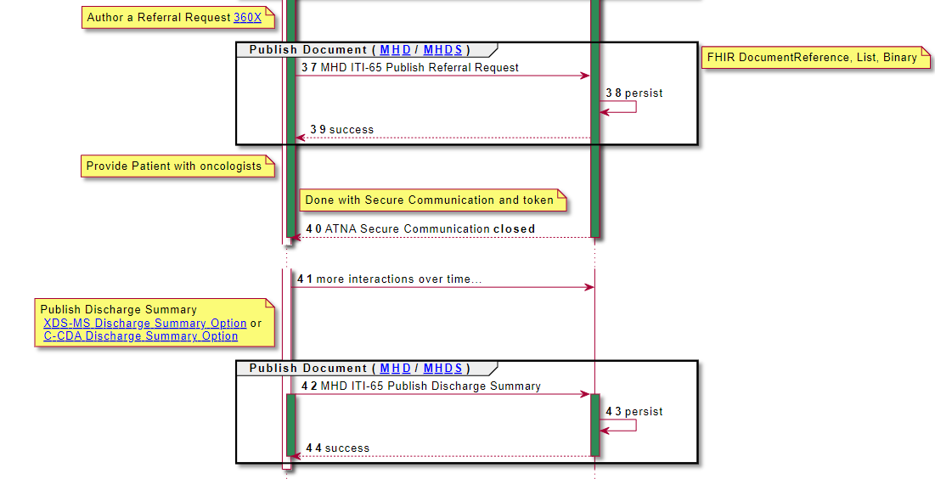
Publish Document
Publish new documents
Many kinds of document types profiled
Many more possible
International Patient Summary

Slide 14
Conclusion
MHDS is based on concepts learned from XDS
Brings them all together into one Implementation Guide
Organizational Directory
Patient Management (golden patient)
Security / Privacy
Document Management
Alternative - Retrieve FHIR Resources

Slide 15
MHDS Spec
https://profiles.ihe.net/ITI/MHDS/
Questions?

