Slide 1
IHTSDO
Nursing Problem/Diagnosis Subset
Proposed by:
Susan Matney, MS, RN
Judith Warren, PhD, RN
Audrey Dickerson, MS, RN
Vivian Auld, MLIS

Slide 2

Nursing Problem Subset Project
Creation of a nursing problem list subset
  Distributed through the US National Library of Medicine Unified Medical Language System (UMLS).
  Includes all UMLS codes that have a SNOMED CT code and nursing diagnosis or problem mapping from the nursing terminologies.
The purpose of the nursing problem list subset is to provide the integration and translation of nursing problems between care settings
.
The subset will provide a semantically interoperable nursing problem list that can be shared across information systems.

Slide 3
Background
The IHE Patient Care Domain; IHE Nursing SC has developed a “Patient Plan of Care” (PPoC) profile. The Patient Plan of are is a framework document designed to hold content lists, value sets, and models for patient care. PPOC has been designed for use with multiple disciplines; nursing is the first discipline in the care plan. The first draft that has gone to ballot requires a value set for nursing problems.
There are currently five nursing terminologies that include nursing problems or diagnosis, four are integrated into SNOMED CT and the fifth, ICNP is in development.

Slide 4




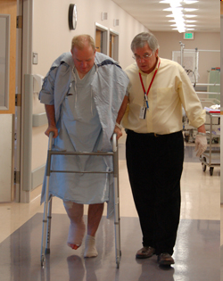
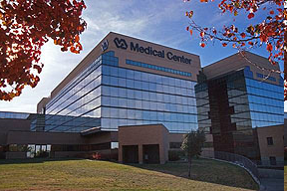


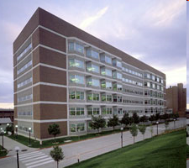




Long Term Care
Providers & Patients
Hospitals & Clinics
Researchers

Slide 6
NANDA Diagnosis
00132
CCC Diagnosis
Q45.1
ICNP
Diagnosis
10000454
SNOMED Diagnosis
274663001Acute Pain
Diagnosis
Acute Pain

Slide 7

Beneficiaries
The patient
  When a patient is transferred to another facility, the nursing problems can be sent within the PPoC.
The Nurse caring for the patient.
  Knowing the nursing problems will facilitate the provision of safe, accurate patient care.
  Will also ensure the continuity of care between care delivery sites.
The researcher.
  Nursing problem data will be consistent and measurable across multiple enterprises.

Slide 8
Risks
Inability of the incoming SNOMED CT code to be translated in receiving system.
  Incoming applications will need a translation methodology for translating the SNOMED CT code to the nursing terminology they use.
  There will need to be a process for handling SNOMED CT codes that do not translate into the terminology used in the receiving care setting
SNOMED CT Nursing Problem List set will become out of synch with corresponding nursing terminologies when they release new versions.
  To mitigate this risk the Nursing SIG will communicate with the developers to gain their collaboration.

Slide 9
Nursing Problem Subset Content
Create a SNOMED CT nursing problem subset. The subset will:
  Contain only SNOMED CT codes that have a mapping in UMLS to other nursing terminologies;
  Be chosen from the Clinical Findings hierarchy;
  Will not contain concepts with names prefaced with a symbol in square brackets e.g. ‘307724003 [D] Left upper quadrant pain (situation)’ are excluded. LOINC codes.
Coordinate with the Data Elements for the Patient Plan of Care (PPoC) and eNursing Summary IHE Profiles.
Notes:
These are legacy concepts inherited from the National Health Service Clinical Terms, version 3 (CTV3) and are not recommended for use in clinical recordsIn the future the subset may be expanded to include appropriate

Slide 10
Subset Development Process
The UMLS Metathesaurus was queried to create an initial nursing problem list subset using the versions of SNOMED CT and the nursing terminologies available in the 2010AA version of the UMLS Metathesaurus.
The subset will be distributed through the UMLS following the model used for distributing the CORE Problem List Subset of SNOMED CT.
The subset will be rebuilt with each updated version of each terminology.
Notes:
(see http://www.nlm.nih.gov/research/umls/Snomed/core_subset.html)

Slide 11
IHTSDO Subset Development
Proposal idea presented to the Nursing SIG October 2009 (received approval)
Formal proposal presented to the Nursing SIG April 2010 (approved)
Proposal presented to the IHTSDO Board of Directors May 2010 (approved)
Problem/diagnosis list created by August 2010 (it was September)
Validated by the Nursing SIG by October 2010
Approved by Nursing SIG and forwarded to the Content Committee by October 2010 ---moved to IHE Proposal
Final product to the IHTSDO Board for Approval

Slide 12
Results
714 Rows in spreadsheet from UMLS
591 Concept Unique Identifiers (CUI)
  Included some Interventions and Outcomes
Final Number of SNOMED Nursing Diagnosis in the subset = 370

Slide 13
Use Case
Doris Redding, a 42 y/o Diabetic type 2 was admitted from home health to Memorial Hospital ED with a wound in her lower right limb with pain, swelling and redness. The Emergency Department nurse opened the EHR and began a nursing problem list. As part of the EHR, the list will be sent with the integrated health record on Doris.

Slide 14
Movement of Data
Home Health Agency data
  To the Hospital Emergency Department
Hospital Emergency Department EHR
  ED EHR Nursing Problem list moves to:
    Hospital Nursing Unit
    Hospital Discharge
    Hospital Medical Records
Home Health Agency EHR
June - September 2009

Slide 15
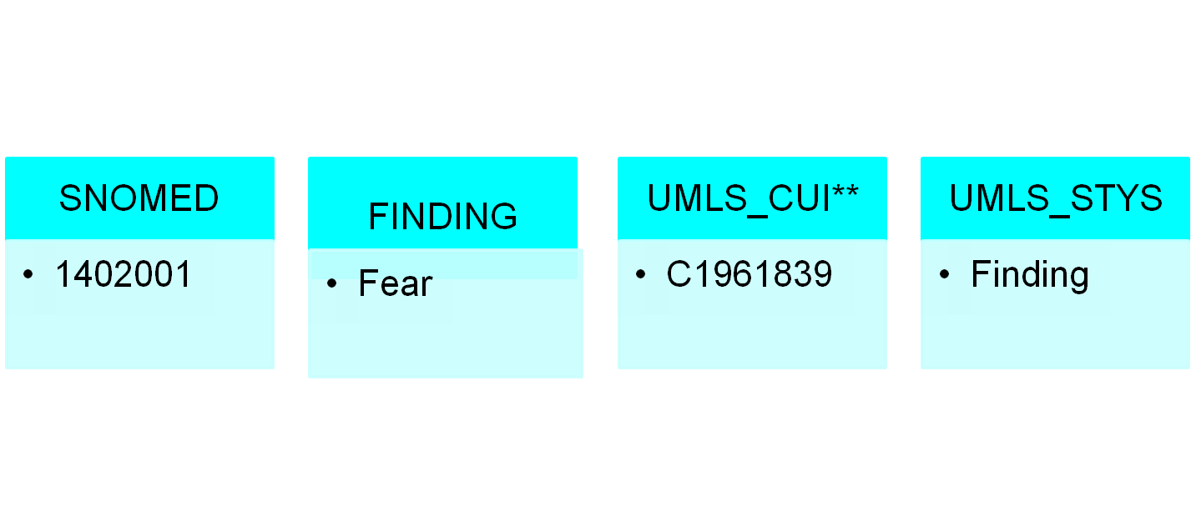
Problem List Defined
1402001 Fear (finding) C1961839 Finding
CUI= Concept Unique Identifier
June - September 2009

Slide 16
Use Case Nursing Problem List
274663001 Acute pain (finding) C0184567 Sign or Symptom
45346005 Alteration in nutrition: more than body requirements (finding) C0231352 Finding
78648007 At risk for infection (finding) C0582147 Finding
129702000 At risk for peripheral neurovascular dysfunction (finding) C1268632 Finding
54777007 Deficient knowledge (finding) C0231391 Finding
June - September 2009

Slide 17
Use Case Problem List Continued
6. 190902006 Fluid imbalance (disorder) C0267995 Pathologic Function
7. 130969003 Health seeking behavior (finding) C1321107 Individual Behavior
8. 129827004 Ineffective therapeutic regimen management (finding) C1268736 Finding
9. 129836000 Noncompliance with therapeutic regimen (finding) C0184543 Finding
10. 48694002 Anxiety (finding) C0003467 Mental Process
June - September 2009

Slide 18
Standards Used
PPOC, FSA and eNS profiles
XPHR, EDR, XDS-MS profiles
XDS/XDR/XDM Cross –community and Cross enterprise Document Sharing
PIX Patient Identity Cross Reference
PDQ Patient Demographics query
ATNA Audit Trail and Node Authentication
CT Consistent Time

Slide 19
Review Nursing Diagnosis Final Subset
Conclusions and recommendations
  Accept work as scoped
  Title = A SNOMED CT Nursing Problem List Subset for the U.S.
    Conclusions
    This is an extract of all the nursing dx within the UMLS that have a SNOMED CT association.
    The methodology was effective for the first use case of the project.
    The method served to quality review the nursing diagnosis content of the source and target terminologies.
    The query results highlighted the need to further explore representation of nursing content in the UMLS.

Slide 20
Recommendations
Recommend that this list be published by NLM to satisfy the first use case.
Communicate to IHE that the list will be available from NLM for the first use case and may inform further development of nursing problem list for other use cases.
Technical report (including summary of detailed recommendations) will be posted to the collaborative as a draft for comment.
The final technical report will be submitted to the IHTSDO I&I committee with a request for dissemination to quality and content committees with a request for action on the detailed recommendations.

Slide 21
Future Work
Explore the representation of ICNP in the UMLS.
Define a project to generate an international SNOMED CT nursing problem list
Validate that the attributes used in the editorial guidelines for modeling a finding are in compliance with ISO 18104 2011.
Validate that all the problems have been fully modeled according to editorial guidelines.
Compare the current list (and all future revisions) with the content of CMT problem list.

Slide 22
Quality Measures Achieved
Number of UMLS concepts reviewed – 591.
Number of concepts from source terminology identified in SNOMED CT - 675.
Number of concepts constructed through post-coordination - 0.
What are the obvious missing nursing problems/diagnoses?
  Those clinical findings in SNOMED CT that do not have equivalents in well known nursing terminologies and classifications.
  Missing updates from know nursing terminologies
Number interactions with Nursing SIG participants (fall 2009, spring 2010, fall 2010).

Slide 23
Proposed Quality Measures Not Achieved
The following measures were found to be beyond the scope of the project
While logically they were measures, as the project evolved, new understanding occurred
  Number of missing concepts or gaps.
  Number of concepts completely modelled – did not review, beyond scope.
  Number of concepts belonging in the SNOMED CT Core.
  Number of concepts to be moved to country extensions (includes identification of extension).

Slide 24
Quality Issues Identified
Erroneous mappings in UMLS
Ambiguous concepts
Many-to-one mappings
  SCT concept ID to UMLS CUI
Division of concepts
  Trauma plus injury vs injury

Slide 25
Major Take-Away Points
Nursing problem list available for multiple users through the National Library of Medicine
Builds on previous Nursing work done by the IHE Nursing SC in PCC
  Patient Plan of Care
  eNursing Summary
Meets the main mission of the IHE Nursing SC to move clinical nursing data across the continum of care settings and time.

Slide 26

June - September 2009

