Slide 1
Cross-enterprise Basic eReferral Workflow Definition
(XBeR-WD)
First TF Volume presented to the
PCC Technical Committee
Luca Zalunardo, Arianna Cocchiglia, Mauro Zanardini
February, 6th 2012

Slide 2
The Problem
This profile proposal born as development of the ITI XDW profile to manage the Cross Enterprise Basic eReferral Workflow.
Without an instrument which manage the workflow, the eReferral is only an order without any information about the status of the order itself. The definition of a workflow with fix rules and task is needed in a scenario cross enterprise in which many actors are involved in the same process
We have estimated that only in the Veneto Region the introduction of the use of digital referral (eReferral) will entail a saving of about 56 million Euro thanks to:
a better quality control of the process
the reduction of the errors in the management of all clinical documents and related workflows
the increasing of the efficiency of the process itself.

Slide 3
XDW profile and Workflow Definition profile
Cross Enterprise Document Workflow is:
  a framework to manage workflows
  a platform upon which a wide range of specific workflows can be defined with minimal specification and implementation efforts
  workflow independent
  applicable on different document sharing infrastructures
Workflow Definition Profile is:
  the definition of a specific clinical process
  a set of rules and task definition which characterize the process
  the definition of the actors involved in the process and their roles

Slide 4
Purpose and Scope
The creation of an eReferral by a GP opens a clinical process that involves many actors and that is a cross-enterprise workflow.
This workflow is composed by many clinical and organizational steps
The purpose of the XBeR-WD profile is exactly define:
-the workflow associated with an eReferral Document
-the actors involved
-the digital documents related with this process (produced in this process or produced in other clinical processes but interesting also in this one).

Slide 5


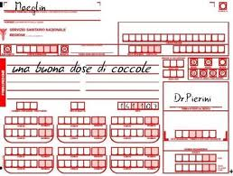




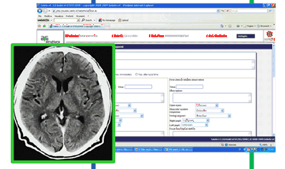
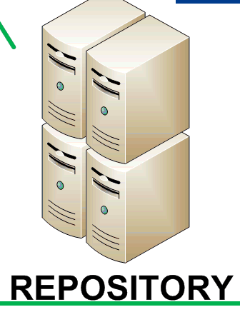
Basic eReferral Workflow
2-Booking of the visit
3-Admission of
the patient
1-Visit and production of eReferral
4- Start of the Consultation
5– End of the consultation and creation of the clinical report
6 – Possible notification to the GP
The workflow within the organization is encapsulated into a single XDW step

Slide 6
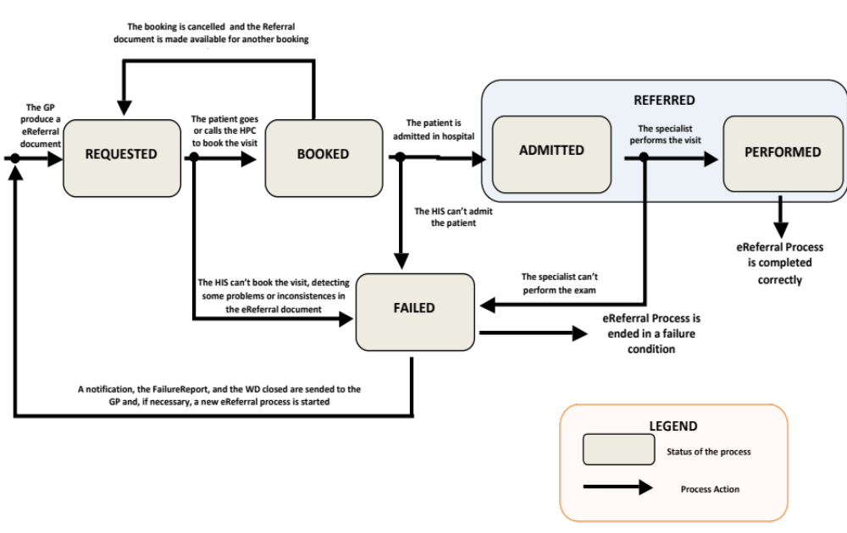
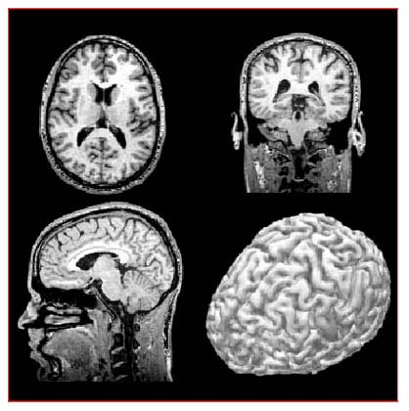
eReferral process flow

Slide 7
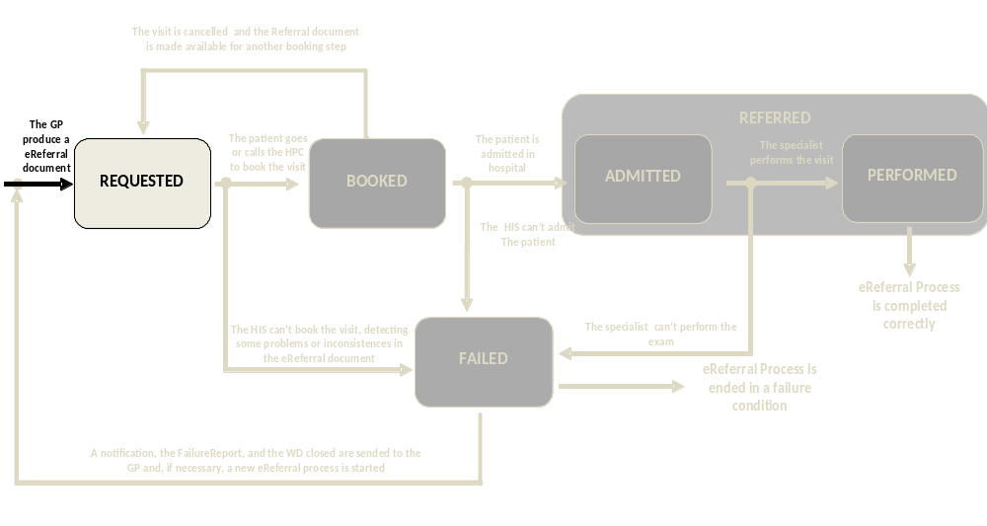
Use-case: basic eReferral workflow
Workflow Document
Task Name:
REFERRAL REQUESTED
TaskStatus: COMPLETED
Author: Mr.Rossi
Time: date/time/utc
Inputs:
-> Lab Report
Outputs:
-> eReferralDoc1
taskEventHistory
Status of the process: Requested
Task 1: Referral Requested
TaskStatus 1: Completed
TaskEvent: 1
Status: COMPLETED
Inputs:
-> Lab Report
Outputs:
-> eReferralDoc1

Slide 8
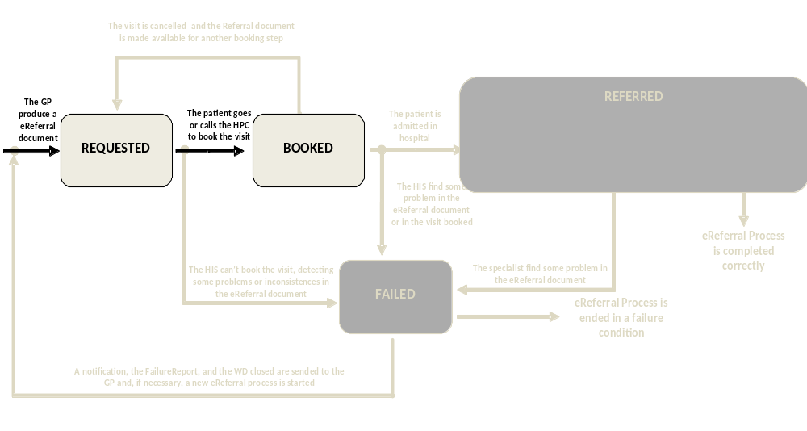
Use-case: basic eReferral workflow
Workflow Document
REFERRAL REQUESTED
Task Name:
REFERRAL BOOKED
TaskStatus: COMPLETED
Author: HIS
Time: date/time/utc
Inputs:
-> eReferralDoc1
Outputs:
->
taskEventHistory
Status of the process: booked
Task 2: Referral Booked
TaskStatus 1: Completed
TaskEvent: 1
Status: COMPLETED
Inputs:
-> eReferralDoc1
Outputs:
->

Slide 9
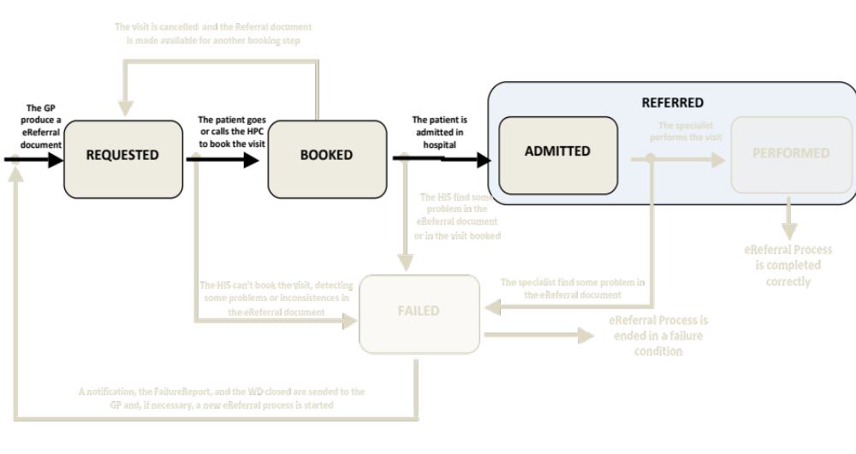
Use-case: basic eReferral workflow
Workflow Document
REFERRAL REQUESTED
REFERRAL BOOKED
Task Name:
REFERRAL REFERRED
TaskStatus: IN-PROGRESS
Author: HIS
Time: date/time/utc
Inputs:
-> eReferralDoc1
Outputs:
->
Status of the process: Admitted
Task 3: Referral Referred
TaskStatus 1: in-progress
taskEventHistory
TaskEvent: 1
Status:
IN-PROGRESS
Inputs:
-> eReferralDoc1
Outputs:
->

Slide 10
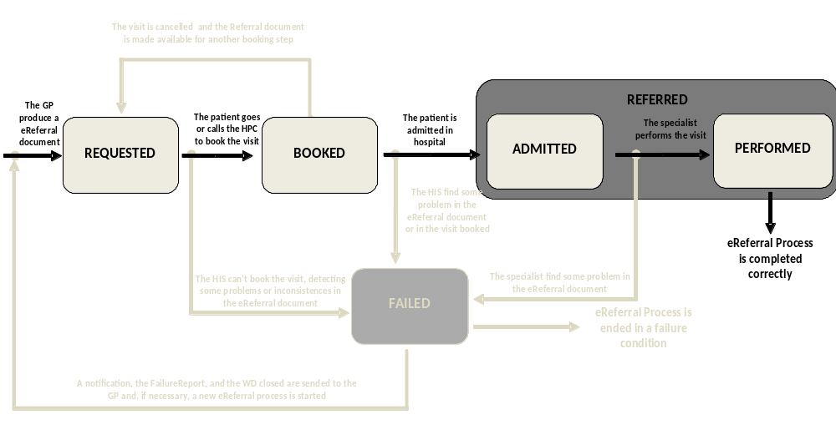
Use-case: basic eReferral workflow
Workflow Document
REFERRAL REQUESTED
REFERRAL BOOKED
Task Name:
REFERRAL REFERRED
TaskStatus: COMPLETED
Author: Specialist’s sw
Time: date/time/utc
Inputs:
-> eReferralDoc1
Outputs:
->ClinicalReport
taskEventHistory
TaskEvent: 1
Status: IN-PROGRESS
Status of the process: Performed
Task 3: Referral Referred
TaskStatus 2: completed
TaskEvent: 2
Status:
COMPLETED
Inputs:
-> eReferralDoc1
Outputs:
-> ClinicalReport

Slide 11
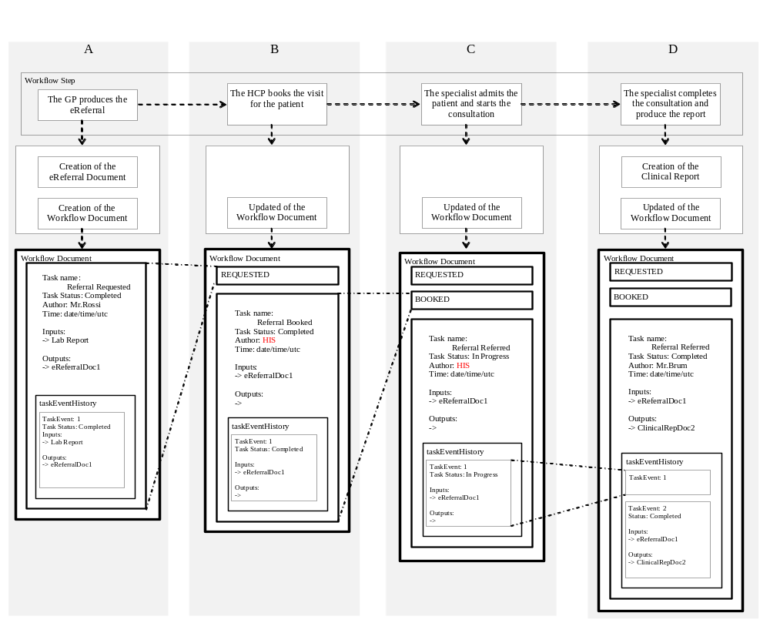
Use-case: basic eReferral workflow
Clinical actions
Technical actions
Evolution of shared Workflow Document

Slide 12
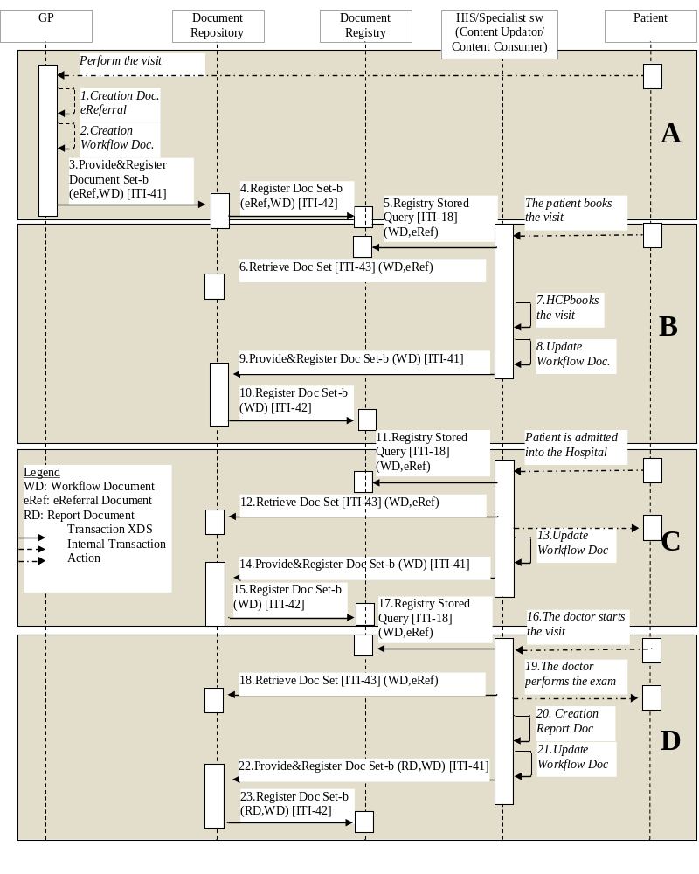
Use-case: basic eReferral process flow

Slide 13
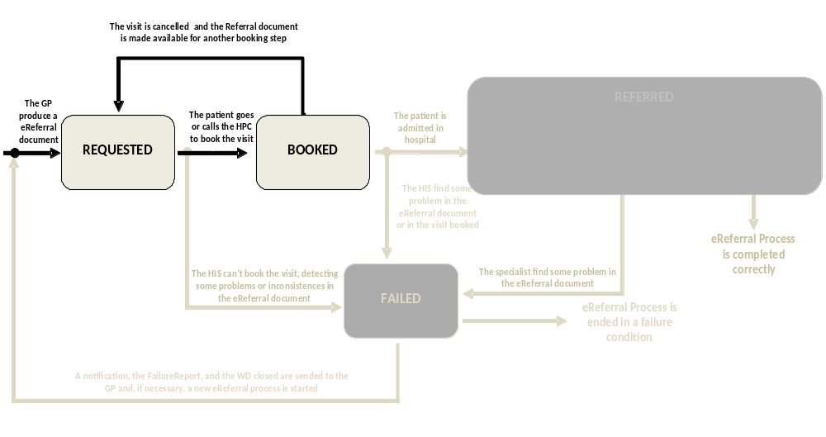
Use-case: eReferral workflow Manage of a nonlinear situation
Workflow Document
Booking cancellation process:
REFERRAL REQUESTED
REFERRAL BOOKED
Task Name:
REFERRAL REQUESTED
TaskStatus: COMPLETED
Author: HIS
Time: date/time/utc
Inputs:
-> eReferralDoc1
Outputs:
->
taskEventHistory
TaskEvent: 1
Status:
COMPLETED
Inputs:
-> eReferralDoc1
Outputs:
->
Status of the process: eReferral Available
Task 3: Referral Requested
TaskStatus 1: completed

Slide 14
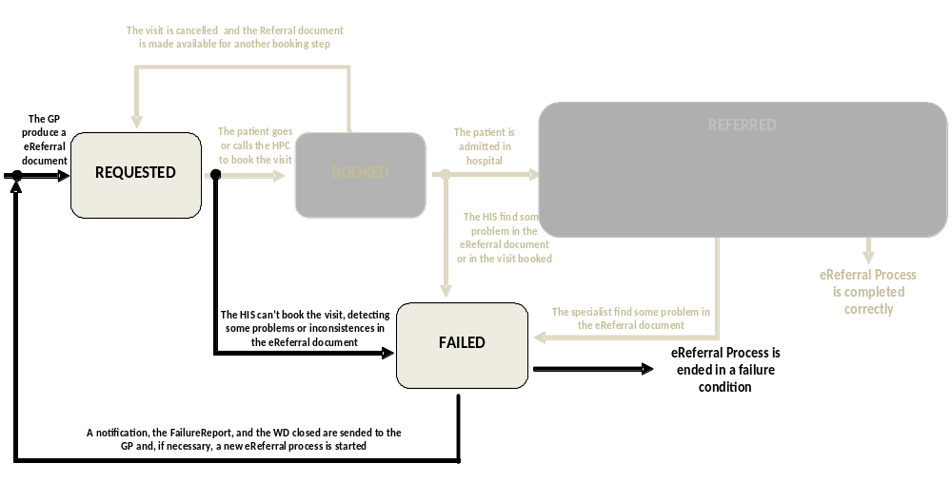
Use-case: eReferral workflow Manage of the failed situations
Failure booking step:
Workflow Document
REFERRAL REQUESTED
Task Name:
REFERRAL BOOKED
TaskStatus: FAILED
Author: HIS
Time: date/time/utc
Inputs:
-> eReferralDoc1
Outputs:
-> FailureReport
taskEventHistory
TaskEvent: 1
Status: FAILED
Inputs:
-> eReferralDoc1
Outputs:
->FailureReport
Status of the process: Booking Failed
Task 2: Referral Booked
TaskStatus 1: failed

Slide 15
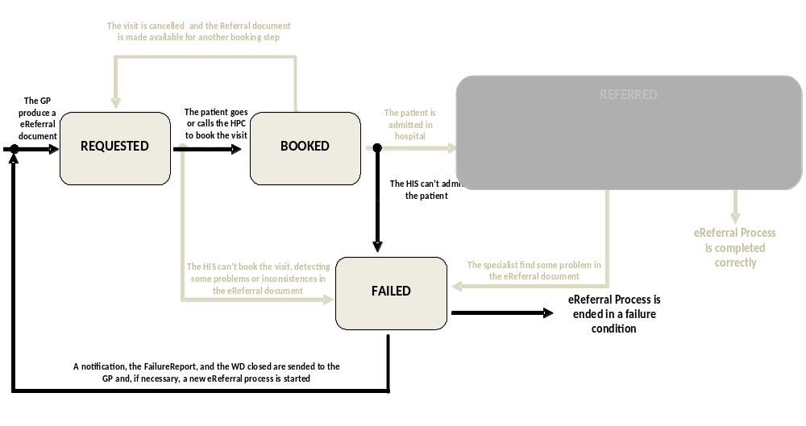
Use-case: eReferral workflow Manage of the failed situations
Workflow Document
Failure reception step:
REFERRAL REQUESTED
REFERRAL BOOKED
Task Name:
REFERRAL REFERRED
TaskStatus: FAILED
Author: HIS
Time: date/time/utc
Inputs:
-> eReferralDoc1
Outputs:
->FailureReport
taskEventHistory
TaskEvent: 1
Status:
FAILED
Inputs:
-> eReferralDoc1
Outputs:
->FailureReport
Status of the process: Admission failed
Task 3: Referral Referred
TaskStatus 1: failed

Slide 16
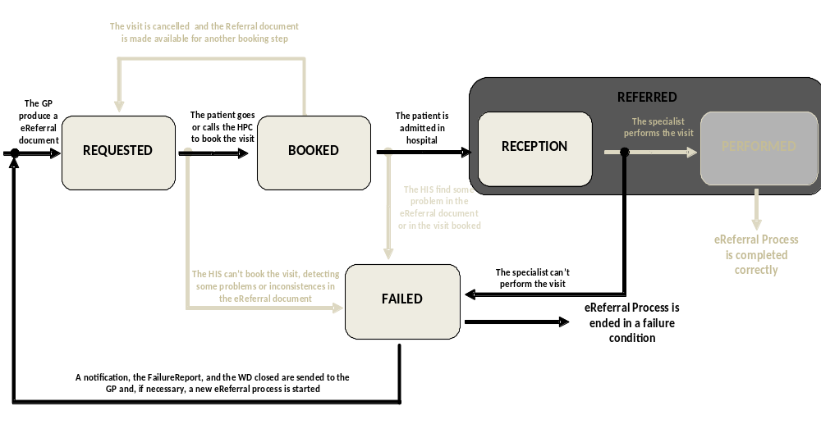
Use-case: eReferral workflow Manage of the failed situations
Failure visit performing step:
Workflow Document
REFERRAL REQUESTED
REFERRAL BOOKED
Task Name:
REFERRAL REFERRED
TaskStatus: FAILED
Author: Specialist’s sw
Time: date/time/utc
Inputs:
-> eReferralDoc1
Outputs:
->FailureReport
taskEventHistory
TaskEvent: 1
Status: IN-PROGRESS
Status of the process: Performation failed
Task 3: Referral Referred
TaskStatus 2: failed
TaskEvent: 2
Status:
FAILED
Inputs:
-> eReferralDoc1
Outputs:
-> FailureReport

Slide 17
Use-case: eReferral workflow Manage of the failed situations
Workflow Document
Each time there is a failing situation, a notification is sended to the GP.
IF NECESSARY the GP can start a new process producing a new eReferral document. In the new workflow document the GP can track the link to the failure report and the reference to the previous process aborted in the INPUT of the first task.
Task Name:
REFERRAL REQUESTED
TaskStatus: COMPLETED
Author: Mr.Rossi
Time: date/time/utc
Inputs:
-> Lab Report
-> Failure Report
->FolderID
Outputs:
-> eReferralDoc1
taskEventHistory
TaskEvent: 1
Status: COMPLETED
Inputs:
-> Lab Report
->Failure Report
->FolderID
Outputs:
-> eReferralDoc1
New Workflow Document

Slide 18
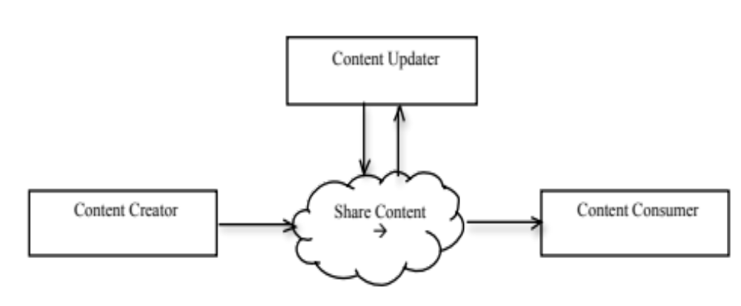
XDW Actors
The Workflow Document is managed by XDW actors, and is shared and exchanged using a document infrastructure (XDS, XDR, XDM…)
XDW Actors:
  XDW Content Creator: creates new workflow producing the Workflow Document
  XDW Content Updator: replaces exixting workflow document with the updated one
  XDW Content Consumer: obtains and reads a Workflow Document

Slide 19

GP’s sw
1. Producing of the WD
With one task ˮREFERRAL REQUESTEDˮ and referencing of it to the XDS Infrastructure
XDS Infrastructure
HIS
Content Creator
2. Query for the patient WD active
Content Consumer
XDS Document Source
3. Retrieve of the WD to check the status of the eReferral
XDS Document Consumer
HIS
4. Updating of the WD adding a new task ˮREFERRAL BOOKEDˮ
6. Query for the patient WD active
Content Updator
Content Consumer
5. Referencing of the new version of the WD to the XDS Infrastructure
XDS Document Source
XDS Document Consumer
7. Retrieve of the WD to check the status of the eReferral
8. Updating of the WD adding a new task ˮREFERRAL REFERREDˮ with status IN-PROGRESS
Specialist’s sw
Content Updator
10. Query for the patient WD active
Content Consumer
XDS Document Source
9. Referencing of the new version of the WD to the XDS Infrastructure
11. Retrieve of the WD to check the status of the eReferral
XDS Document Consumer
12. Updating of the WD adding a new taskEvent (completed)
Content Updator
13. Referencing of the new version of the WD to the XDS Infrastructure
XDS Document Source

Slide 20
eReferral Process Entities
A Process Entity:
  Is a logical actor
  Acts in a higher level compared to physical actors or XDW/XDS actors
  Is defined to better understand the role of an actor in the process
  Is responsible for a specific transition between tasks
  -Referral Requester: is the entity that produces the eReferral and the related Workflow Document starting the eReferral process.
  -Referral Booker: is the entity responsible for the booking process. This entity can book or cancel the visit, updating the Workflow Document.
  -Referral Performer: is the entity responsible for the reception of the patient and the execution of the visit. This entity can produce the report of the visit, and can terminate the eReferral process.
  -Failure Manager: is the entity that manages the failure condition of the process, terminating the wrong process producing the Failue Report.

Slide 21
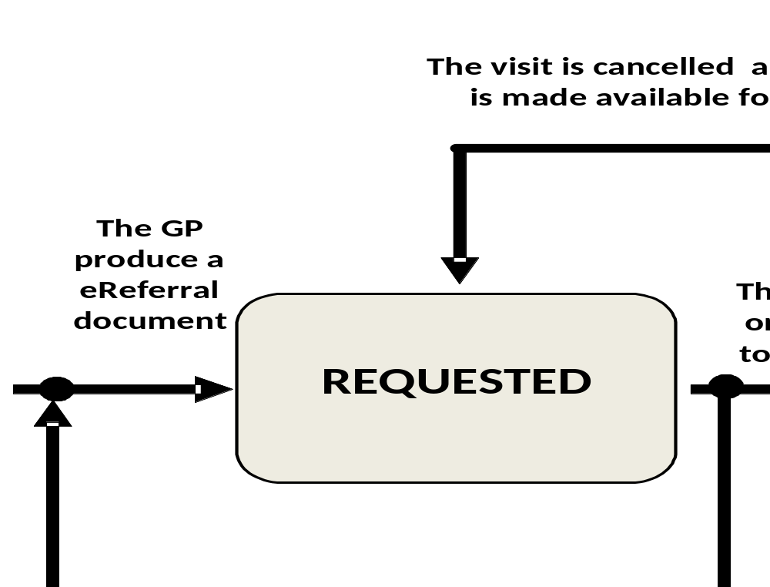
eReferral Process Entities:
Referral Requester
Skills:
  Can create the eReferral document and the Workflow Document related
Physical interpreter:
  GP’s software
XDW/XDS actors grouped:
  XDW Content Creator
  XDS Document Source
Referral Requester

Slide 22
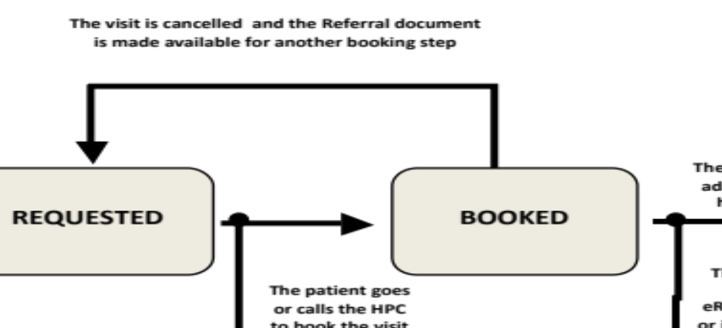
eReferral Process Entities:
Referral Booker
Skills:
  Can check the status of the eReferral document and, updating the WD, is responsible for the booking process.
Physical interpreter:
  HIS
XDW/XDS actors grouped:
  XDW Content Consumer
  XDW Content Updator
  XDS Document Consumer
  XDS Document Source
Referral Booker

Slide 23
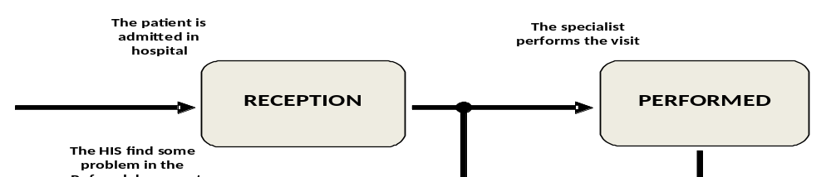
eReferral Process Entities:
Referral Performer
Skills:
  Can check the status of the eReferral document, can update the WD and can terminate the process producing a Report and changing the status of the WD (WorkflowStatus =ˮCLOSEˮ)
Physical interpreter:
  HIS, Specialist’s software
XDW/XDS actors grouped:
  XDW Content Consumer
  XDW Content Creator
  XDS Document Consumer
  XDS Document Source
Referral Performer
Referral Performer

Slide 24
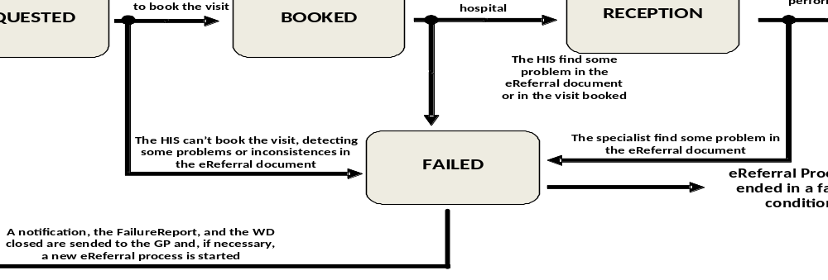
eReferral Process Entities:
Failure Manager
Skills:
  Can terminate the process changing the status of the WD (WorkflowStatus=ˮCLOSEˮ), producing a Faliure Report and sending a notification to the GP
Physical interpreter:
  HIS,specialist’s software
XDW/XDS actors grouped:
  XDW Content Consumer
  XDS Document Consumer
  XDW Content Creator
  XDS Document Source
Failure Manager
Failure Manager
Failure Manager
Failure Manager

Slide 25
Discussion
The value statement of this proposal is:
the use of an instrument, the ITI XDW profile, which provides a shared solution with different process which guarantees the interoperability between the different workflows and their management.
The standardization of clinical and organizational workflow involved in eReferral process
The contextualization of the data set of rules specific for the eReferral Workflow Definition Profile.
The specification of Workflow Definitions is distinct from the XDW Profile, out of the scope of the ITI Domain and is currently best handled with a natural language expression, it is specific duty of each domain to define the workflow definition profile to manage the different specific workflow.
This is a simple process which can provide the basis to the definitions of other more complex clinical workflows.

Slide 26
Proposed Standards & Systems
Afferent IHE Domains
  IT Infrastructure, Patient Care Coordinator
Afferent IHE Profiles:
  XDW, XDS.b, XDM, XDR, DSUB, NAV, XCA, BPPC, ATNA, XUA
Other standards items:
  OASIS HumanTask
Stability and robustness:
  No new transaction are introduced
  No XDS Metadata extension expected, but specific rules about Metadata content for the workflow Document
Notes:
Radiology, Cardiology, Ophthalmology, Radiation Oncology, Reporting Workflow, Mammo CAD, Labs, and Pharma all fit this structure

