Slide 1
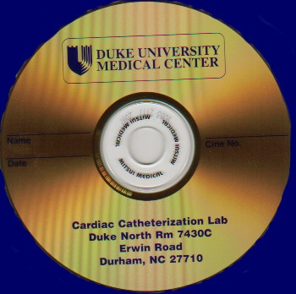

Flexible Infrastructure: Sharing, Reliable Interchange, and Media
Health Information Exchange or RHIO
XDS
Structured objects
Pull
Publish
Pull
XDR
Send to
Reliable Interchange
Send to
XDM
Export
Import
Media Interchange

